Slide 1
ACA 2012 - Boston
Evolution of Small Molecule Instrumentation in North America
Susan K. Byram, Charles F. Campana, Daniel F. Frankel
Sue.byram@bruker-axs.com or 1-608-276-3000

Slide 2
Reflections on Chemical Crystallography Evolution, 1950 - 2012
Film Cameras
Scintillation Counters
Multi-wire Proportional Counters
TV Detectors
Image Plates
CCD Detectors
CMOS Detectors
And their influence on
Size of Structures
Time per Structure
Total Structures Published in CSD

Slide 3
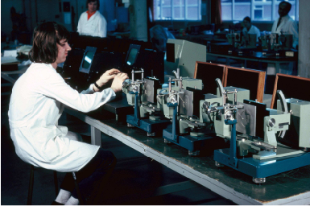
Chemical Crystallography in the 1950’s
Equipment
Film methods (Weissenberg & Precession cameras – assembly at Nonius started in 1948, shown here in 1970)
Manual estimation of intensities (spot judgers, densitometers)
Computers
A few large mainframe computers (SWAC, IBM 704)
Software Packages
FORTRAN programs for specific mainframe computers: Fourier maps, least-squares refinement

Slide 4
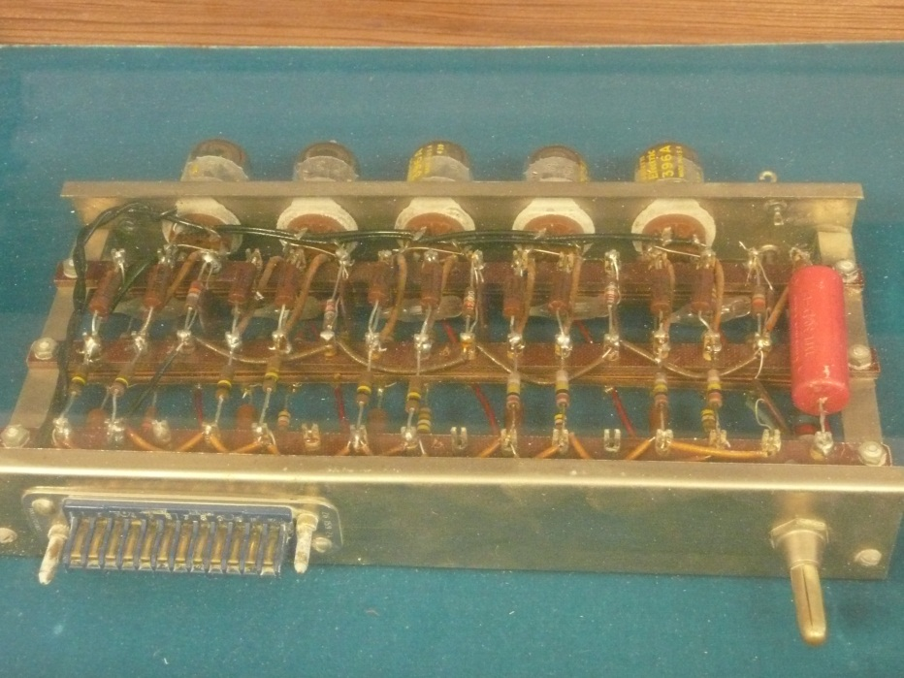
Chemical Crystallography in the 1950’s: very early computers
A module from SWAC given to me by Bob Sparks
SWAC is the Standards Western Automatic Computer built in 1950 for National Bureau of Standards and used from 1954 to 1967 at UCLA
SWAC was used to solve the vitamin B12 structure in 1955

Slide 5
Chemical Crystallography in the 1950’s
Size of Structures
Usually < 30 atoms total; mostly inorganic, minerals, organic with heavy atoms
Time per Structure
Approximately one year
Total Structures Published
<500 (1959 est.)

Slide 6
Chemical Crystallography in the 1960’s
Equipment
Film methods (Weissenberg & precession cameras)
Scintillation counter diffractometers (GE, Picker, Hilger Watts etc)
Computers
Large mainframe computers (CDC6600, IBM 360, UNIVAC 1107)
Software Packages
FORTRAN programs for mainframe computers: ORFLS (Busing & Levy), ORFFE, ORTEP (Carroll Johnson, shown at ACA Knoxville 2008), XRAY67 (J. Stewart)

Slide 7
‘At least 9 ’ diffractometers were shown at IUCr Stonybrook 1969
Datex/ GE (1969) GE Crystal Orienter Eulerian cradle
Hilger & Watts (1963) Eulerian cradle
JEOL Eulerian cradle
Nonius (1962) CAD-3 Open Eulerian
Nonius (1969) CAD-4 prototype Kappa
North American Philips (1963) PAILRED Weissenberg
Philips (1969) PW1100 Eulerian cradle
Picker (1965) FACS-I Eulerian cradle
Rigaku AFC-2 Eulerian cradle
Siemens (1964) AED ¼ Eulerian cradle
Stoe (1968) STADI-4 Eulerian cradle
Syntex (1969) P1bar Eulerian cradle
Per Tom Furnas in Crystallography in North America, Eulerian cradle name was from ‘Dave Harker who sensed that the proposed coordinate system was the ancient set of Euler’s angles’
(introduction dates) from Sparks talk June 1987 at Erich Woelfel’s birthday fest at Stoe

Slide 8
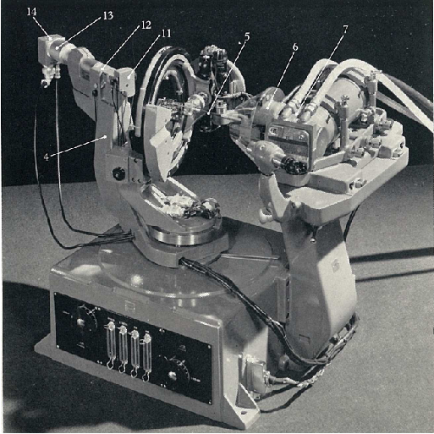
Hilger & Watts full circle diffractometer (1969) – Arndt & Willis part of design

Slide 9
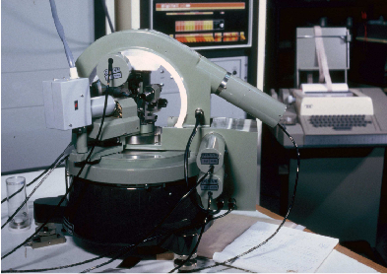
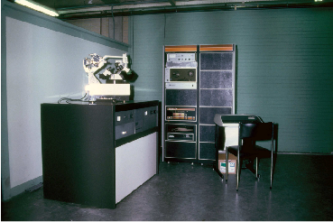
Nonius CAD-3 (Tech Univ Delft, early 70’s) CAD-4 (PDP-8 control 1976) Siem Poot design

Slide 10
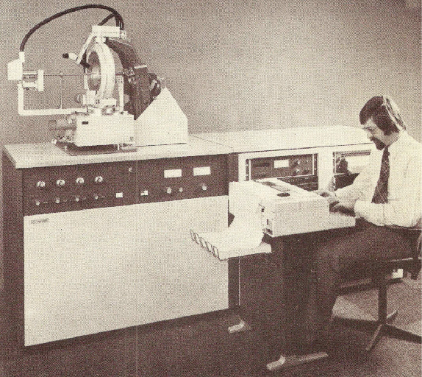
Philips PW1100 diffractometer (1970) Evert Keulen design

Slide 11
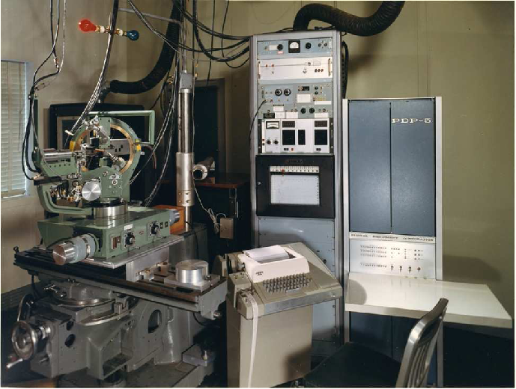
Picker FACS-I diffractometer (PDP-5 control 1964); Tom Furnas design with ORNL control ( Picker was my ‘first diffractometer’ in the Nyburg group at University of Toronto)
Bill Busing, ORNL,
at IUCr Hamburg

Slide 12
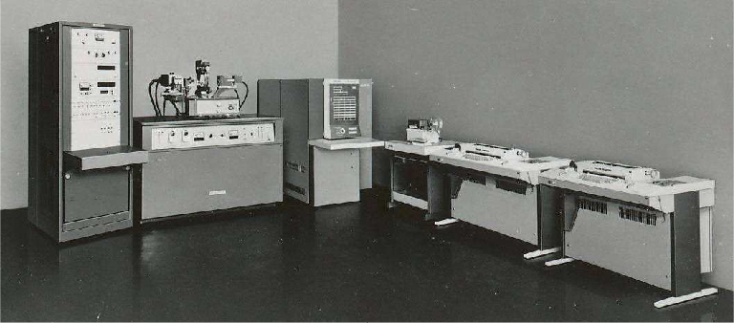
Rigaku AFC-2 four-circle diffractometer with Facom computer (1969)

Slide 13
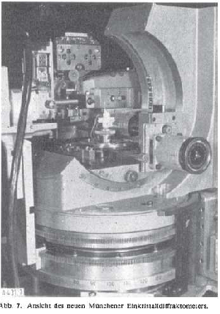
Siemens quarter-chi circle diffractometer (1965); designed by Hoppe at MPI, Munich & commercialized by Siemens

Slide 14
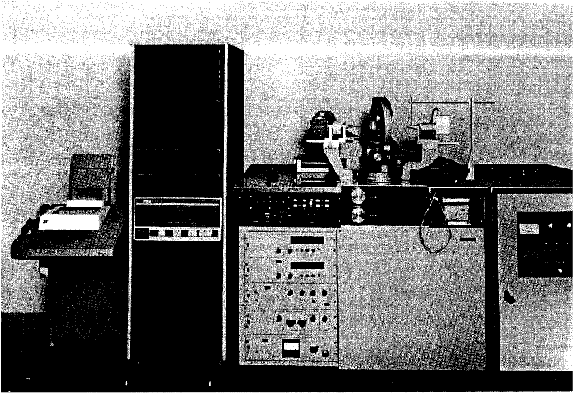
Stoe STADI-4 diffractometer (1970) Dir. Erich Woelfel (shown at IUCr Hamburg)

Slide 15
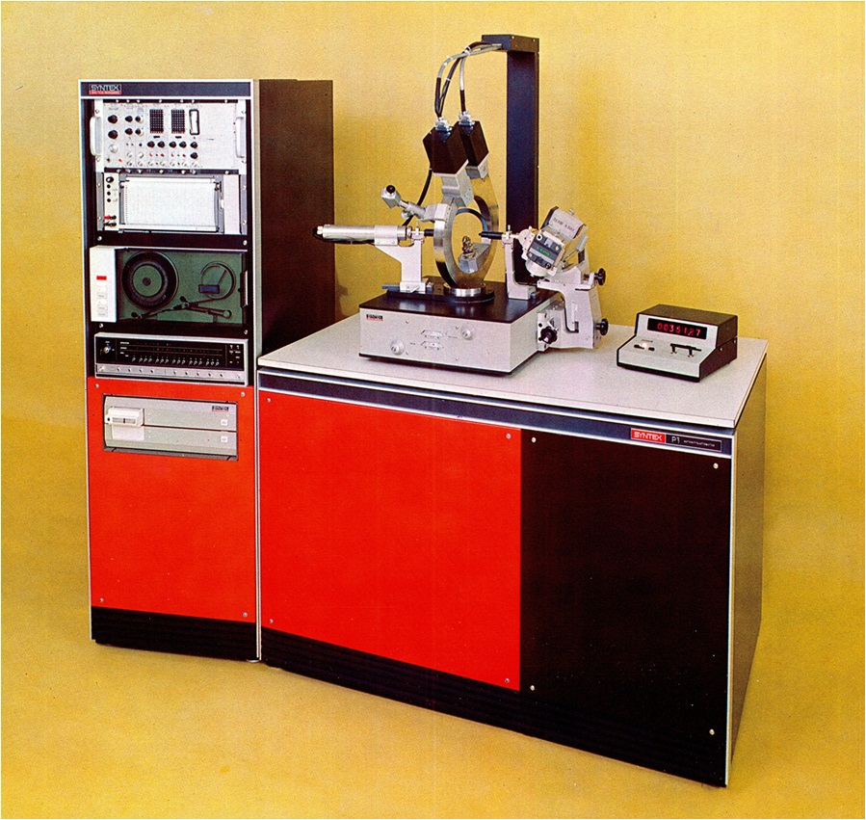
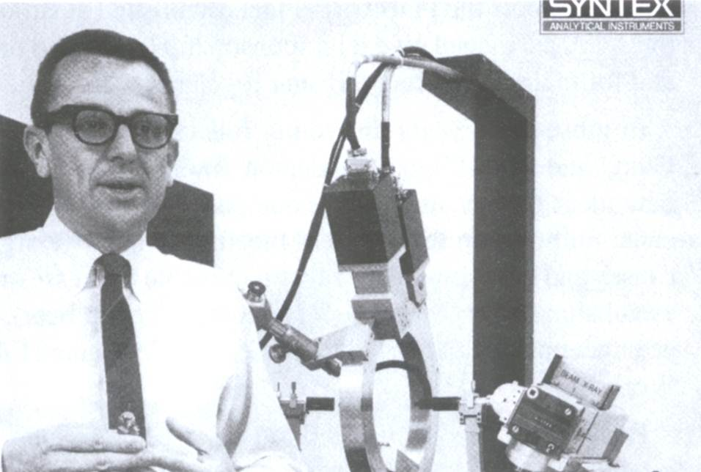
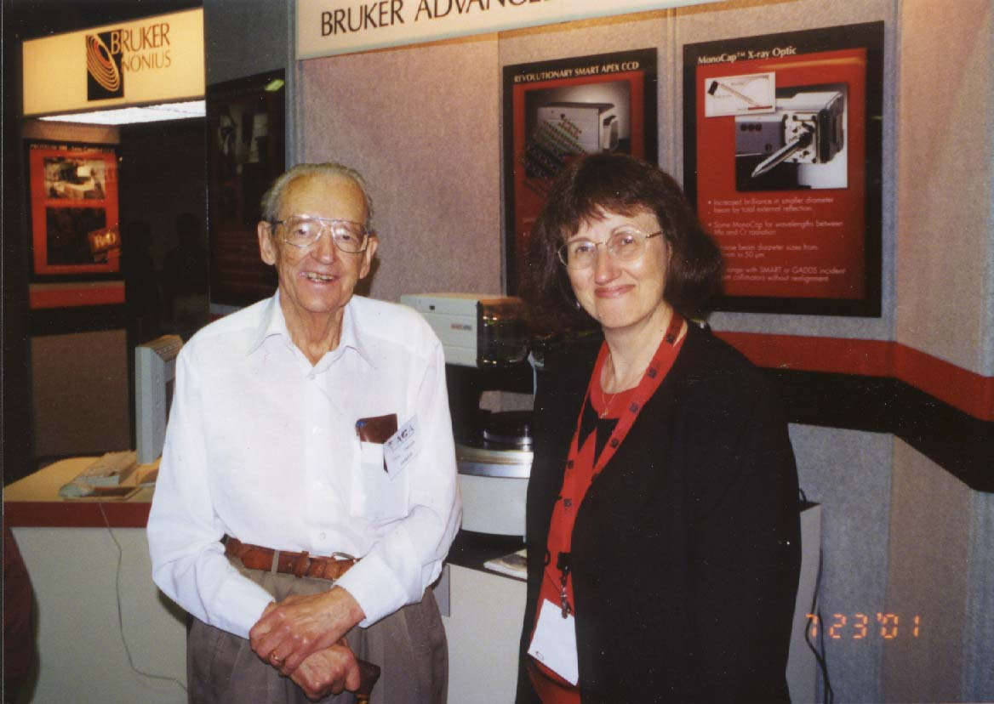
Syntex P1bar diffractometer (1969) Bob Sparks software design (shown upper R) Sten Samson mechanical design (shown at ACA LA 2001)

Slide 16
Chemical Crystallography in the 1960’s
Size of Structures
Usually < 100 non-H atoms; more organic structures
Time per Structure
Typically 2 - 6 months
Total Structures Published
8,300 (1969 est.)

Slide 17
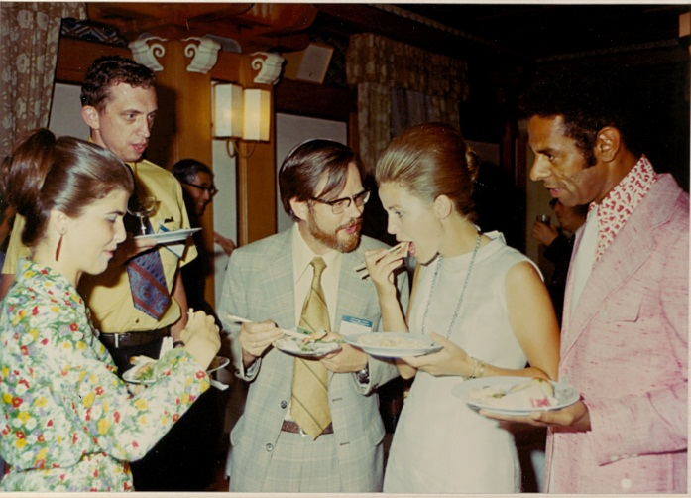
Chemical Crystallography in the 1970’s
Equipment
Computer-controlled diffractometers (Syntex P1bar, P2₁, P3/R3, Enraf Nonius CAD-4)
Low temperature devices gain in routine use (Syntex LT-1 on right, with H. Hope, UC Davis, shown here at IUCr Kyoto 1972)
Computers
Departmental computers (IBM 7094, VAX 11/780)
Dedicated mini-computer systems (Nova 1200, Nova 4, Eclipse S/140, PDP 11)
Software Packages
Public domain software large computers: XRAY76, MULTAN (Main & Woolfson), CRYSTALS (Carruthers, Rowlett), SHELX76 (Sheldrick)
Commercial software for dedicated minicomputers: Syntex XTL & EXTL, Nicolet SHELXTL, Enraf Nonius SDP

Slide 18
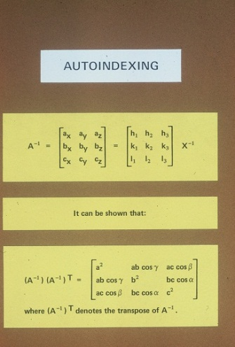
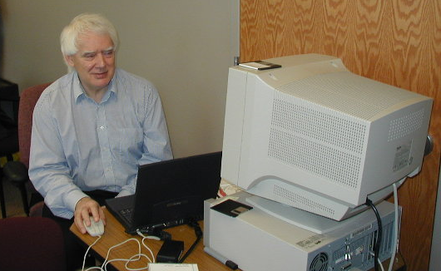
Chemical Crystallography in the 1970’s: the decade of software
At Syntex, Bob Sparks tried to introduce something new every year at crystallographic meetings; milestones were:
1970 ACA Ottawa autoindexing (Bob Sparks)
1972 IUCr Kyoto P21 automated diffractometer, AD-1 autodensitometer and LT-1 low temperature device
1973 ACA Storrs XTL full structure solution, refinement & display on Data General minicomputer with custom floating point processor
1973 red/green TV display (Edgar Meyer, Texas A&M)
1979 first SHELXTL proprietary release (George Sheldrick, shown here on right)

Slide 19
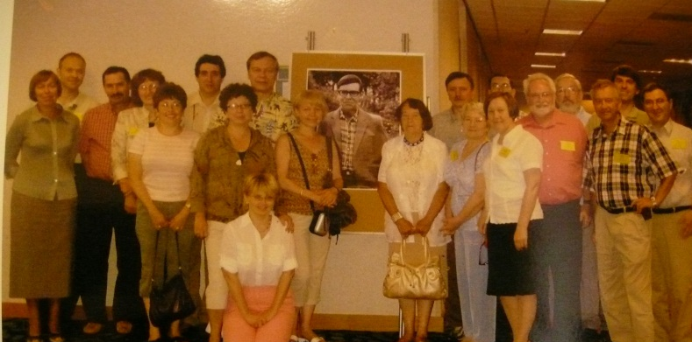
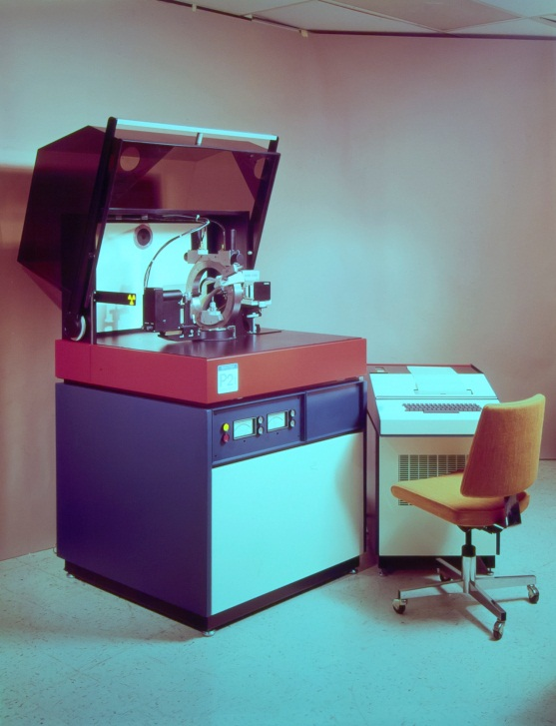
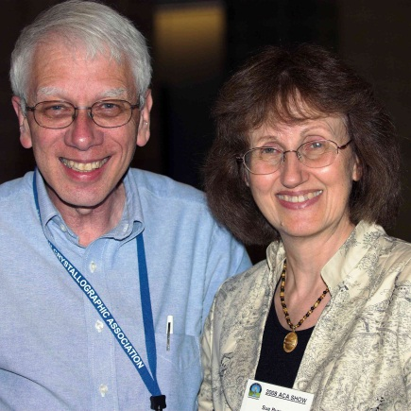
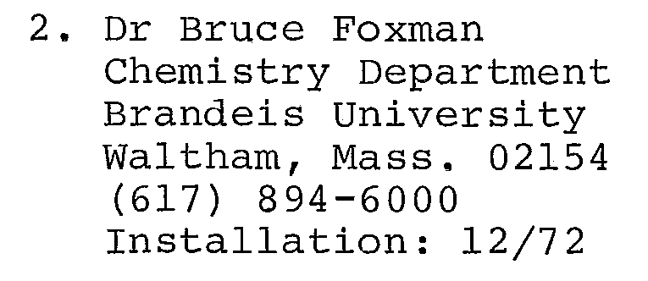
Chemical Crystallography in the 1970’s: facilitating productivity
The introduction of the P21 (below), LT-1 and XTL facilitated some immensely productive research groups, including the Yuri Struchkov group at INEOS in Moscow (shown at USA reunion).
Staff crystallographers evolved; first was Curt Haltiwanger, University of Colorado (on R)
Notable early users include Prof Bruce Foxman honored yesterday at ACA Boston (shown at ACA Knoxville 2008)
P21 users list:

Slide 20
Chemical Crystallography in the 1970’s
Size of Structures
Usually < 200 non-H atoms
Time per Structure
Typically one month
Total Structures Published
32,000 (1979)

Slide 21
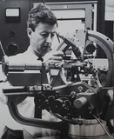
Chemical Crystallography in the 1980’s
Equipment
Computer-controlled diffractometers (Nicolet R3m/V, Siemens P4, Nonius CAD-4, Rigaku AFC-6 & AFC-5)
2-D detectors primarily for protein data used occasionally for chemistry (Nicolet X-100, Nonius FAST, ADSC multiwire, Rigaku image plate)
Computers
Dedicated mini-computer systems (Eclipse S/140, MicroVAX II)
Personal Computers (DOS) (386, 486 & PENTIUM PC’s)
Software Packages
Public domain software small computers: SHELX, NRCVAX (LePage, White, Eric Gabe above), CRYSTALS (David Watkin, below)
Commercial software for personal computers (Nicolet/Siemens SHELXTL, MSC Texsan)

Slide 22
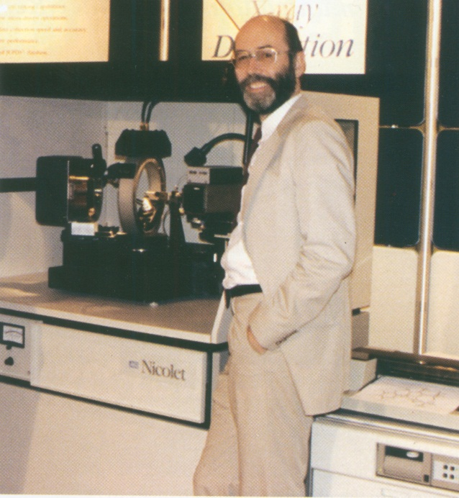
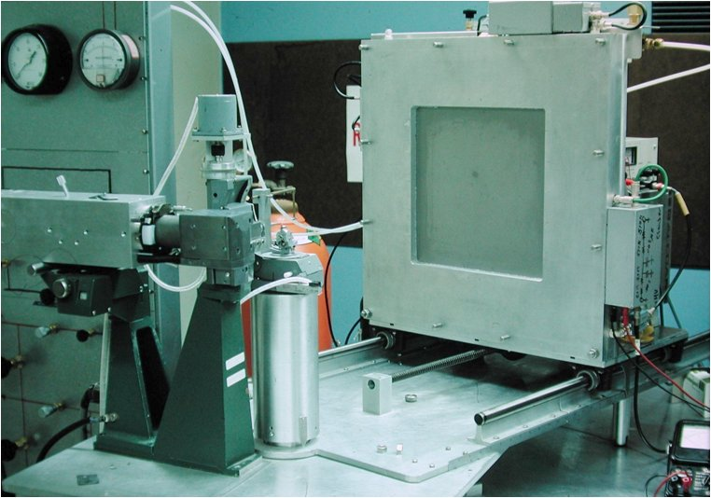
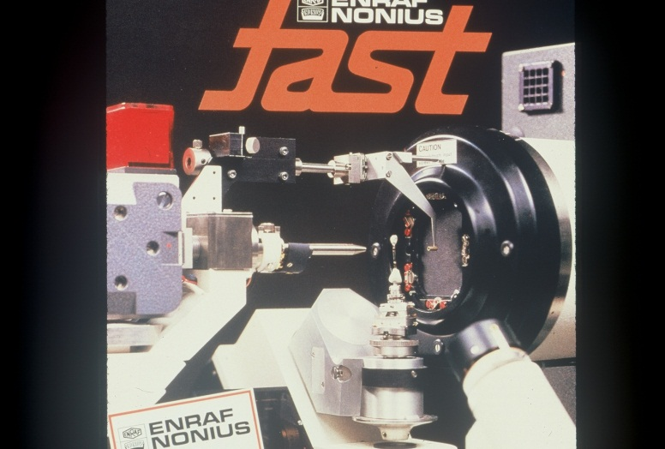
Commercial Area Detectors in the 1980’s
ADSC multiwire introduced 1970’s but not used in chemical crystallography until 1980’s (N. Xuong, Ron Hamlin – Mark I model shown here on left 1975)
Nonius FAST 1982 (U. Arndt) (brochure below)
Nicolet/Xentronics X-100 1984 (Ron Burns, shown here on right at ACA McMaster 1986)
Rigaku image plate 1986

Slide 23
Chemical Crystallography in the 1980’s
Size of Structures
Usually < 400 non-H atoms
Time per Structure
Typically 1 -2 weeks
Total Structures Published
95,000 (1989)

Slide 24
Chemical Crystallography in the 1990’s
Equipment
Computer-controlled diffractometers (Siemens P4, Nonius CAD-4, Rigaku AFC-7)
Rotating anode sources with Cu x-ray mirrors (Siemens P4/RA here with multiwire, Rigaku AFC7R, Huber)
First multilayer Goebel mirrors
First commercial Mo CCD systems (Siemens SMART CCD)
Computers
Dedicated mini-computer systems (SGI Personal Iris)
Personal Computers (Win NT, Win XP)
Software Packages
Public domain software small computers SHELX, CRYSTALS, NRCVAX, PLATON (Ton Spek, shown here), SIR (Giacovazzo)
Commercial software for personal computers: Bruker SHELXTL, Nonius MaXus, MSC Texsan

Slide 25
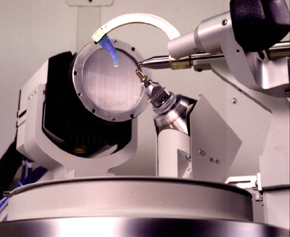
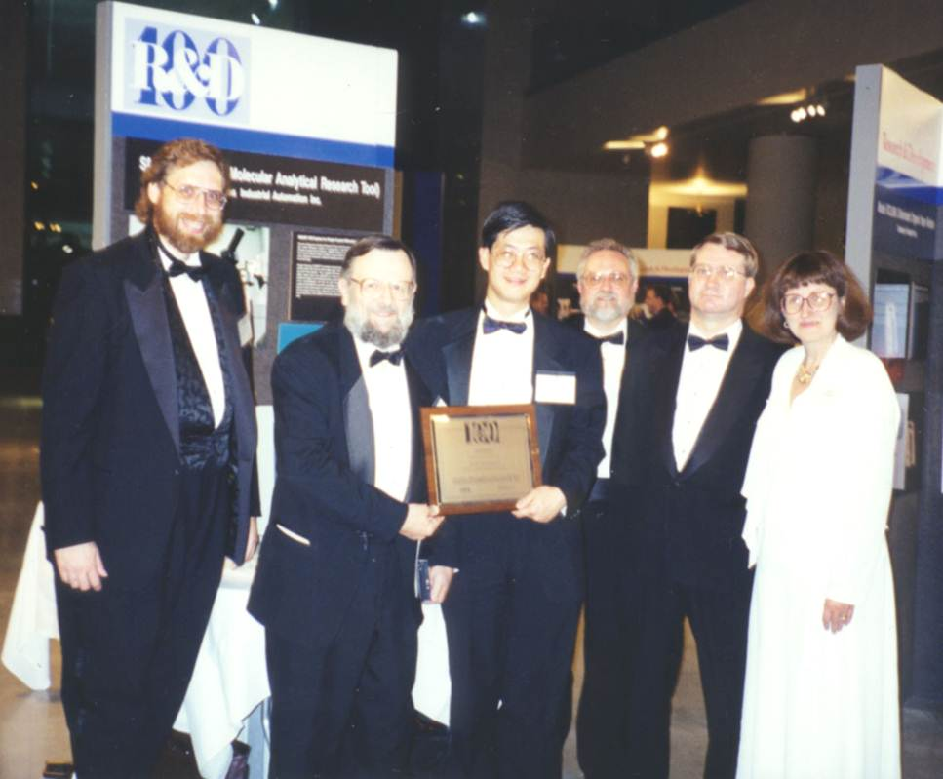
1993: the SMART CCD system for chemical crystallography
SMART CCD (shown right) revolutionized the chemical crystallography experiment in 1993 (R&D 100 award ceremony 1994 below: the only picture of Bob Sparks in a tuxedo!)
SMART collected FASTER DATA on a Mo sealed tube than feasible on a Mo point detector rotating anode
hours, not days, for structures
electron density studies in days, not months
SMART measured highly redundant data, thus giving BETTER DATA for difficult crystals
very small samples
very large unit cells eg 50- 75 A

Slide 26
Chemical Crystallography in the 1990’s
Size of Structures
Usually < 600 non-H atoms
Time per Structure
Typically one week
Total Structures Published
229,000 (1999)

Slide 27
Chemical Crystallography 2000 - 2009
Equipment
CCDs commonly used (Bruker SMART APEX I & II, Nonius KappaCCD & KAPPA APEX II, KUMA/Oxford Diffraction)
Advanced LT devices (Oxford Cryosystems 700, Cobra, DTC; Bruker KRYO-FLEX, MSC X-STREAM, Cryo Industries)
Benchtop systems for chemists introduced (Rigaku SCX mini, Bruker SMART X2S)
Microfocus sealed tube source/optics for home labs (Incoatec/Bruker IμS, Osmic/Rigaku, Xenocs, AXO Dresden)
Computers
Personal Computers (Win2000, WinXP, LINUX)
Software Packages
Public: SHELX, CRYSTALS, PLATON, SIR, JANA2000 for modulated structures (Petricek, Dusek, Palatinus),
GUI’s: WinGX (Farrugia), OLEX2 (Dolomanov, Puschmann, Bourhis, Gildea, Howard), ShelXle (Huebschle)
Commercial software for personal computers: Bruker SHELXTL, Rigaku/MSC Crystal Clear

Slide 28
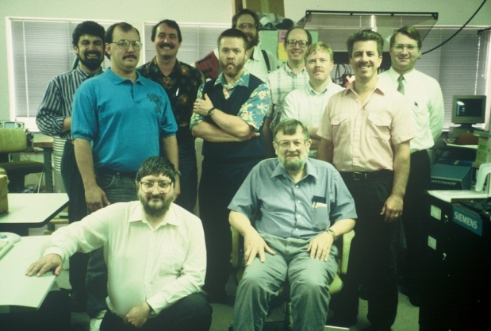
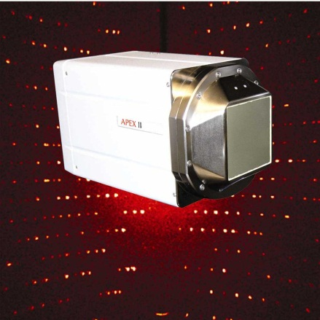
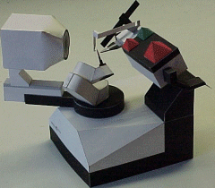
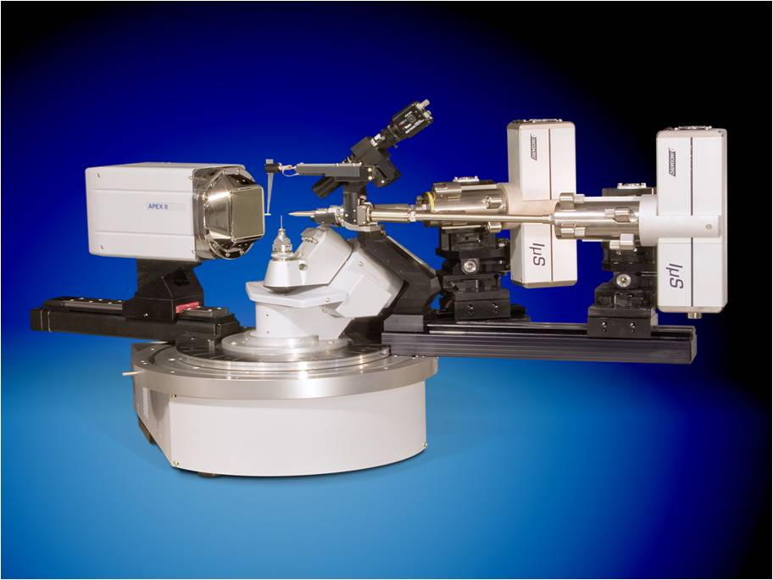
CCD systems commonly used 2000-2009 (Bruker SMART APEX I & II, Nonius KappaCCD & Bruker KAPPA APEX II, KUMA/Oxford Diffraction)
Bruker design team + George Sheldrick; John Chambers rear 4th from R
SMART APEX
KAPPA CCD
KAPPA DUO

Slide 29
Chemical Crystallography 2000 - 2009
Size of Structures
Usually < 1000 non-H atoms; many twinned structures solved
Time per Structure
Typically a few hours to overnight
Total Structures Published
528,000 (2009 est.)

Slide 30
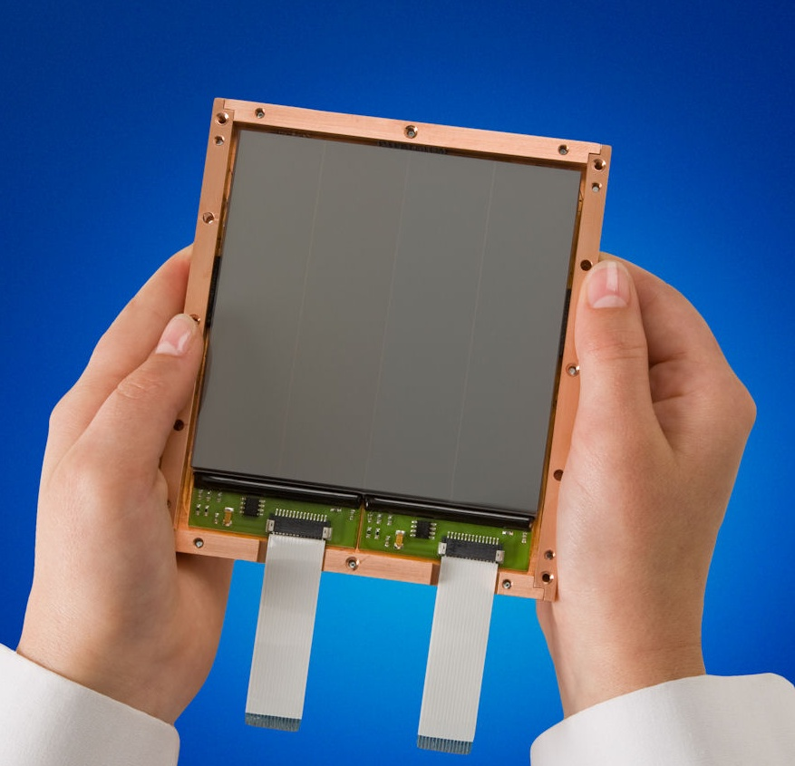
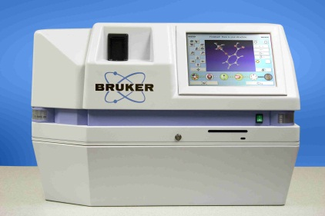
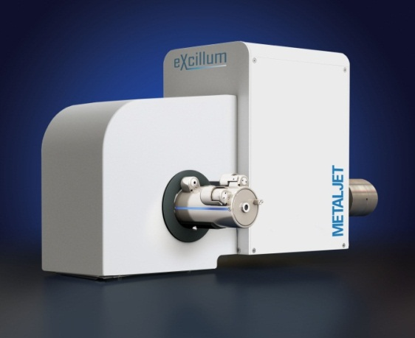
Chemical Crystallography 2010 forward
Equipment
CMOS systems introduced for home lab use (Dectris Pilatus, Bruker PHOTON 100 sensor shown here)
Increasing use of benchtop systems for teaching crystallography (Bruker SMART X2S, Rigaku XtaLAB mini)
Even brighter home lab sources (Excillum METAL JET shown here, Rigaku and Bruker rotating anode generators)
Increasing use of Microfocus Sealed Tube Sources for brightness and low maintenance (green solutions)
600,000 structures reached in 2012

Slide 31
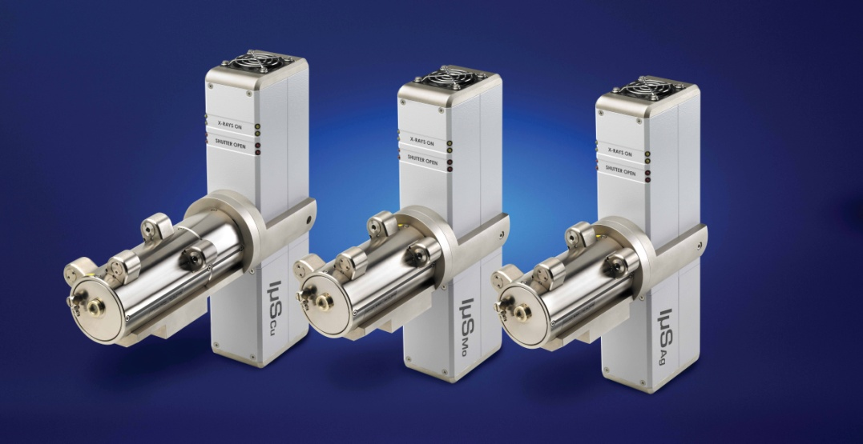
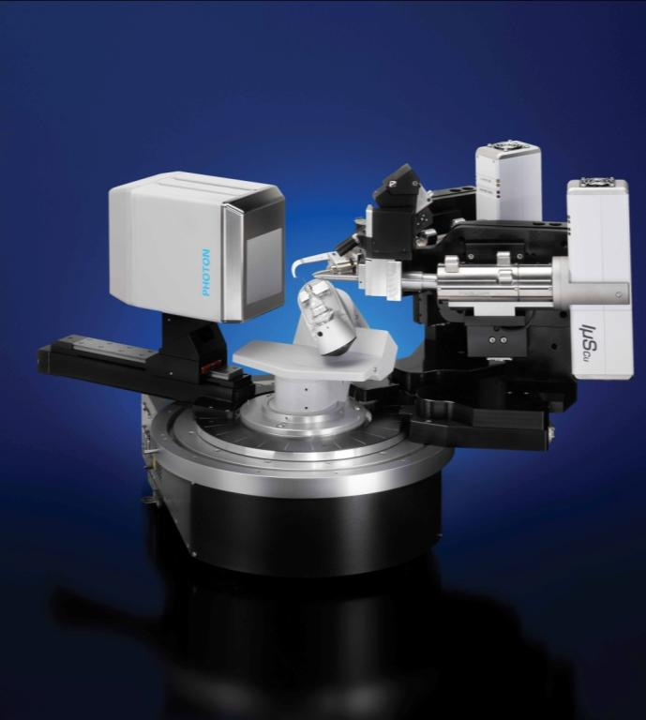
Increasing Use of Microfocus Sealed Tube Sources
Microfocus sealed tube sources coupled to multilayer optics (on right) deliver a much brighter, very stable beam, making it easier to measure small or weakly diffracting crystals on a low maintenance system
Bruker/Incoatec dual source options, shown below, are facilitated by microfocus source/optics:
Mo Sealed tube plus Cu IμS
Dual IμS
(Mo + Cu) or (Ag + Mo)

Slide 32
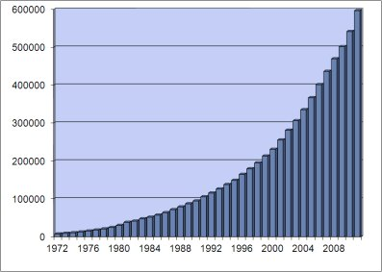
These Developments Have Brought Benefits to Chemists
Better Quality Crystal Structures
Rapid Structure Determination for Routine Problems
Crystallographic Expertise, Validation and Report Generation Built into Programs
Improved Capabilities to Analyze
Larger Structures
Smaller Crystals
Unstable Compounds
Twinned Specimens
Modulated Structures
As George Sheldrick just said,
it is a very interesting time to be around!

Slide 33
ACKNOWLEDGMENTS
With much thanks in particular
to my co-author Charles F. Campana (on right) for a framework and my colleague Frank van Meurs for the historical Nonius and other diffractometer slides
to Catherine Klein & Lee Daniels at Rigaku to permission to use the AFC-2 & XtaLAB mini slides
to Ron Hamlin at ADSC for the Mark-I multiwire photo
to the newsletters of IUCr for Eric Gabe photo, ACA for Picker FACS-I
to David Watkin for permission to use his photo
to Peter Mueller of MIT, the ACA roving photographer
to the CCDC for the # of structures & data base chart
and to our Syntex/Nicolet/Siemens/Nonius/Bruker company archives

