Slide 1
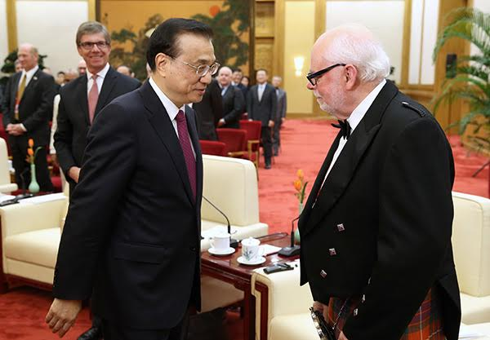
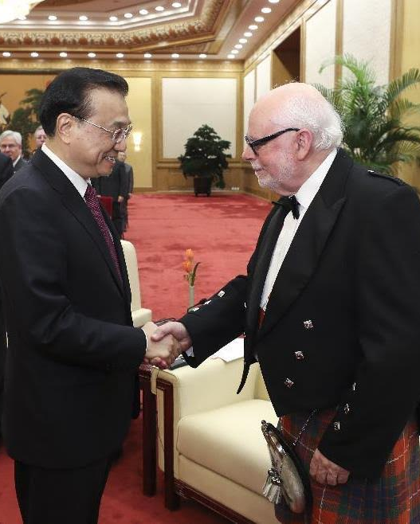
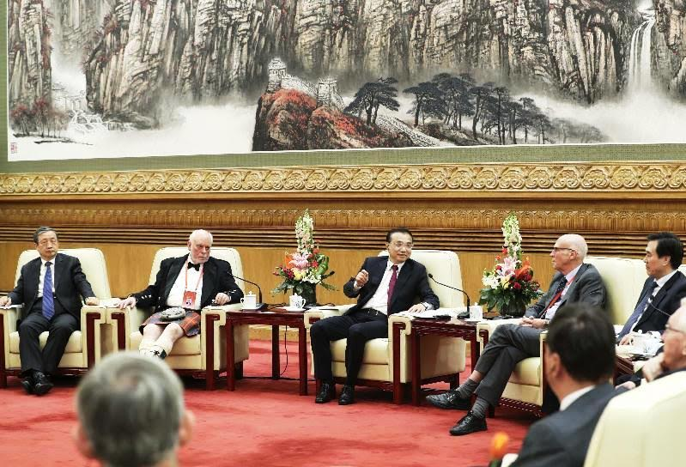
MEETING PREMIER Li Keqiang

Slide 2
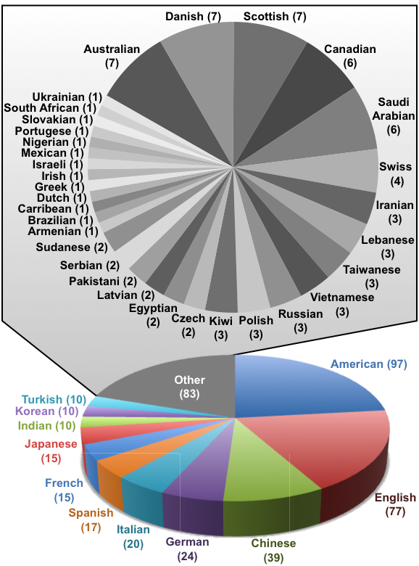
DIVERSITY PAYS OFF BIG TIME
Stoddart Research Group
1967 – 2017
Five Universities
Sheffield
Birmingham
UCLA
Northwestern
Texas A&M
One Company
ICI Corporate Laboratory
Three Countries
US / UK / China
During 50 years
43 Different Nationalities
among
413 Grad Students / Postdocs
SCIENCE IS GLOBAL / SCIENCE KNOWS NO BOUNDARIES

Slide 3
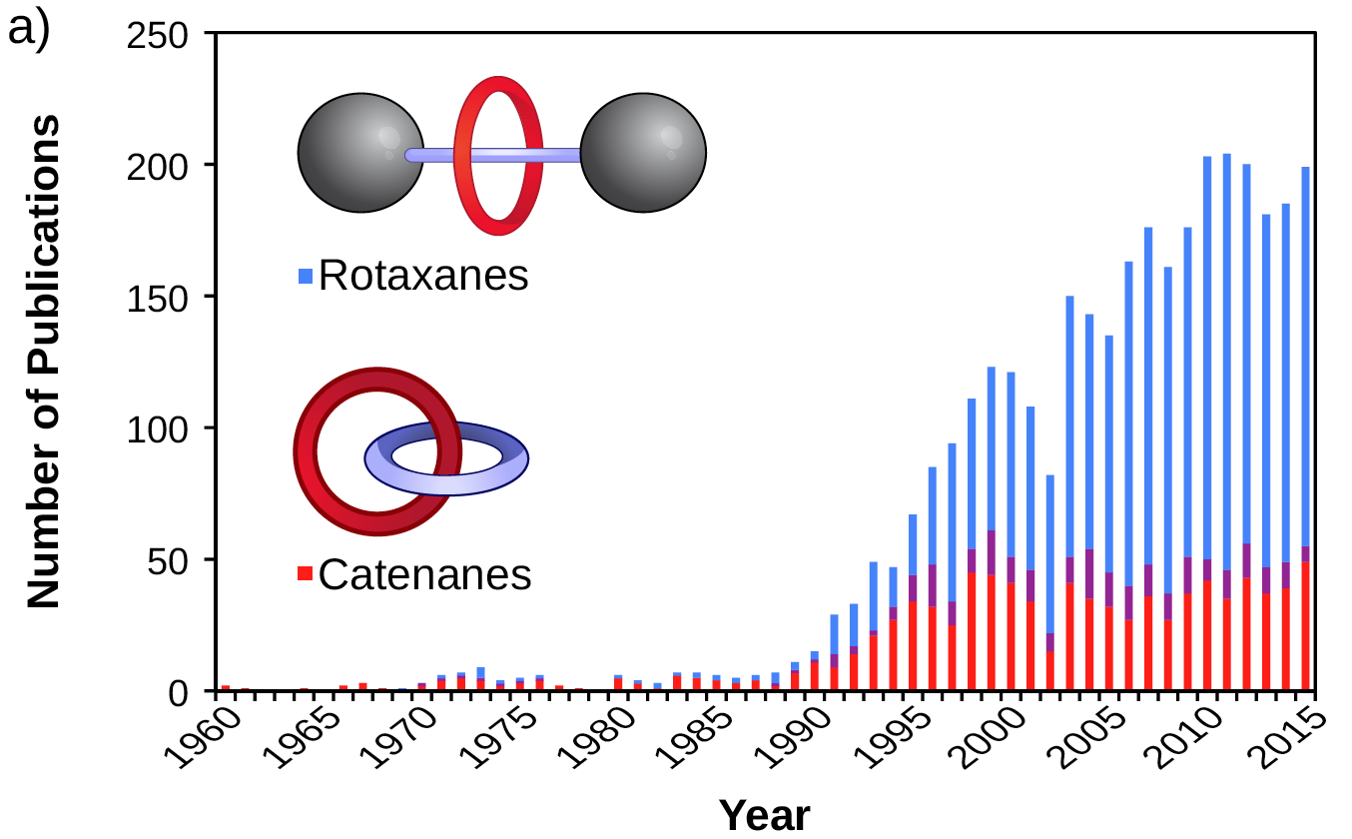
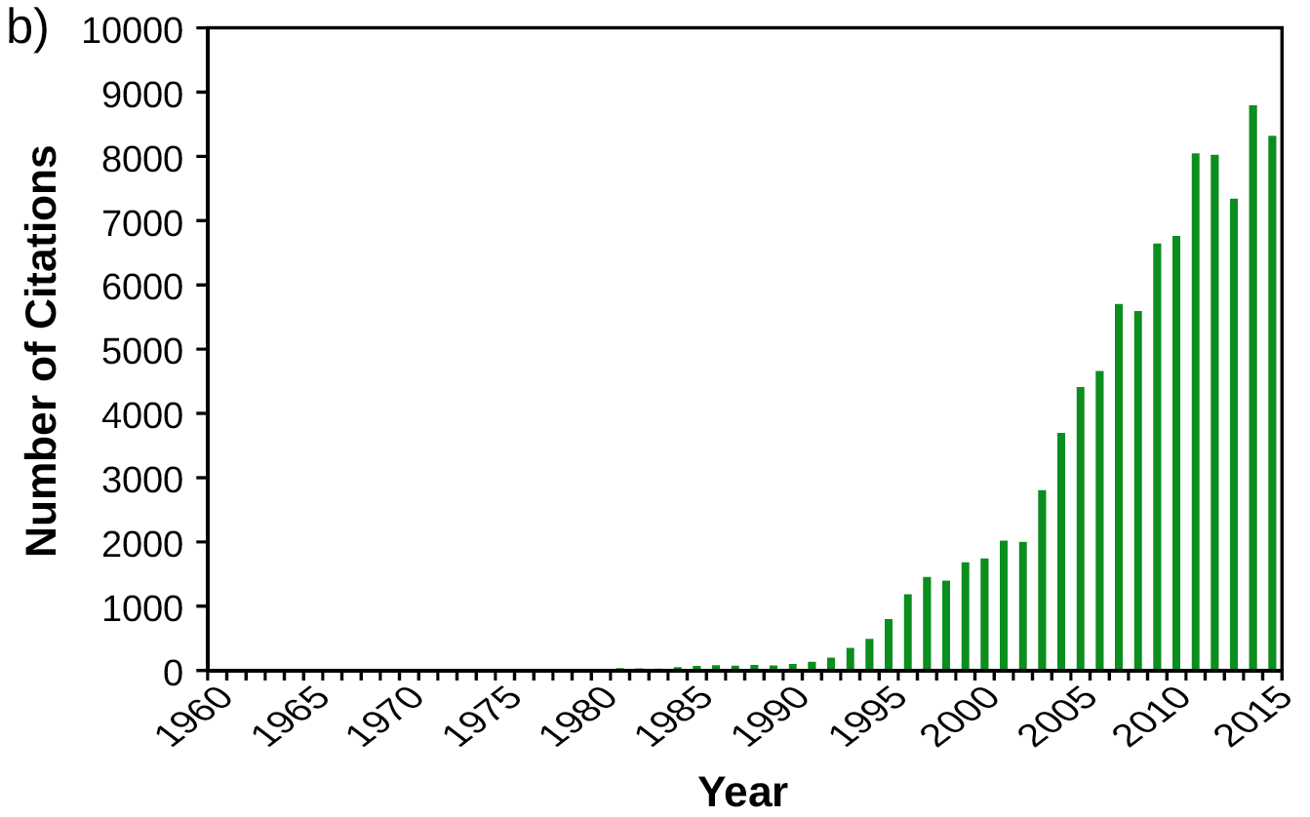
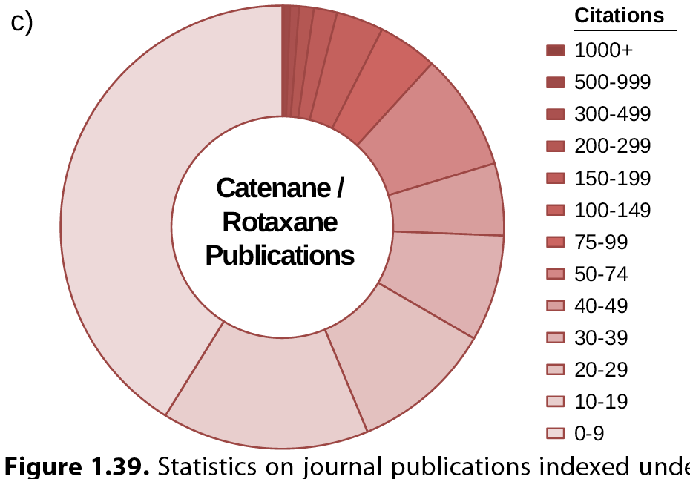
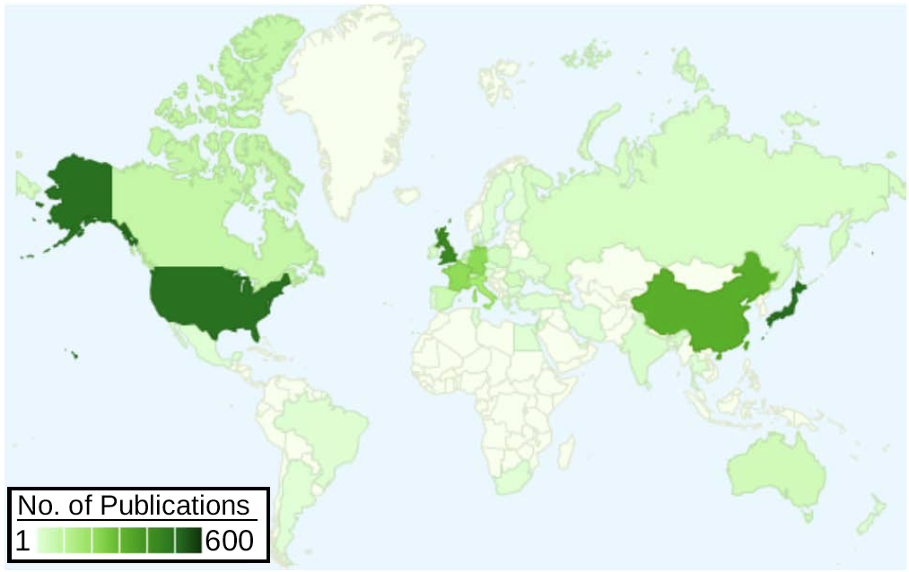
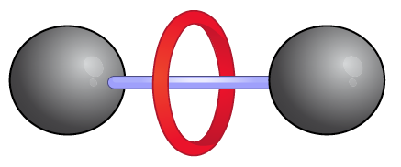
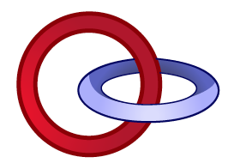
STATISTIC AND GLOBAL DISTRIBUTION
> 100,000 Total
> 5000 Publications

Slide 4
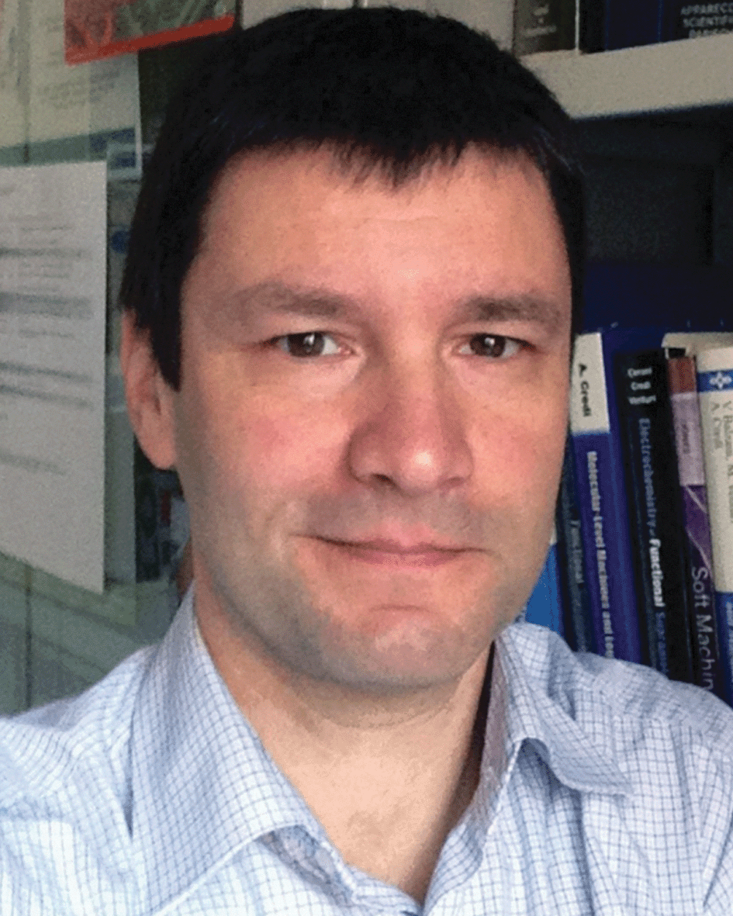
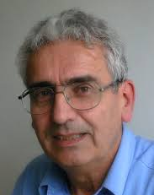
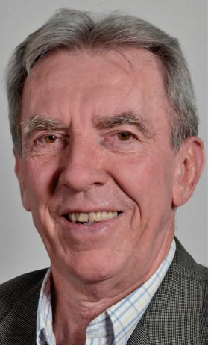
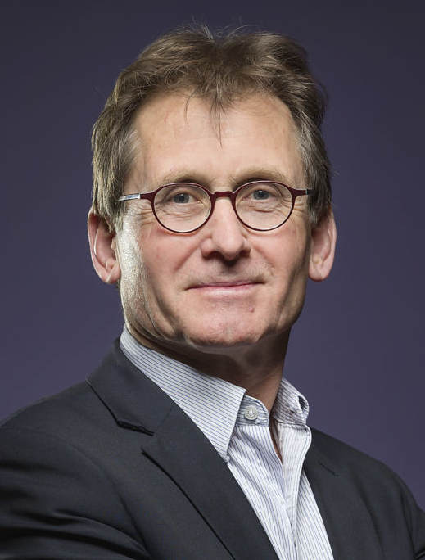
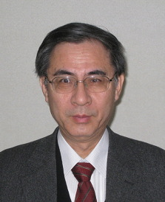
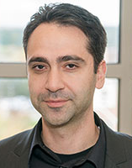
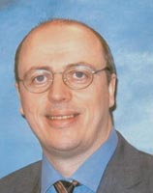
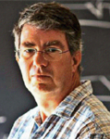
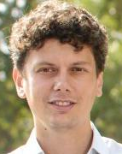
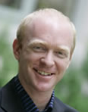
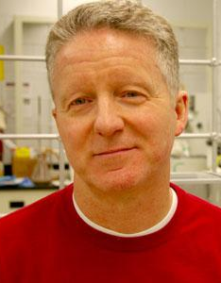
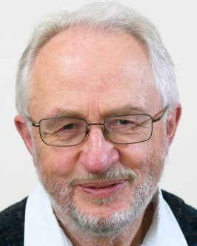
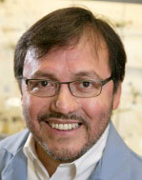
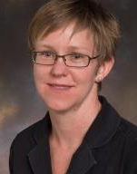
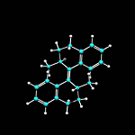
SOME LEADING MOLECULAR MACHINISTS
Alberto Credi
Vincenzo
Balzani
Akira Harada
Ivan
Aprahamian
David
Leigh
Dean
Astumian
2016
Nobel Laureate
Chemistry
Rafal
Klajn
Amar
Flood
Ben Feringa
2016
Nobel Laureate
Chemistry
Jean-Pierre Sauvage
Steve
Loeb
Josef
Michl
Miguel
Garcia-Garibay
Edie
Sevick

Slide 5
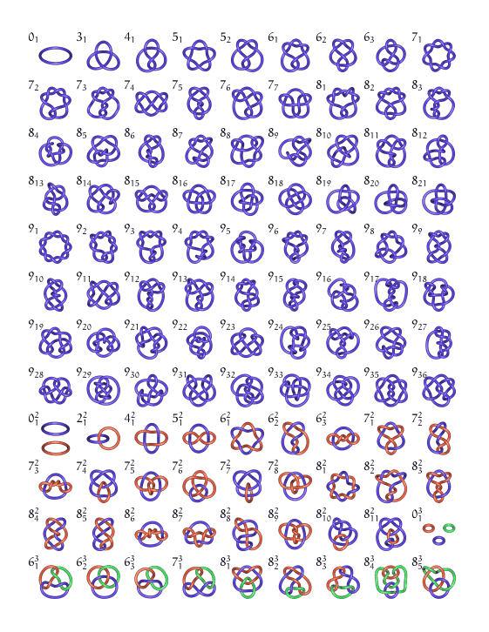
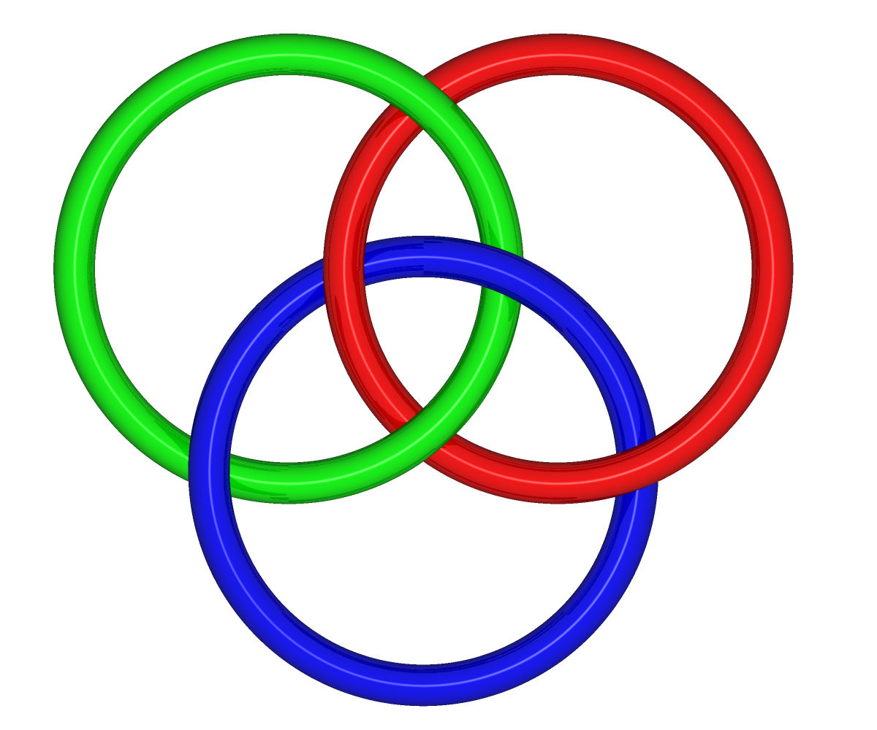
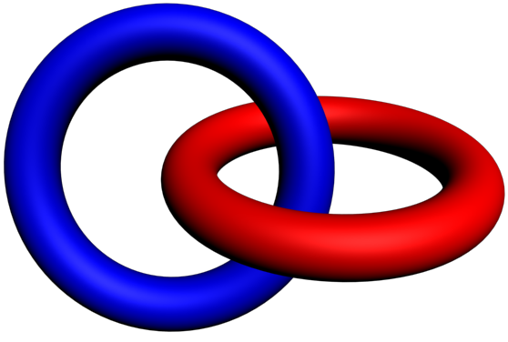
CHEMISTS ARE ‘KNOT’ FINISHED YET
Knots Galore
3
6
2
2
2
1
aka “Borromean Link”
aka “Hopf Link”
http://www.math.unl.edu/~mbrittenham2/ldt/table9.gif

Slide 6
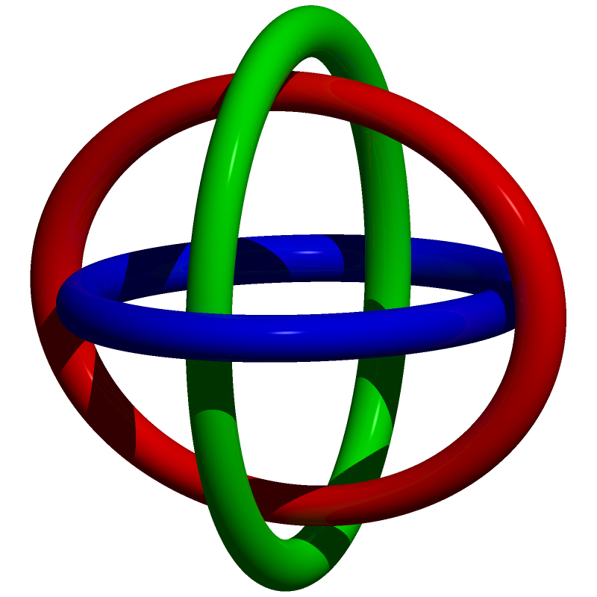
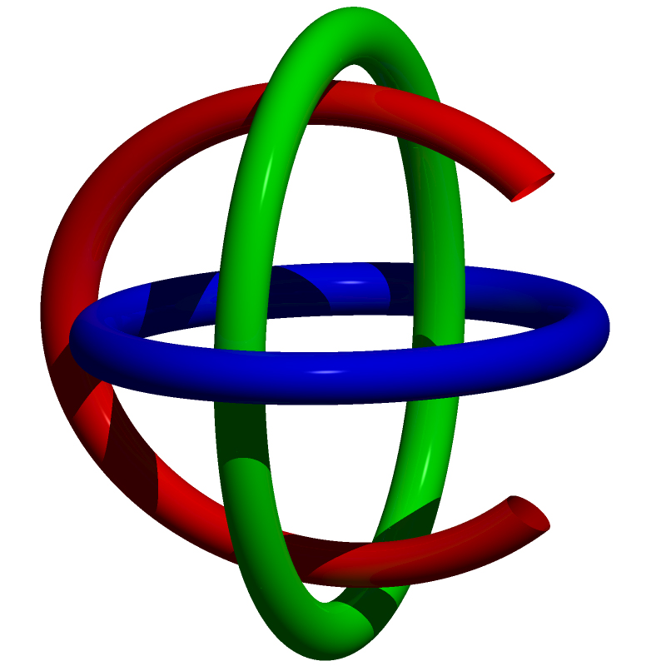
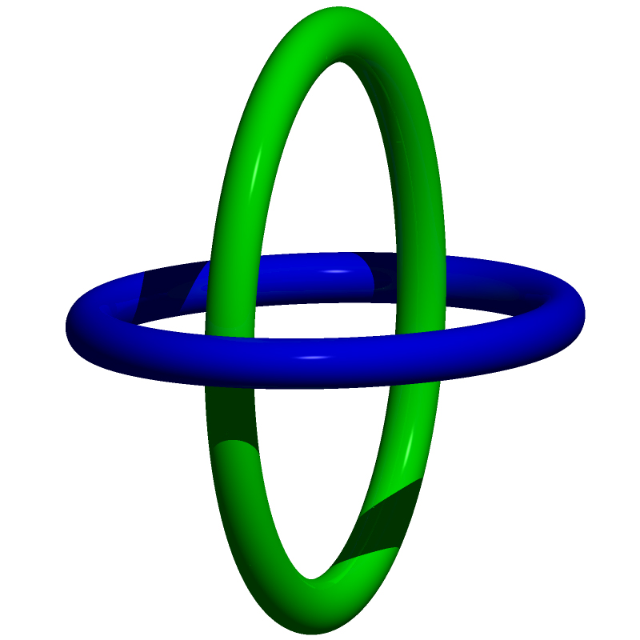
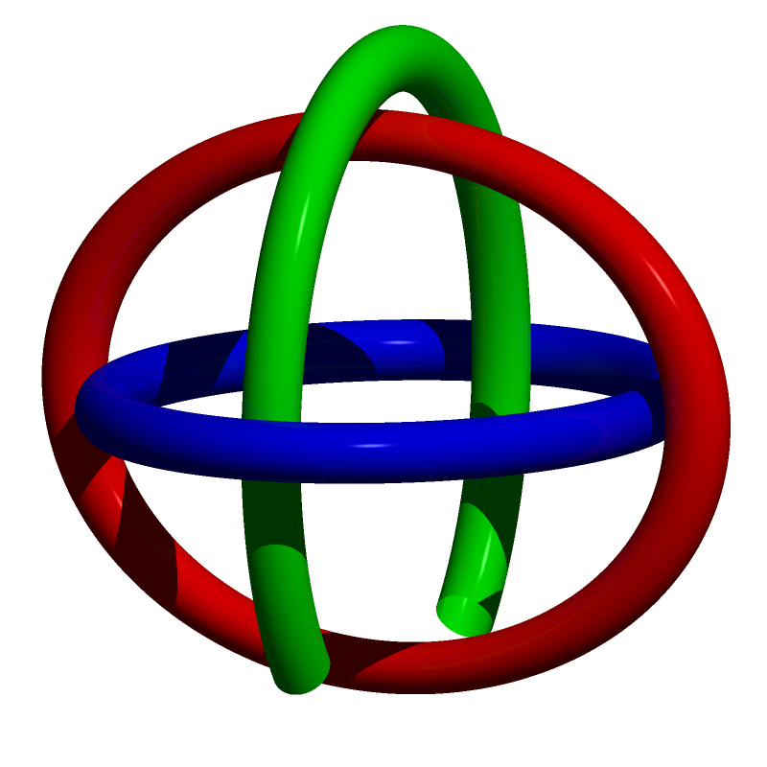
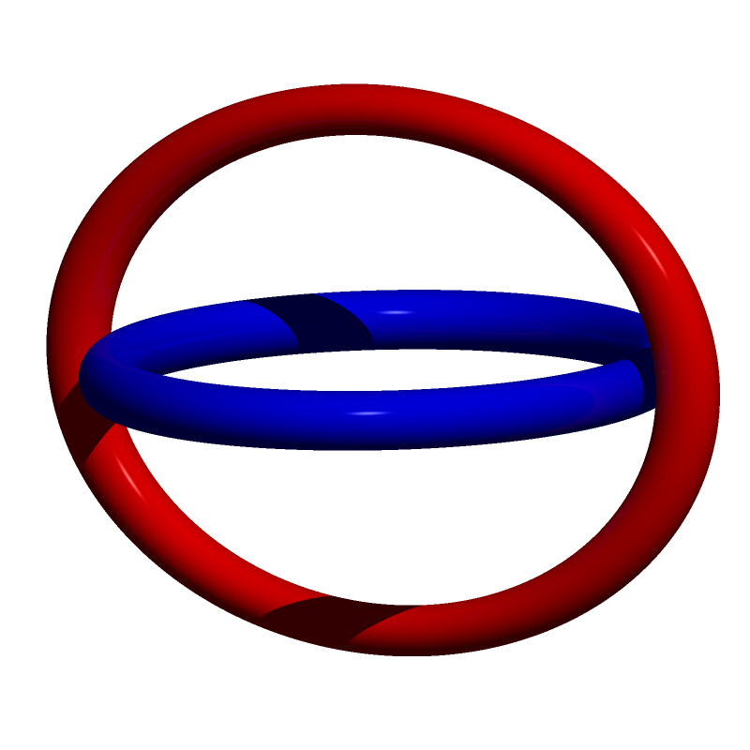
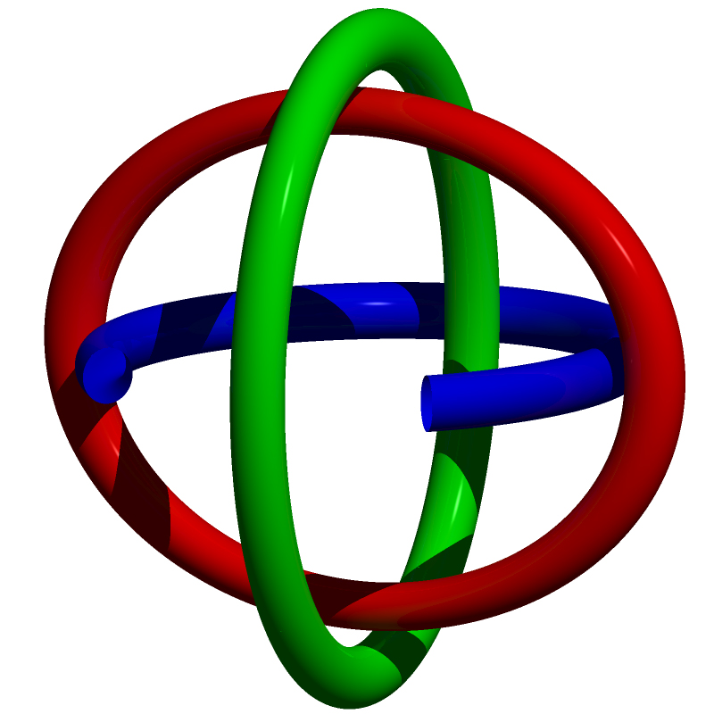
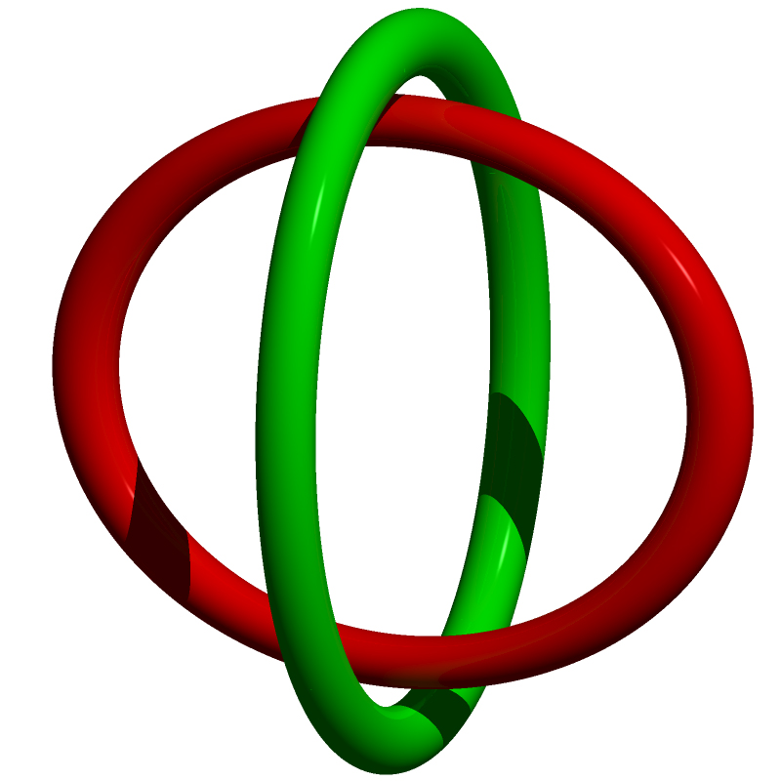
TOPOLOGICAL CONSEQUENCES
Cleave
Red Ring
Cleave
Green Ring
Cleave
Blue Ring

Slide 7
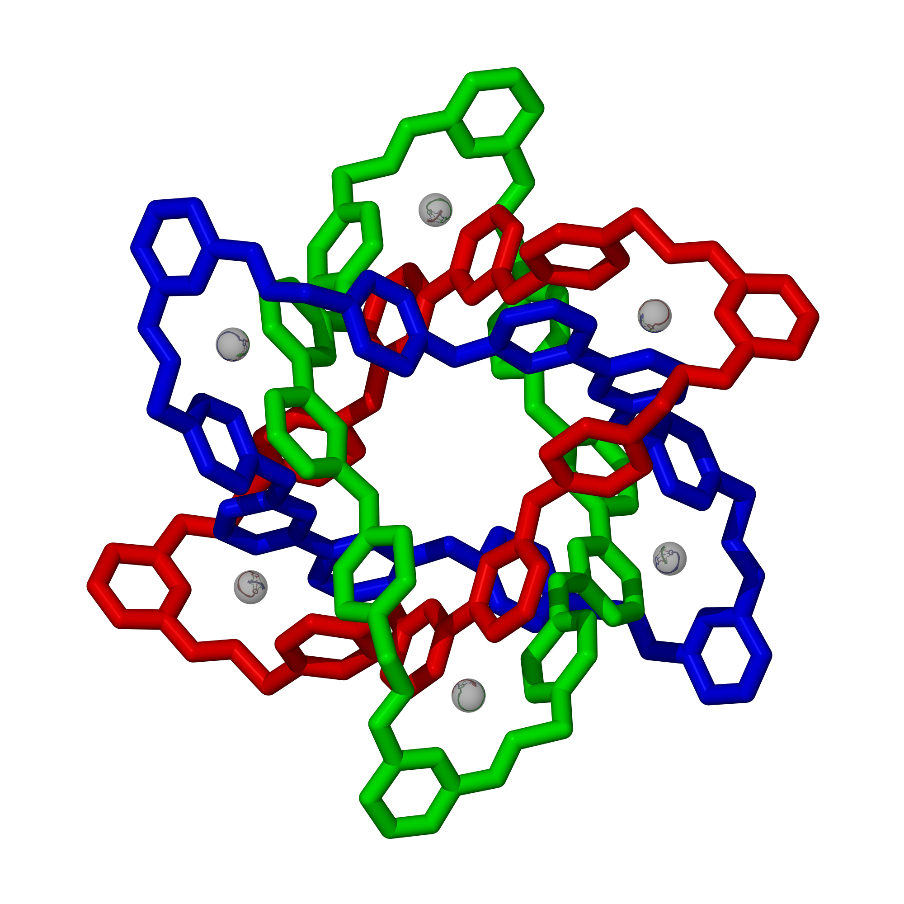
AN ORGANOMETALLIC NANOPARTICLE
S₆
~2.5 nm

Slide 8
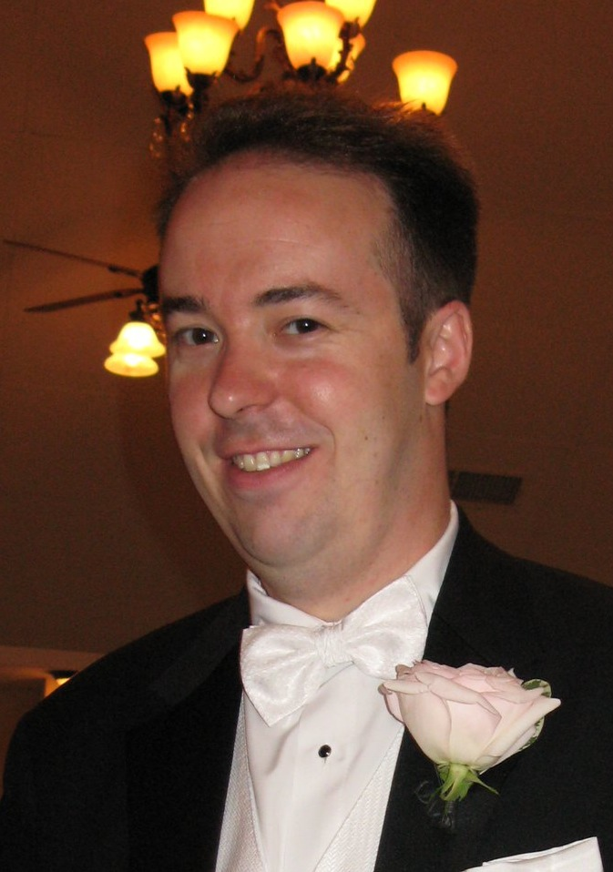
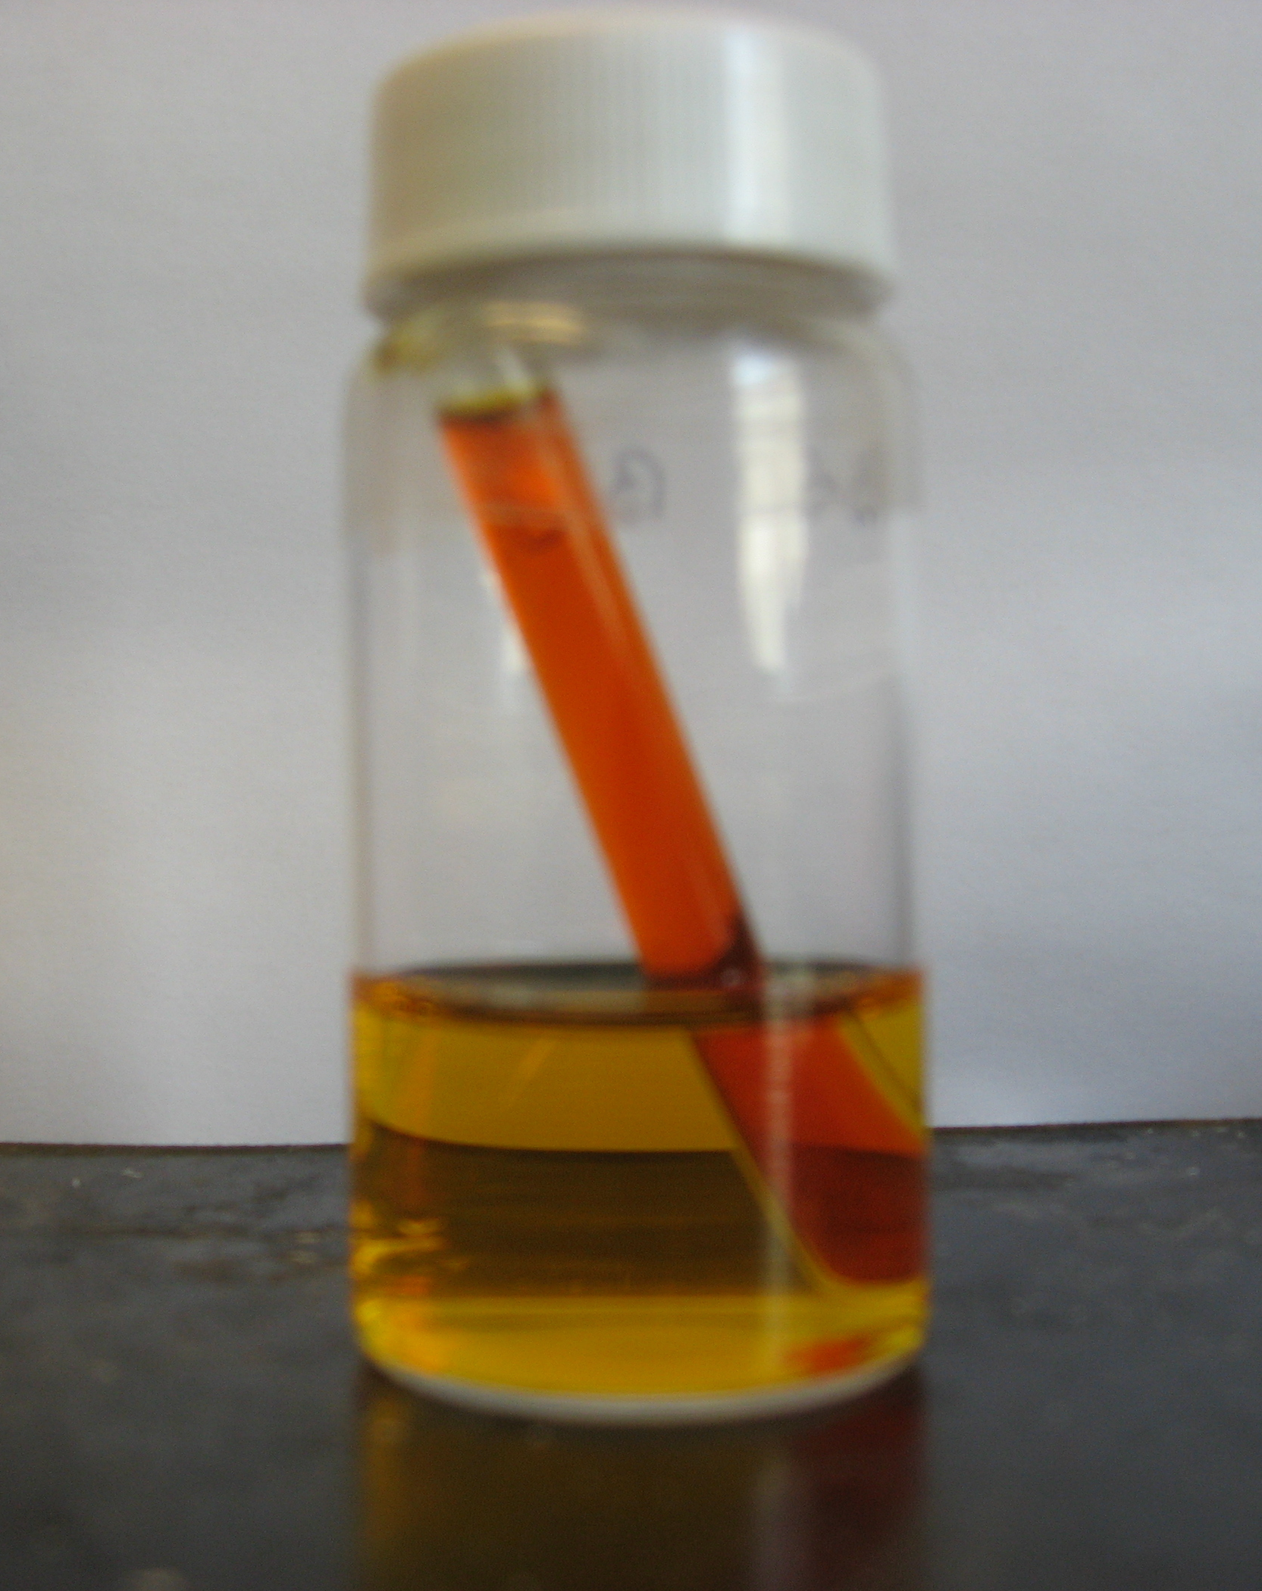
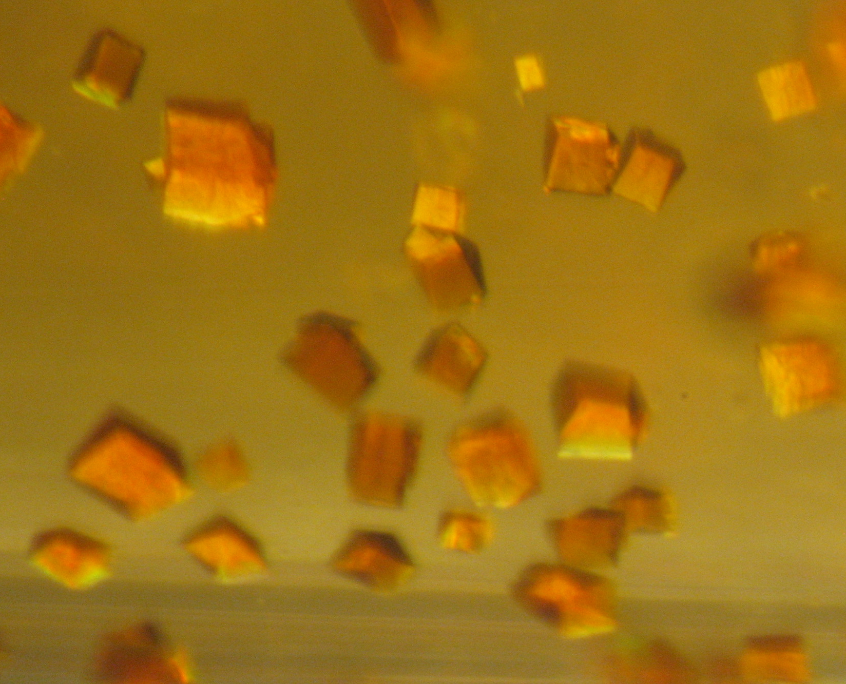
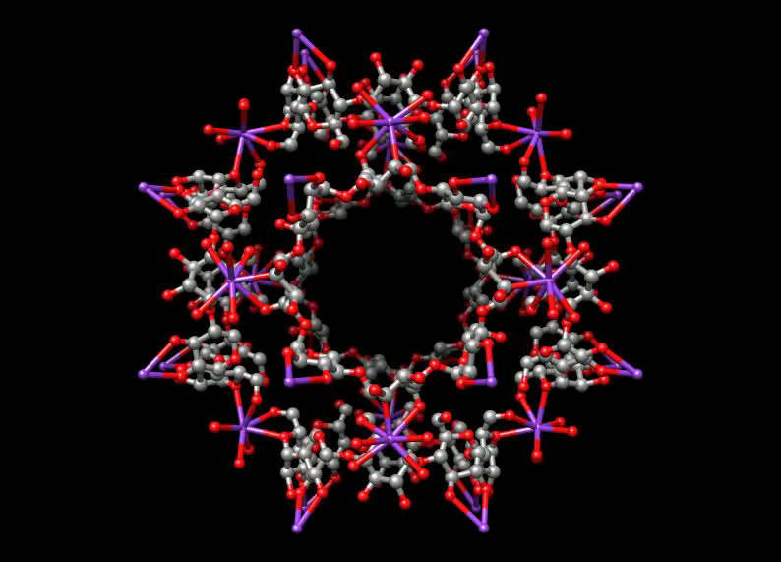

SERENDIPITY LENDS A HAND
H₂O
MeOH
+
γ-Cyclodextrin
Dr Ron
Smaldone
Ring-in-Ring precursor
+
Professor Alex Slawin
St Andrews University
Notes:
NATURE figure

Slide 9
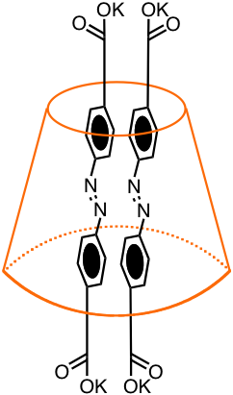
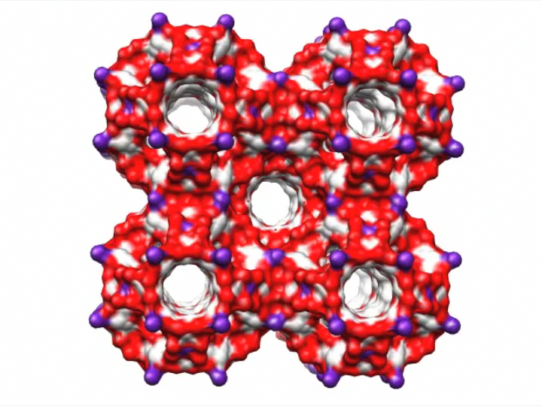
SERENDIPITY LENDS A HAND
“I see the cyclodextrin. I see 4 atoms of K weight, I see water but no other guest molecule.”
Prof Alexandra Slawin
Notes:
Fix movie

Slide 10
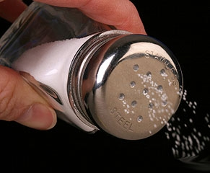
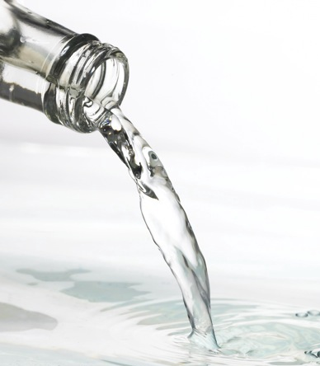
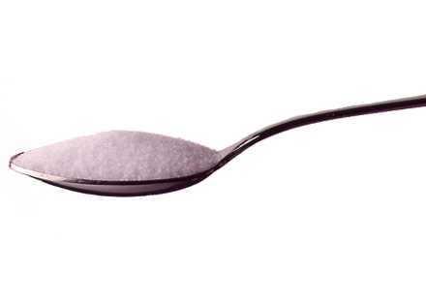
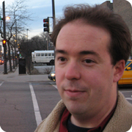
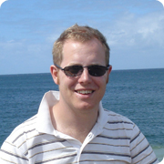
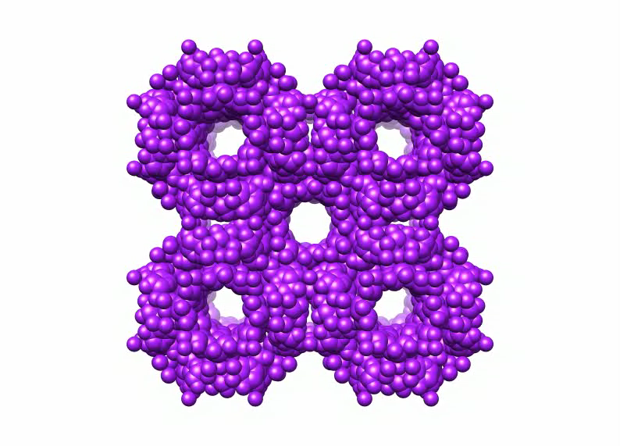
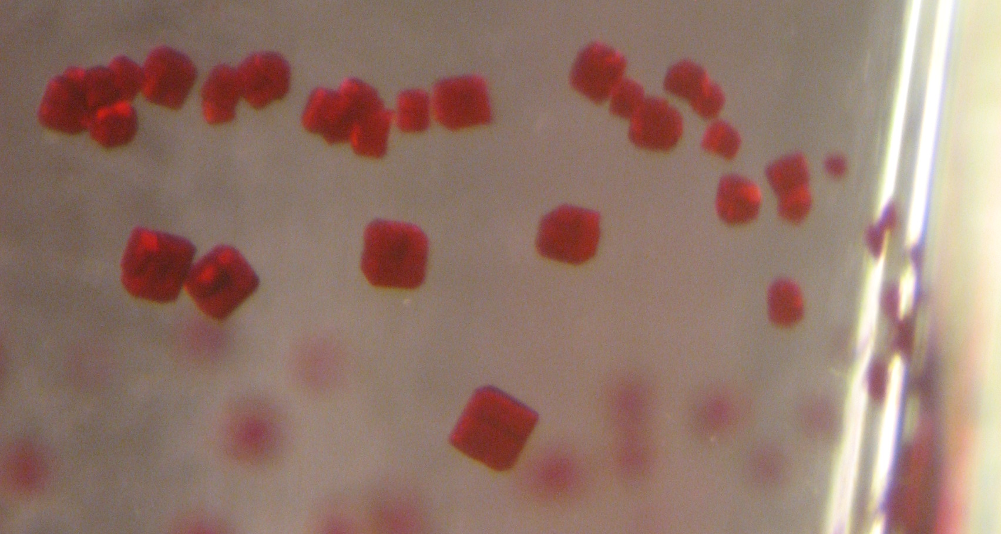
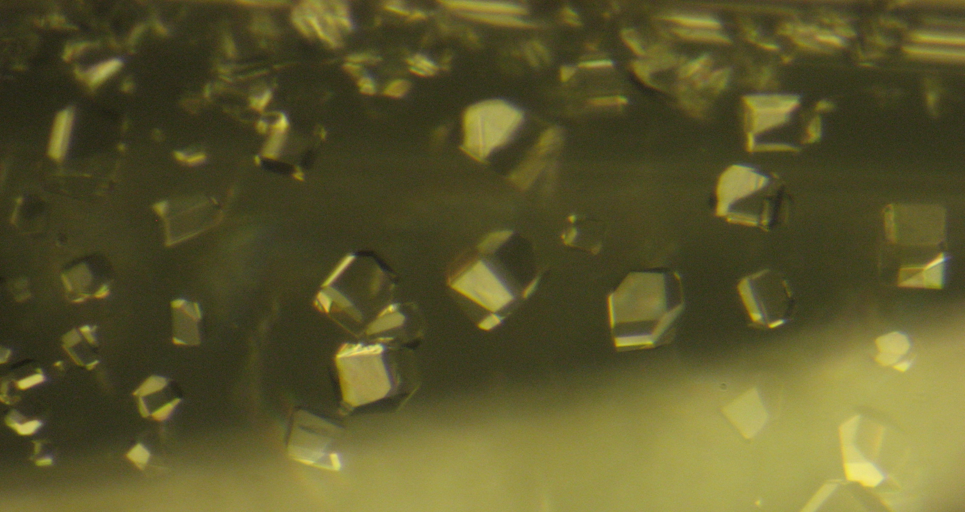
BOB’S YOUR UNCLE CHEMISTRY
+
+
A spoonful of sugar
A pinch of salt
A swig of alcohol
Ron SMALDONE
Ross FORGAN
CLEAN ENERGY
Storage of hydrogen, methanol, methane, carbon dioxide
BIODEGRADABLE
MOLECULE STORAGE
Drug delivery, bioimaging with quantum dots
BIOCOMPATIBLE

Slide 11


A FOOD-GRADE SOLUTION
A Food-Grade Solution
w We have developed a porous material, that is.…
  w Safe (non-toxic, USDA and USP certified ingredients)
  w Cheap (MAX 7¢/g)
  w Easily Made (see above — you can make them in your kitchen)
w For industries that consume a huge percentage of world GDP…
  w Food (Spoilage alerts, time released ripening agents, preservatives)
  w Personal Care (Toothpastes, deodorants)
  w Home Care (Extended release air fresheners, HVAC filtration

Slide 12








PanaceaNano
START-UP 1
Cosmetics
PanaceaNano Inc. develops and manufactures Organic Nano-Cubes
for products across many commercial platforms
Organic Nano-Cube materials are green, scalable, and low cost
We welcome collaborations and partnerships
Chemical Separation
Home & Personal Care
http://www.panaceanano.com
panaceanano@panaceanano.com
Food
Co-founders
Fraser Stoddart and Youssry Botros
Pharmaceuticals
From Nano-Cubes to Crystals

Slide 13




THANKS TO THEM
Ron
Smaldone
Ross
Forgan
Jeremiah
Gassensmith
Zhichang
Liu

Slide 14

CD-MOF-1 PREPARATION
+
+
=
A spoonful of sugar
(γ-cyclodextrin)
A pinch of salt
(alkali metal salt)
A swig of alcohol
(H₂O / methanol)
+
+
CD-MOF-1
=
CD-MOF-1 is assembled from γCD and KOH in water
γCD units linked by coordination to K⁺ ions
CD-MOF-2 with RbOH, CD-MOF-3 with CsOH
A variety of alkali metal salts give similar results
K⁺
F– Cl–
Br– I–
Rb⁺
MeCO₂–
THE NATURE OF THE ANION DOES NOT MATTER
Cs⁺
F₃CCO₂–
Angew. Chem., Int. Ed., 2010, 49, 8260–8265.
J. Am. Chem. Soc. 2012, 134, 406–417

Slide 15


PUTTING THE CAT AMONG THE PIGEONS
A Food-Grade Solution
Unique Supramolecular wire
KAuBr₄
α-CD
Long
Needles
2 mL 0.005 M in H₂O
2 mL 0.01 M in H₂O
Zhichang Liu
Shake
5 min
80%
An α-CD aqueous solution (0.01 M, 2 mL) …
… and a KAuBr₄ aqueous solution (0.005 M, 2 mL) …
… are mixed together and shaken at room temperature for 5 min.
An off-white suspension with a silky gloss is gradually formed.
The solid is obtained as an off-white powder …
… by centrifugation and drying under vacuum in 80% yield.
Nature Commun 2013, 4, Article 1855 J. Am. Chem. Soc. 2016, 138, 11643–11653

Slide 16



DISSECTION OF X-RAY CRYSTAL STRUCTURE
Nanocable
1º 2º 2º 1º 1º 2º 2º 1º
Supramolecular
Nanotube
+
Ion Wire
The longitudinal Br–O distances are less than 3.4 Å
[K(H₂O)₆]⁺ and [AuBr₄]– are connected by O–H···Br–Au hydrogen bonding

Slide 17




















SINGLE CRYSTAL SUPERSTRUCTURES OF ALL SIX COMPLEXES
Front View
Side View
α•Br β•Br γ•Br
α•Cl β•Cl γ•Cl
α•Br β•Br γ•Br
α•Cl β•Cl γ•Cl
Axial direction
φ = 9.2°
42.2°
45°
17.1°
40.8°
45°
θ = 2.6°
49.6°
90°
2.6°
50.2°
90°
Top View
Rotation angle φ
Inclination angle θ
≡ [AuBr₄]⁻
≡ [AuCl₄]⁻
≡ K⁺
X ≡ Cl or Br
Nature Commun 2013, 4, Article 1855 J. Am. Chem. Soc. 2016, 138, 11643–11653

Slide 18

SINGLE-CRYSTAL STRUCTURES OF 20 COMPLEXES
J. Am. Chem. Soc. 2016, 138, 11643–11653

Slide 19

SCHEMATIC REPRESENTATION OF ALL SINGLE-CRYSTAL STRUCTURES
J. Am. Chem. Soc. 2016, 138, 11643–11653

Slide 20

GLOBAL DISTRIBUTION OF GOLD PRODUCTION IN 2012
7.6%
3.8%
8.5%
13.7%
3.3%
3.3%
Others
34.6%
3.5%
6.1%
9.3%
6.3%
COUNTRY | PRODUCTION tonnes | COUNTRY | PRODUCTION tonnes
China | 370 | Peru | 165
Australia | 250 | Canada | 102
United States | 230 | Indonesia | 95
Russia | 205 | Uzbekistan | 90
South Africa | 170 | Ghana | 89
Rest of the world | 847 | World | 2700
Cyanide leaching is the standard method used for recovering approximately 83% of the gold throughout the world today.
Norgate, T.; Haque, N. J. Clean. Prod. 2012, 29–30, 53.

Slide 21




START-UP 2
Roger Pettman

Slide 22
TO BE SUCCESSFUL IN ACADEMIA YOU NEED
To put teaching students before research
To let students take ownership of their research
To put your students before yourself
To support your students through thick and thin
To identify a line of research that is receiving little attention
To recognize that progress in research will be slow
To be able to appreciate the significance of a ‘discovery’
To find out how to manage research
To employ best practice in writing grants and scientific papers
To set very high standards in presentations – oral and written
The strength of a horse
The hide of an elephant
The work ethic of a honey bee

Slide 23
TO BE SUCCESSFUL IN LIFE AT WHATEVER
Treat people how you would expect to be treated yourself
Be respectful towards people younger than yourself
Treat people from different ethnic and cultural backgrounds the same
Don’t speak ill of other people
Think before opening your mouth
Realize we live in a ‘village’
Be more ready to give than to receive
Be supportive towards those around you
Be ready, willing and able to give praise
Work out how to turn a pig’s breakfast into a sow’s ear
“The secret of success is the capacity to survive failure
– Noel Coward

Slide 24
WE ARE ALL ONE PEOPLE ON EARTH
Then let us pray that come it may
(As come it will for all that)
That Sense and Worth over all the earth
Shall have pre-eminence and all that
For all that, and all that,
it's coming yet for all that
That Man to Man the world over
Shall brothers be for all that.
– Robert Burns

Slide 25














Northwestern University
Department of Chemistry
Texas A&M University
Department of Chemistry
Friday 26 May 2017
Fraser Stoddart
@sirfrasersays
Thank You
For Your Attention

