Slide 1



Synchrotron Radiation in Structural Biology: The machines and ideas that make SR work for you
Robert M. Sweet
Photon Sciences and Biosciences
Brookhaven National Laboratory
Long Island, New York

Slide 2
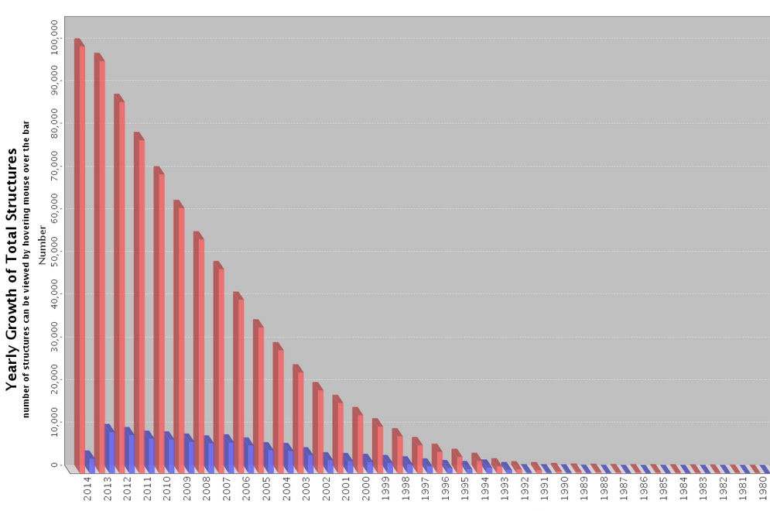
The impact of synchrotron x-ray scattering and diffraction on structural biology
There are 100,000 depositions in the PDB. In 2013 there were about 10,000 in one year; this is about 50 per working day.
Recently, 80% of these result in part from data measured at a synchrotron.
Multiple Nobel-Prize winners

Slide 3
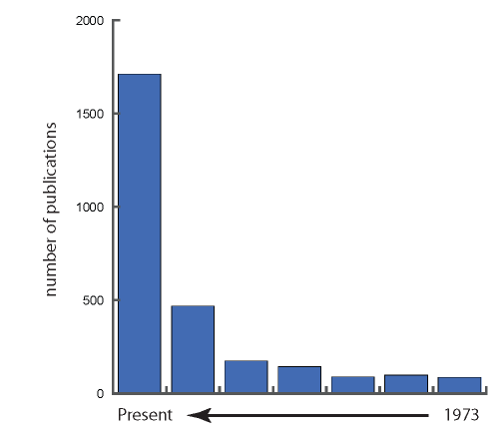
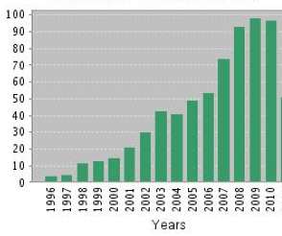
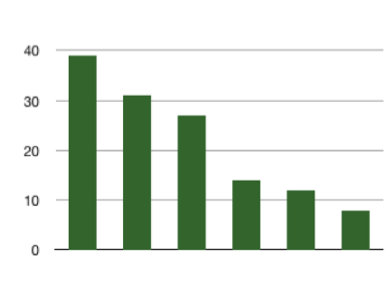
The pace of publications in SAXS is increasing very rapidly, and many of these depend on SR.
1999-1994
1995 Svergun & Stuhrman: SASHA
software for shape determination
1995 Svergun: CRYSOL
calculate SAXS curve using PDB
accounts for solvent layer
Synchrotrons
1999-1994
1973
Publications containing SAXS
CRYSOL Citations

Slide 4
One might ask, how did they do that?
We know that advances in biochemistry and crystal growth are critical, but why are synchrotrons so useful?
The answer: under the hood in synchrotron x-ray facilities, there have been monumental improvements in several types of technology.
We’ll review these technologies, where they came from and how they work:
  The sources themselves – accelerators, magnets.
  X-ray optics to control the beam.
  Diffractometers.
  Handling crystals
  Detectors
  Software

Slide 5
The sources themselves – accelerators, magnets.

Slide 6
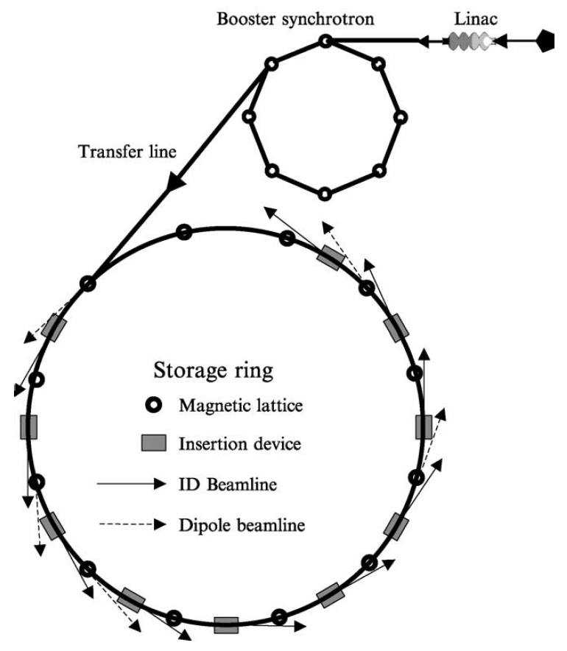
A Synchrotron Light Source
Electrons or positrons are accelerated to relativistic speeds, ~ 1 GeV energy or larger in a polygon-shaped ring.
I recommend that one reads Michael Hart’s chapter “What can I have as a source of X-ray synchrotron radiation? A primer for potential users.” In vol. 368 of Methods in Enzymology (2003 pp. 239-254). I take some details from there, including this diagram.

Slide 7
The Source of Synchrotron Radiation
It’s like flicking a string!
Electron trajectory
Induced Electric Vector
Synchrotron Light
Relativistic Electron
The harder the bend, and the faster the electrons (higher energy), the shorter is the wavelength of the light. The Characteristic Wavelength goes as
λ_{c} ~ R / E³
Dipole Magnet

Slide 8
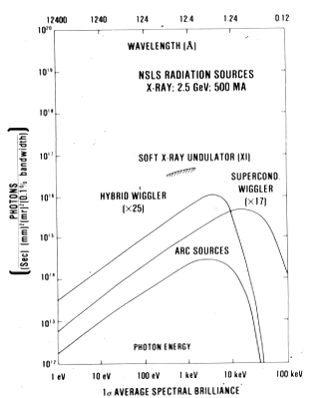
There’s a wide spectrum of x-rays available to us for diffraction studies. Here you see the arc (dipole or bending-magnet) and wiggler sources.

Slide 9
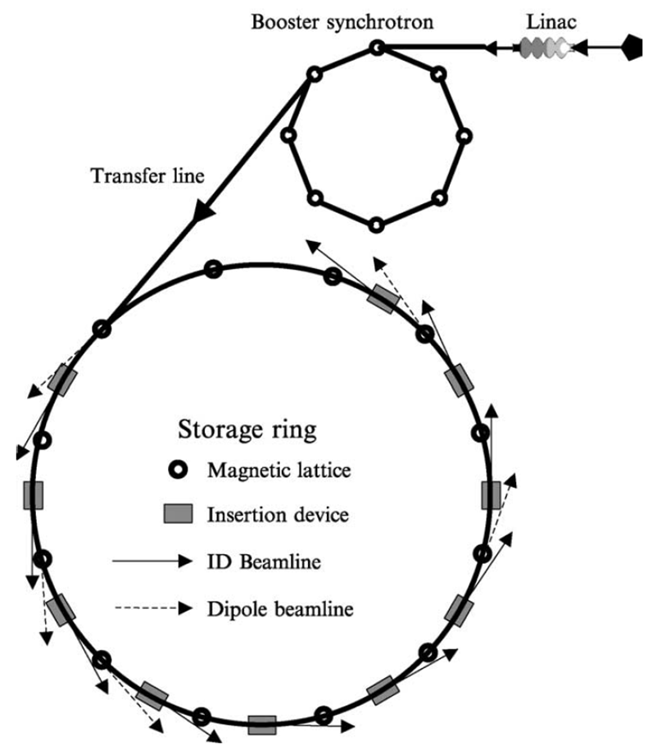
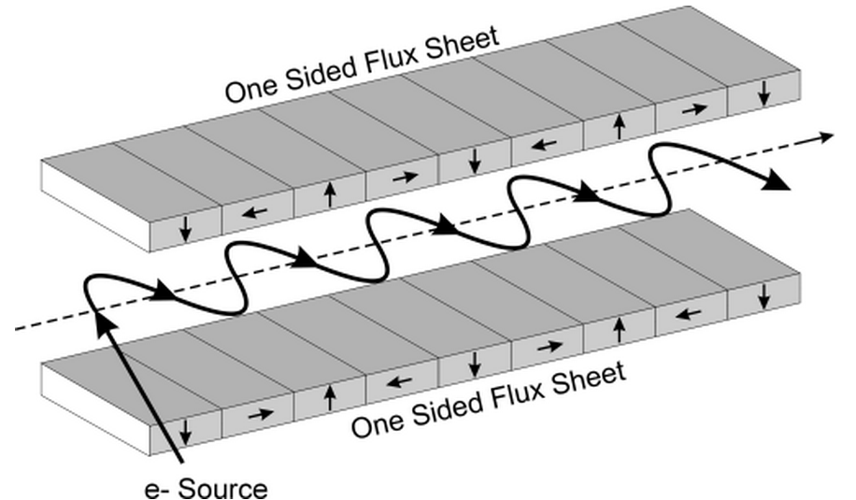
One can insert a multi-magnet device into a straight section of the synchrotron to amplify the intensity.
A wiggler is a row of alternating dipoles that make a wiggly trajectory. The first wiggler beamline was at SSRL in 1979.
Wiggler goes here.
The intensity from a wiggler is multiplied by the number of magnets in the device.
A Halbach Array.

Slide 10
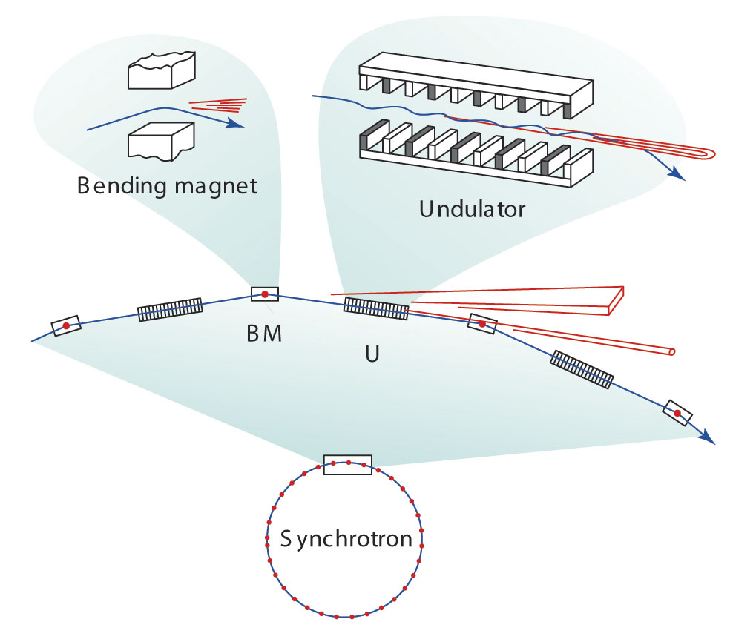
An undulator is an array of magnets like a wiggler, but the magnets are weaker and the period is shorter. The photons are emitted at the little dipoles as the relativistic electrons run along-side.
Each packet of photons will interact with each successive magnet, the intensity from an undulator is multiplied by the SQUARE of the number of magnets in the device.
Hart points out that this is like diffraction from a One-Dimensional lattice.
Courtesy of
Wayne Hendrickson

Slide 11
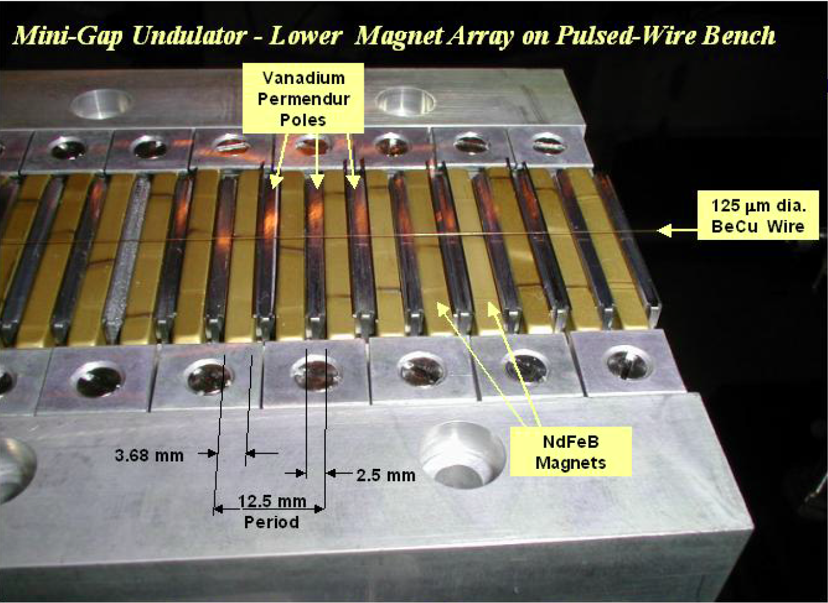
This is similar to the undulator installed in NSLS X29

Slide 12
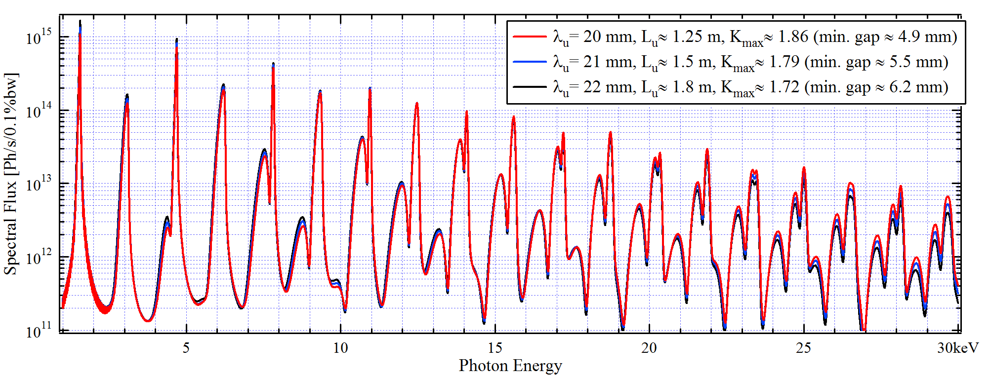
Estimated Spectrum for several NSLS-II undulators, viewed through a ~ 2 mm aperture lying 30 m from the source, about where the monochromator will be.
Spectral Flux at Minimal Gap (Maximal K) for Three Different IVU
E-Beam Current: 0.5 A. Undulator Center located ~1 m after the Center of a Low-Beta Straight Section
Oleg Tchoubar, Calculated by SRW (Synchrotron Radiation Workshop)
This graph shows the fundamental emission energy, then 18 harmonics. Imagine fretting your guitar to get the 18th harmonic to sound! The 280 magnets in this array must be precisely tuned in field strength and position to create this pattern.

Slide 13
How do you make your electron beam strong, straight, and fine to create these harmonics?
For the electron beam to be small the electrons must run along-side one another: the beam is collimated. We define this collimation of the electrons by its Emittance – the product of the size of the beam and its angular crossfire (Small Emittance is Good).
Hart explains that a synchrotron ring behaves like diffraction from another one-dimensional lattice, the dipole magnets in one turn of the ring. So the emittance becomes some higher power of both the electron Energy and the Number of dipoles.
ε ≈ E² / N³
  NSLS has eight 2-dipole magnet cells for a total of 16 dipoles.
  NSLS-II has thirty 2-magnet cells for 60 total.
  MAX-IV (Sweden) will have twenty 7-magnet cells for 140.
  ESRF will have thirty-two 7-magnet cells for 224.
You can see where we’re going here….
Synchrotron Sources of the future will be very, very bright.

Slide 14
The ultimate undulator source available now
I’ll not discuss the Laser Coherent Light Source at Stanford’s SLAC laboratory except to summarize its qualities.
The old SLAC tunnel was used to create a linac that would produce very short electron bunches, as short as 7 femtoseconds.
The beam travels through an undulator that is 120 m long.
The x-ray pulses are very intense and quite coherent – they are laser pulses.
In general single pulses completely destroy protein-based specimens, but not before one gets diffraction.
The results from here are very interesting and portend a great future, especially for time-resolved studies.

Slide 15
2. X-ray optics to control the beam.

Slide 16
To monochromatize a synchrotron source:
Rays are nearly parallel
Use a perfect crystal
Si cut to use the (1,1,1) planes is a good choice
Often we use two crystals:
  One to monochromatize
  One to deflect the beam back up into the horizontal plane
Braggs’ law determines the wavelength

Slide 17
Beam Focusing (Use of a bent mirror)
A way we can focus for x-rays, is to do some optical things by total reflection at very low angles.
Physically, it’s like internal reflection in a prism.
These are very low angles: < 0.25 deg.
We can bend mirrors to an ellipse to get focusing
One can employ a pair of mirrors mounted perpendicularly to give H and V focusing (Kirkpatrick and Baez, 1948; Franks, 1955).
With a single mirror shaped to a cylinder one can make a toroid to do H and V focusing

Slide 18
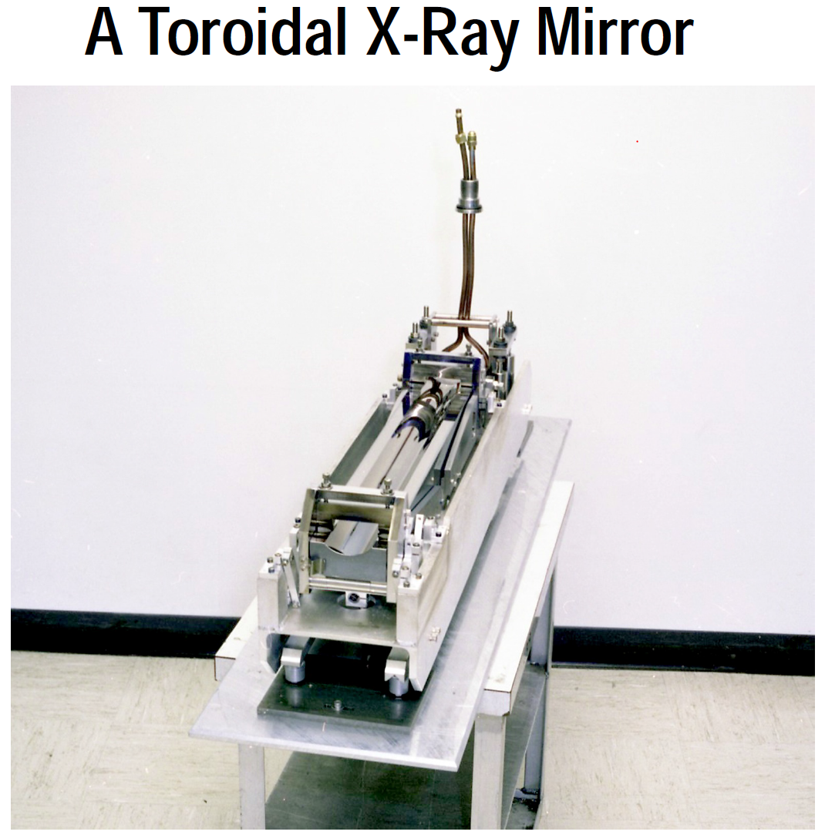

Slide 19
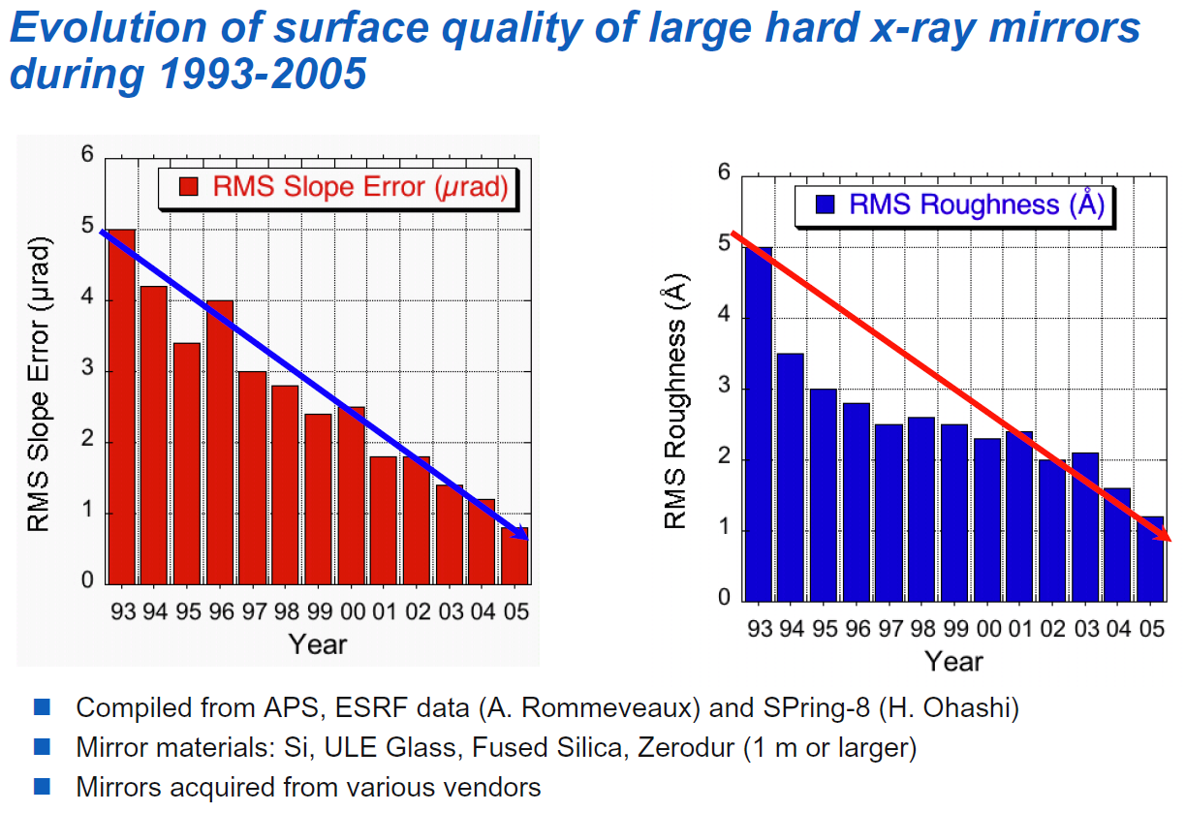
How have optical systems improved to match the improvement in the x-ray beams?
Errors in the shape of the mirror (slope or figure) will impact the quality of the focus.
Rough mirrors will scatter x-rays without focusing them.
Lahsen Assoufid, APS

Slide 20
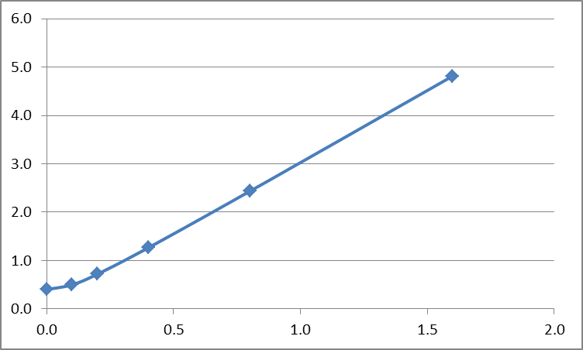
The electron beam in NSLS-II will have a vertical Gaussian distribution height σ of 4 microns (FWHM ~ 10 microns). I want to set up a mirror with a 10:1 demagnification ratio. How small will the image be for various slope errors?
A value of 0.1 – 0.2 µ-radians looks pretty good.
Value of the σ of height of the demagnified source in µm.
A value of 1.25 µ-radians is no better than what you start with!!
RMS slope error of the mirror in µ-radians.

Slide 21


How big is 0.1 µrad? That’s 10⁻⁷ radians.
Firstly, 3000 km = 3 x 10⁶ m
Then 3 x 10⁶ m * 10⁻⁷ = 0.3 m = 30 cm.
3000 km
Me in New York
You in Albuquerque

Slide 22
Elastic Emission Machining can give the slope/figure accuracy we need.
A suspension of 2 μm quartz spheres at 3% concentration are directed at features to be reduced. This is an ultra-precision machining method that can fabricate shapes with 0.1-nm accuracy.
Structure of EEM nozzles used to generate high-shear flow on the workpiece surface in elastic emission machining. Diameters of streams are in the range 1 mm × 300 μm. Working distances 0.4 – 1.8 mm. (a) Straight-flow nozzle. (b) Focusing-flow nozzle.
Takei and Mimura Nanoscale Research Letters 2013, 8:237

Slide 23
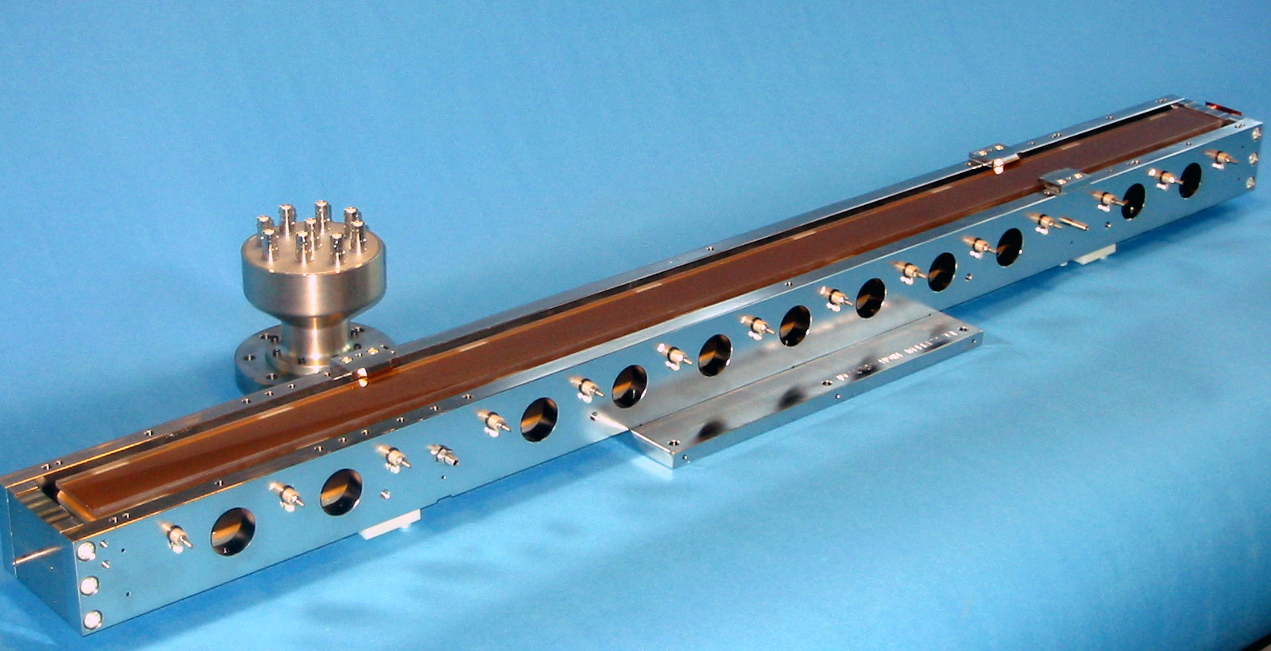
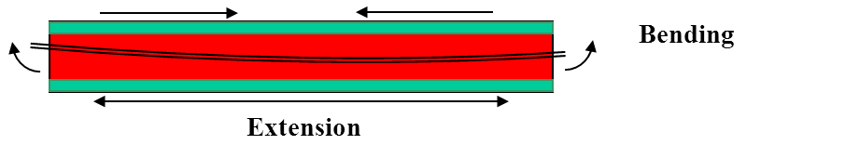

Correcting Figure Errors and Making Accurate Bends
The SESO company, now owned by Thales have been creating “bimorph” benders, which are piezo-electric bars glued to solid mirrors of single-crystal Si or fused silica.
Several electrodes are connected along the length of the bars to make short-range bends.
Correction with 12 electrodes on a 600 mm mirror can provide small height errors of 1.3 nm RMS and slope errors in the range we want, 0.15 µrad RMS.
Mirror Surface
Piezo-electric bars
Piezo-electric
bars
Main Mirror Substrate
Thales SESO

Slide 24
3. Diffractometers.

Slide 25
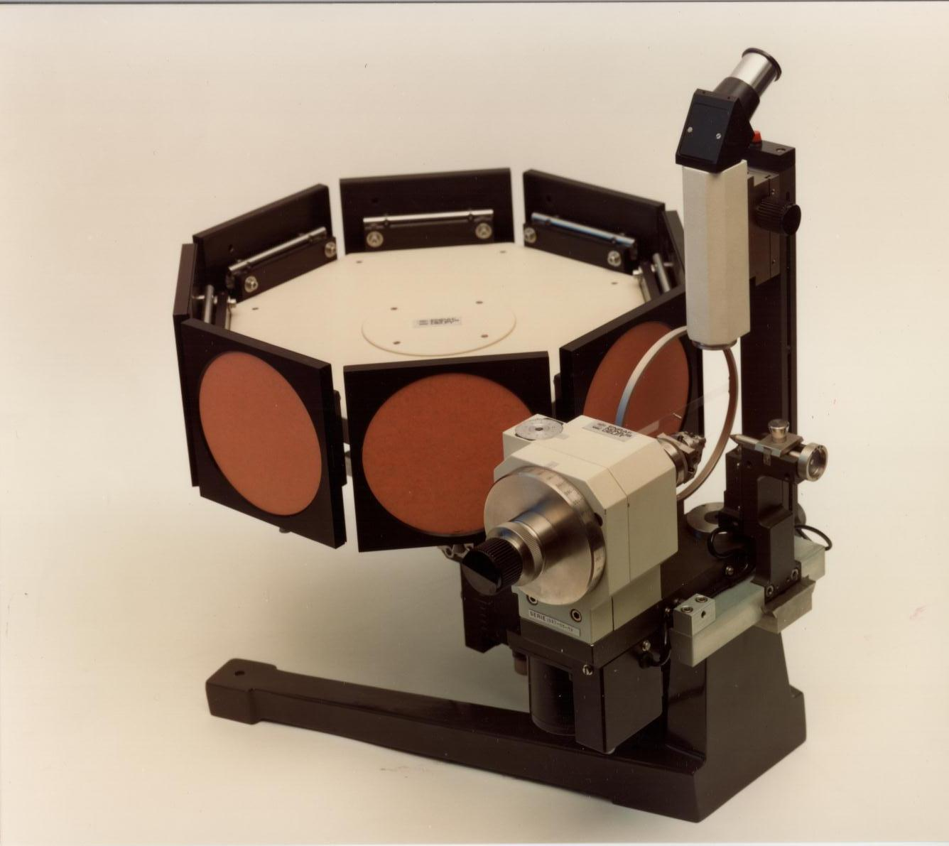
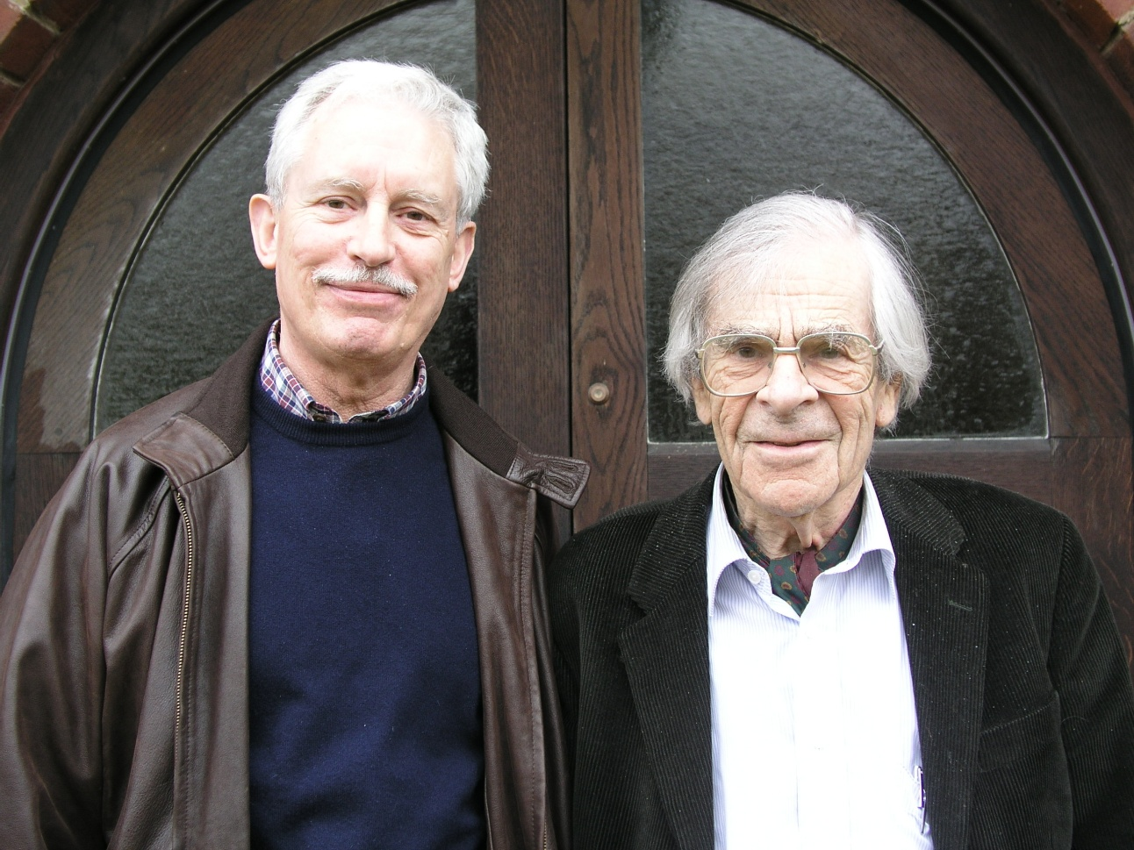
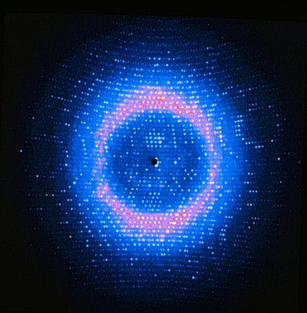
Uli Arndt and Alan Wonacott invented the automated rotation camera. Still x-ray film, but very much more efficient.
Bram Schierbeek,
Notes:
1974 A Wonacott Between Toulouse and Bordeaux.
Our address is: La Marechalerie, Roquefere, 47150 Monflanquin and our
telephone number is 05 53 01 27 08 (if you call from a french phone).

Slide 26
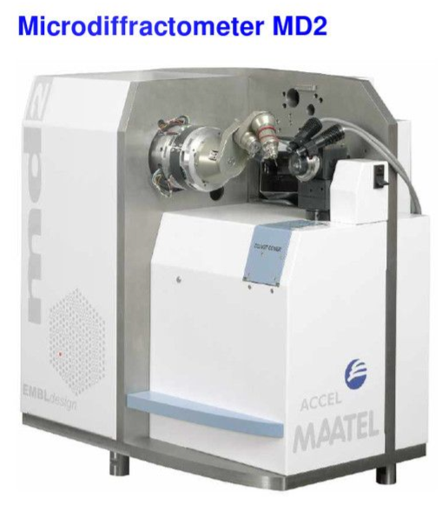
A commercial microdiffractometer.
The MD2 was invented by Annastasis Perrakis and Florent Cipriani and the team at the EMBL in Grenoble in about 1999. It has been commercialized by several companies, now Bruker, and it is used at many beamlines. It handles crystals nicely down to dimensions of 5 µm.

Slide 27
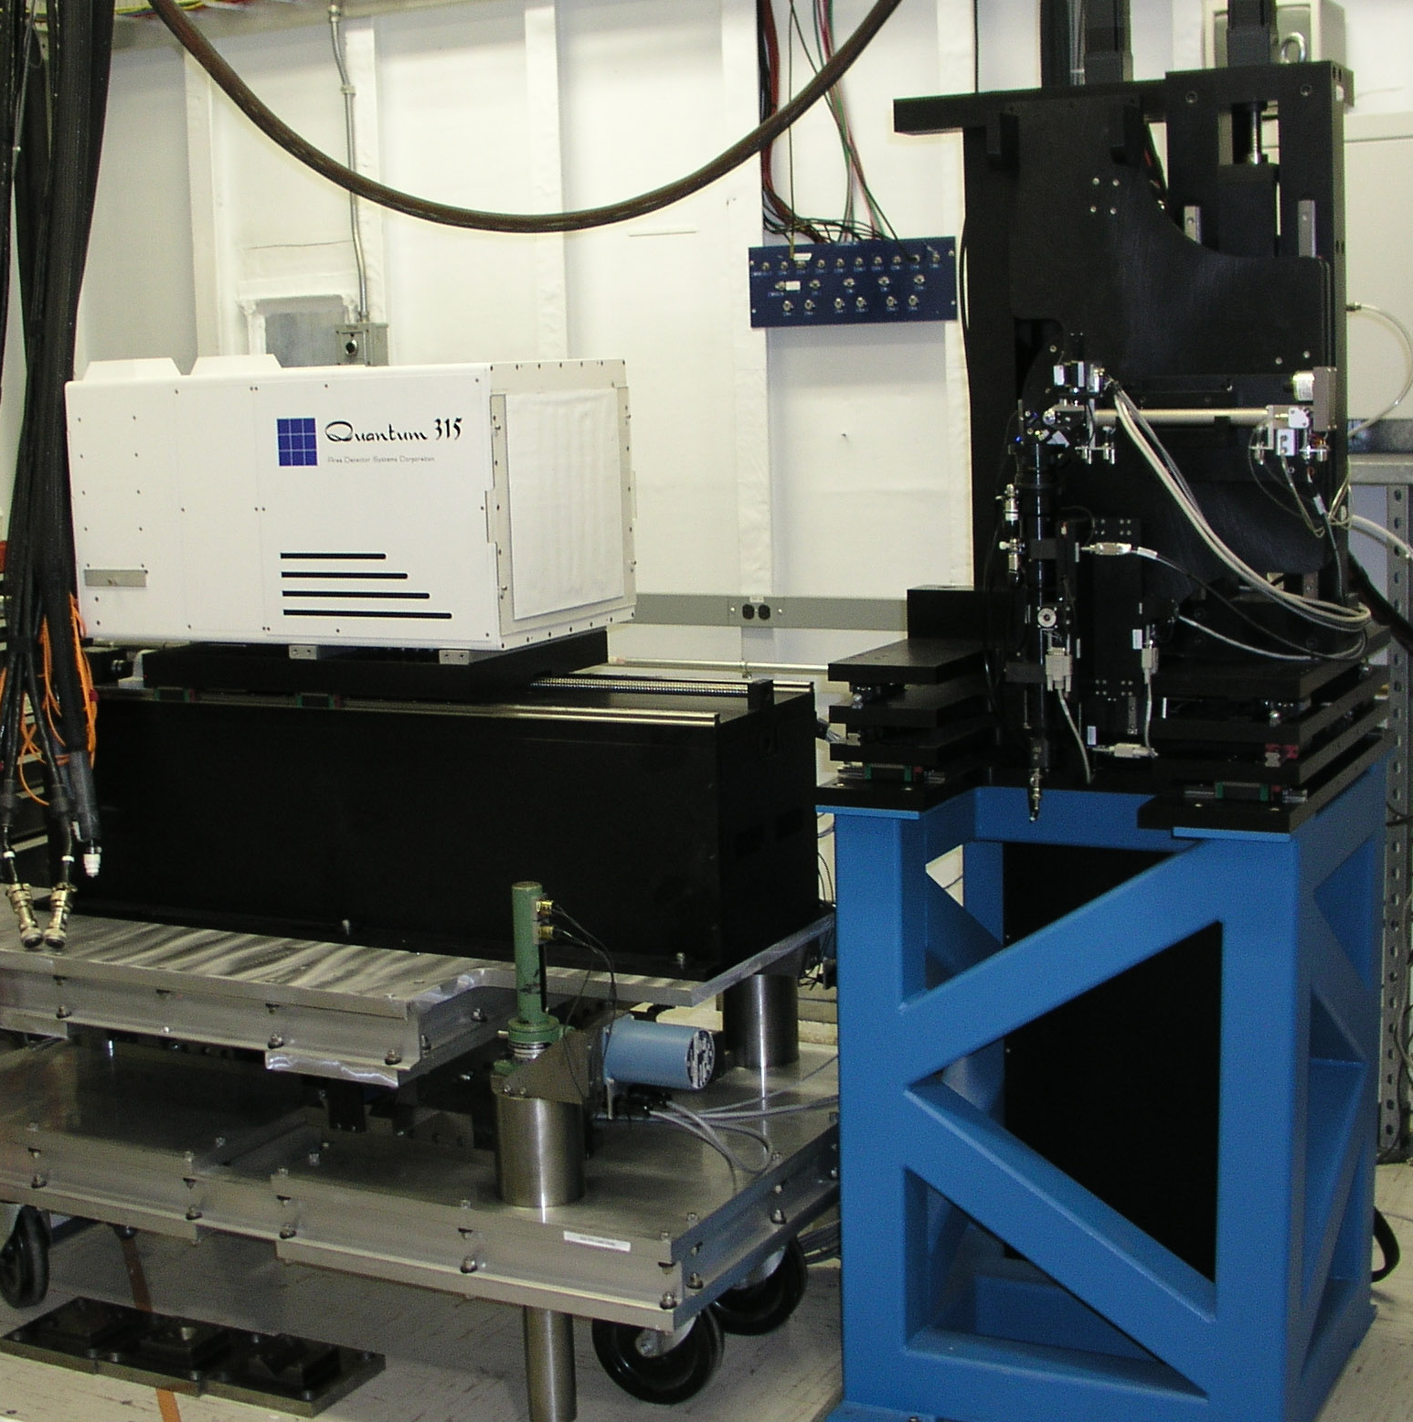
Another commercial system.
This system was created by Chuck Strouse and Crystal Logic of Los Angeles especially for X25 at the NSLS.
This steel frame is quite stable enough for this work.

Slide 28
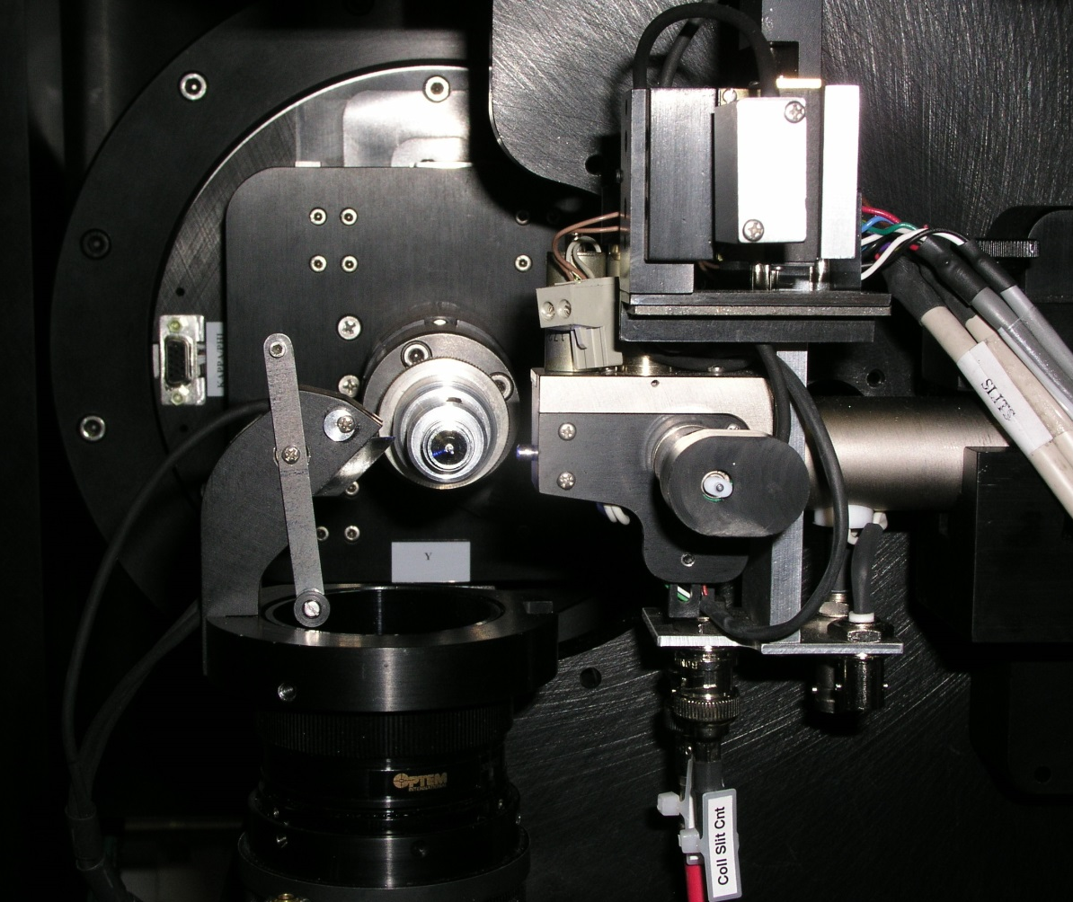
With an 8” air-bearing motor and massive x-y-z stage, this Crystal Logic goniometer has equivalent stability and resolution of the MD2, able to handle several-micron crystals.

Slide 29
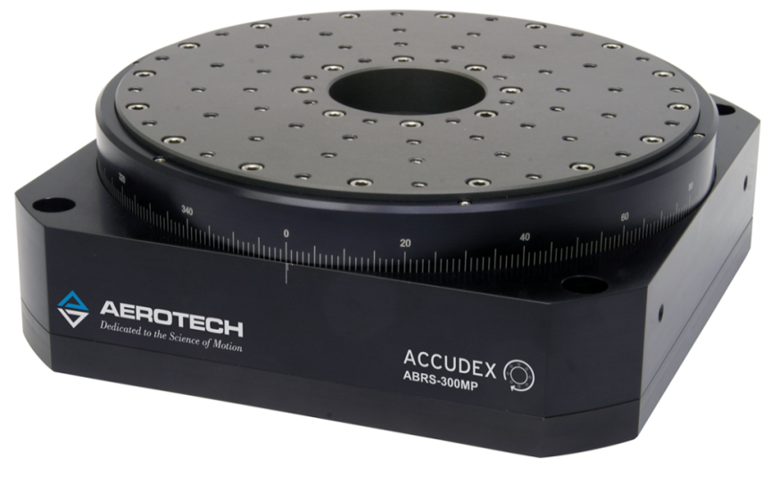
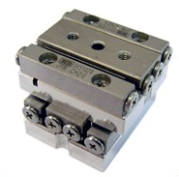
But those times are gone!
Our new Frontier beamline at NSLS-II should produce a beam that is 1 x 0.5 µm, producing 10¹³ x-ray photons per second. We’ll need to move to the next generation components of our new diffractometer, and to put the whole thing on an ultra-stable tombstone.
Here are components we are considering:
A 150 mm version of this Aerotech air-bearing servo motor, able to rotate up to 300 rpm, will give 5 x 10⁻⁵ deg angular resolution with 20 nm positional stability.
This X-Y stage by SmarAct will hold about 1/5 lb, can move at 13 mm/sec, and can position with a repeatability of 26 nm.

Slide 30
4. Handling crystals

Slide 31
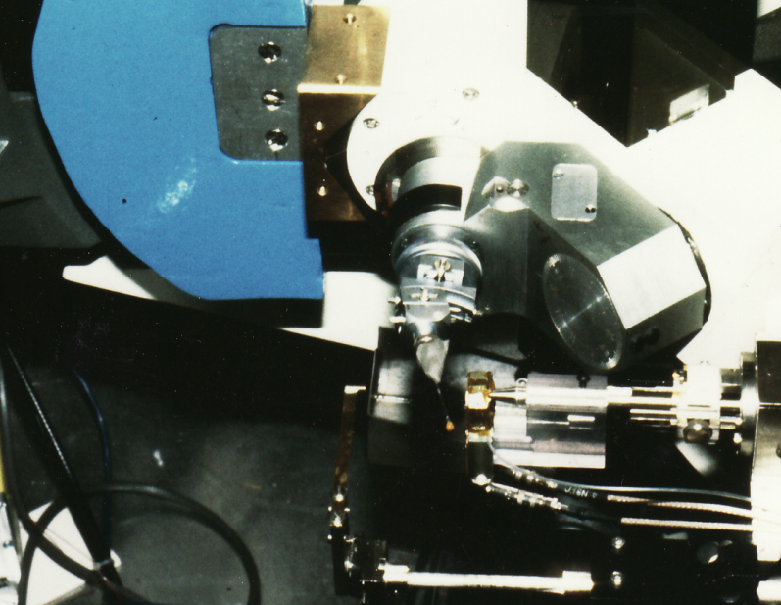
In the BC days (Before Cryo) we mounted our crystals in thin-walled glass capillaries with a drop of mother liquor to prevent drying.

Slide 32
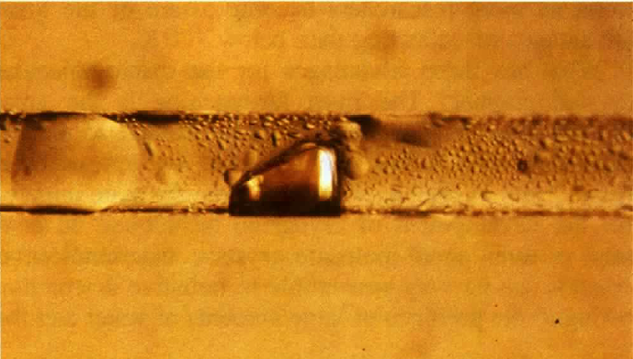
This led to the sort of damage that Elspeth Garman documented in this famous photograph.
A capillary-mounted crystal of hen-egg-white lysozyme. Total exposure was 10 h at room temperature on the EMBL beamline BW7B at DESY in Hamburg. The brown trace on the crystal tracks the path of the synchrotron beam. (Garman and Schneider, 1997)

Slide 33
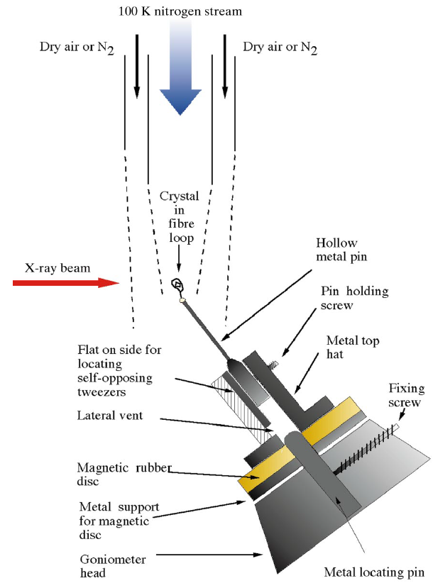
These days we use cryogenics.
Liquid nitrogen temperatures slow the rate at which our specimens are damaged by the x-rays.
In the ensuing 17 years many workers in the discipline have simplified the system so the apparatus becomes commodities and the whole thing can be automated.
Garman and Schneider, 1997.

Slide 34
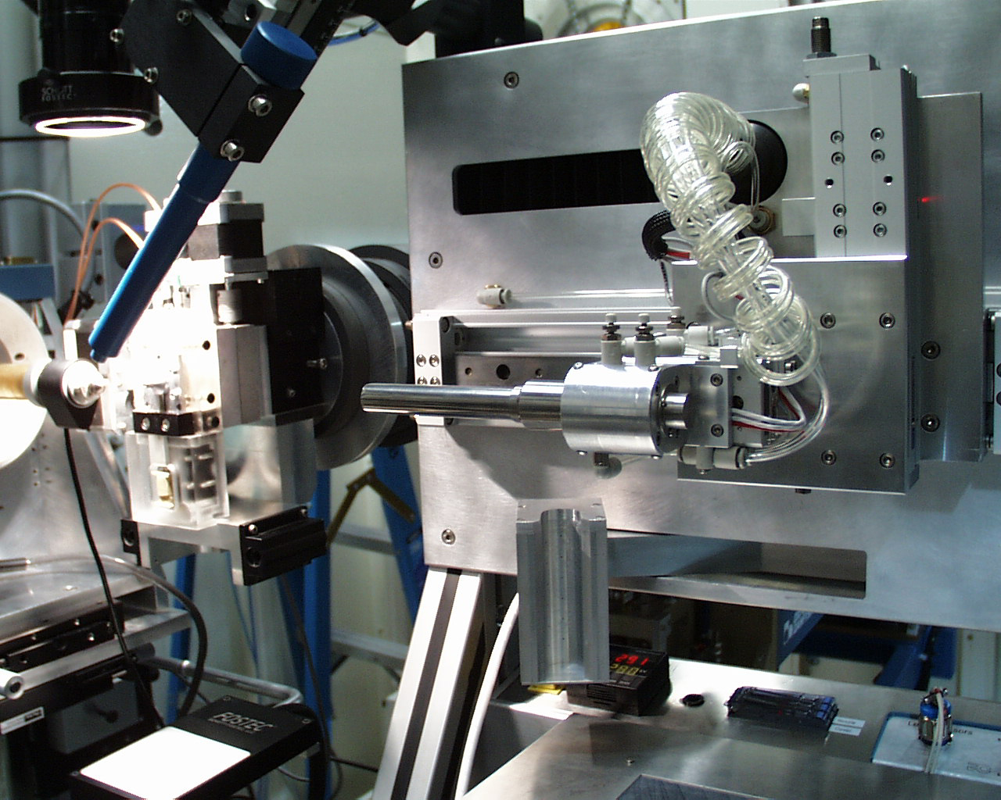
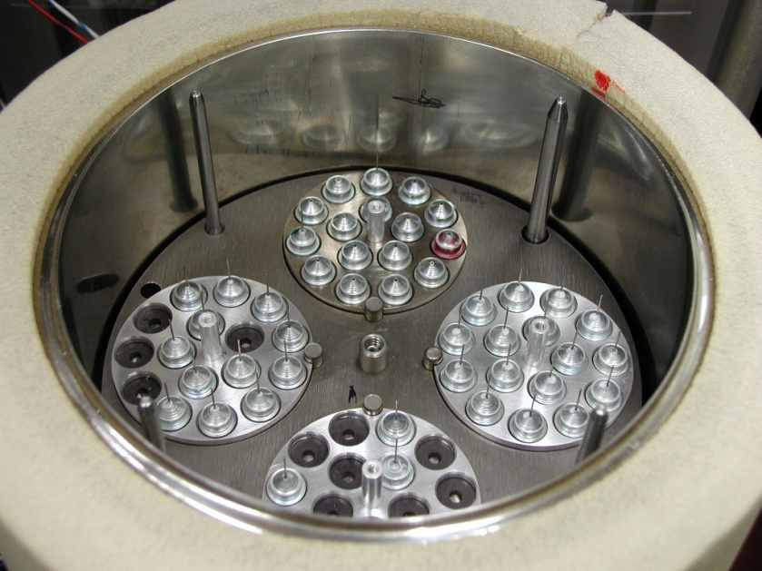
Automated systems like this one, invented at the ALS by Thomas Earnest and his crew, are part of the fully automated synchrotron experience.

Slide 35
Special-purpose robots automate the observation of crystal growth.
The NatX-Ray company made this commercial device, and a similar system is offered by Irelec Co.
View of the 96-well plates used for crystal growth and diffraction study of the growing crystals.
Detailed view of the geometry of the plate well.
View of the plate, held by the G-Rob system in the x-ray beam during data collection.

Slide 36
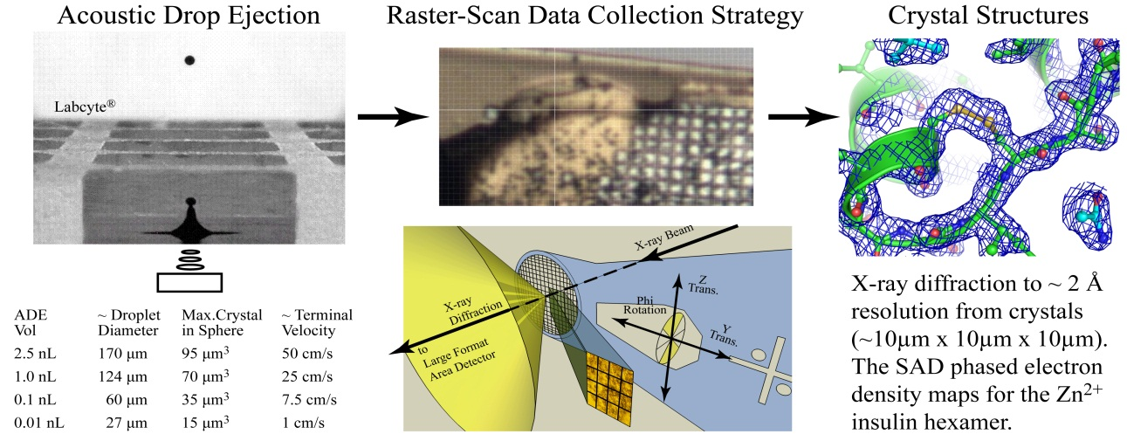
Alex Soares leads a team which is employing acoustic droplet ejection (ADE) to mount tiny crystals for diffraction.
ADE methods launch a 2.5 nL droplet (left) which, when caught on a mesh and coupled with a raster-scan data collection (middle), yields crystal structures (right).

Slide 37
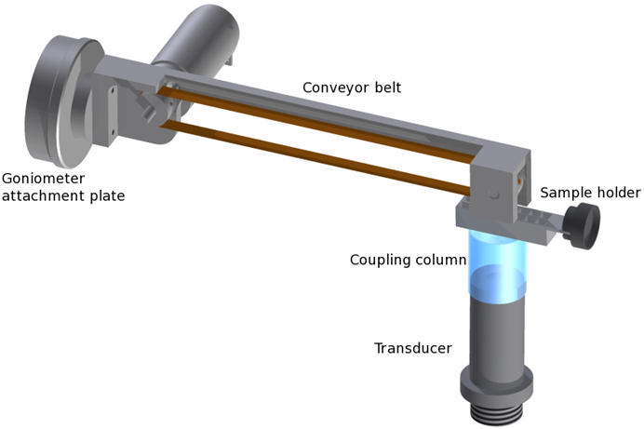
Acoustic droplet ejection has other uses
Roessler, Orville, and others have created a conveyor-belt system for ADE delivery of crystals to the x-ray beam. A motorized apparatus holds an x-ray-transparent “conveyor belt” in the beam. A sample holder containing crystals sits beneath the conveyor belt. Below that is an acoustic transducer, coupled acoustically to the sample holder.
Crystal-containing droplets ejec­t upwards onto the underside of the conveyor belt, where they are then translated into the cryostream and rapidly cryo-cooled. Automated alignment and data collection follow. (Roessler et al., 2013)

Slide 38
5. Detectors

Slide 39
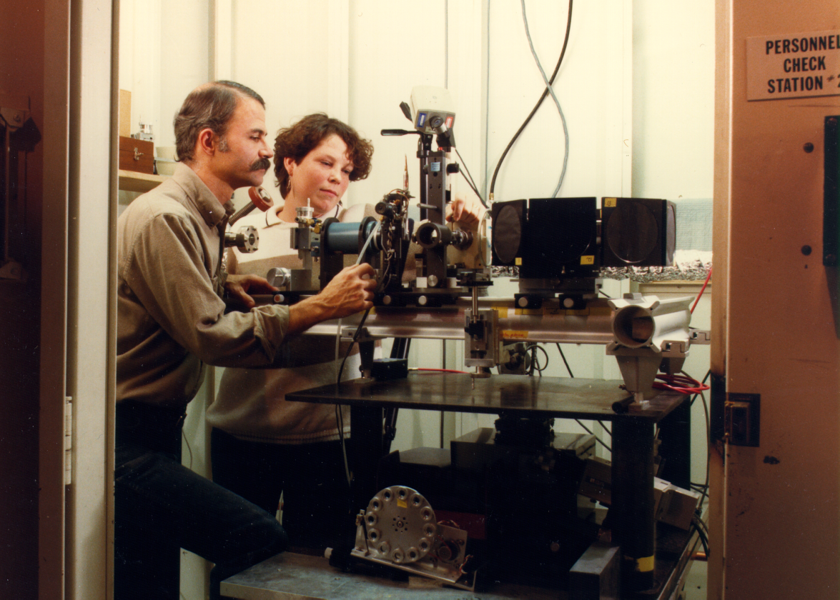
The mid ‘80s, X-Ray Film as a Detector
Many crystal structures were solved with a Rotation Camera and x-ray film.
Good points:
Inexpensive when that seemed important
Pretty linear
Excellent spatial resolution
Bad points:
Poor dynamic range
Data processing for each film pack took an hour, after developing!
Extremely inconvenient
Bob Sweet and Donna Cyr messing with an Arndt/Wonacott Rotation Camera, NSLS Beamline X12-C. Circa 1986.
Notes:
These detector visuals come from doe-det-4.ppt of 2000.

Slide 40
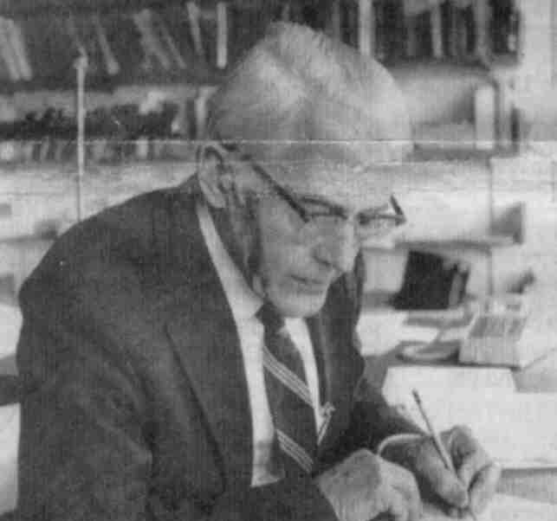
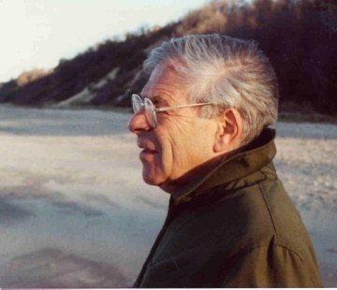
We needed electronic detectors. Here were the important players in synchrotron detectors for MX
Uli Arndt, Cambridge, UK – Gifted inventor, including first commercial synchrotron detector.
George Reynolds, Sol Gruner, Princeton – Parallel video developments. Moved to CCD work.
Jules Hendrix, Hamburg – Commercialized an automated imaging-plate camera.
Michael Strauss, Ed Westbrook, Steve Naday, Argonne – First CCD-based detector array.
Walter Phillips, Marty Stanton, Brandeis – Our collaborators.
Ron Hamlin, Chris Nielsen, ADSC – First sold large-array detectors.
Christian Broennimann, Dectris – First commercial pixel-array detector.

Slide 41
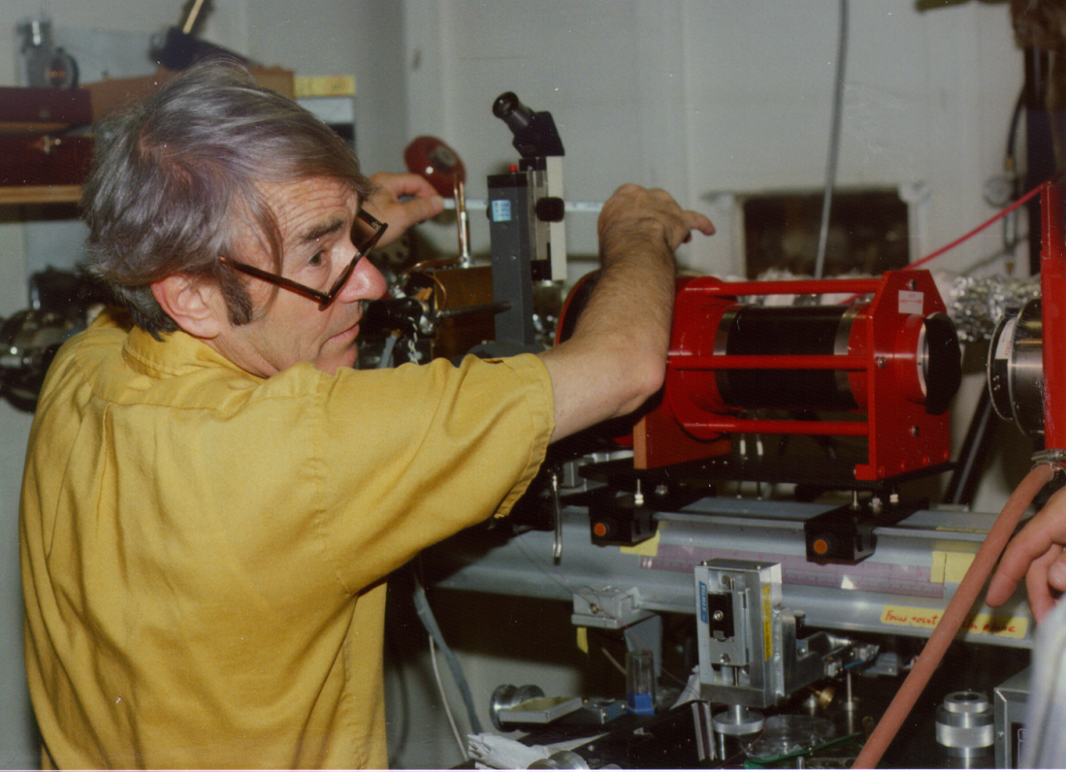
Early Argonne CCD detector
Ed Westbrook and Mike Strauss of Argonne brought their first CCD-based detector, to test at NSLS beamline X12-C in 1987.
The light chain was:
Phosphor
115:40mm fiberoptic taper.
2-stage image intensifier
f 1.0 Lens
Tektronics 512x512 CCD
Mike Strauss, fooling with his detector at X12-C

Slide 42
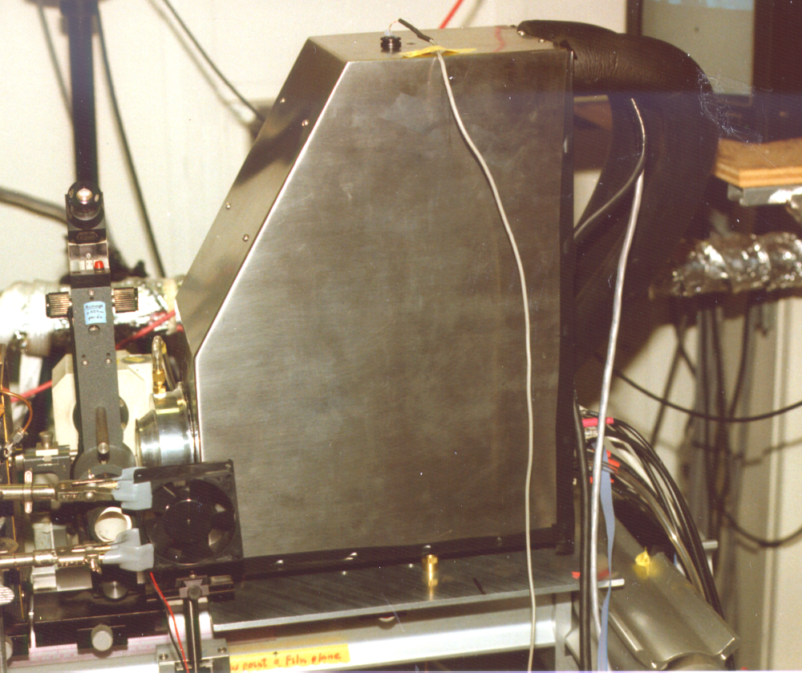
Early Brandeis CCD detector
At the same time, Walter Phillips and Ken Kalata were developing detectors. The first is shown here, being tested at BNL in early 1989.
Its (folded) light chain is:
Phosphor: X-ray to light.
75mm image intensifier
75:38mm fiberoptic taper
40mm image intensifier
38:18mm fiberoptic taper
Mirror
50mm f 2 macro lens
1.3k x 1.0k Kodak CCD (7 µm pixels).
Again, on the rotation camera at X12-C

Slide 43
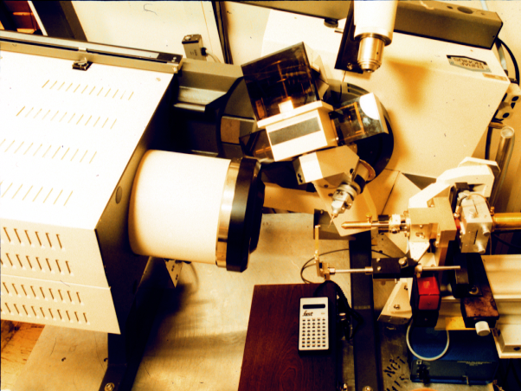
The Nonius/Arndt FAST detector
Finally Uli Arndt collaborated with Enraf Nonius to create the first fast-framing area detector, installed at X12-C in late 1989.
Phosphor
Image intensifier
Fibre-optic taper,
Silicon-Intensifier-Target video tube.
Good points:
Single-photon counting
100% duty cycle
Nearly the first automatic data-collection system.
The FAST in the X12-C hutch
Bad points:
Narrow dynamic range
Few pixels.

Slide 44
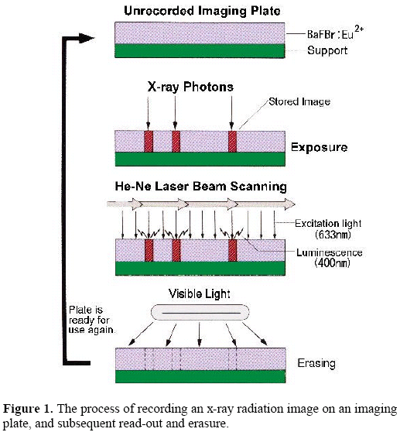
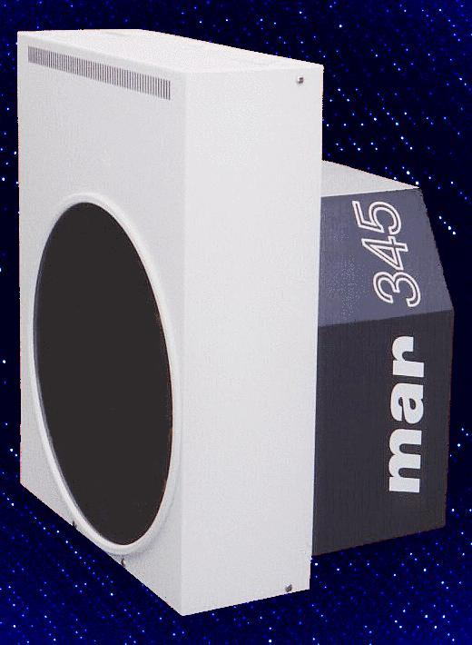
An important advance was photoluminescent imaging plates. MAR research, followed by Rigaku, made a successful camera that worked like electronic x-ray film, but much better.
Notes:
Maybe 1989

Slide 45
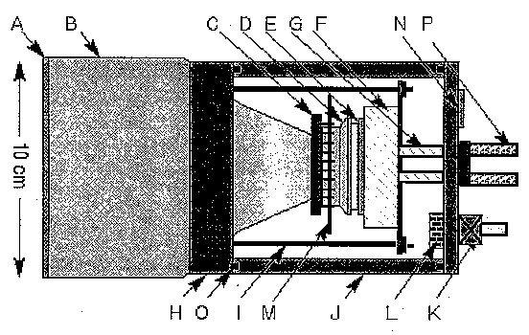
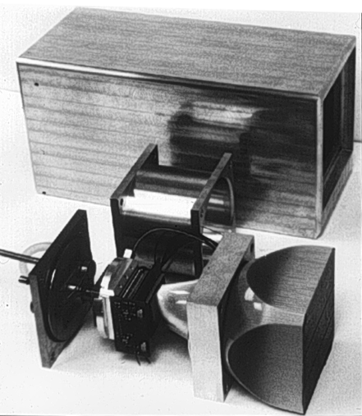
Most X-Ray Detectors at synchrotrons are based on the advances reflected in the 2009 Nobel Prize in Physics: fiber optics and CCD imagers.
W. Phillips and M. Stanton, Brandeis U.

Slide 46
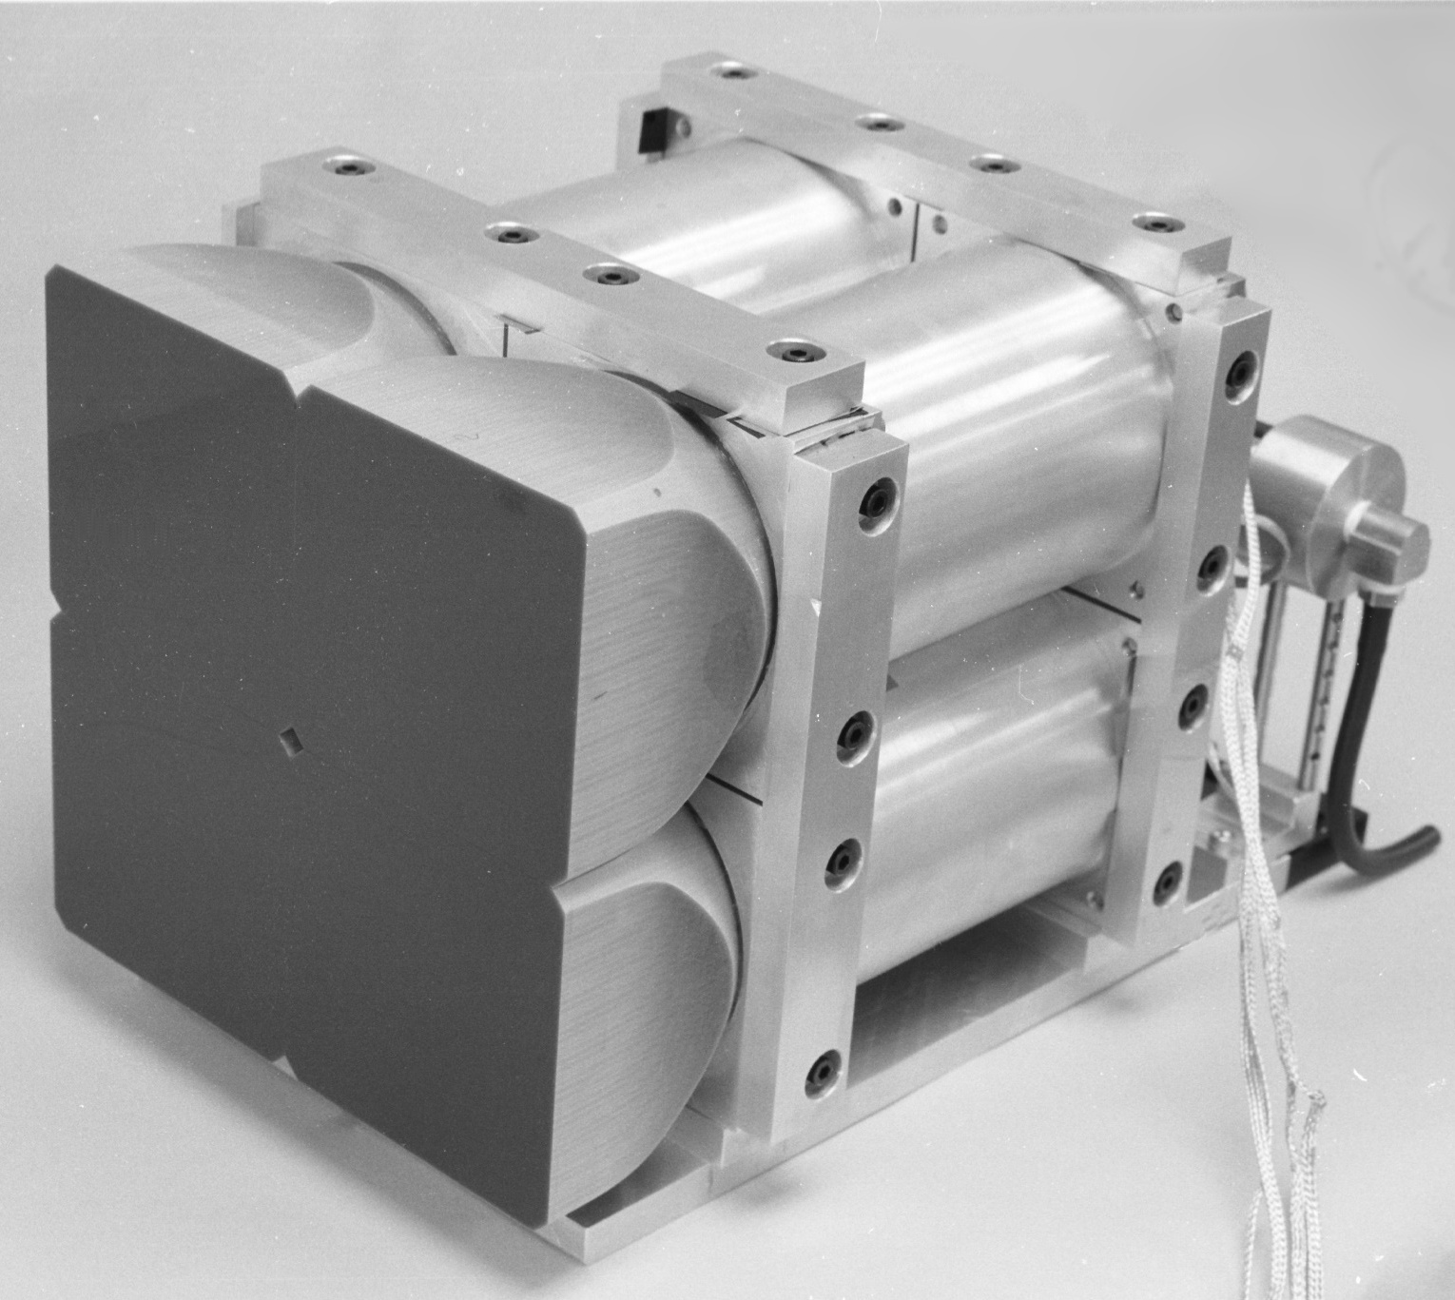
Several of these can be bonded together to make a large detector…
Notes:
Installed at X12-C fall 1997
INSIDE THE BRANDEIS 4-CCD CAMERA

Slide 47
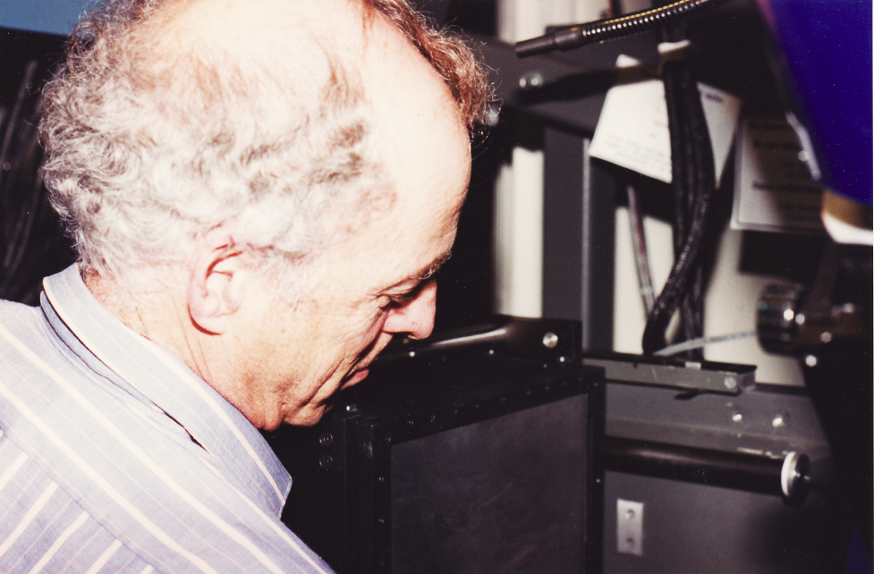
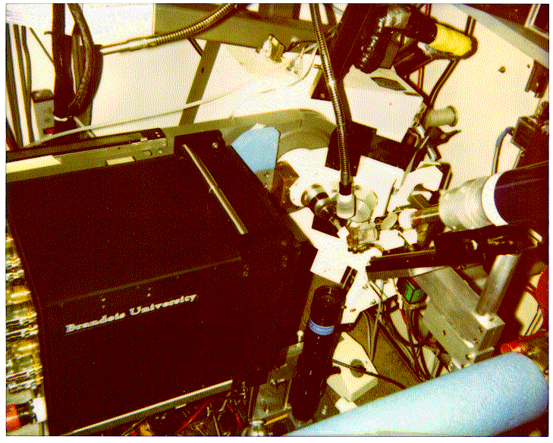
Like this one, installed by Walter Phillips in X12-C in the fall of 1997: the four-module B4.
Technology from the B4 was incorporated directly into the ADSC Q4.
Much of the early ribosomal 50S subunit data were taken on this beamline and detector.

Slide 48
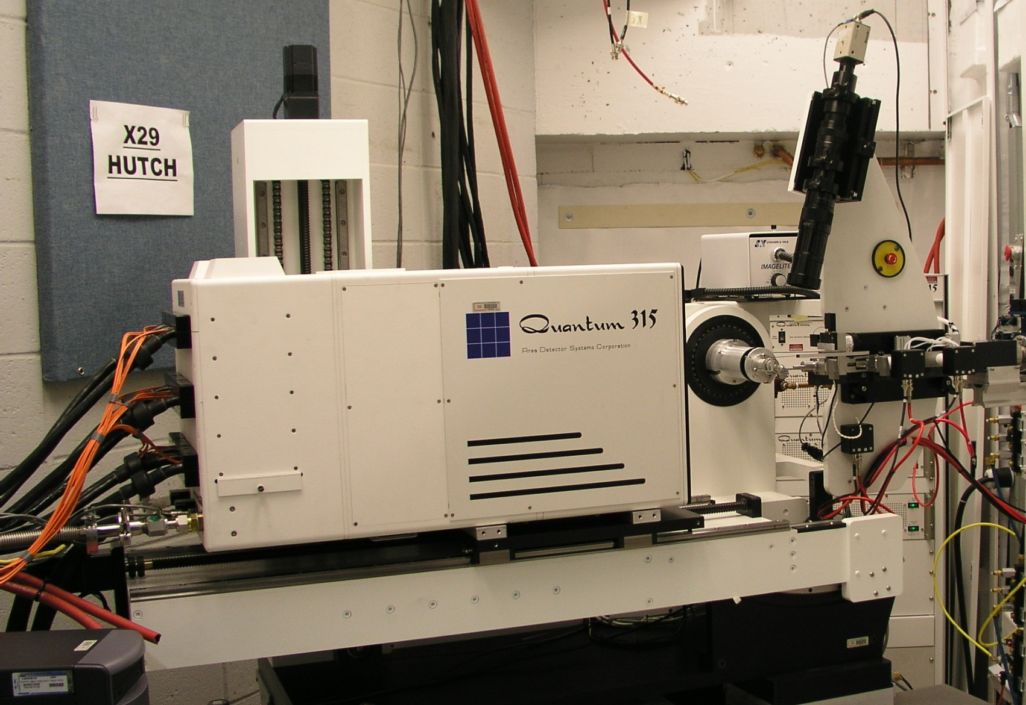
And the modern commercial versions are large, fast, and very accurate.
Detectors like these are the basis for modern, high-throughput crystallography!
Notes:
January 2002 an ADSC Q315 (3×3 module, 315mm square CCD-based detector) mounted on a Crystal-Logic κ-axis diffractometer was installed at beamline X25.
The new undulator beamline at X29 began operation in mid 2004

Slide 49
After CCD’s the next generation is Pixel-Array Detectors. They are noise free, and can produce high photon-count images quickly.
Basic Structure of Pixel-Array Detectors
X-ray
Diode detection layer
  Direct x-ray conversion
  in fully depleted
  high resistivity silicon
~3200 e- / 12keV x-ray
Connecting bumps
  1 per pixel
  Solder bump
CMOS electronics:
pixel signal processing,
  frame storage: the
  “ASIC”.
Ron Hamlin
Notes:
First commercial versions of this delivered in 2009.
49

Slide 50
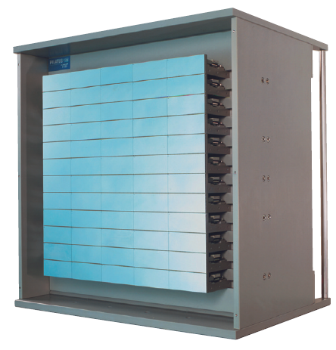
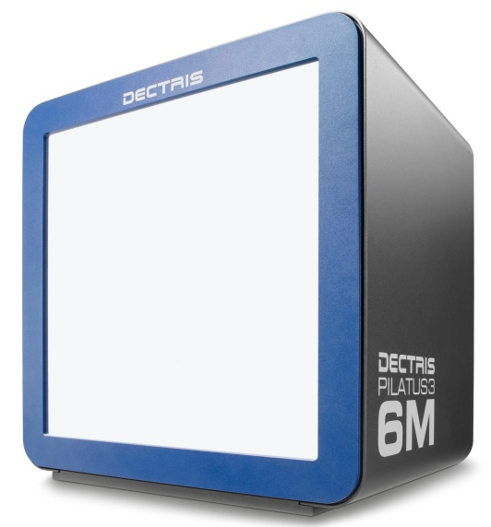
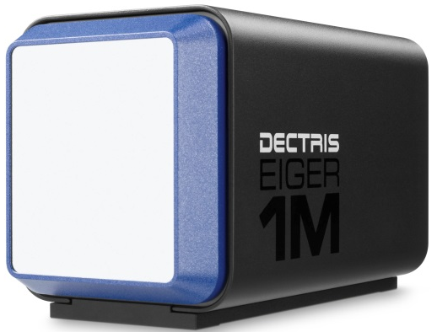
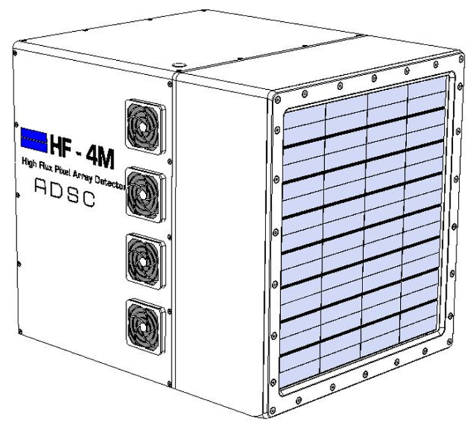
Here’s what the market looks like for PAD’s
Dectris has quite a few Pilatus 6M (six million pixels) detectors in the field – 12 – 25 frames per second. Dectris has orders for more than one Eiger 16M with smaller and faster pixels pixels give a pixel density five-times higher than the P6. It will operate at ~200 fps.
ADSC is in the final stages of assembling their HF-4M which will also produce frames quickly.
Notes:
First commercial versions of this delivered in 2009.
50

Slide 51
6. Software

Slide 52
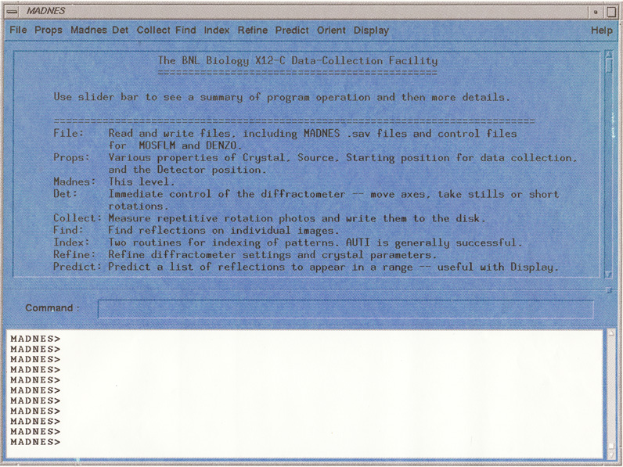



One of the most important things I did was to hire John Skinner in early 1992. He created the first ever Graphical User Interface to control an MX beamline experiment, and to handle data reduction.

Slide 53

This was our idea for automated data processing, from about 1997. We called it
“One-But”
And there was a single button you pushed to get it to go.

Slide 54

Our current plan for the MX beamline-control software of the future.

Slide 55
The Conclusions.
Technology marches, and will continue to march.
Brighter sources.
Better optics.
Evolving automation.
Faster detectors.
Software to hold it all together.

