Slide 1
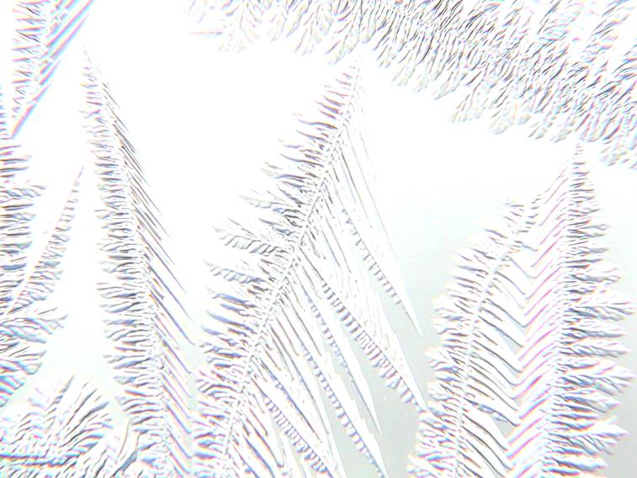
Fankuchen Award Lecture
New Orleans
May, 2011
Crystallography – The Gold Standard
Is it getting tarnished?
David Watkin
Chemical Crystallography
Oxford

Slide 2
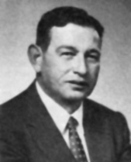
Fankuchen Award
The citation includes the phrase:
“To recognize contributions to crystallographic research by one who is known to be an effective teacher of crystallography.”
If I have been any good as a teacher, it is because I have found the work of clever people difficult to understand, and have tried to reduce its essence to the level of people like myself.

Slide 3
Fankuchen Award
“for his stewardship of the crystallographic software package CRYSTALS”
The success of CRYSTALS is entirely due to the contributions from very clever people.
I have simply ensured that their work has been maintained.

Slide 4
Fankuchen Award Lecture
New Orleans
May, 2011
In this talk I will:
Speak a little about people who have been very important in my early career.
Recall some of the evolution of crystallography as it impacted both the role of structure analyses and the development of CRYSTALS
Affirm that The Gold Standard is not tarnished, but warn that its value is as much the responsibility of the user as of the practitioner.

Slide 5
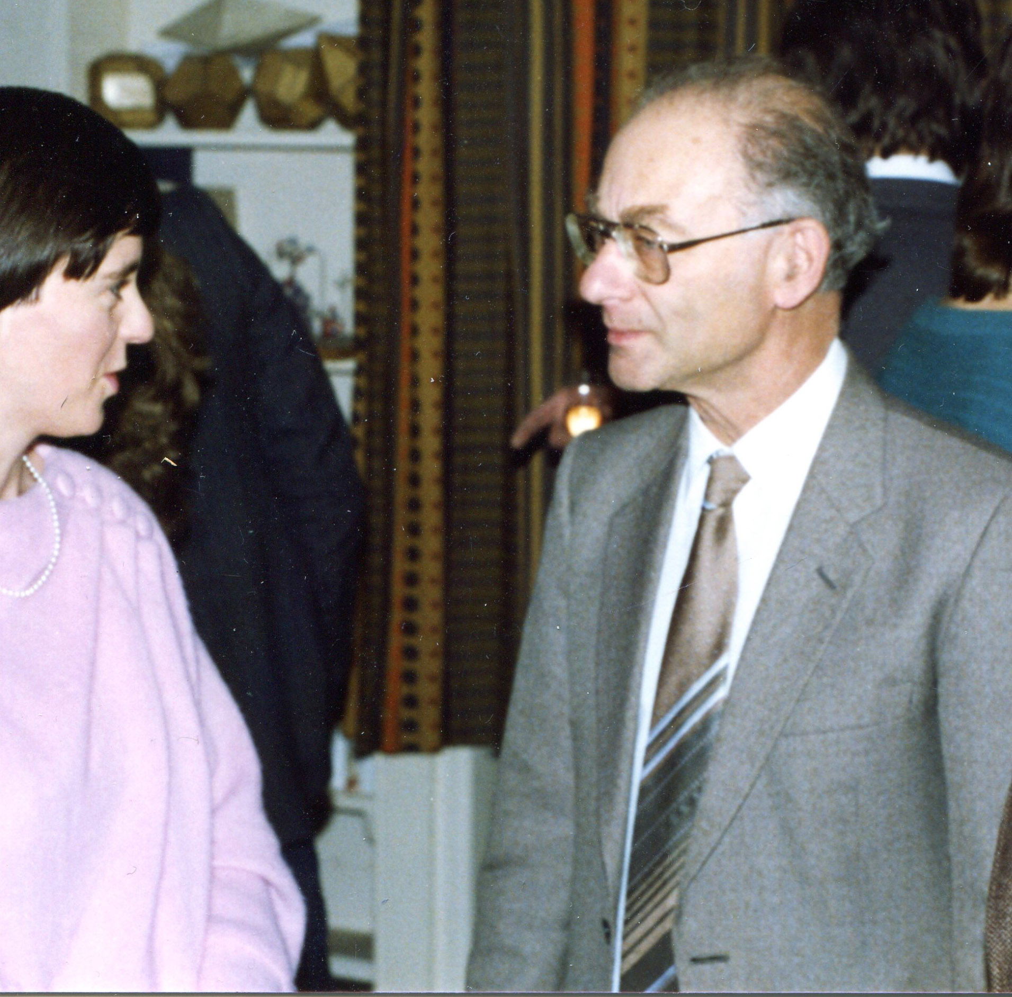
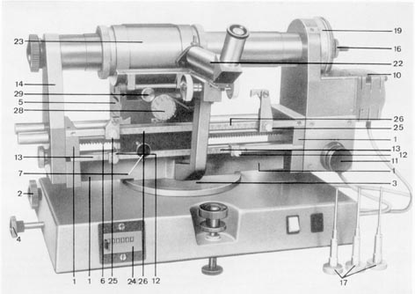
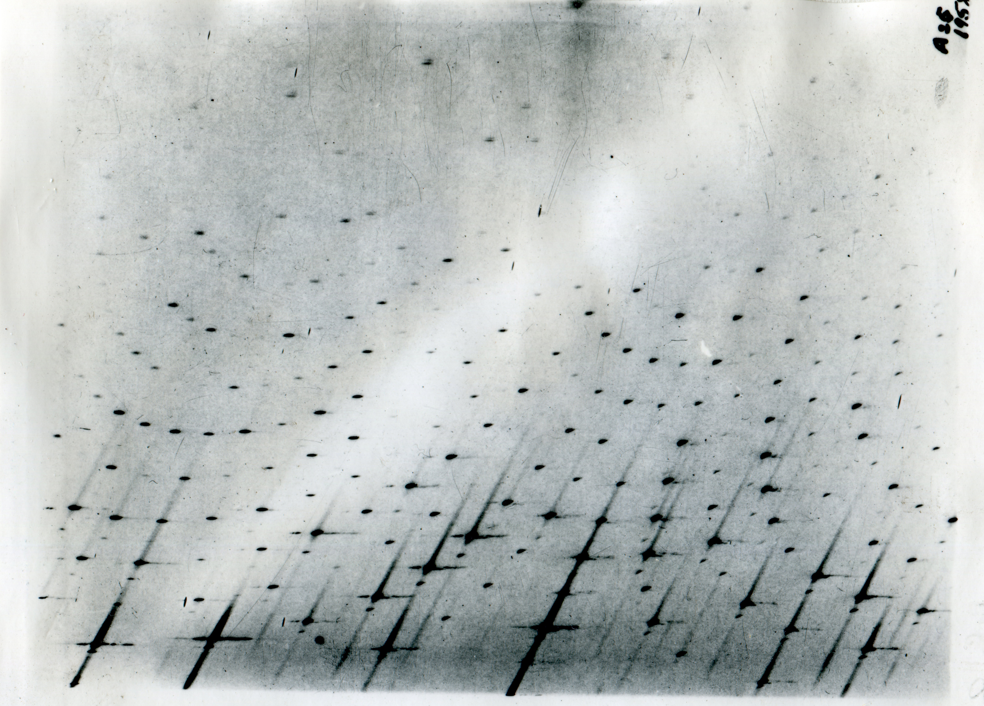
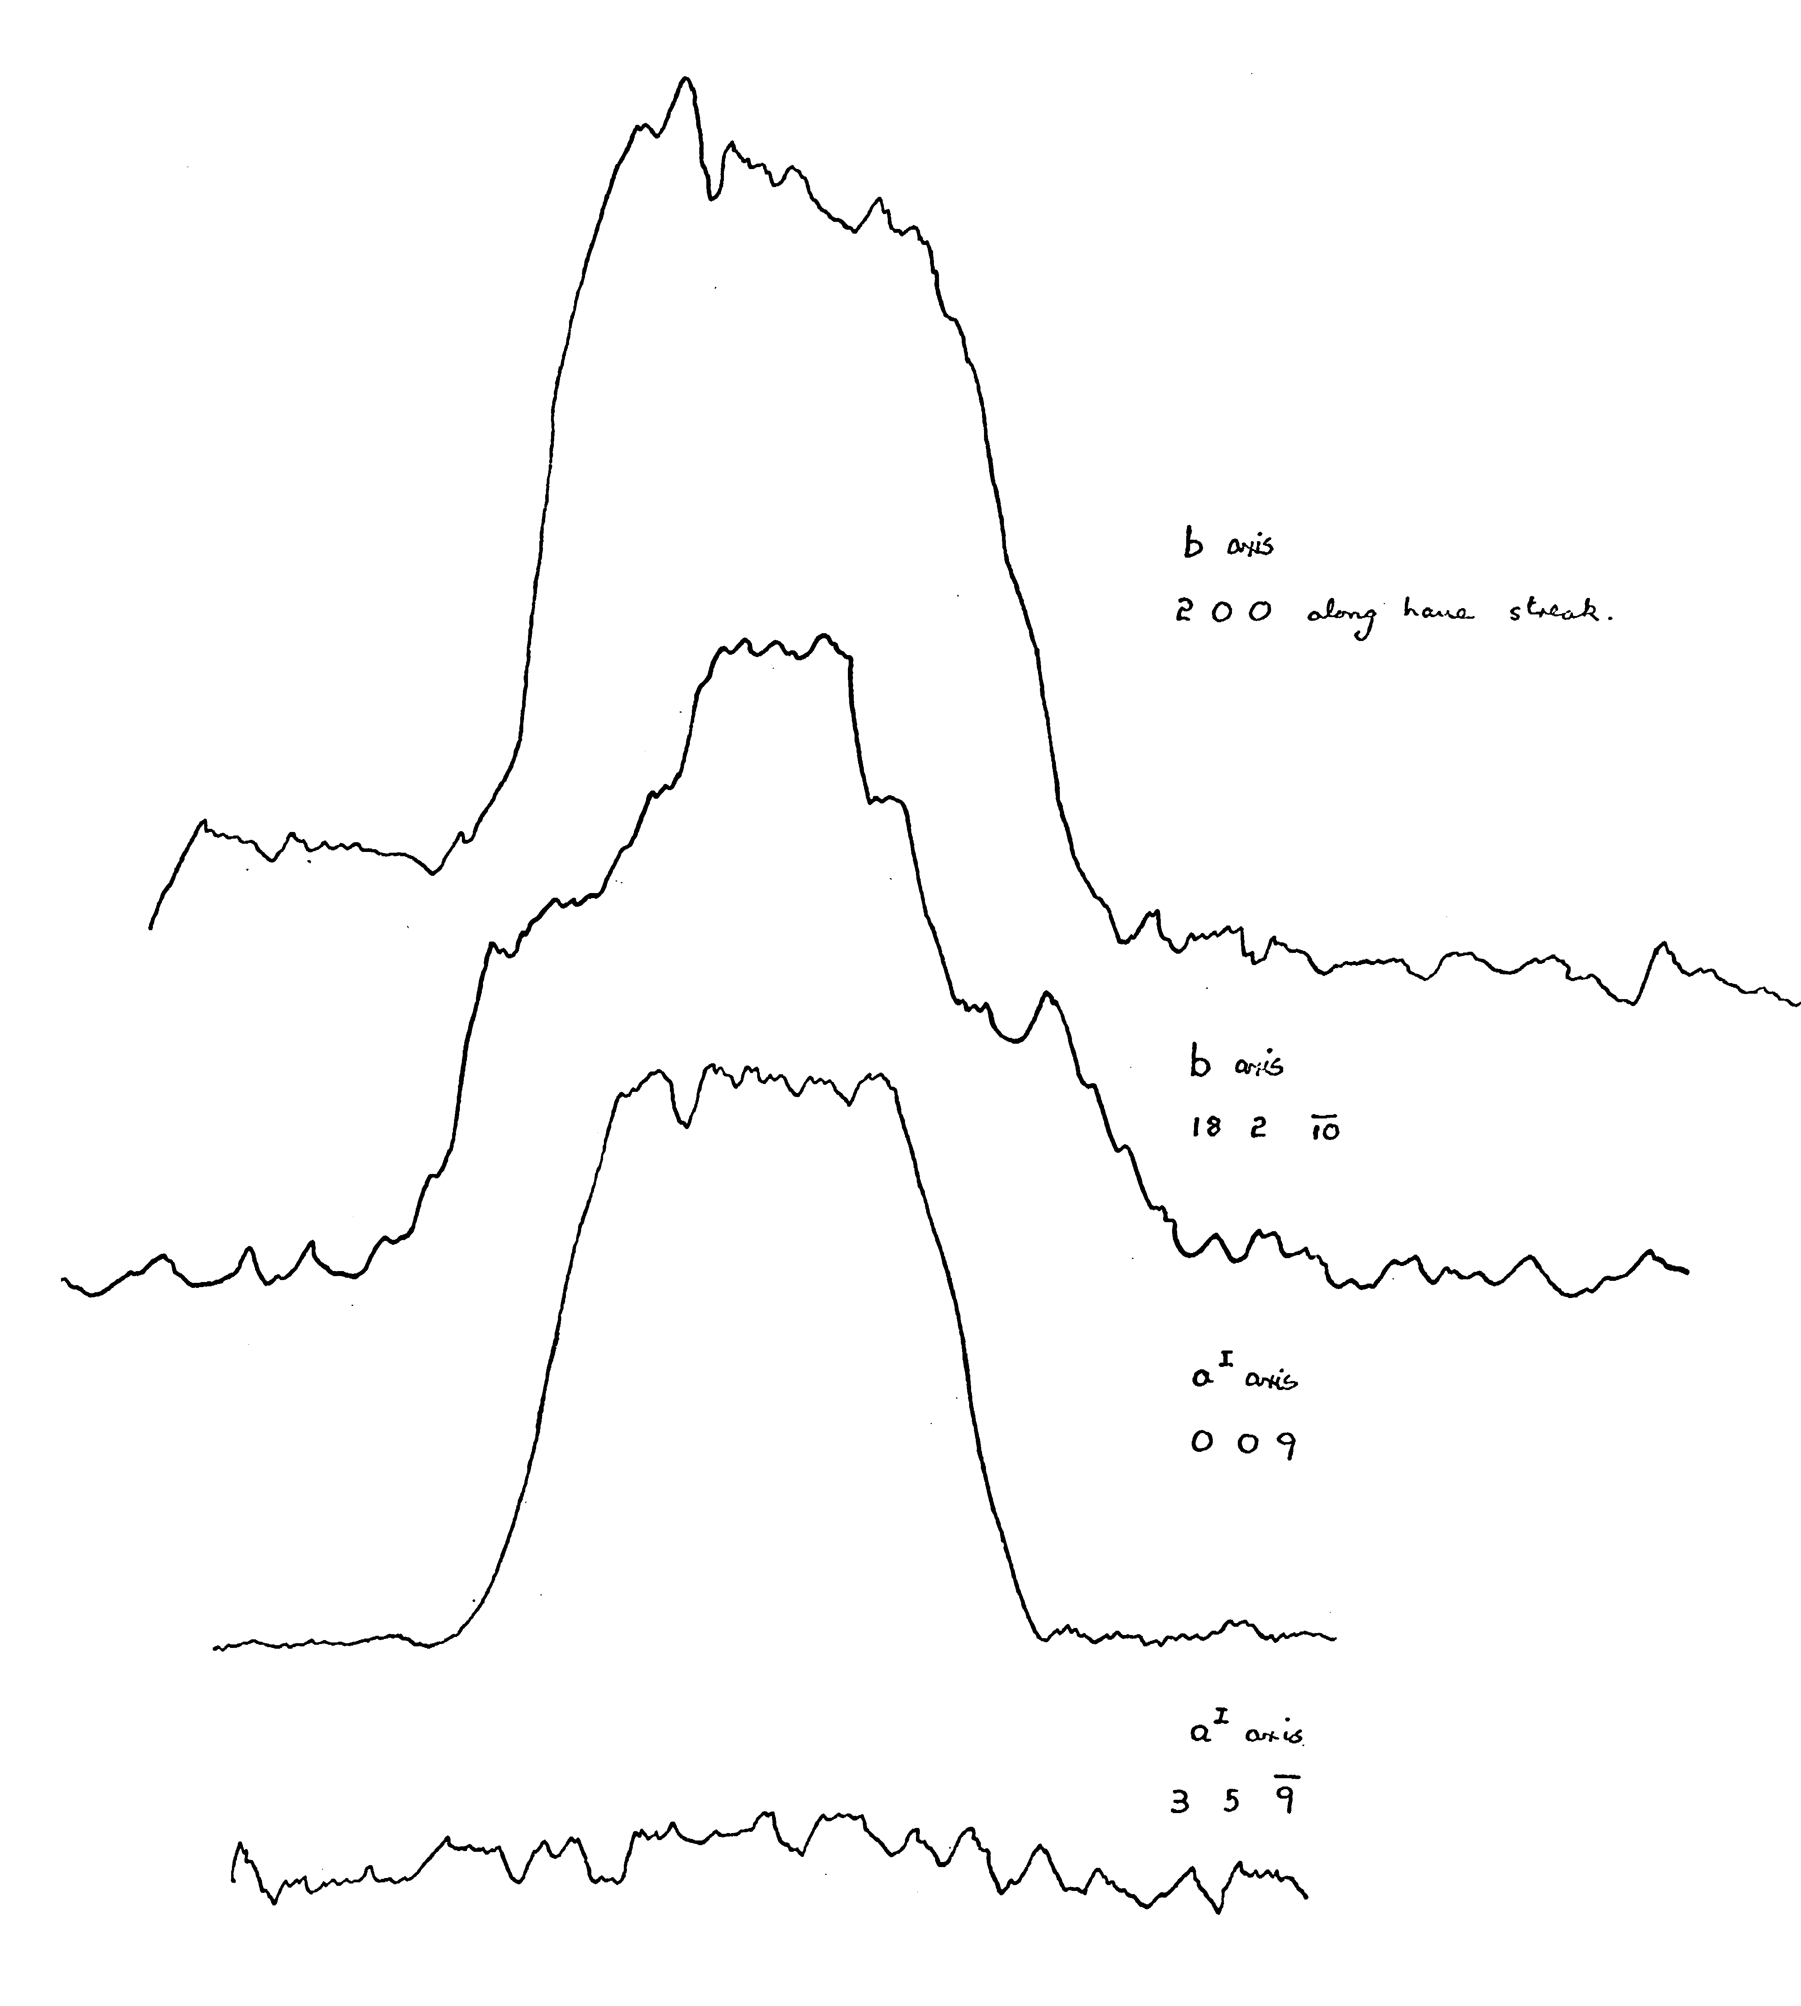
Tom Hamor, PhD supervisor, 1964-67
The integrating Weissenberg Camera has a loose relationship to coarse slicing on an area detector diffractometer.

Slide 6
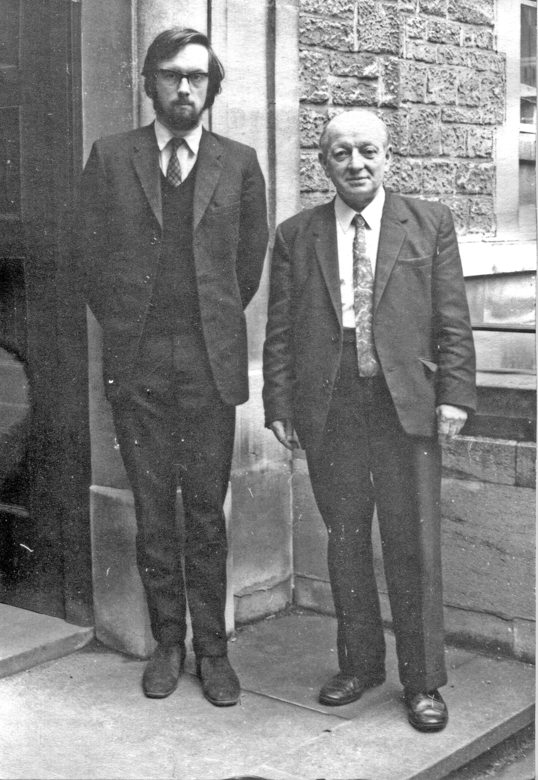
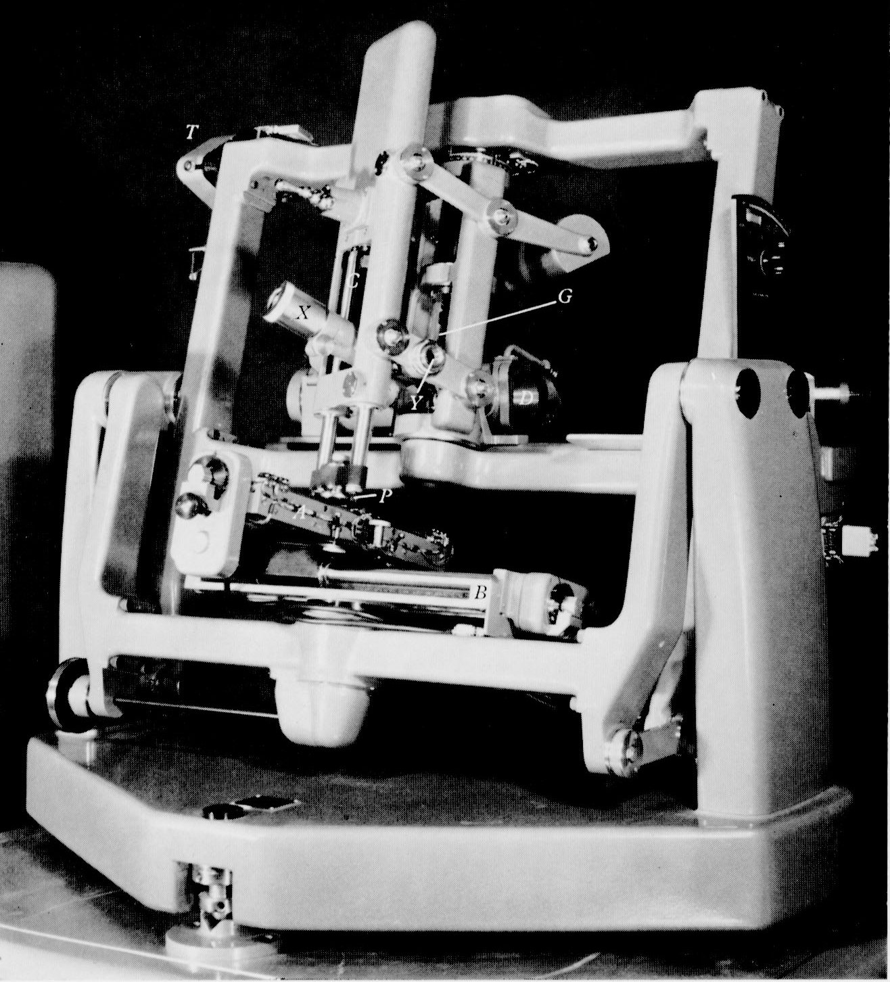
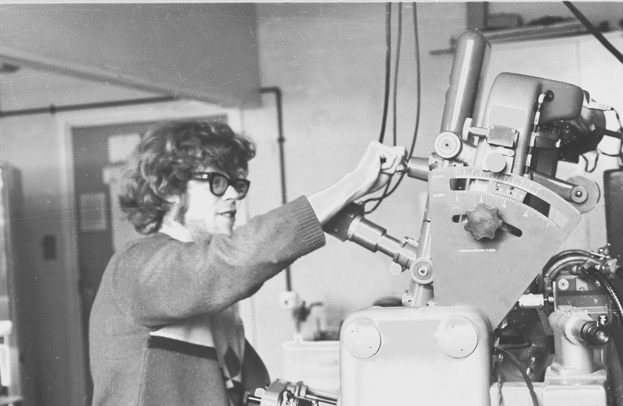
Herbert Marcus (Tiny) Powell
and his last Post Doc, 1971
The Royal Institution Linear Diffractometer.
It used a mechanical analogue to the Ewald Construction.

Slide 7
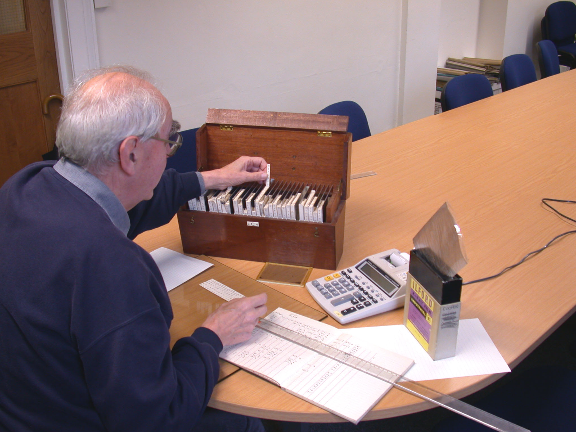
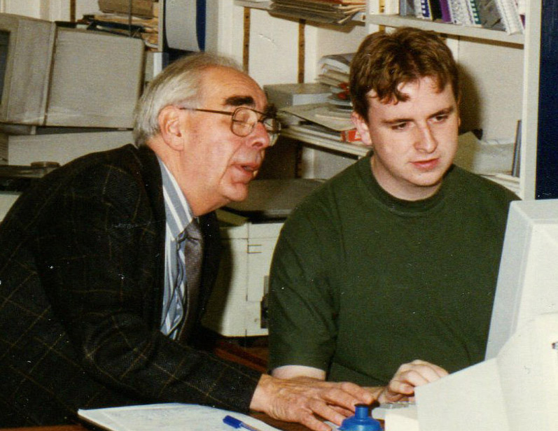
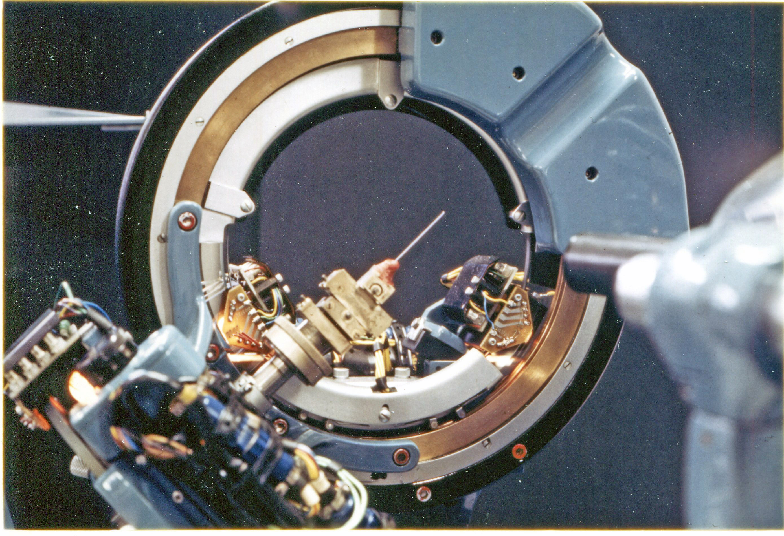
Keith Prout, a caring and dedicated teacher
Keith encouraged the development of CRYSTALS

Slide 8
Evolution of CRYSTALS
‘EDITION 1’ (Plain text data base definition) (Cruickshank, Freeman, Rollet, Truter, Sime, Smith and Wells, 1964)
‘NOVTAPE’ (In AUTOCODE) (Hodder, Rollet, Prout and Stonebridge, Oxford, 1964),
‘FAXWF’ (In ALGOL) (Ford and Rollett, Oxford, 1967)
‘CAOS’ (In FORTRAN) (Carruthers and Spagna, Rome, 1970)
‘CRYSTALS’ (In FORTRAN, major re-write) (Carruthers, Prout, Rollet and Spagna, Oxford, 1975)
‘CRYSTALS’ Issue 2 (In FORTRAN, major re-write) (Carruthers, Prout, Rollet and Watkin, Oxford 1979)
‘CRYSTALS’ Issue 7 (in FORTRAN, VAX SMG user interface) (Betteridge, Carruthers, Prout and Watkin Oxford, 1983)
‘CRYSTALS’ Issue 11 (in FORTRAN with C++ GUI) (Watkin, Prout, Carruthers, Betteridge, Cooper, 1997)

Slide 9
CRYSTALS
As the caretaker of a body of code, you have to train yourself to be receptive of criticism, and even to welcome it.
Few users will comment on the thousands of lines of code which function faultlessly.
Some will grumble in corridors about the lines which don’t work.
You have to encourage them to complain directly to you.

Slide 10
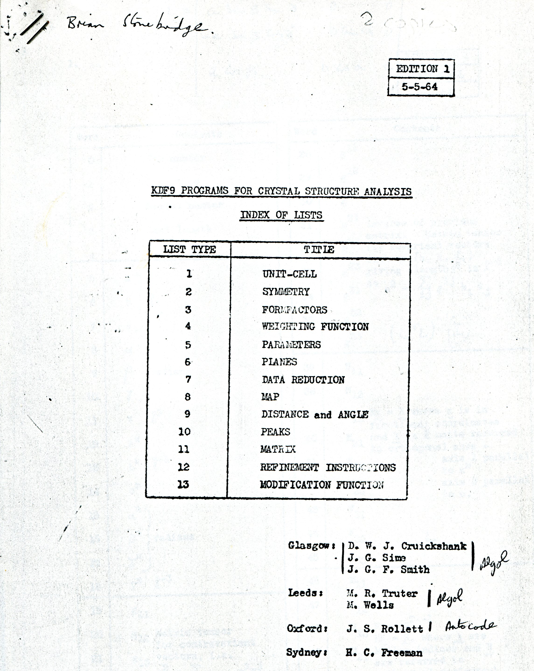
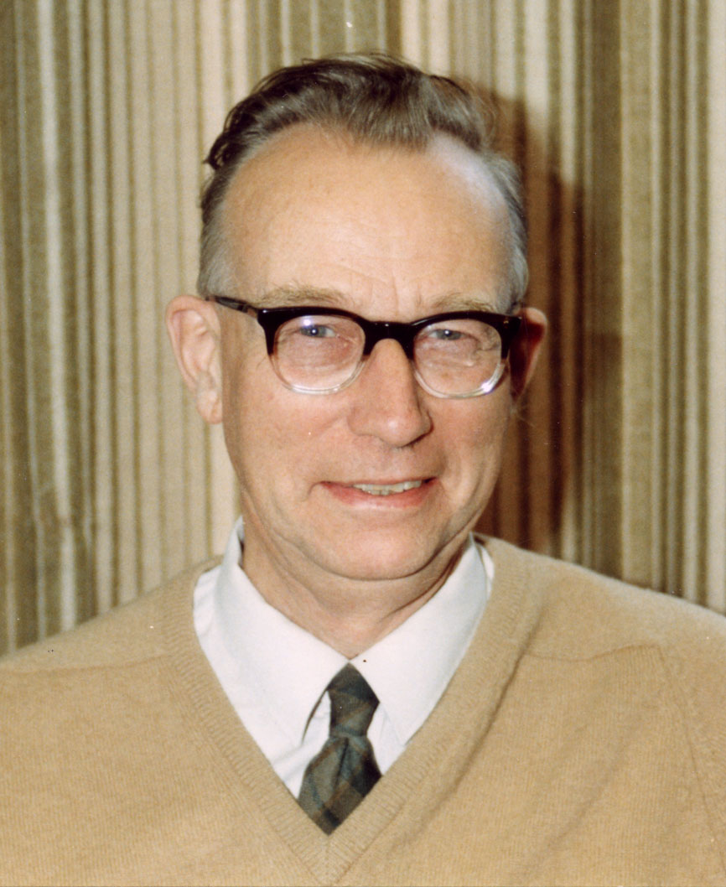
John Rollett
The father of CRYSTALS
The idealised plans for a new crystallographic program even included such ideas as a structure being partially in one space group, and partially in another.

Slide 11
The Early Days
For the first 10 years, all the effort that went into the program which was to become CRYSTALS was concerned with reliability, functionality, flexibility and speed.
Until the first FORTRAN version, users would often have to program little patches either to control workflow or to deal with special cases.
In the 1960’s -70’s pretty well every crystallographer was also a programmer.

Slide 12
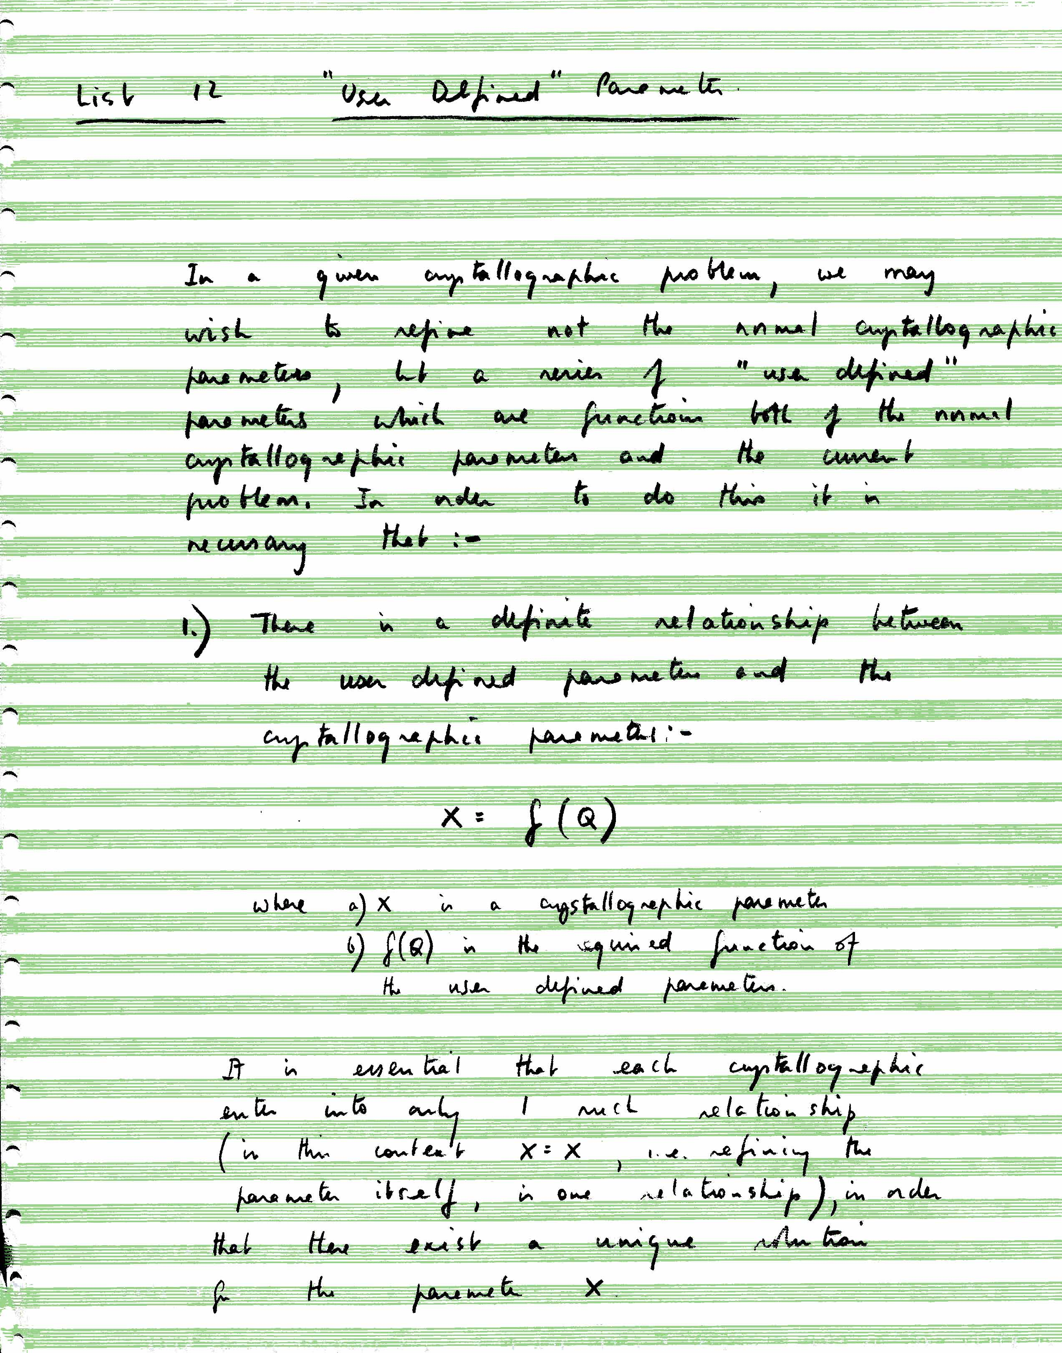
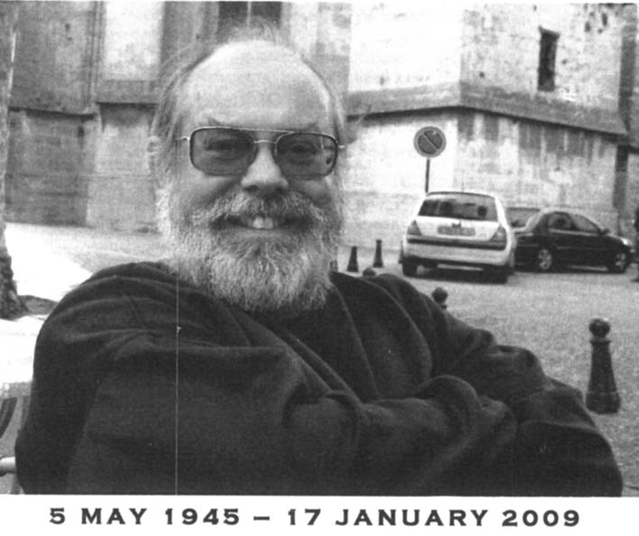
Bob Carruthers
His detailed plans for CRYSTALS still exist, and show a care for detail which still enables the program to meet most modern requirements.

Slide 13
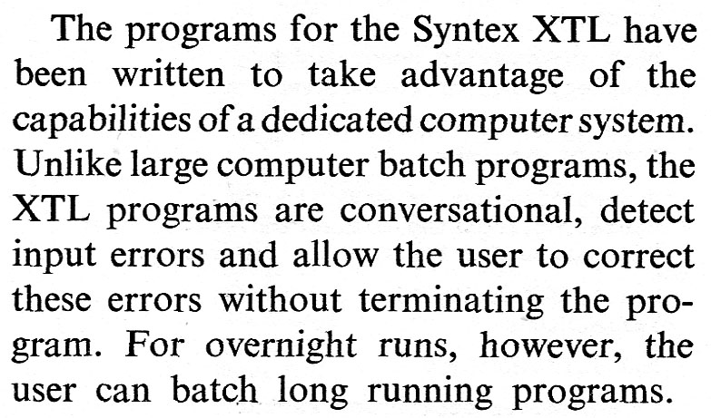
Workstations and Real-time Computing.
A computer in the Lab (1976)
The availability of workstations in the crystallographers own laboratory opened the way for interactive computing, including graphics.
R.A.Sparkes, Crystallographic Computing Techniques, 1976

Slide 14
The 1980’s
Work-flow began to be a design criterion.
During the 1970’s job control languages (JCL, DCL etc) had developed to enable users to string together a series of programs under the control of another program, the JCL. Job control languages were early examples of what has since developed into a wealth of scripting languages.
$! Command procedure for running the RC93 program.
$!
$ ON CONTROL_Y THEN GOTO ERROR
$ ON ERROR THEN GOTO ERROR
$!
$ ASSIGN/USER SYS$COMMAND FOR005:
$!
$!
$ RUN CRRC93:RC93
$!
$!
$ ON CONTROL_Y THEN $EXIT
$ ON ERROR THEN $EXIT
$
$ if f$search("''scf'").nes."" then SET FILE/ATTRIB=(RAT:CR) 'scf'
$ if f$search("''hkli'").nes."" then SET FILE/ATTRIB=(RAT:CR) 'hkli'
$ if f$search("''outhkli'").nes."" then SET FILE/ATTRIB=(RAT:CR) 'outhkli'
$!
$ERROR:
$ ON ERROR THEN GOTO TIDYUP
$ ON CONTROL_Y THEN GOTO TIDYUP

Slide 15
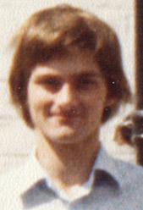
Paul Betteridge
Paul recognised the need for a scripting language as a means for building complex crystallographic procedures.
No suitable language existed in 1980, so he wrote his own, in FORTRAN.
It is still in use today because of the prohibitive cost of re-writing the SCRIPTS in a modern language.
It will continue to work as long as FORTRAN works.

Slide 16
Intel 386 processors:
Your own computer on your own desk
The availability of proper FORTRAN compilers and memory management meant that workstation programs were easily ported to personal computers running under MS DOS.
It now also made interactive graphics a practical reality

Slide 17
Automatic Structure Analysis
Until the mid-1990’s, we had been trying to build fully automated systems, e.g.
Automatic Solution and Refinement of Crystal Structures by Means of the Package UNIQUE
Cascarano, Giacovazzo, Camalli , Spagna and Watkin. Acta Cryst. (1991). A47, 373-381
We realised that it was easier to teach chemists some basic crystallography than to teach programs sophisticated chemistry.

Slide 18
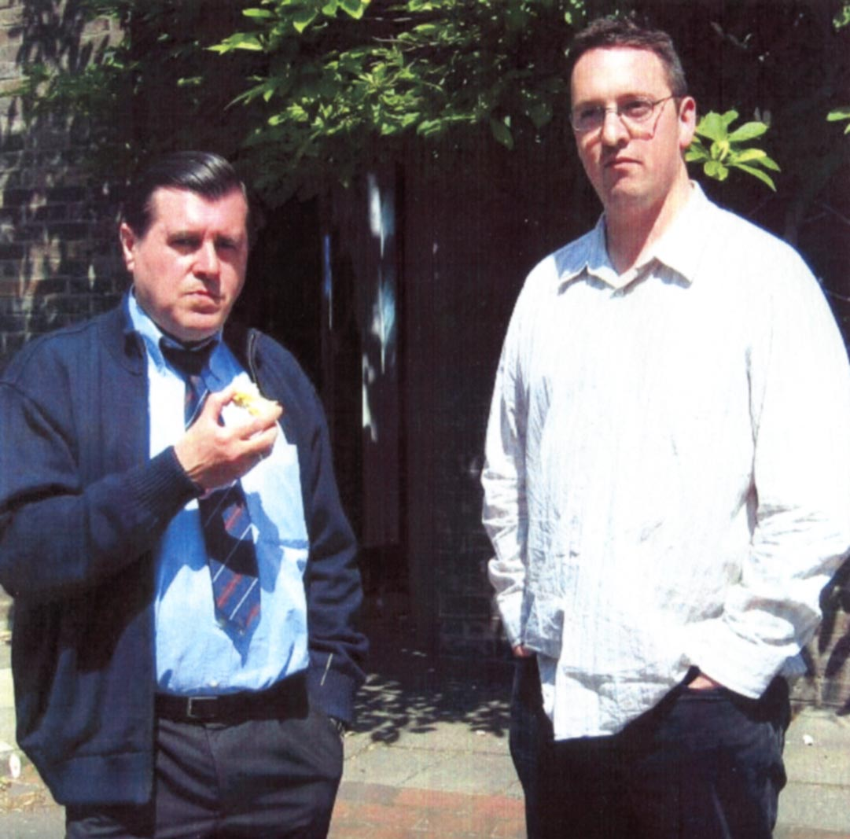
The Fully Interactive GUI
Richard Cooper prototyped our first proper GUI
The prototype was successful, but he also decided that commercial API (at that time) were not ideal for our purpose.
He went on to extend the SCRIPT processor to enable user-written scripts to build and control the GUI.

Slide 19
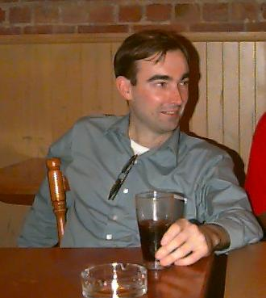
Lachlan Cranswick
CCP14 1998-2003
Lachlan tried to play the role of the novice chemist-in-the-street, trying to foresee the pitfalls which awaited the inexperienced crystallographer.
His quest for eye-candy strongly influenced CRYSTALS, and hence in its turn, OLEX2

