Slide 1
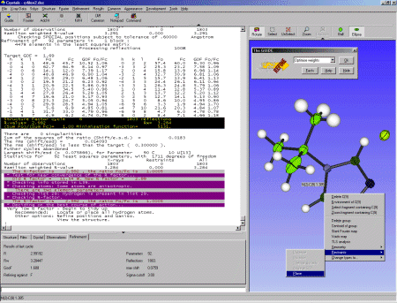
CRYSTALS 2000
Most of the infra-structure needed to enable enhanced functionality to be added was in place for The Millennium.
Since then the underlying FORTRAN and user accessible features have continued to be developed in response to the communities needs.
Publicity material, 2003

Slide 2
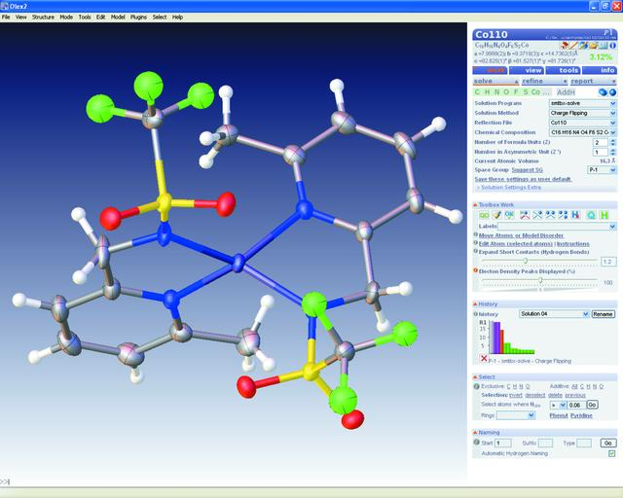
Age Concern
As part of the EPSRC “Age Concern” project the group in Durham has shared complete access to CRYSTALS source code and SCRIPTS to help them develop their own user interface.
OLEX2: a complete structure solution, refinement and analysis program
Oleg V. Dolomanov, Luc J. Bourhis, Richard J. Gildea, Judith A. K. Howard and Horst Puschmann

Slide 3
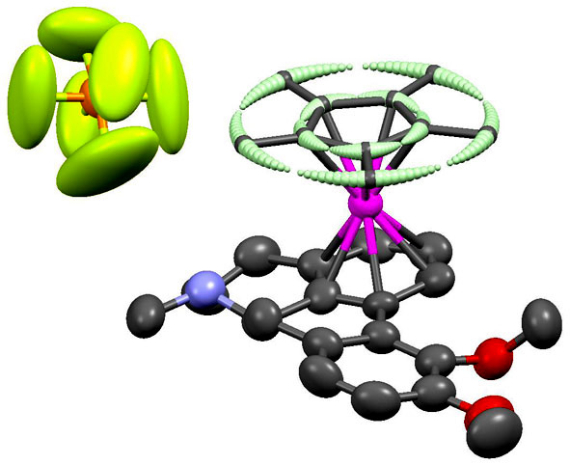
Age Concern
The project has also given rise to two refinement sub-systems.
smtbx/cctbx
“focusing on those key computational details which have been the treasures of the classic programs CRYSTALS or SHELX.”
ACA 2010: 07.26.4 Solution and Refinement with the cctbx and smtbx
Luc Bourhis, Oleg Dolomanov, Richard Gildea, Judith Howard, Horst Puschmann
SMTK/cctbx
“provide a modelling design process, where the model formulation is kept separate from the optimization process.”
SMTK – a small-molecule toolkit library for crystallographic modelling and refinement
Mustapha Sadki* and David J. Watkin J. Appl. Cryst. (2011). 44, 52–59

Slide 4
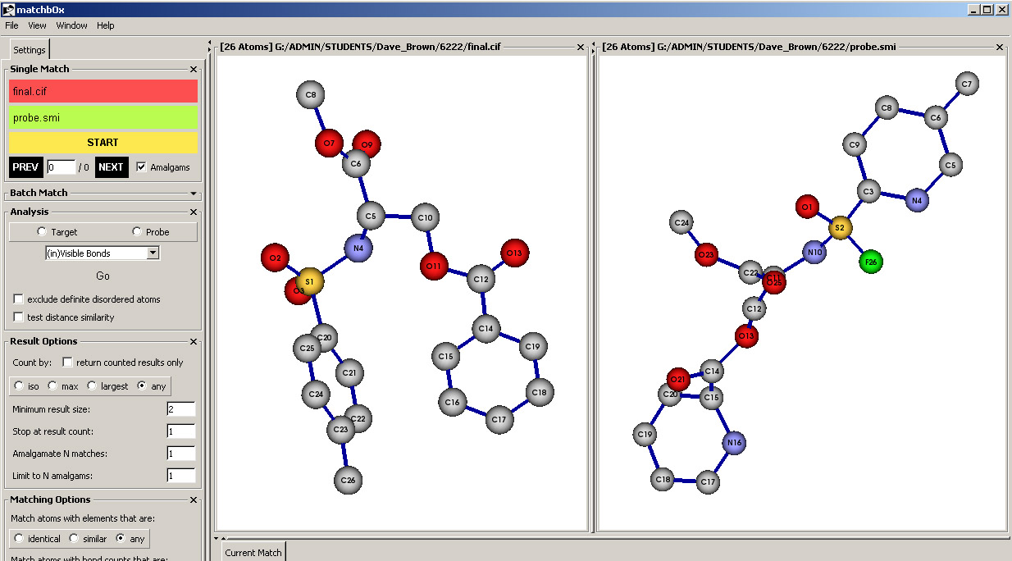
Age Concern
Regression to the 1990’s
The speed of instruments and computers is such that crystallographers have become the slowest link.
Once again, we are trying to teach computers some chemistry.
Dave Brown is working on a project to use chemical information in the form of SMILES strings to help analyse proposed structure solutions and unpick disorder.
O=S(c1Ncc(C)cc1)(NC(COC(C2=NC=CC=C2)=O)C(OC)=O)=F

Slide 5
X-Ray Structure Analysis
The Gold Standard

Slide 6
Why was X-ray Structure Analysis a Gold Standard?
The materials were carefully chosen.
The materials were already well characterised
There were no other techniques to compete with it
The people who did it knew what they were doing

Slide 7
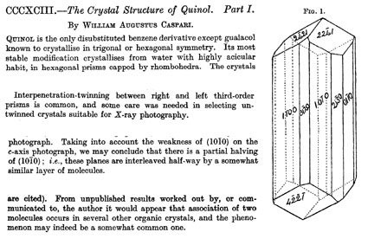
Early Structures J Chem Soc, 1926, 2944
habit &
polymorphism
twinning
pseudosymmetry
hydrogen bond
dimerisation

Slide 8
The unavailability of computers forced workers to think about problems Hexachlorobenzene, 1931

Slide 9
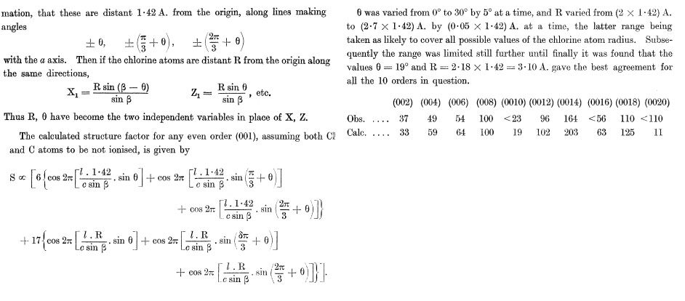
Hexachlorobenzene - Rigid Body Refinement Lonsdale, 1931
From the distribution of the h0l intensities, Lonsdale argued that the 6 (x0z) coordinates of the three Cl atoms could be replaced by a rigid body with only its orientation and radius (θ and R) to be determined
The structure factor expression can be “simplified” to contain only two variables.

Slide 10
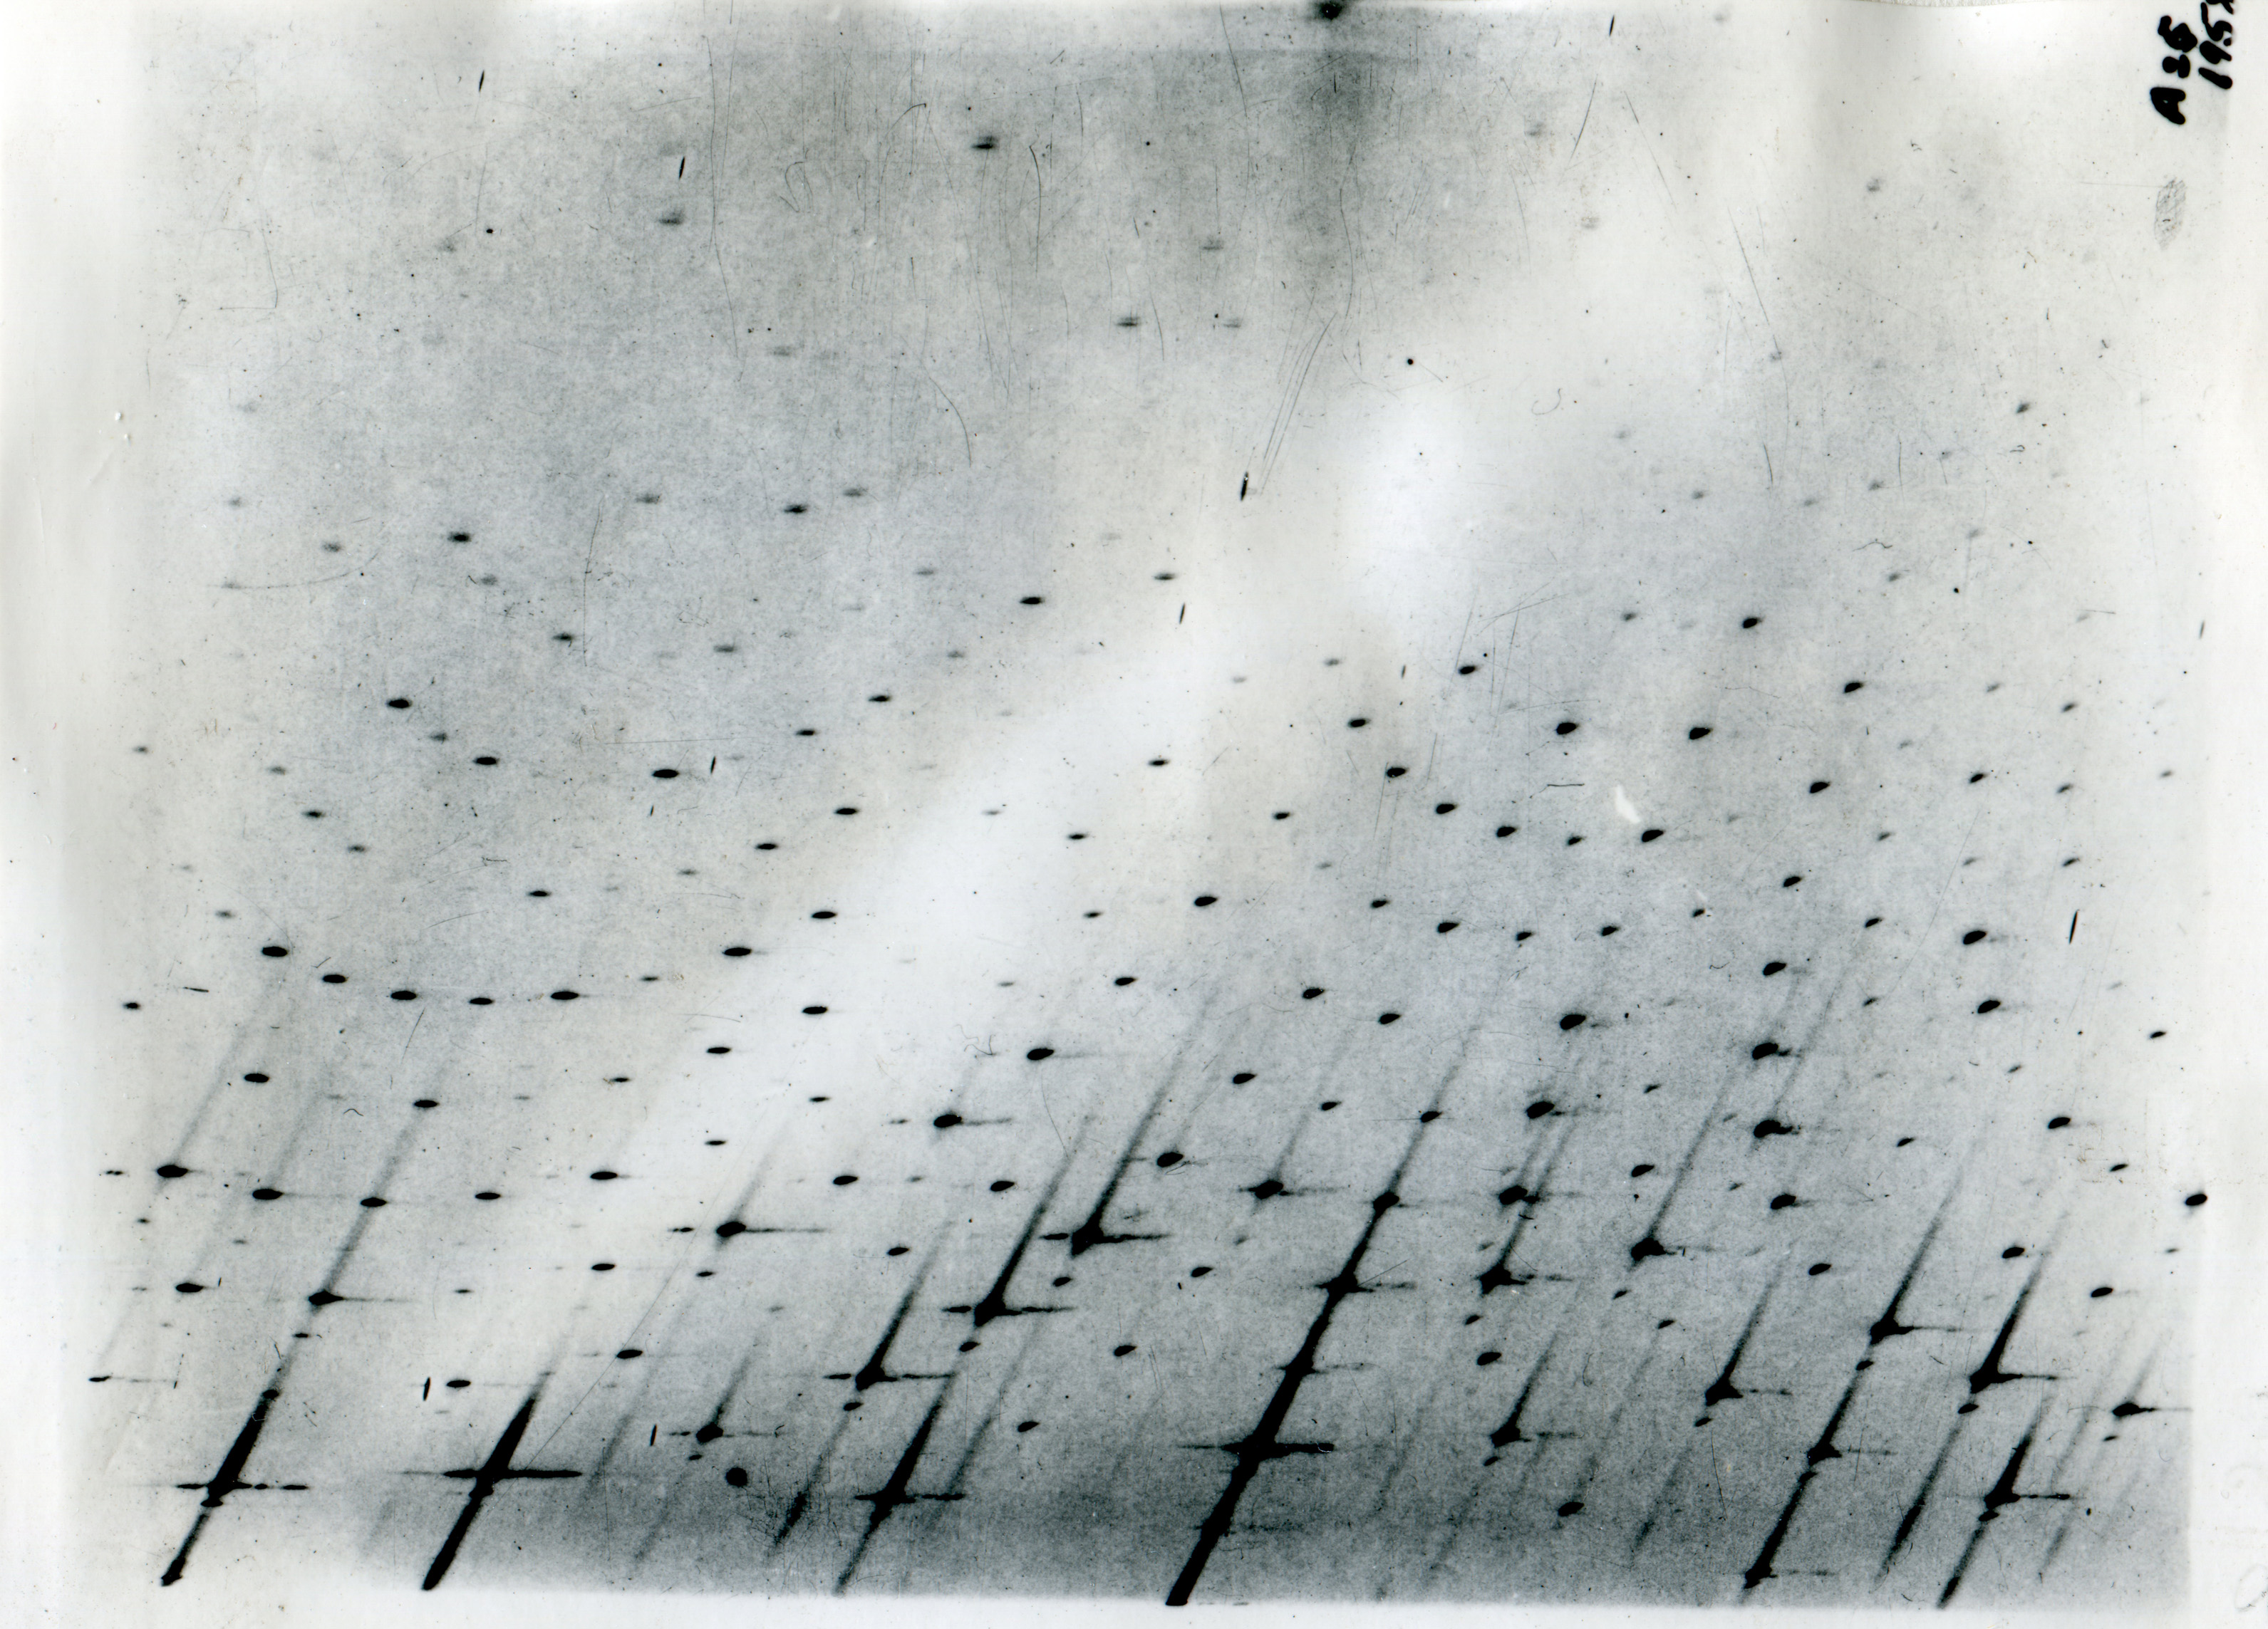
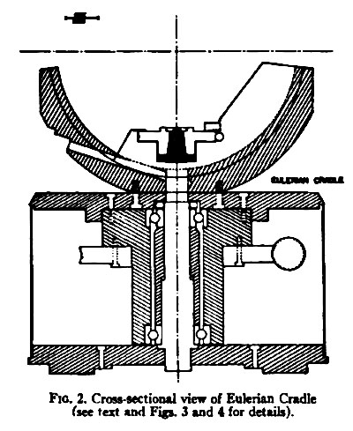
Data Collection
Film methods gave views of large swathes of reciprocal space alerted the crystallographer to potential problems
Serial diffractometers were about to change that
Apparatus for Measuring Complete Single-Crystal X-Ray Diffraction Data
by Means of a Geiger Counter Diffractometer
Thomas c. Furnas, jr., and David Harker
The Review of Scientific Instruments, volume 26, number 5 May, 1955

Slide 11
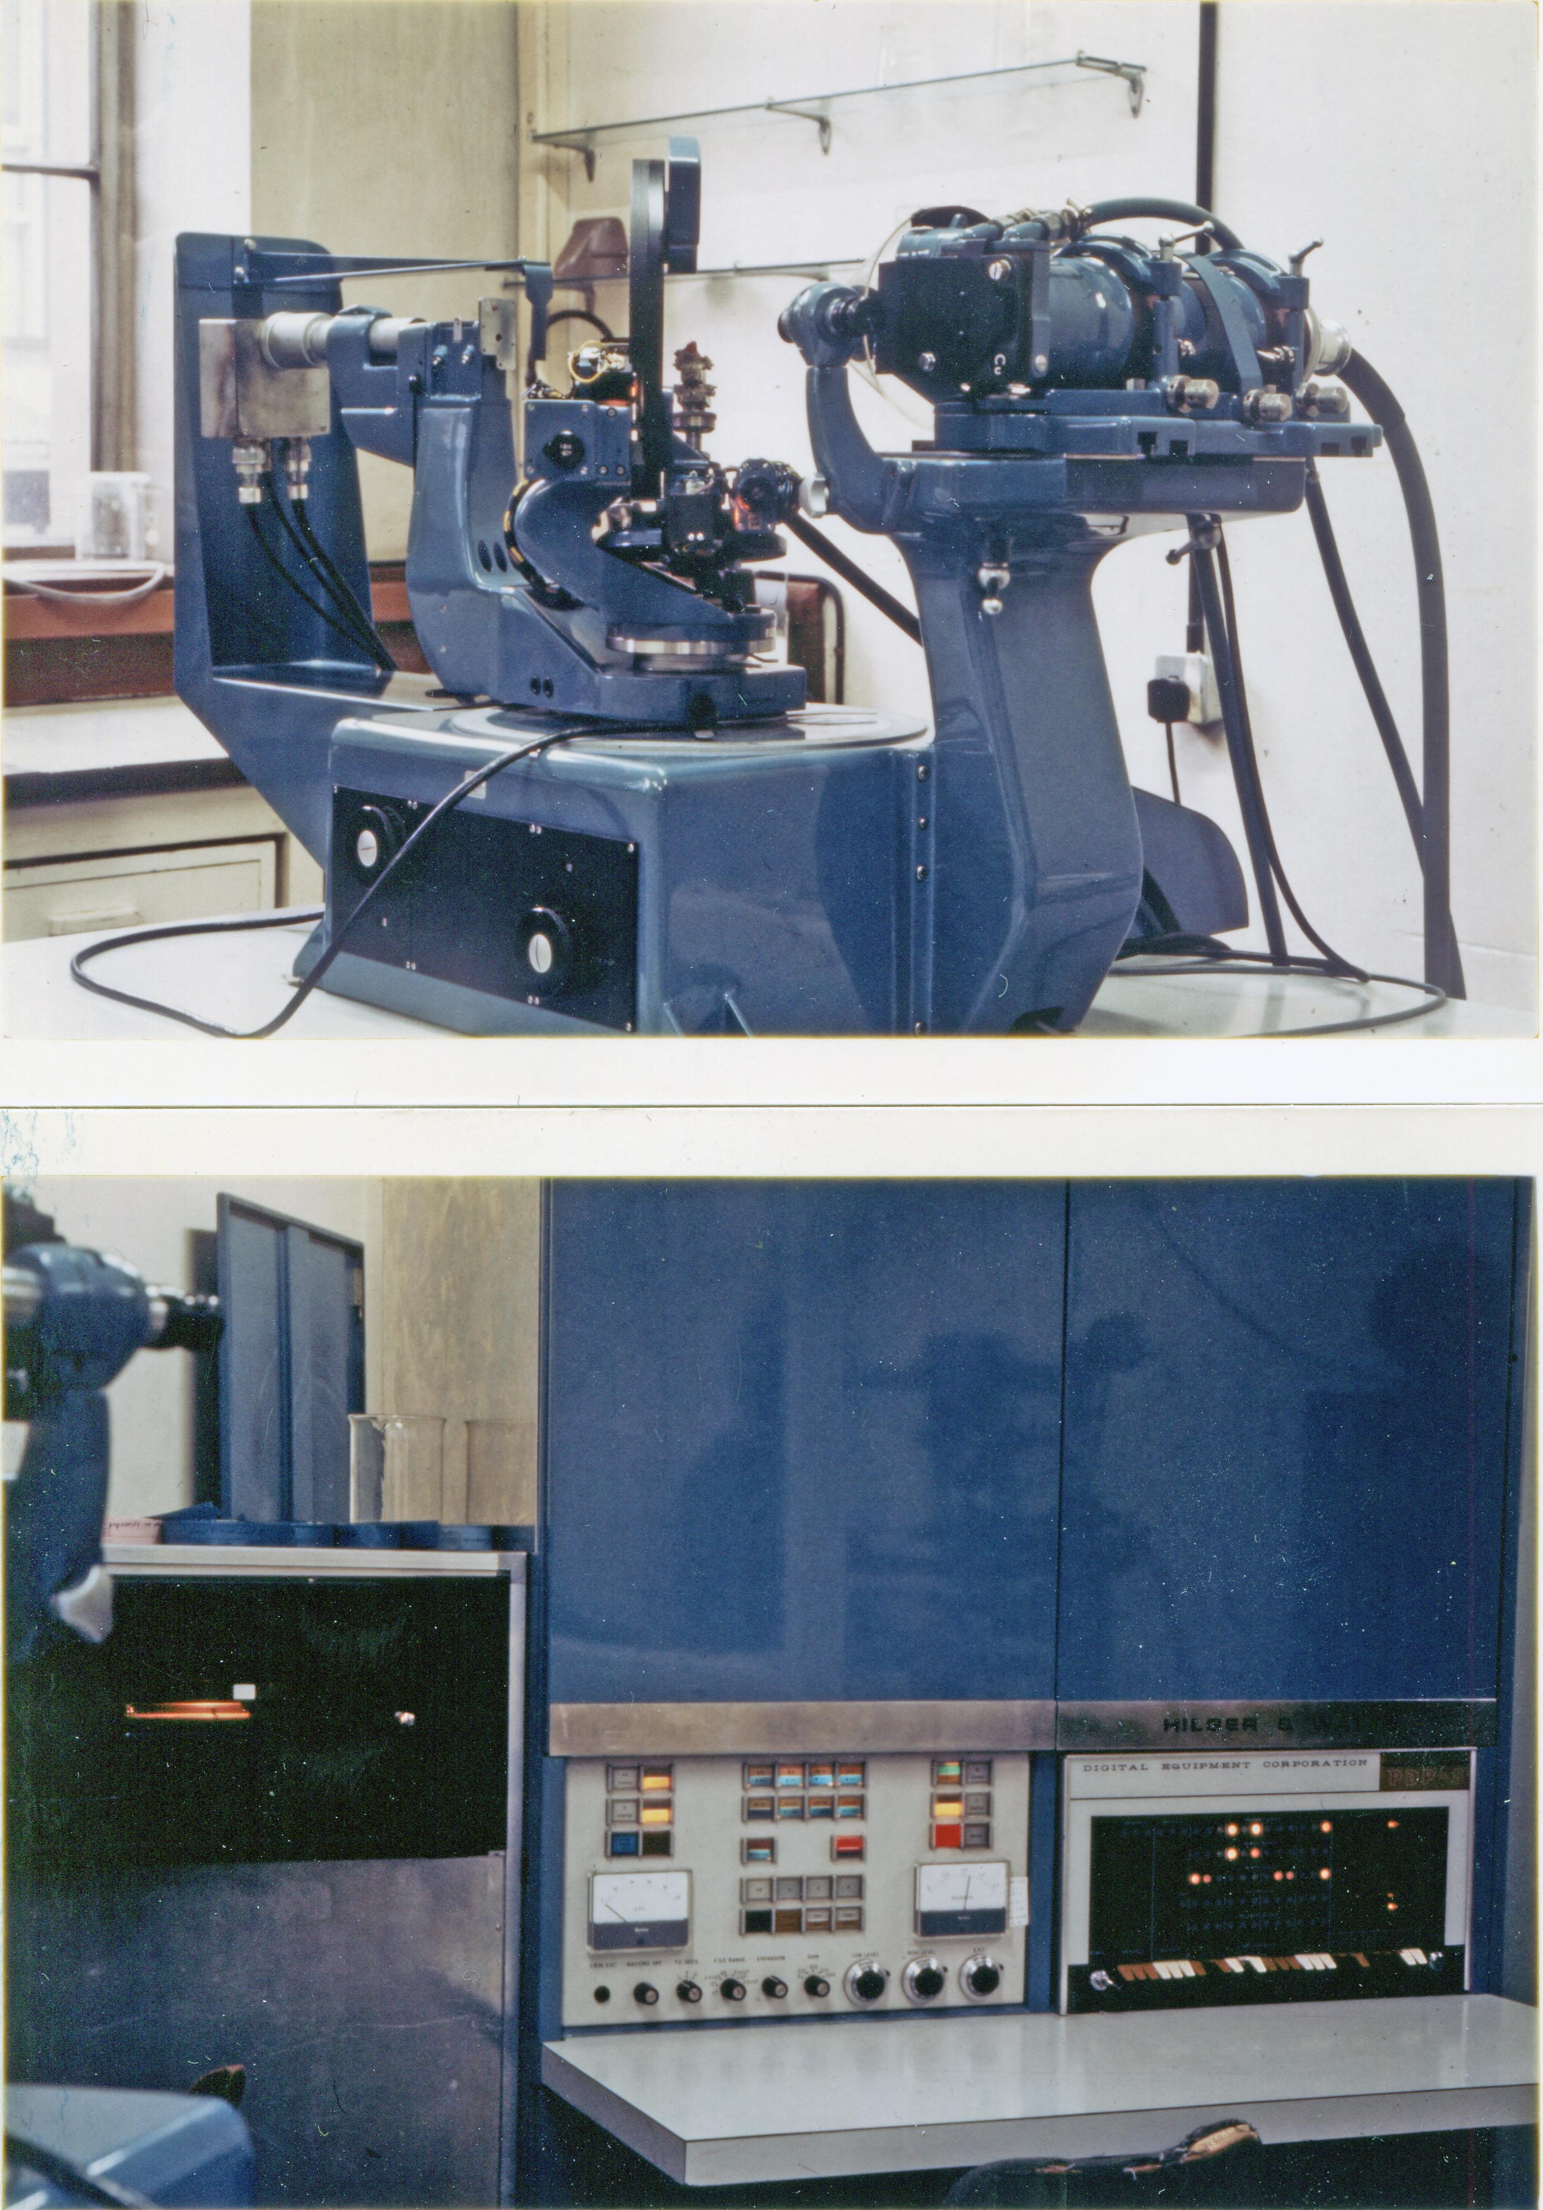
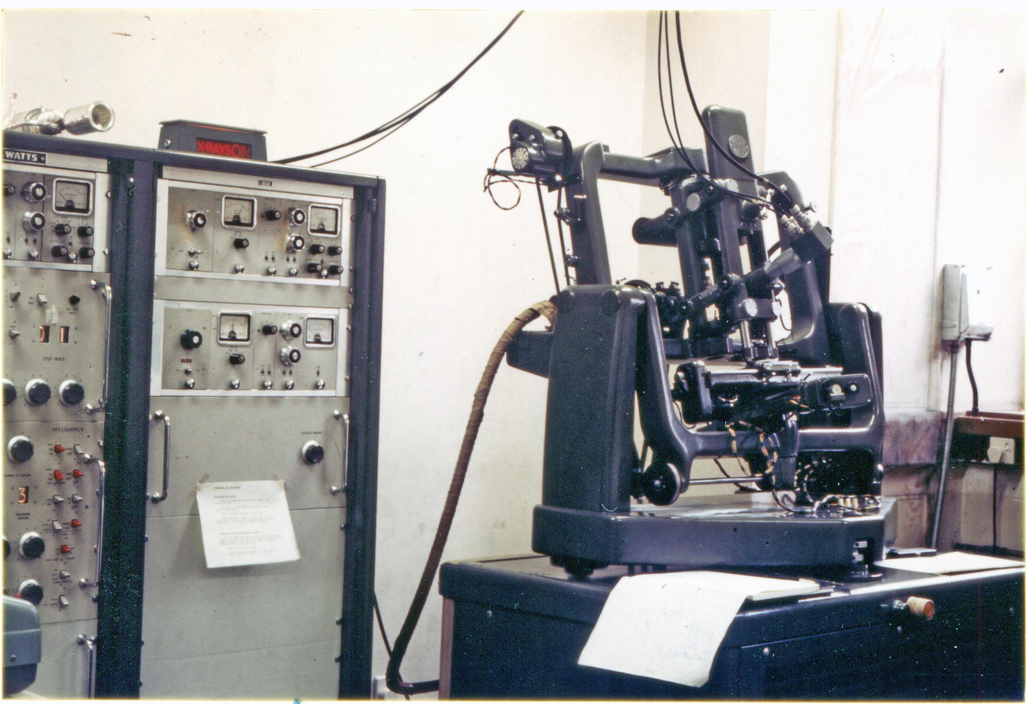
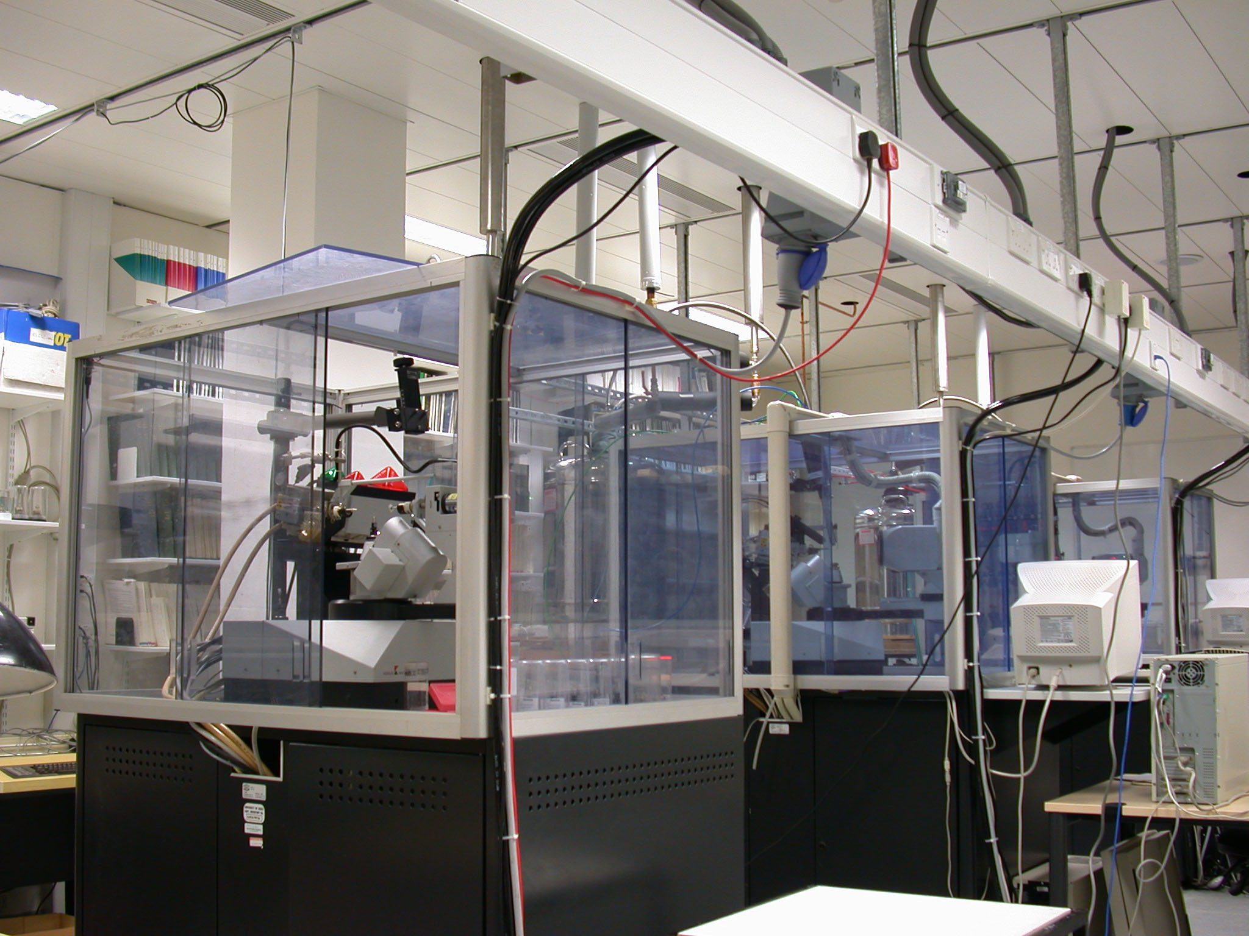
Royal Institution Automated Analogue Diffractometer
Hilger & Watts Y190
Hilger & Watts Y290
Fully Automated Digital Diffractometer
Chemical Crystallography Laboratory, Oxford 2000
The computer is a first generation PDP8, built with discrete transistors and a ferrite core. It became know as the Straight 8
Two Nonius Kccd instruments.
8am-2pm
Booking: 2pm-6pm 6pm-8am
Stepping motors moved across a layer of reciprocal space.
One or two layers of data could be measured in 24 hours.

Slide 12
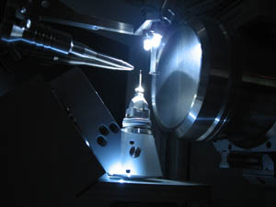
Chemical Crystallography Laboratory, Oxford
Agilent Supernova
In 2011, data collection from fair crystals is no longer an issue.

Slide 13
Digital Computing
Digital computers have revolutionised
crystallography.
Has computing replaced thinking?
Bob Sparks matrix-accumulation benchmark:
Microvax 3800 (1989) 1,824 secs
1.8Ghz Athlon, (2005) 3secs
3.0Ghz Intel Duo (2010) 1sec
We can now do in one day what would have taken three days in 2005, and almost five years in 1990

Slide 14
Crystallography 2011
In 2011 we have diffractometers of great sensitivity, we have low-energy laboratory sources and we have immensely powerful synchrotron sources.
Work at 100K is routine, and 10K reasonably feasible.
Diamond Anvil Cells enable samples to be examined at pressures up to 10 GPa
Computers work at breath-taking speeds.
In effect, we have amazing technology available.
What science can we do with it?

Slide 15
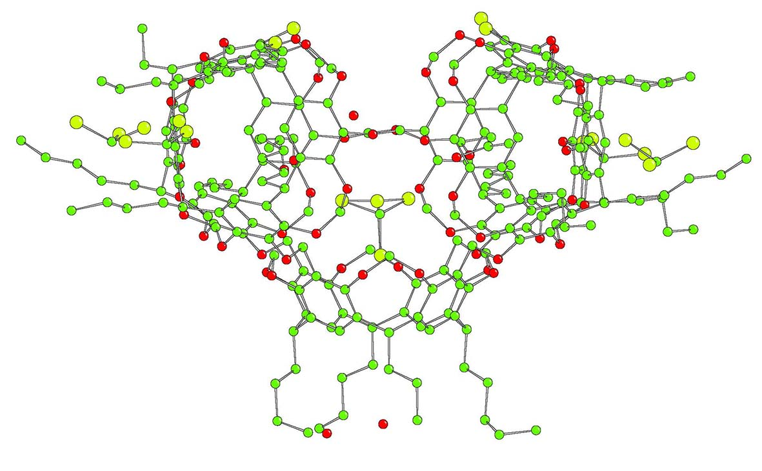
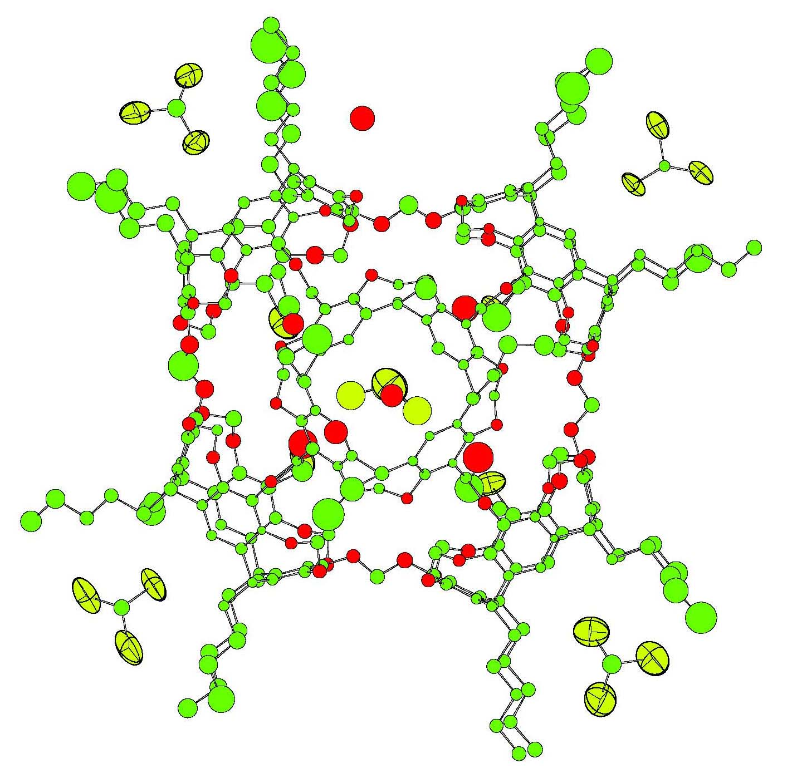
What’s Happening to Crystallography?
“The age of intramolecular structural chemistry is declining for small molecules.
There is very little that can be added to the average intramolecular geometrical data collected by use of the Cambridge Structural Database; anything at variance with these well-established averages is most probably wrong.”
Gavezzotti & Flack, 2005
http://www.iucr.org/iucr-top/comm/cteach/pamphlets/21/21.html

Slide 16
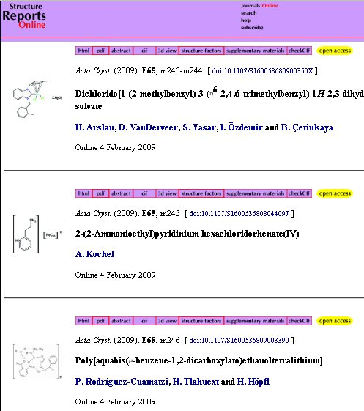
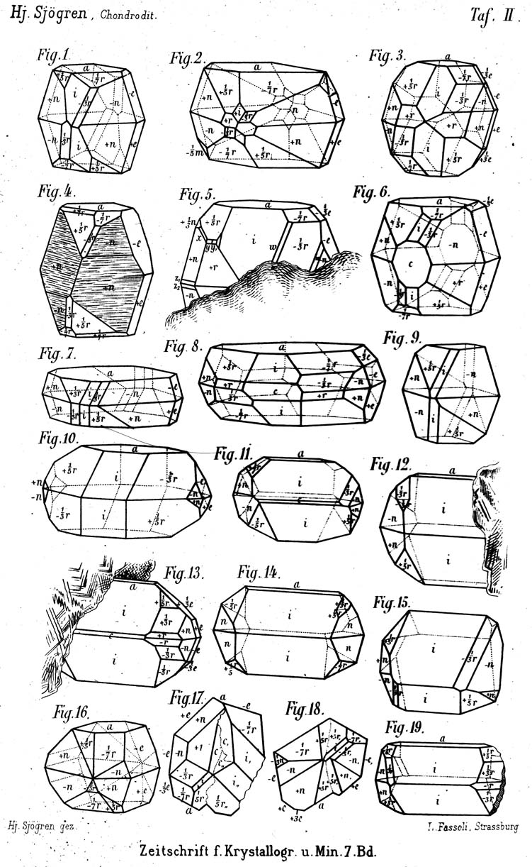
Just Stamp-Collecting?

Slide 17
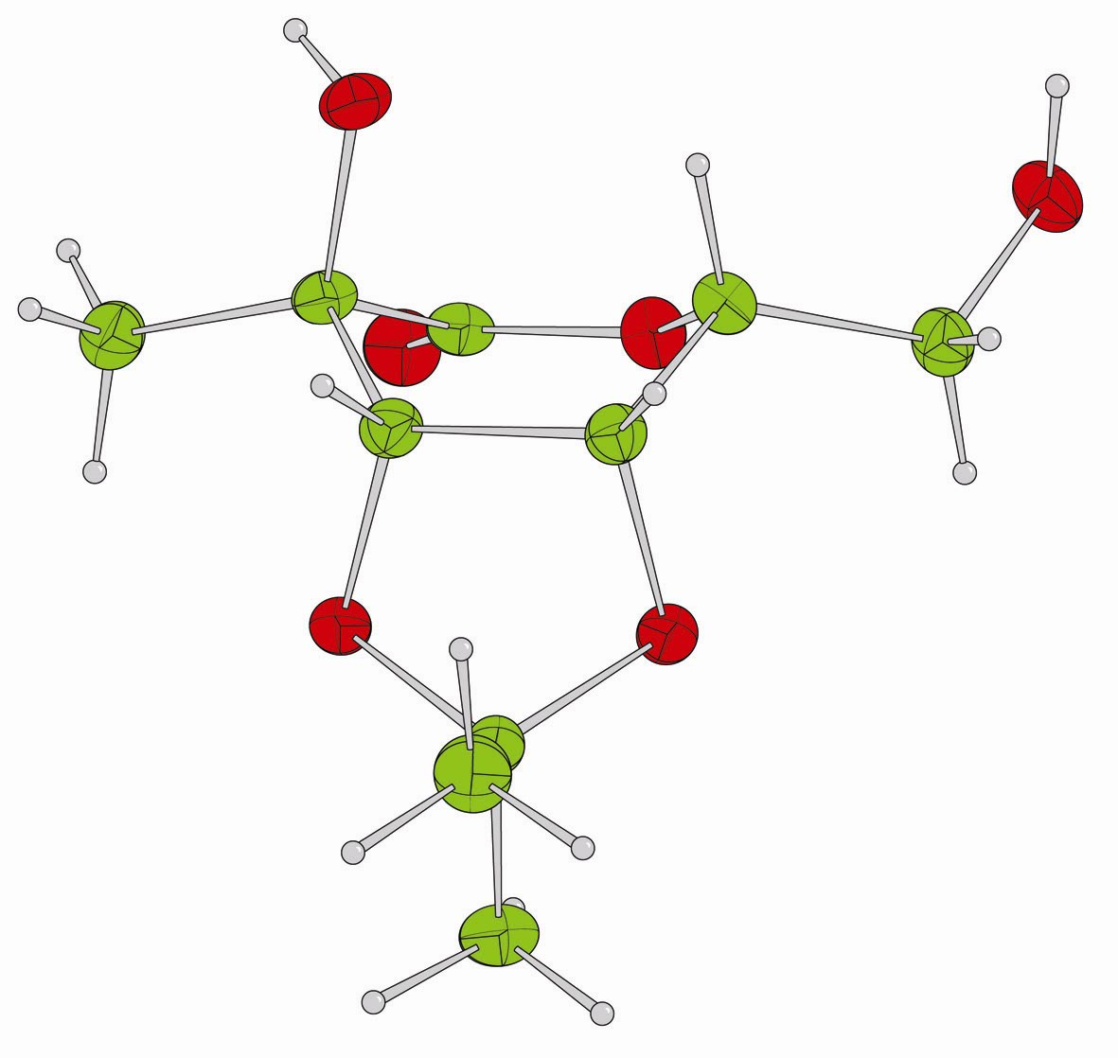
The Journals of Squeaky-Clean Structures
On a one-by-one basis, “perfect” structures probably have a very limited crystallographic interest.
“X-ray crystallography unequivocally confirmed the stereochemistry of the 2-C-methyl group.”
Rint 2.8%
R1 2.9%
wR2 6.8%
94% with I>2σ(I)
3,4-O-Isopropylidene-2-C-methyl-D-galactonolactone
N. Dai, S. F. Jenkinson, G. W. J. Fleet and D. J. Watkin

Slide 18
The Journal of Rotten Structures
Much more interesting are the careful but imperfect analyses, where the analyst has had real problems which he is happy to share with the community.

Slide 19
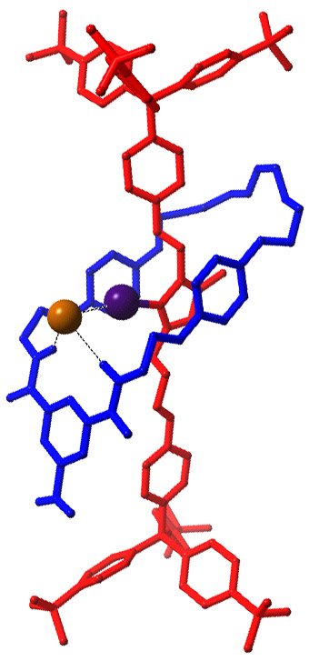
Halogen-bond Templated Rotaxane (R1 = 15.0%)
Even low temperature synchrotron data were weak and the sample suffered radiation damage
Final refinement had a data to parameter ratio of 3.6 :1 and required 4401 restraints
Theta
Completeness vs Theta

Slide 20
The Cambridge Structural Database
Museum?
Grave Yard?
Gold Mine?
The CCDC grew out of the activities of the crystallography group led by Dr Olga Kennard OBE FRS in 1965.
Building a database is now an easy technology.
The scientific contribution from CCDC is the expertise to devise products to turn data into knowledge.

Slide 21
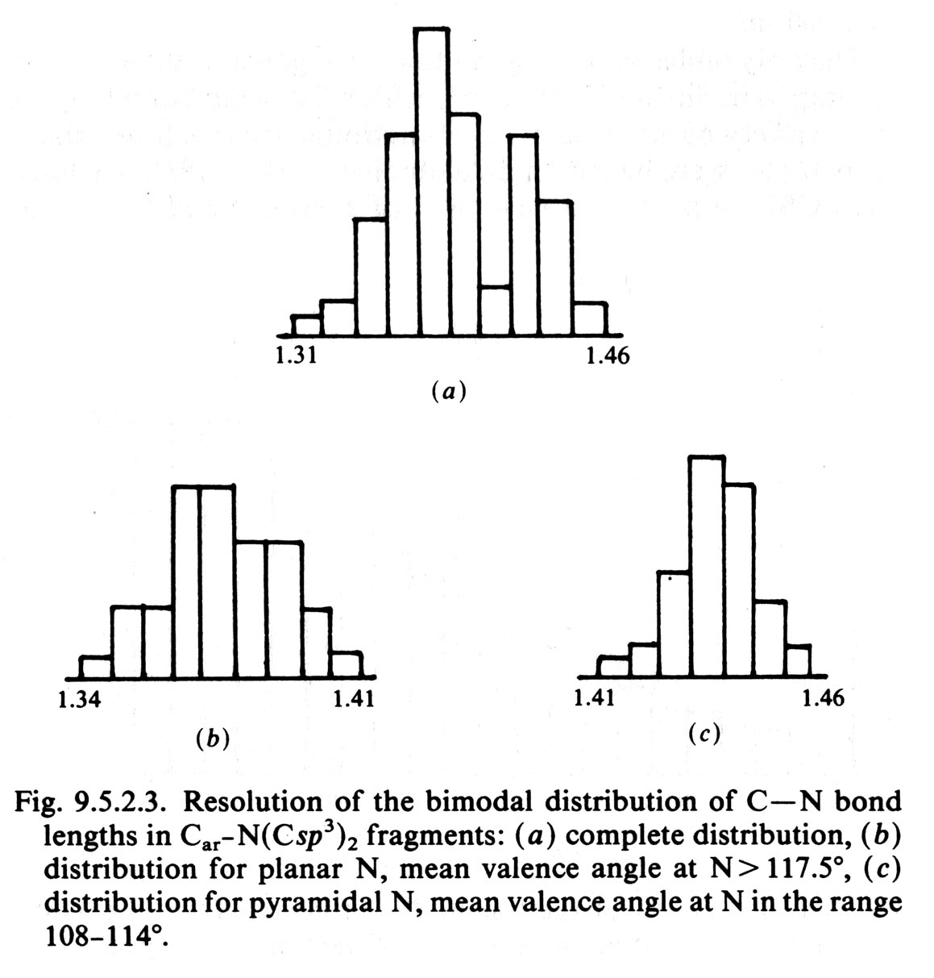
The CSD and Validation
PLATON may let us know if there is something wrong with the physics.
The CSD may let us know that there is something wrong with the chemistry.
Simple frequency distributions of bond lengths are meaningless.
In MOGUL, bond lengths have been classified according to their local environment.

Slide 22
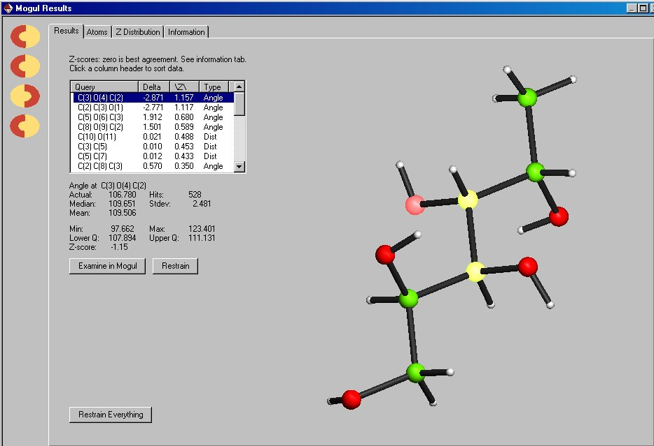
CRYSTALS interface to MOGUL

Slide 23
Just Stamp-Collecting?
Not entirely
Structure determination by X-ray crystallography has become a vital tool for modern preparative chemistry.
This form of crystallography is certainly a technology, but the technology is immature.
The scientific challenge now is to make the total systems robust when used by informally trained chemists.

Slide 24
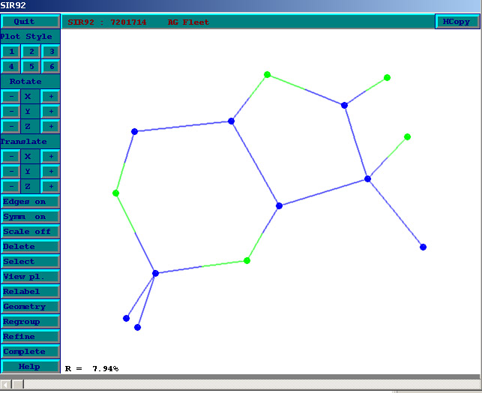
Automatic Structure Solution and Refinement
Direct methods and charge flipping are now very powerful procedures for phasing a Fourier map to the level that the atomic skeleton of the structure can be seen.
However, physics alone cannot always make automatic unambiguous assignment of atomic sites.
Worse than that, some molecules refuse to fit into normal space groups - they are disordered.

Slide 25
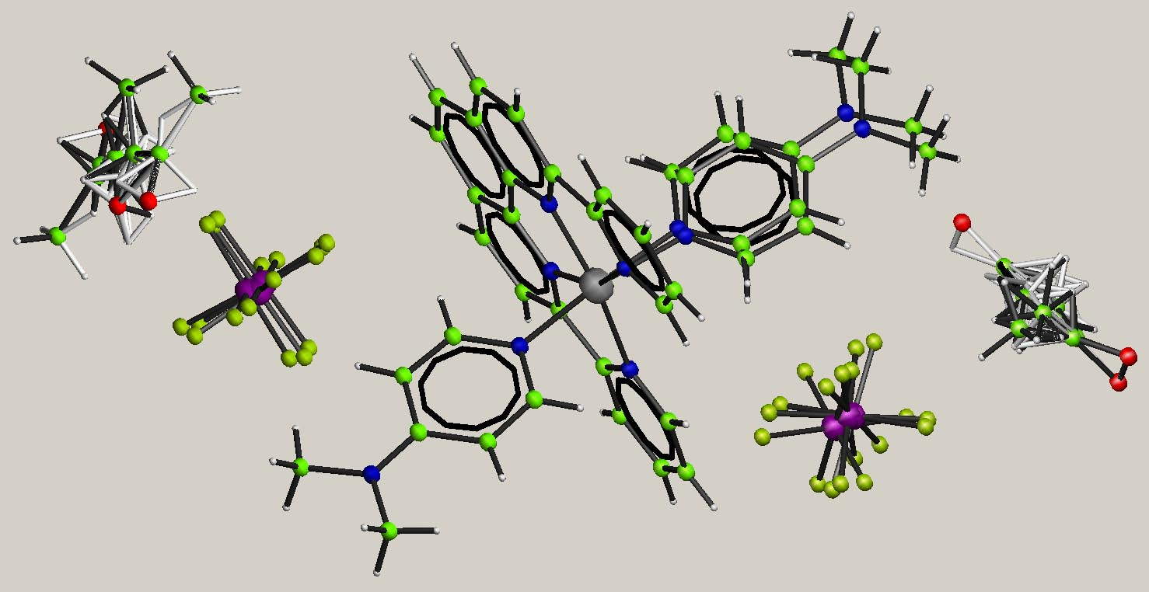
Disorder
Disorder is a bottomless pit into which crystallographers throw time, effort and money.
When disorder is eventually resolved, it is often clear that the resolution has added nothing significant to the scientific value of the structure. Was it worth the effort?

Slide 26
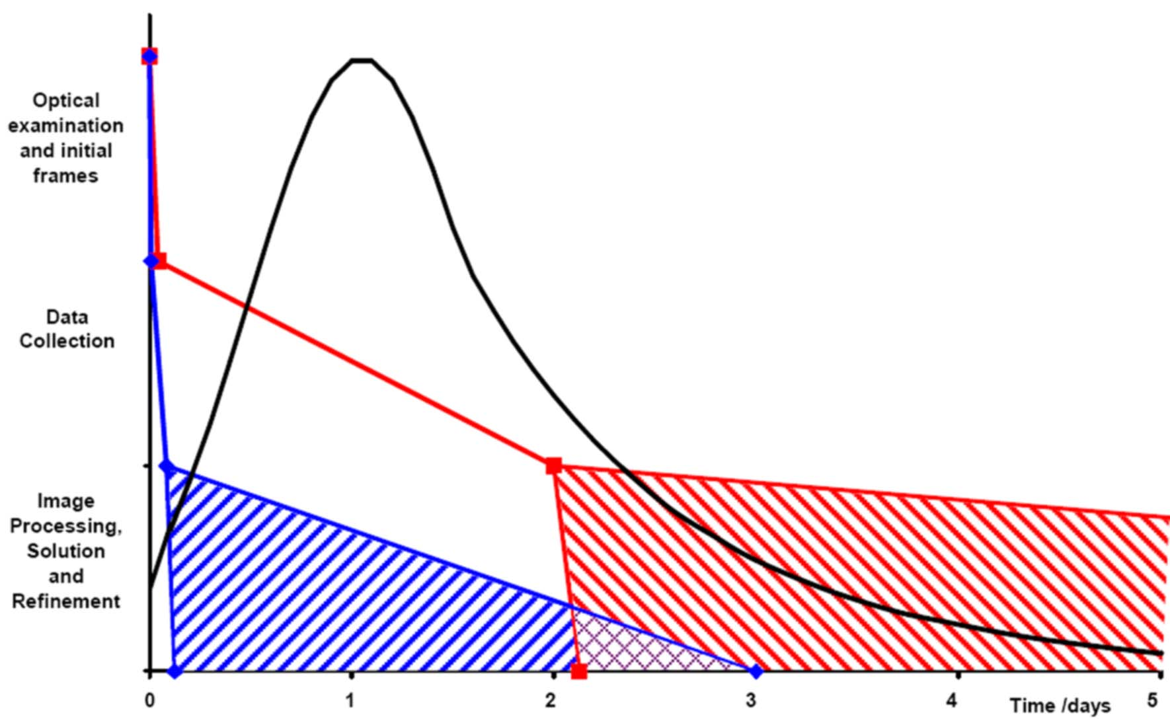
What is the cost of an X-ray Structure Analysis?
About ½ of the structures going through a laboratory could be made ready for publication in one working day.
Number of Structures

Slide 27
What is the cost of an X-ray Structure Analysis?
However, most of these cost continue even if the instruments are turned off.
The recoverable cost of not doing an analysis is perhaps only $30.

Slide 28
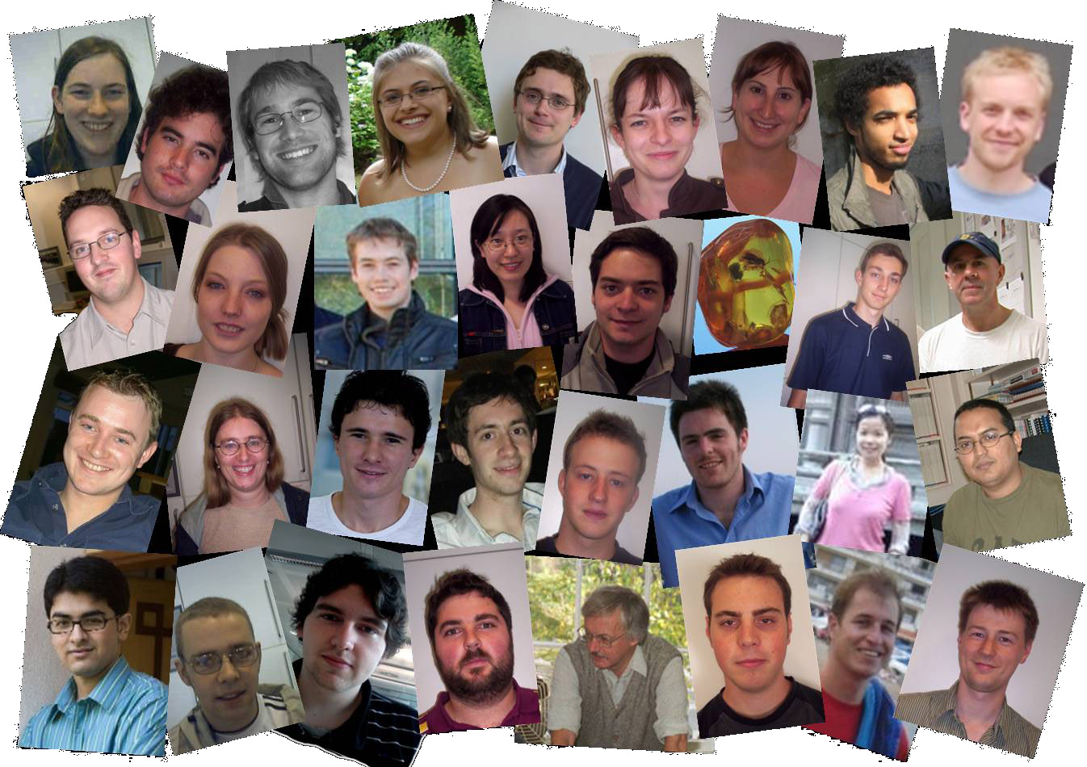
Bringing Down the Cost
A number of things can be done to bring down the unit cost:
Put more samples on the instruments each day. This increases the burden on the analyst, and may even require additional analysts
Provide better automation for the treatment of disorder.
Have a clear strategy to limit the amount of time spent on each structure.

Slide 29
Cost-benefit Analysis
In the UK, research funding is not so generous that we can be wasteful of resources.
Before starting an analysis it is important to declare what the analysis will be used for.
It is important to agree with the customer if/how the work will be published.
The experiment and data processing can then be tailored to those aims.

Slide 30
Cost-benefit Analysis
Occasionally the analysis proves to be much more important than was foreseen.
In general, it is a better use of resources to re-measure a few data sets than to collect everything to the highest standards first time around.

Slide 31
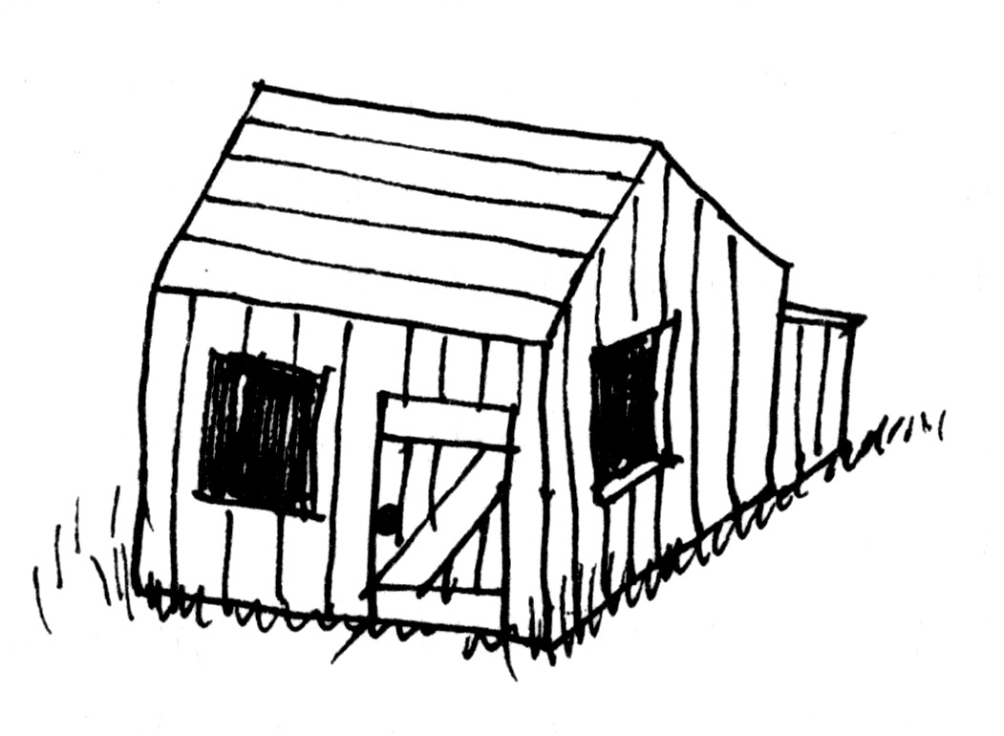
The Gold Standard
We do not use a micrometer to measure the timber for a chicken house.
Crystallography can still be the Gold Standard, but a gold standard is not needed for all work.
The analyst simply needs to demonstrate fitness-for-purpose.
If the customer changes the purpose later, that is a separate issue.

Slide 32
The Gold Standard
The problem for journals is to understand the purpose of the work, and see if it is satisfied.
The purpose cannot be evident from the information currently included in a cif, therefore it is unlikely that a program can make this decision.
checkCIF may help the referee decide if the analysis is ‘good enough’ for the purpose described in the text.
In the future, cifs may also need to record what the analysis was ‘good enough’ for.

Slide 33
Where Next?
The molecular solid state has become interesting in its own right.
Why does Nature choose to use space groups?
Does Nature use space groups?
What are Z’>1 structures?
What are modulated structures?
How do molecules share information about each other?
How can I get this ****** material to crystallise nicely?

Slide 34
The Molecular Solid State
Structure Prediction
Progress is painfully slow.
Morphology Prediction
Even when the crystal structure in known, reliable morphology predictions fall a long way short of experimental observations.
Growth of x-ray quality crystals. Still a ‘black art’.
Even in a single laboratory, some people have “better luck” than others.

Slide 35
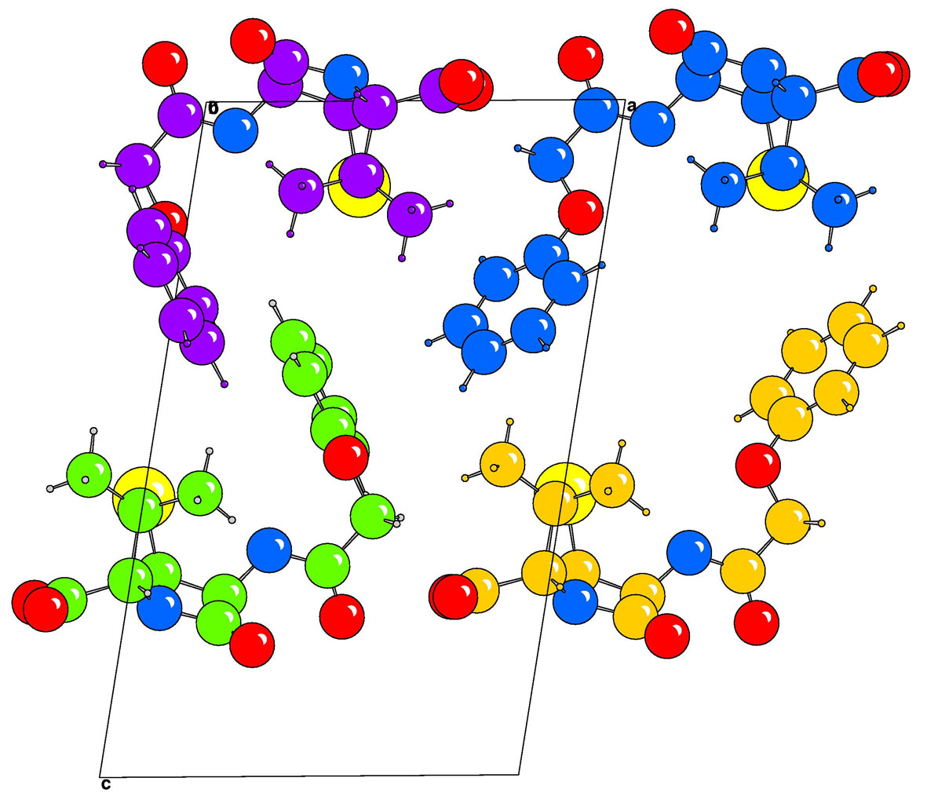
KpenV, P1, Z'=4
This chiral molecule in the non-centrosymmetric space group P1 would just love to pack in P-1.
Why can’t these molecules get their act together, and crystallise with Z’=2?
Carol Brock calls this “Frustrated symmetry”

Slide 36
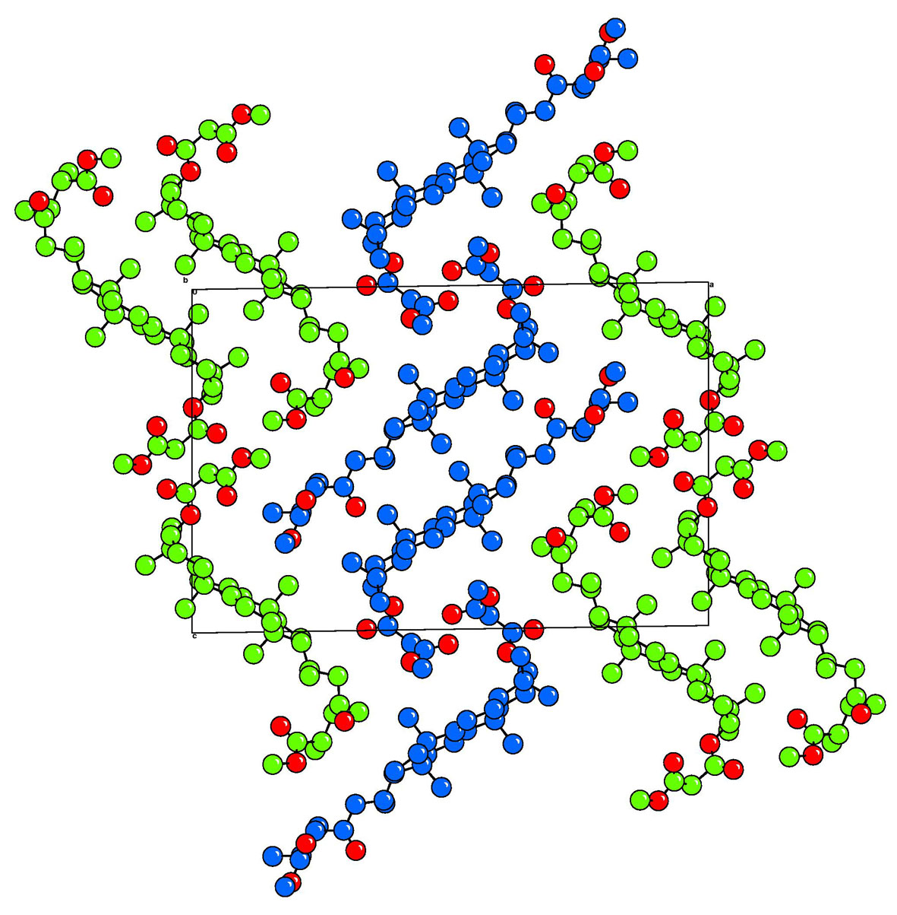
VONVUP, P21, Z'=2
Another enantiopure material in a non-centrosymmetric space group.
There is no pseudo-symmetry. The blue molecules assume an L shape.
The green molecules assume an S shape

Slide 37
Where Next?
Molecular Structure Determination is a done-deal
Most modern technology depends upon second or third order effects.
Worrying about whether ‘completeness’ is 89% or 98% is almost irrelevant.
Understanding molecular crystals is a New Frontier for crystallographers

Slide 38
I would like to thank the American Crystallographic Association for this opportunity to have shared some of my ideas with its members,
and thank the dozens of colleagues who helped form those ideas.

