Slide 1
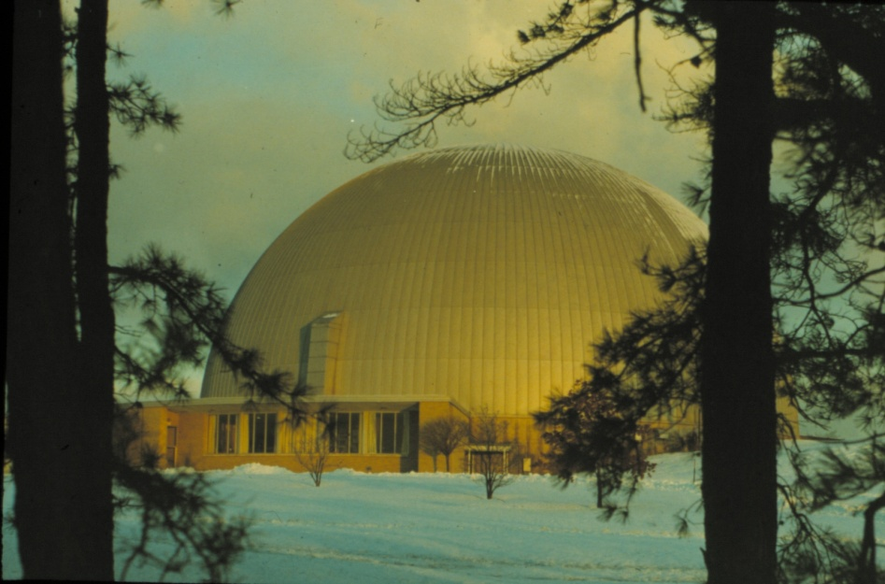
From the Amino Acid Structures to Metal Hydrides: Four Decades of Single-Crystal Neutron Diffraction Thomas F. Koetzle Suffolk Community College Selden, New York 11784
ACA Honolulu
July 20-24,2013
Bau Award Lecture AW.01
Work at Brookhaven and Argonne National Laboratories was Supported by the Office of Science, U. S. Department of Energy.

Slide 2
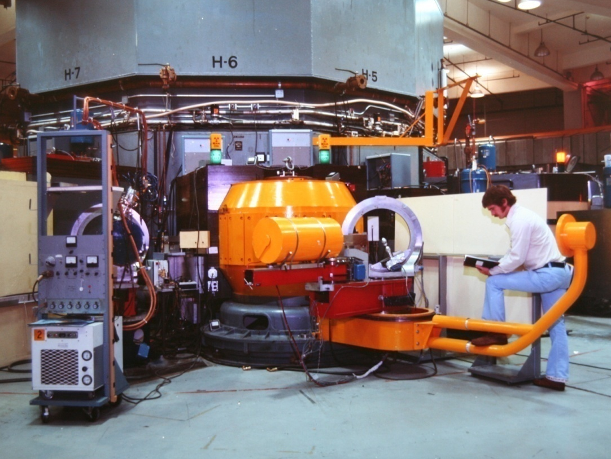
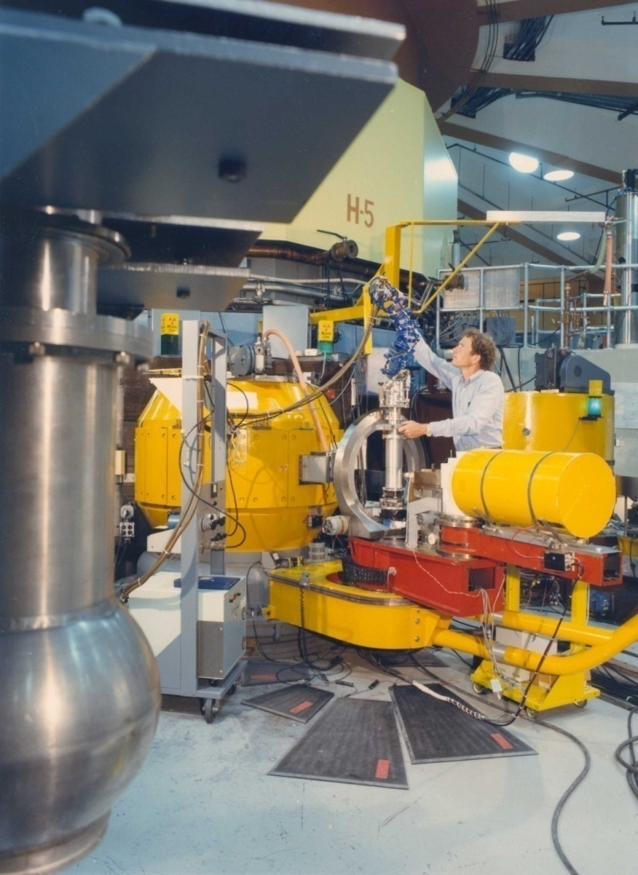
1976
Single-Crystal Neutron Diffractometers at the Brookhaven High Flux Beam Reactor
1985
Notes:
Point detectors! Main improvement from was the introduction of closed-cycle He refrigerators enabling routine low-temperature data collection.

Slide 3
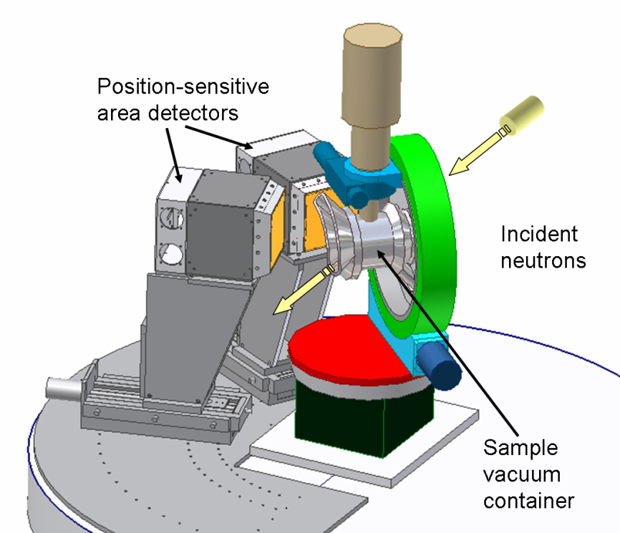
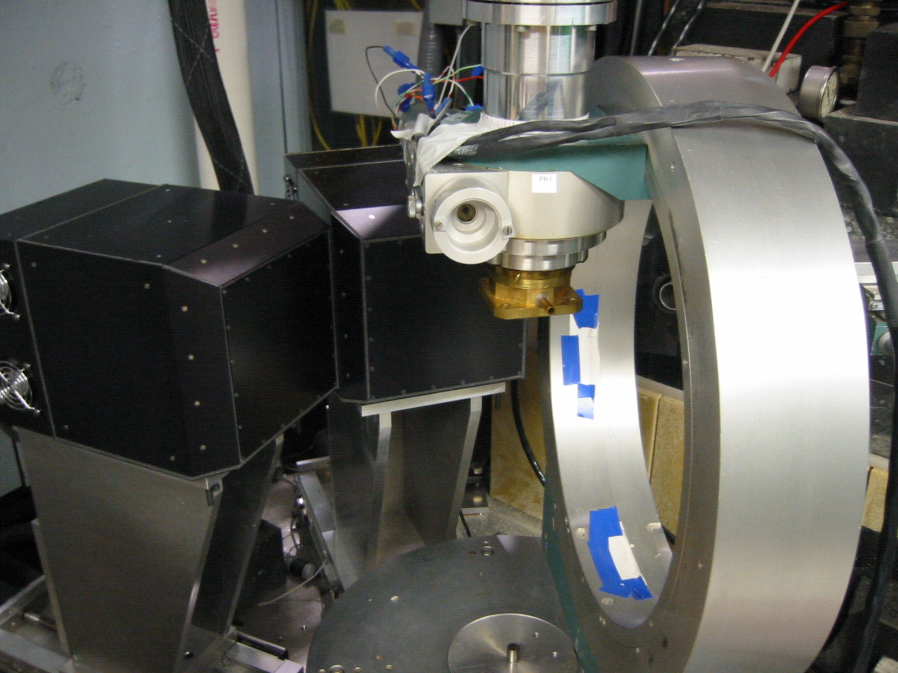
SCD Instrument at Argonne IPNS
Figures, dated circa 2005, courtesy of Arthur Schultz
Notes:
Time-of-Flight Laue instrument.

Slide 4
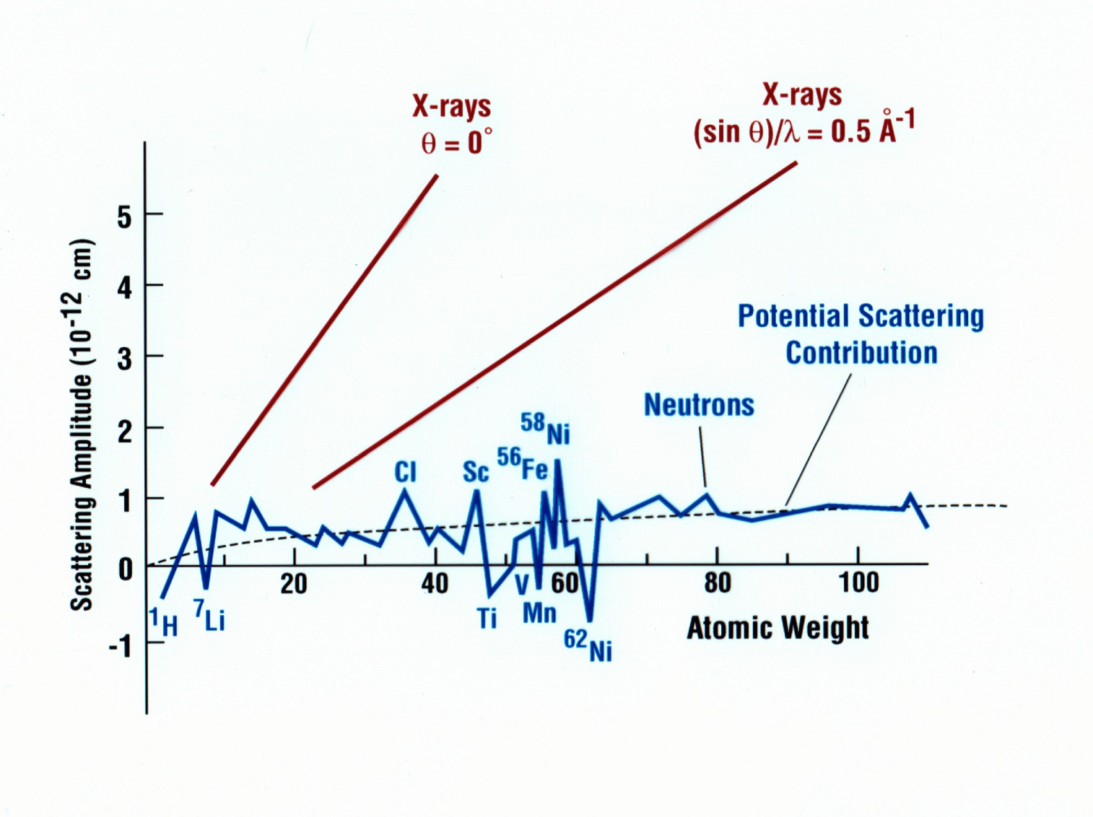
Neutron and X-Ray Scattering Amplitudes
Adapted from Bacon, G. E., “Neutron Diffraction”; 3rd Ed.; Oxford University Press: London, 1975.
Notes:
Neutrons are point scatterers (cf. Rutherford, 1911). Thermal neutron energies mean that neutrons are useful for both diffraction and spectroscopy. Mention neutron magnetic moment and studies of molecule-based magnets, which will be discussed by Javier Campo in tomorrow afternoon’s session 10.01, ” Interplay of Crystallography, NMR and Theoretical Methods,” which has been organized by Alberto Albinati and Larry Falvello and will be chaired by Ray Teller.
.

Slide 5
Discrimination of Hydrogen from Deuterium in a Neutron Fourier Map
Determination of the Absolute Configuration for + Neopentyl-1-d alcohol (S)
Yuan, H.S. et al. Proc. Natl. Acad. Sci. U.S.A. 1994, 91, 12872-12876.
Notes:
Study to probe the absolute stereochemistry of an enzymatic reaction involving yeast alcohol dehydrogenase.
Mention that it was Hannah who helped to rehearse Bob for his after-dinner Karaoki performance at the Salt Lake City meeting.

Slide 6
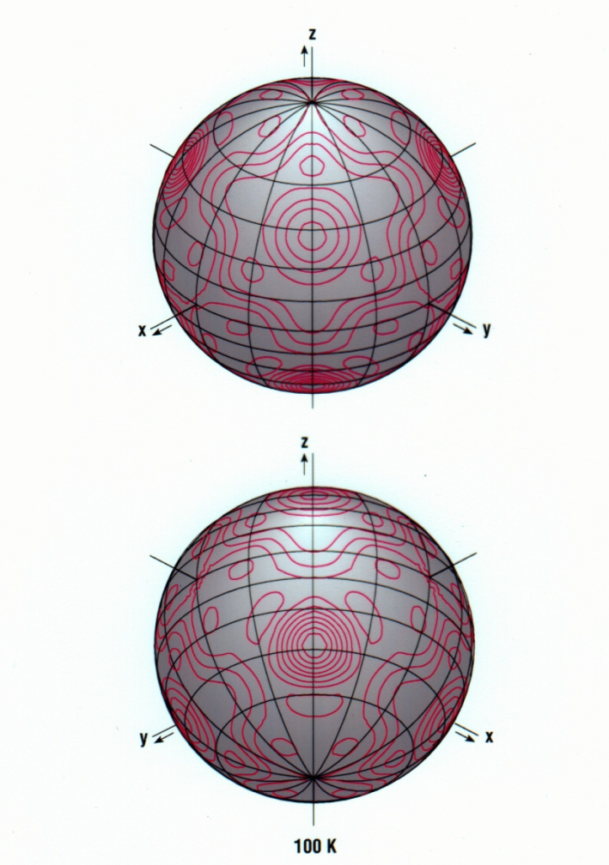
Modeling Disorder in a Type II Gas Hydrate: 3.5Xe·8CCl₄·136D₂O
CCl₄ encapsulated in 16-hedron
CCl₄ chlorine scattering density
McMullan, R.K.; Kvick, Å. Acta Crystallogr., Sect. B 1990, B46, 390-399.

Slide 7
Pittsburgh Diffraction Conference, 1994
Photo courtesy of J. S. Ricci, Jr.

Slide 8
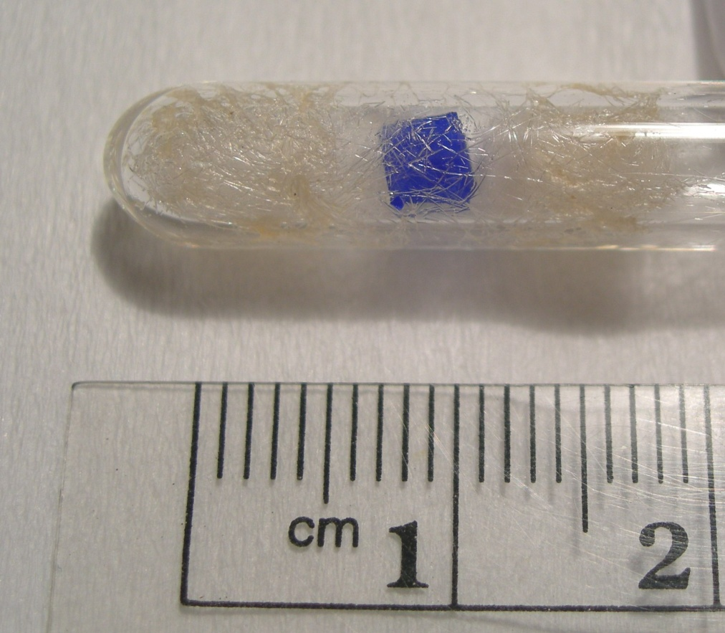
Air-Sensitive Crystal Sealed in a Quartz Tube Ready for Neutron Data Collection at IPNS
Large Crystal Size!
Photo, dated circa 2006, courtesy of Paula Piccoli and Arthur Schultz

Slide 9
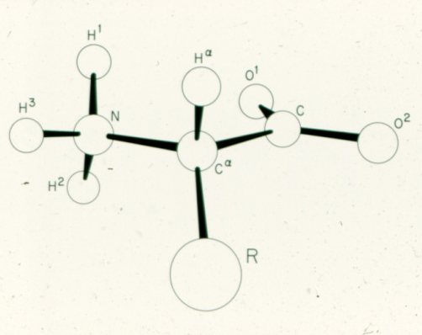
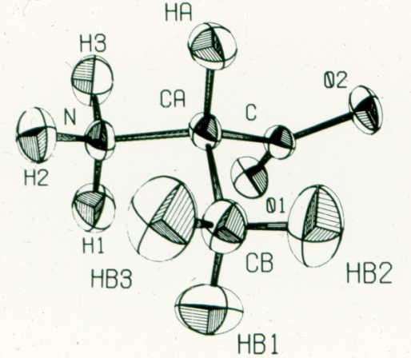
Amino Acids
Lehmann, M. S.; Koetzle, T. F.; Hamilton, W. C. J. Am. Chem. Soc. 1972, 94, 2657-2660.
Notes:
The barriers to rotation for the methyl groups and ammonium groups are estimated to be 3.6 and 20 Kcal/mol, respectively. Mention implications for H-bond strength.

