Slide 1
Notes:
“The first solution of a complex acentric organic crystal structure from the application of direct methods (MULTAN) to neutron diffraction data.”

Slide 2
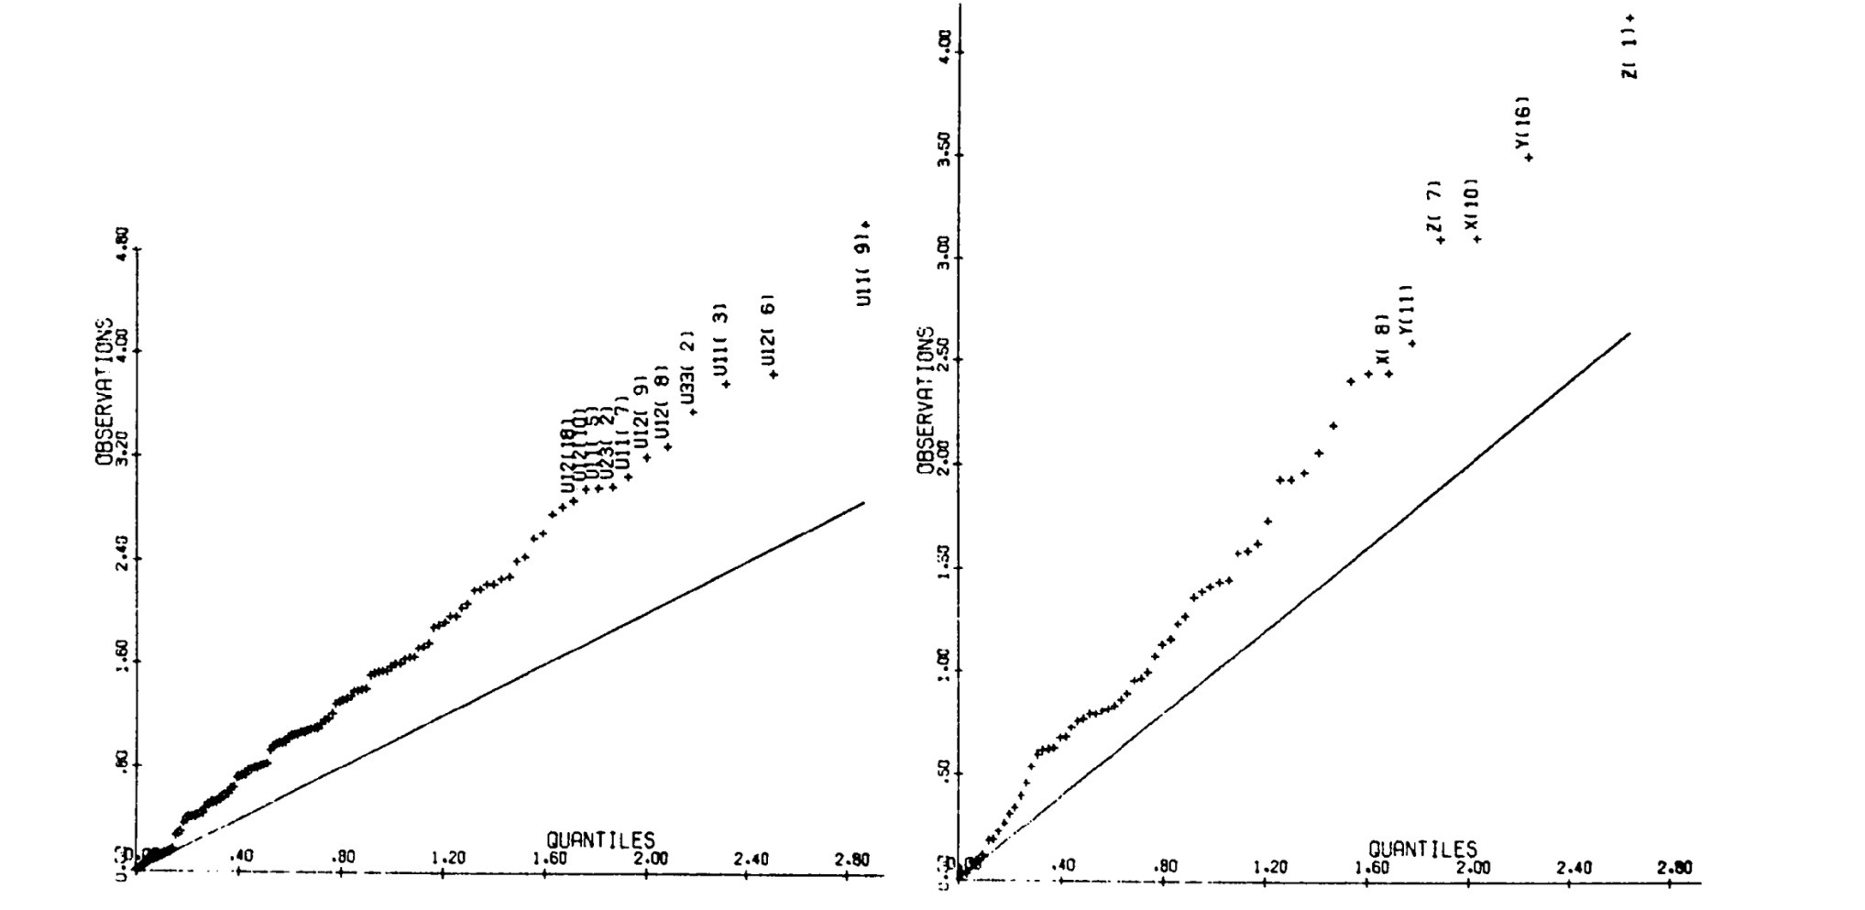
L-Asparagine·H₂O: Comparison of CIRUS and BNL Structures
Half-Normal Probability Plots
Notes:
The two structures are generally in good agreement. Pooled standard deviations likely are underestimated by a factor of 1.3.

Slide 3
En Route to 1972 NATO Summer School in Åarhus, Denmark
Photo courtesy of Carole Koetzle

Slide 4
Neutron Diffraction Study of NaSmEDTA·8H₂0 An Evaluation of Methods of Phase Determination Based on 3-Wavelength Anomalous Dispersion Data
Nuclides with Strong Thermal Absorption Resonances
⁶Li, ¹⁰B,¹¹³Cd, ¹⁴⁹Sm, ¹⁵¹Eu, ¹⁵⁷Gd
b (fm, 1 Å) = −21 + 56i
9-coordinate Sm(III) in [SmEDTA·3H₂O]⁻
Koetzle, T. F.; Hamilton, W. C. in “Anomalous Scattering”; Ramaseshan, S.; Abrahams, S. C., Eds.; Munksgaard: Copenhagen, 1975, pp. 489-502.
Notes:
Anomalous terms are very large compared to x-ray. b_{N} = 9.6 fm!

Slide 5
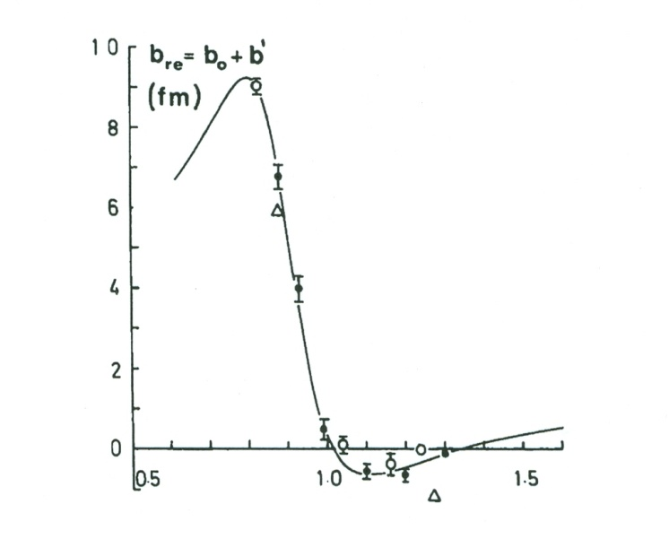
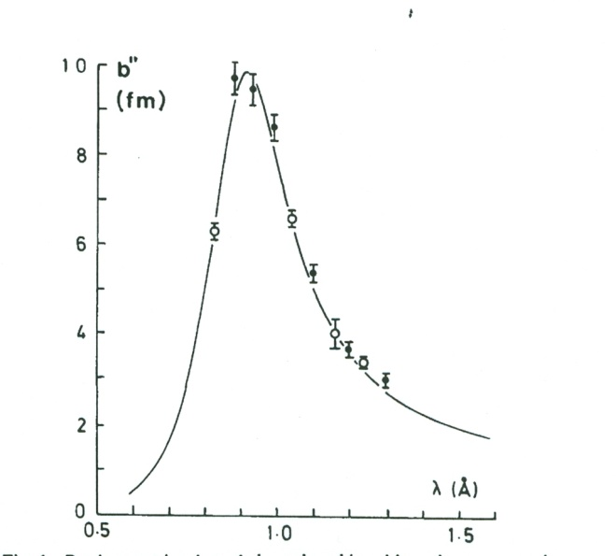
Three-Wavelength Phase Determination
Refined Scattering Lengths for Naturally Occurring Sm
Wavelength | λ, Å | b₀ + b', fm | b'', fm
λ₁ | 0.83 | 9.0 | 6.3
λ₂ | 1.04 | 0.1 | 6.6
λ₃ | 1.24 | 0.0 | 3.4
Engel, D. W.; Koetzle, T. F. Acta Crystallogr., Sect. A 1984, A40, 99-102.
Notes:
Natural abundance of ¹⁴⁹Sm is 14%. High-resolution structure carried out with FusaoTakusagawa of our group at BNL.

Slide 6
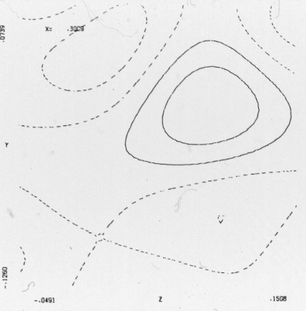
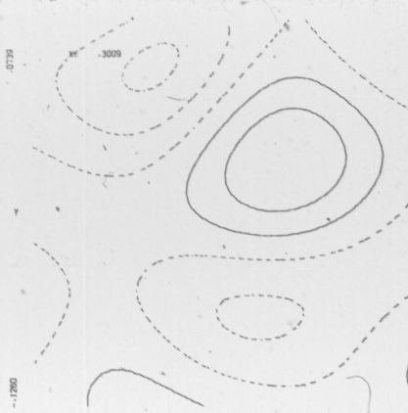
Anomalous Difference Patterson and Fourier Sections
y
H1’
H1’
C1
C1
x
H1
H1
anomalous phases
refined phases
λ₂-λ₃ anomalous difference Patterson, z = ¼ section showing Harker peaks
2 Å Fourier sections through C1 methylene group of EDTA ligand
Notes:
The rms deviation between anomalous and refined phases is 14°.

Slide 7
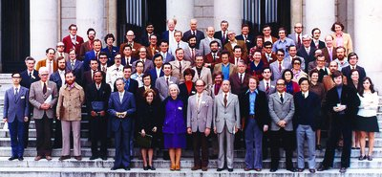
1974 Madrid Inter-Congress Conference
conference participants photographed at the Spanish National Research Council
Notes:
Mention Dorothy Hodgkin, Rudolph Mössbauer, and Arthur Wilson.

Slide 8
Hamilton Seminar Room, Brookhaven National Laboratory, Upton, NY

Slide 9
Transition-Metal Hydrides
Stevens, R. C. et al. J. Am. Chem. Soc. 1989, 111, 3472-3473.

Slide 10
Our First Paper from the BNL-USC Collaboration
Olsen, J.P. et al., J. Am. Chem. Soc. 1974, 96, 6621-6624.
Notes:
Our first paper, published in JACS in 1974. Esd’s on bond distances ca. 0.004 Å! Note that the figure is actually that of HW₂(CO)₁₀⁻

Slide 11
‘Classical’ Hydrides: H Coordination Modes
Notes:
IrH₅[P(i-Pr)₃]₂ – Saeed Khan
[Ph₄P]⁺[W₂H(CO)₁₀]⁻ – Don Hart
Re₂H₈(PEt₂Ph)₄ – Ray Teller
Ni₄H₃(C₅H₅)₄ – Don Hart and Don Tipton
[(Ph₃P)₂N]⁺[Co₆H(CO)₁₅]⁻ – Don Hart, Ray Teller, and C.-Y. Wei

Slide 12
[Pt₂H₂Ph(PEt₃)₄]⁺[BPh₄]⁻
Neutron Structure at 13 K
Solution Equilibrium
Cleavage trans to Hydride
Pt₁…Pt₂ | 3.05(1) Å
∠ Pt₁–H_{b}– Pt₂ | 128(2) °
Albinati, A. et al., Inorg. Chim. Acta 1997, 265, 255-265.
Notes:
Neutron structure carried out with John Ricci and Wim Klooster.

Slide 13
Bis-(η⁵-pentamethylcyclopentadienyl)dicobalt?
Schneider, J. J. et al., Angew. Chem., Int. Ed. Engl. 1991, 30, 1124-1126.

