Slide 1
[Rh₁₃H₂(CO)₂₄]³⁻
Bau, R. et al., Science 1997, 275, 1099-1102.
Notes:
Neutron Diffraction Study at 15 K: The First Accurate Characterization of Five-Coordinate Hydrogen Atoms. 127 independent atoms including the three tetramethyammonium cations and a clathrated meythlethylketone molecule. Refinements based on 11,000 independent F² values. σ(Rh–H) = 0.02 Å. Neutron structure carried out with Mary Drabnis of Bau group and Wim Klooster using crystals prepared by Luigi Garlaschelli in Milan.

Slide 2
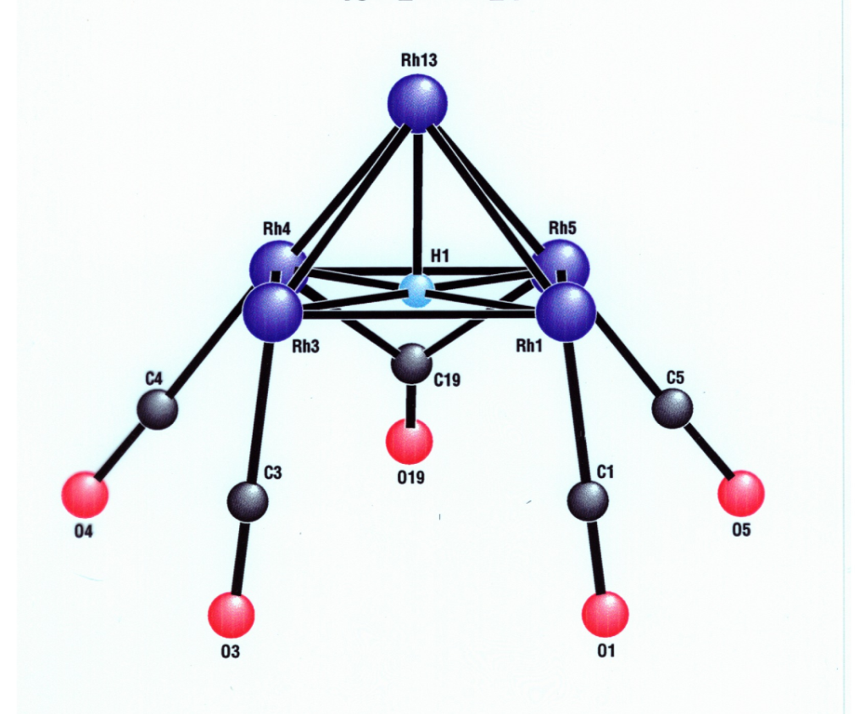
[Rh₁₃H₂(CO)₂₄]³⁻
Five-Coordinate Hydrogen Atoms
Notes:
Positions of bridging hydrides agree with those originally assigned by Albano and co-workers in the 1970’s based on their x-ray structure!

Slide 3
Variation of Rh–H Distance with H Coordination Number
Notes:
Rh–H distance increases with increasing coordination number.

Slide 4
[Y(H)₂(C₅Me₄SiMe₃)]₄.(THF): A Tetrahedral Interstitial Hydride
Yousufuddin, M. et al., Physica B 2006, 385, 231-233.
Notes:
Compound synthesized by Prof. Hou’s group at RIKEN.

Slide 5
η²-Dihydrogen Complexes and H₂ Activation
(Non-Classical Hydrides)

Slide 6
Bonding Schematic

Slide 7
Proton Tunneling

