Slide 1
[Ru(H)(H₂)(PPh₂CH₂CH₂PPh₂)₂]⁺
Albinati, A. et al., Inorg. Chim. Acta 259, 1997, 351-357
Notes:
Neutron structure carried out with John Ricci and Wim Klooster

Slide 2
Inelastic Incoherent Neutron Scattering Proton Tunneling Spectrum
Rotational tunneling barrier 1.0 – 1.4 kcal/mol
Notes:
Unusually broad lines may result from a non-sinusoidal potential with a broad, somewhat flat bottom. Splitting is 3.2 cm⁻¹. IINS with Juergen Eckert.

Slide 3
Fe(H)₂(H₂)(PEtPh₂)₃
Van der Sluys, L. S., et al., J. Am. Chem. Soc. 1990, 112, 4831-4841.
Notes:
Well-resolved tunneling peaks!

Slide 4
IPNS at Argonne National Laboratory
Notes:
HFBR was shut down about the time that we had completed our Rh₁₃ structure.

Slide 5
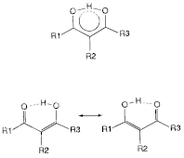
Hydrogen Bonding in Tetraacetylethane (TAE)
resonance assisted hydrogen bonding model
disordered keto-enol tautomers
20 K neutron diffraction study
Piccoli, P. M. B. et al., J. Phys. Chem. A 2008, 112, 6667-6677.

Slide 6
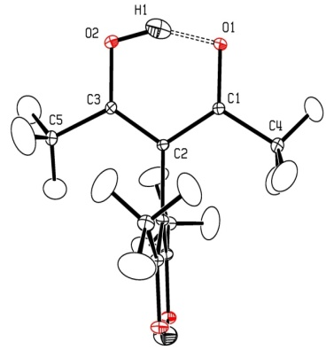
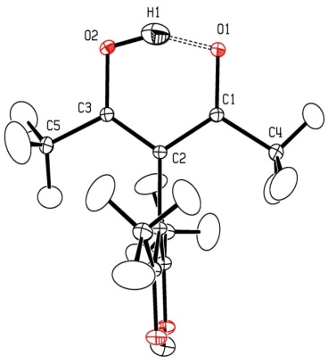
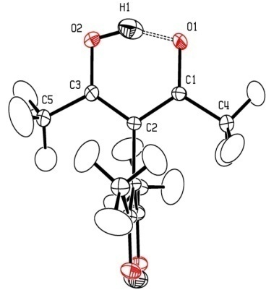
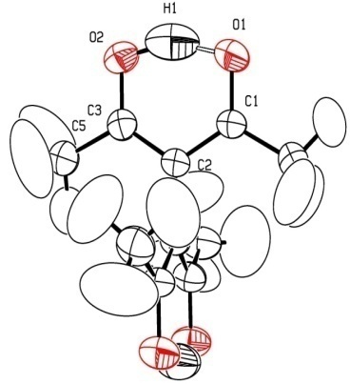
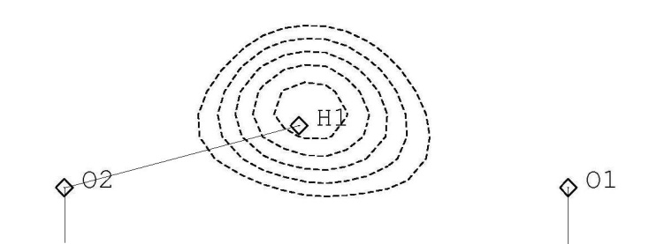
Temperature Dependence of H-Bonding Parameters
40 K
70 K
298 K difference Fourier map with H1 omitted from the structure factor calculation
110 K
298 K
Notes:
Mention work of Chick Wilson, who will be speaking in the Transactions Symposium TR.04 on Tuesday afternoon.

Slide 7
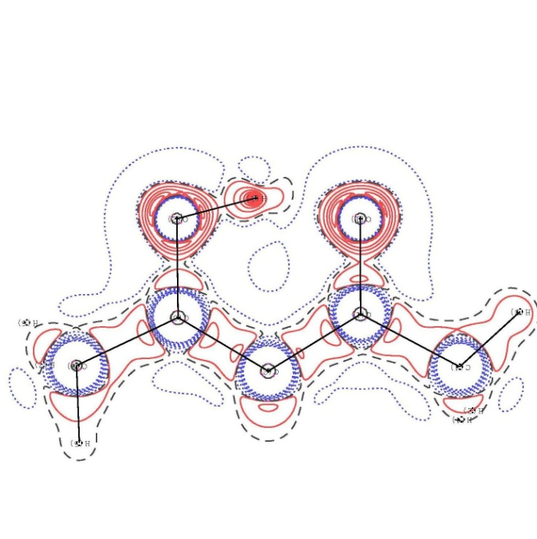
Charge Density Distribution at 20 K – Results of Multipole Refinement
Model Deformation Density
Negative of the LaPlacian
Positive density buildup in red shows where bonding and lone-pair electron density resides in the structure. A localized structure is observed at 20 K.
Positive density buildup in red indicates shared electronic interactions.
Notes:
X-ray charge density work carried out in Alan Pinkerton’s lab.

