Slide 1
Photo, dated 2006, courtesy of Arthur Schultz
Notes:
Photo from 2006 during a helium-3 spin filter test at IPNS SCD. Left to right the people are: Art Schultz, Gordon Jones (Hamilton College), Paula Piccoli, Tom Gentile (NIST), Martha Miller, ???, Ovidiu Garlea (ORNL), and X. (Tony) Tong (Indiana U., now at ORNL).

Slide 2
Flux Increase at Neutron Sources
J-PARC
Notes:
Mention that Garry McIntyre will highlight resent advances in instrumentation at fission reactors in his talk on Monday afternoon.

Slide 3
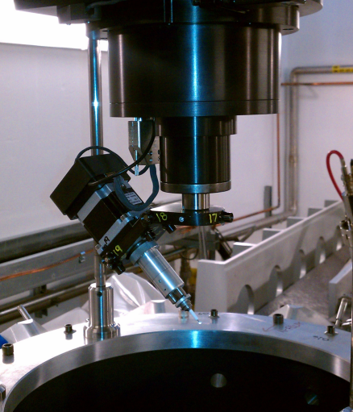
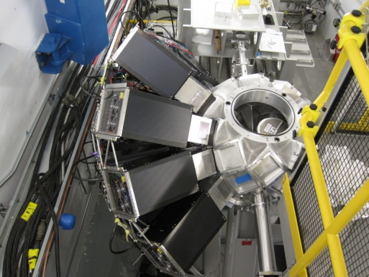
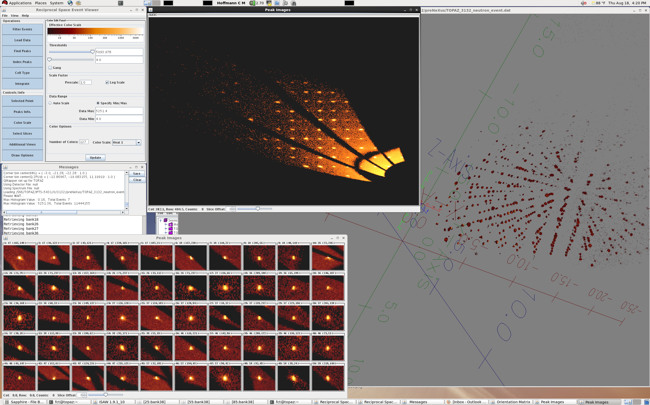
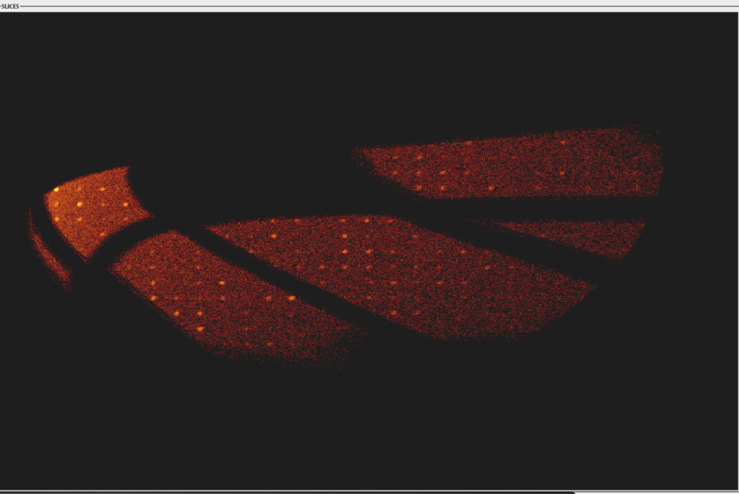
TOPAZ Diffractometer at SNS
Collecting volumes of reciprocal space
TOPAZ is a time-of-flight Laue neutron diffractometer
0.5 – 3.6, (4.2 – 7.3) Å
Super-mirror guide system for neutron transport
Expansive area detector coverage
Systems / Samples:
Small molecules,
Larger molecular systems,
functional materials
Applications:
High resolution Bragg data
Diffuse scattering
Magnetic scattering
Reciprocal space mapping
0.7 – 3 mm diameter sample size
Sample cooling
100 - 450 K (N-cold-stream)
(10 K CCR upgrade path)
Data collection & analysis software:
Real time feedback
Setup data collection
Monitor experiment
Visualize results
GUI based interface
Intuitive use
Example of
reciprocal space view
reciprocal slice view
peak search results
in real time.
Unit Cell: 73.46, 73.46, 99.31, 90, 90, 120
Diffuse scattering
reciprocal slice view for superconductor
reciprocal slice view of (3kl)
λ = 3.8 A – 7.2 A
for macromolecule
Notes:
Call for proposals by July 31, 2013.

Slide 4
Structure of [NiFe]Hydrogenase Active Site Analog Studied on iBIX Diffractometer at J-PARC
iBIX Diffractometer at J-PARC MLF BL03
Ogo, S., et al., Science 2013, 339, 682-684.
Notes:
iBIX = Ibaraki Biological Xtal Diffractometer. Mention Dan Nocera and the hydrogen economy.

Slide 5
IUCr XIX Geneva, 2002 (Photo Courtesy of Prof. Thomas Mak)
Notes:
RB and TFK at the International Congress of Crystallography Banquet, Geneva, Switzerland, 2002.

