Slide 1
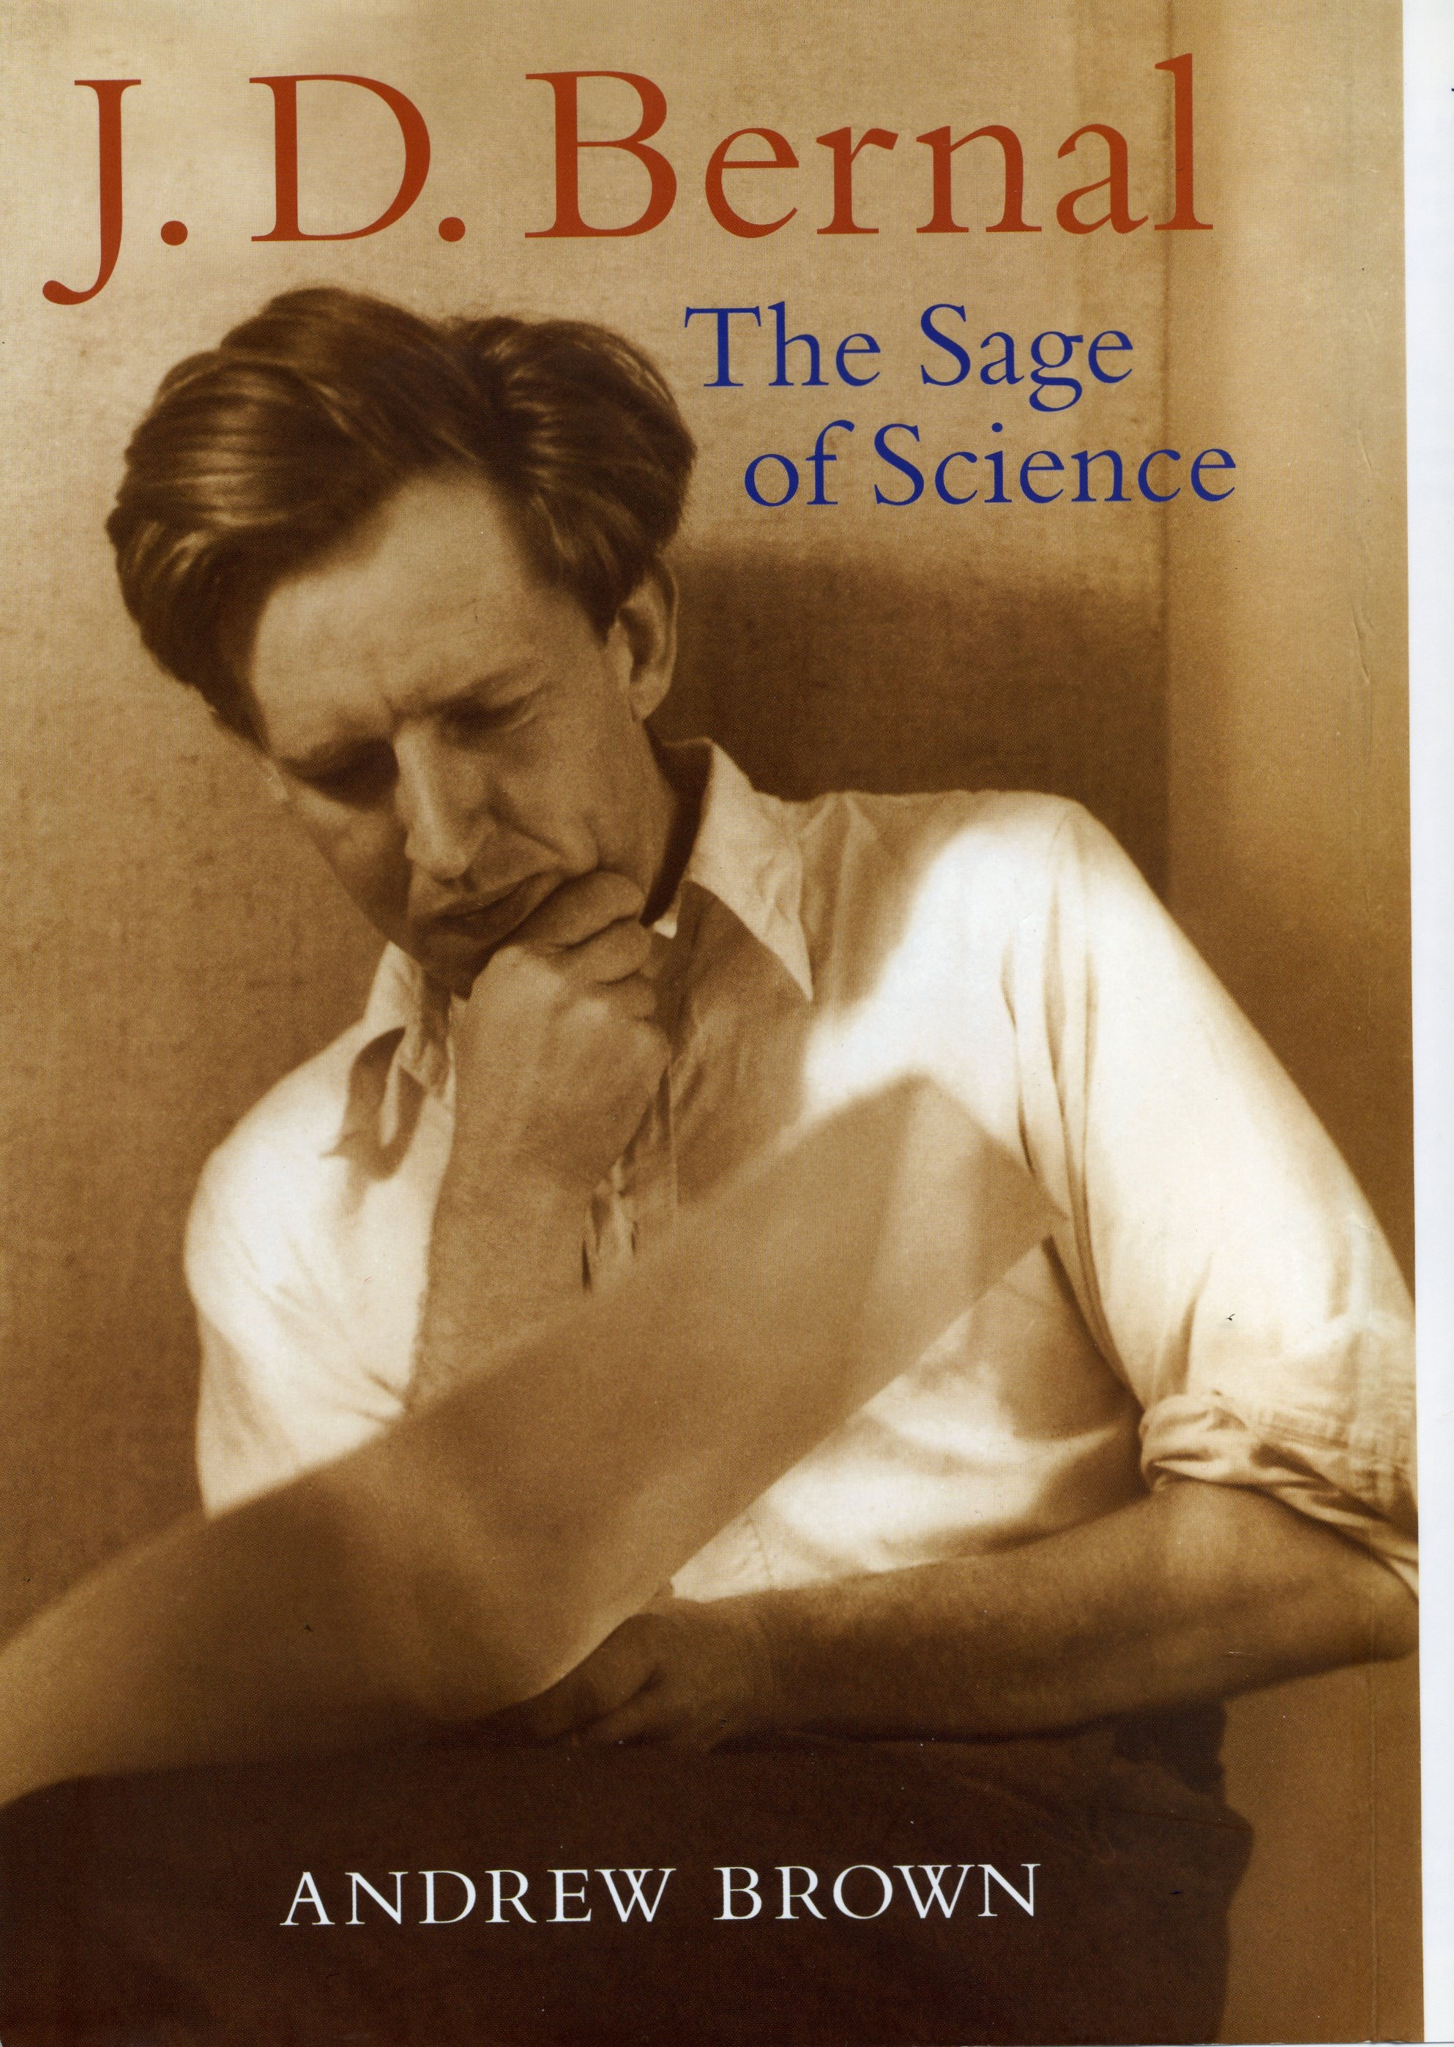
Notes:
While Astbury was being thrilled by alpha and beta keratins in Leeds, J D Bernal was exploring new frontiers as a scientific, political and sexual revolutionary in Cambridge. He was regarded as the brightest intellect in Britain in the 1930s; his friends called him Sage because he knew everything. In 1933, when the pioneering Cambridge photographers Lettice Ramsey and Helen Muspartt captured this pensive image of Bernal, he had just formulated his seminal Theory of Water and Ionic Solutions with R H Fowler. The following year, he invented protein crystallography by keeping protein crystals wet and, with the help of his student Dorothy Crowfoot (later Hodgkin), recorded tantalizing crystal diffraction patterns that promised to reveal the atomic structures of proteins. In 1936, he was joined by his disciples “Fan” Fankuchen and Max Perutz.

Slide 2
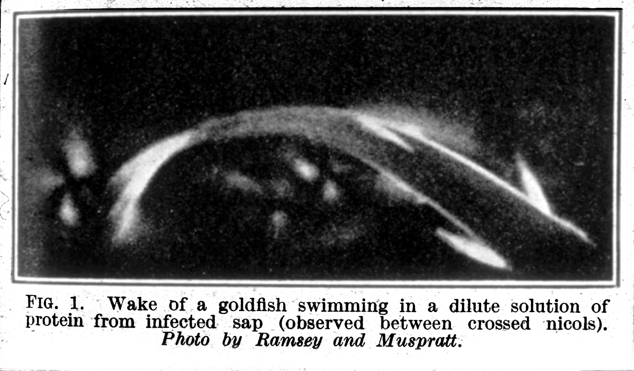
Notes:
In 1936, Bernal began his investigation of the liquid crystalline properties of tobacco mosaic virus solutions.

Slide 3
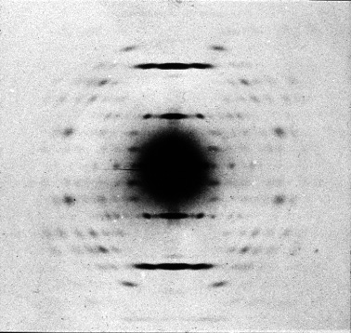
Notes:
But when Fan obtained beautifully oriented liquid crystalline specimens whose diffraction pattern revealed the crystal-like order in the TMV particle, Bernal, with all his genius, could not see the helical symmetry. Seeing the symmetry had to wait for the helical revelations of 1951.
(I. Fankuchen’s 1938 x-ray diffraction pattern of an oriented liquid crystalline specimen of tobacco mosaic virus obtained in collaboration with Sage Bernal.)

Slide 4
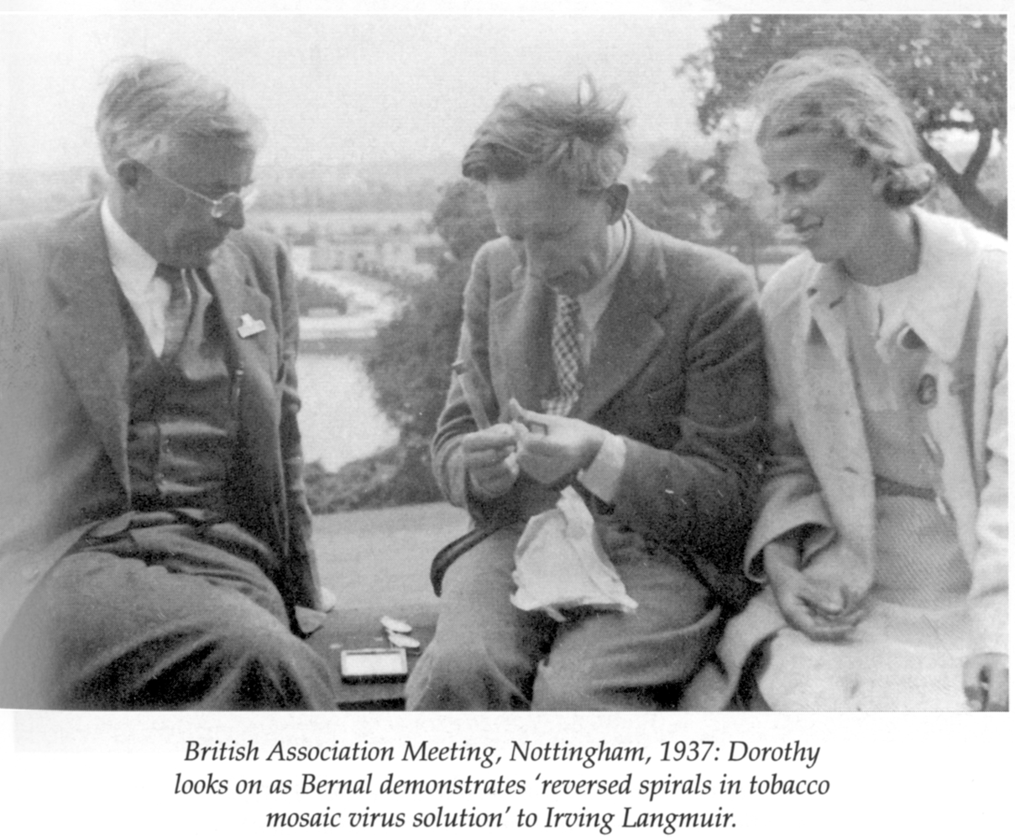
Notes:
Although Bernal could not see the helix in the TMV structure, he made sense of the spiral organization of TMV liquid crystals – here demonstrating to Irving Langmuir while admiring Dorothy Hodgkin looks on.

Slide 5
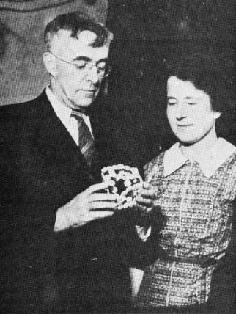
Notes:
In 1938, Langmuir was intrigued with the mathematical elegance of Dorothy Wrinch’s cyclol models for protein structure, which appeared to be in accord with some fashionable numerology about protein amino acid composition. Both cyclols and the numerology were fanciful. But to explain the folding of extended polypeptide chains into the globular forms represented by Wrinch’s cyclols, Langmuir recognized that the driving energy would be provided by removing hydrophobic groups from water. This was in contradiction to Pauling’s notion that it was hydrogen bonds that stabilized the compact form of globular proteins. Pauling and Wrinch were scathing about each other’s ideas – but Pauling went beyond scientific criticism, informing the Rockefeller Foundation that her work was dishonest, which led to termination of her financial support. Bernal recognized the reality of the hydrophobic effect – which only became fashionable two decades later; and he also saw the fanciful nature of Wrinch’s cyclols and Pauling’s polar interactions holding globular proteins together. (Irving Langmuir with Dorothy Wrinch, holding one of her cyclol protein models.)

Slide 6
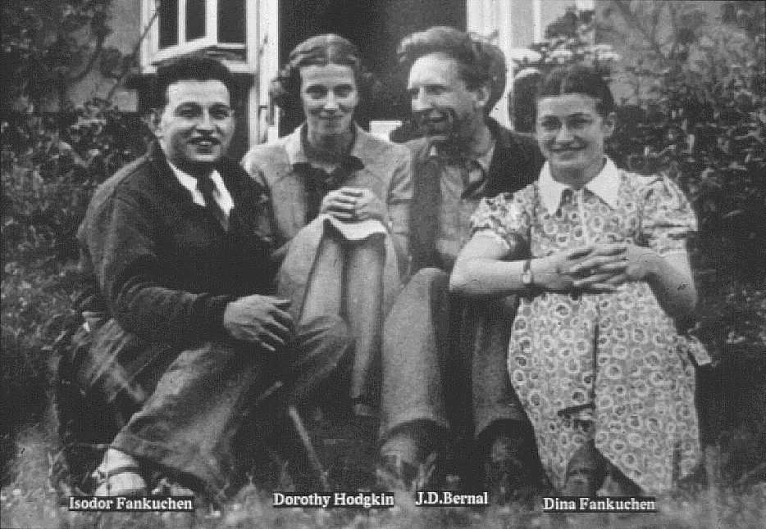
Notes:
This idyllic 1939 photograph in Dorothy Hodgkin’s garden marked the end of an era. Bernal was soon off to the war advising Lord Mountbatten on how to win it. Dorothy Hodgkin turned her attention to penicillin crystallography and Fan and his wife returned to the USA.
(Isidore Fankuchen, Dorothy Hodgkin, J.D. Bernal, Dina Fankuchen)

Slide 7
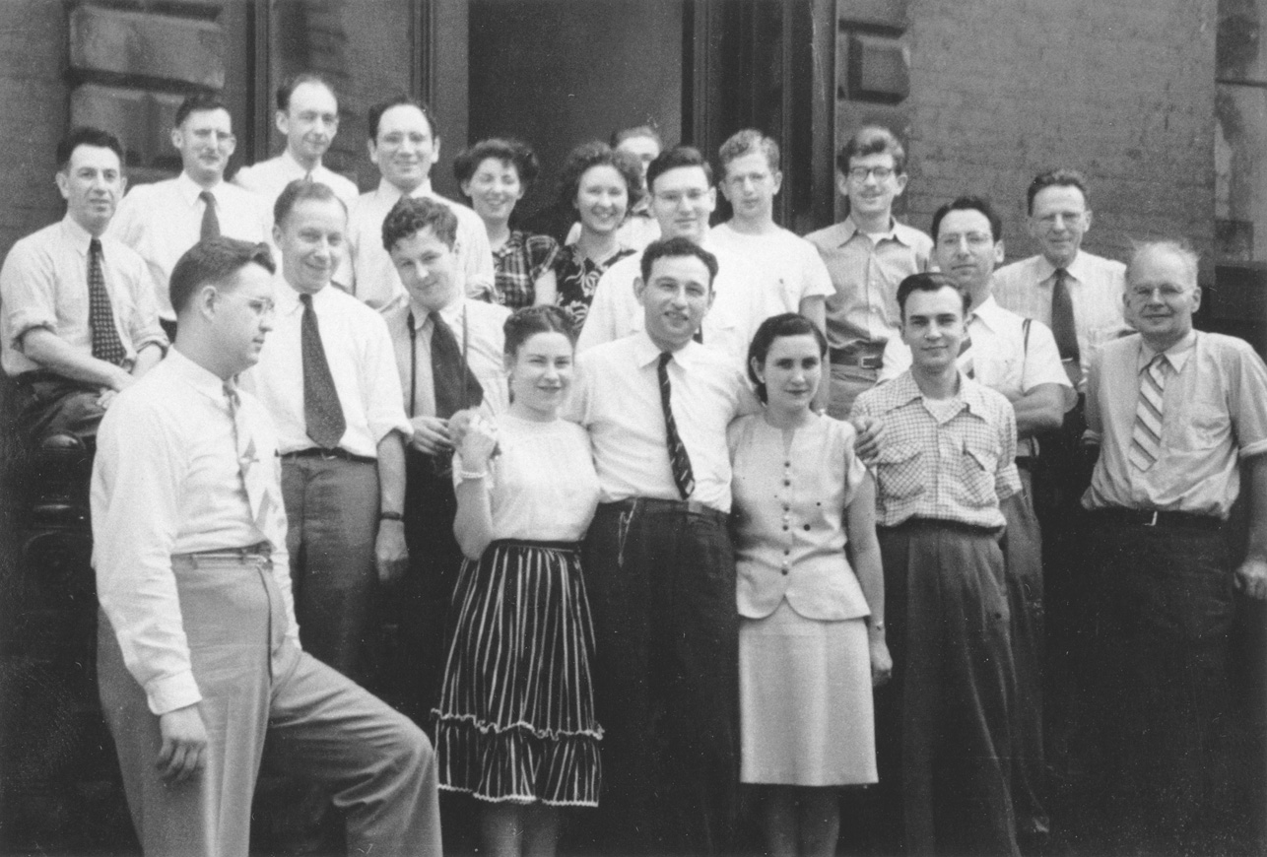
Notes:
Jump to 1947. Fan had become the Apostle of Bernal’s crystallography in the US. Here he is with his class of “two-week wonders” from his summer x-ray diffraction clinic. This was my introduction to x-ray crystallography, just after my Army discharge. More significantly, it was hands-on experience for Prof. John Edsall, a leader in protein physical chemistry, who was convinced that x-ray crystallography was the way to determine protein structures. He was engaged at this time with arranging for Barbara Low, who was in Pauling’s lab at Cal Tech, to come to Harvard to start crystallographic studies on heavy atom derivatives of serum albumin as a way to solve the phase problem. It was the right idea but the wrong protein.
(Isidore Fankuchen, center front row; John Edsall, far right; Ben Post, far left, middle row; Don Caspar, far right, back row.

Slide 8
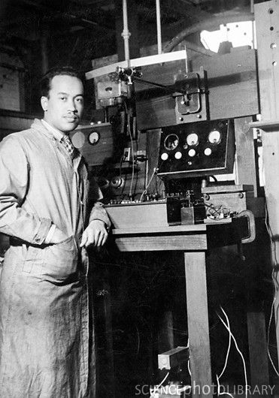
Notes:
As Barbara Low was leaving Pauling’s lab in 1948, Herman Branson, a young physics professor from Howard University, was on his way to Cal Tech for a sabbatical year there. Pauling assigned him the task of building hydrogen-bonded helical peptide models using the Pauling-Corey experimental restraints of planar peptide group and defined bond distances and bond angles. Branson soon produced two helical models –

Slide 9
3.7 residues per turn
5.1 residues per turn
Notes:
One helix with 3.7 residues per turn and the other with 5.1 per turn. Branson recalled that Pauling dismissed these models as “too tight”. When Corey saw them, he is reported to have said “Well I’ll be damned”. Pauling instructed Branson to find some more open models that would allow penetration of water – but with the Pauling-Corey restraints, he could find no loser packing arrangements. In the Spring of 1949, he summarized his results for Pauling and returned to Howard University soon thereafter.
(Herman Branson with his 1948 models.)

Slide 10
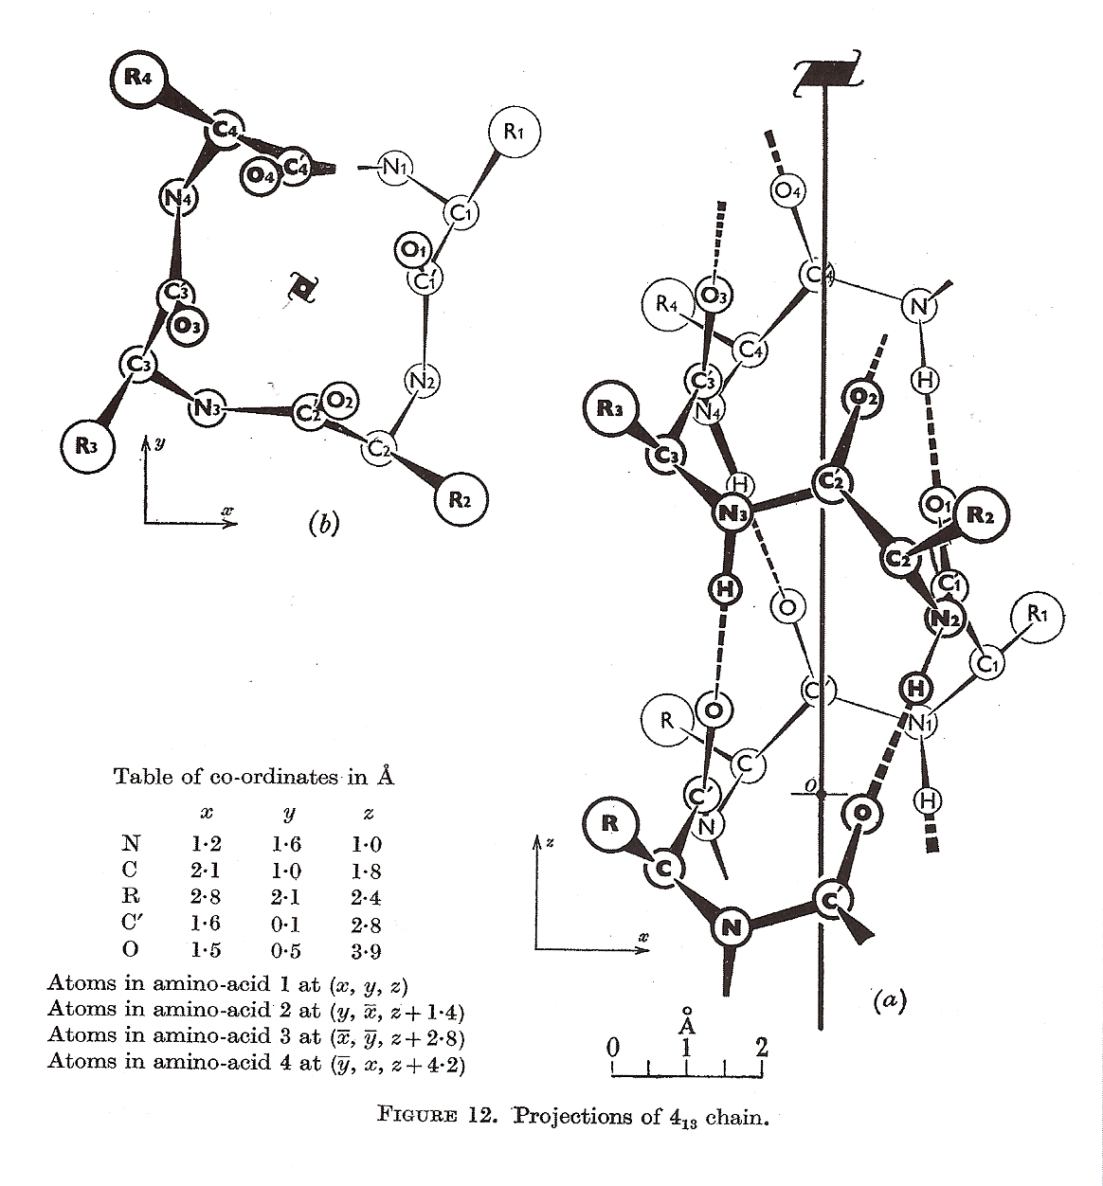
Notes:
4-fold screw model from Bragg, Kendrew & Perutz, Proceedings of the Royal Society of London 203, 321-57, 1950.
Back in Cambridge, England (unaware of Branson’s results in Pauling’s lab) Bragg with Kendrew and Perutz set out to enumerate all possible folded peptide models that might account for Astbury’s 5.15A axial repeat distance indicated the meridional reflection in his alpha keratin diffraction pattern. Imposition of integral screw axes for their helical models was an unfortunate blunder. Their model with a 4-fold screw axis has the topology of Branson’s 3.7 residue helix. The 90 degree rotation and 1.4A translation of 4-fold screw, in contrast to Branson’s ~100 degree rotation and 1.5A translation led to woeful stereochemistry. Bragg later regretted his monumental 1950 polypeptide chain configuration paper with Kendrew and Perutz as the “greatest fiasco” of his scientific career.
Pauling must have gloated when he saw Bragg’s blunder. On October 6,1950 he sent off a draft MS for the PNAS to Branson reporting Branson’s spiral models. On October 13, 1950 Pauling then sent a brief note with Corey as co-author to JACS announcing their discovery of two spiral polypeptide chain configurations, one with 3.7 and the other 5.1 residues per turn. Assistance from Drs. Branson and Weinbaum (who helped with calculations) was acknowledged. This JACS note was published in the November 1950 issue. The MS for the PNAS was finally received on February 28, 1951 with spiral changed to helical to describe Branson’s models.

Slide 11
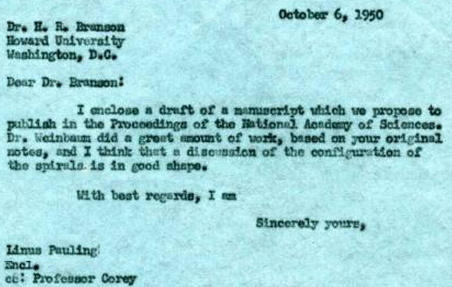

Slide 12
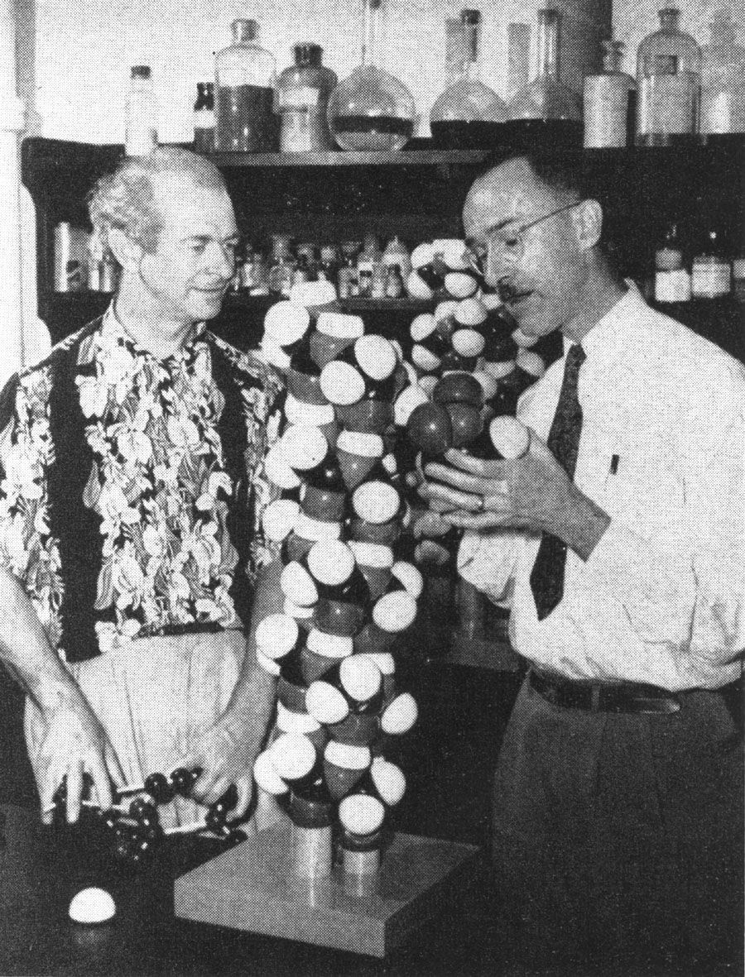
Notes:
Pauling with Robert Corey and the 1951 Pauling, Corey and Branson helix model. Following publication of the Pauling, Corey and Branson PNAS paper in the spring of 1951, Pauling brilliantly promoted the 3.7 residue/turn helix as the structure of Astbury’s alpha class of fibrous proteins and various globular proteins. Soon it was popularly acclaimed as Pauling’s alpha helix and with more careful modeling, the symmetry was adjusted to 3.6 residues/turn.
The 1951 alpha helix was the second embarrassing comeuppance inflicted by the wizard of Pasadena on the inventor of x-ray crystallography.

Slide 13
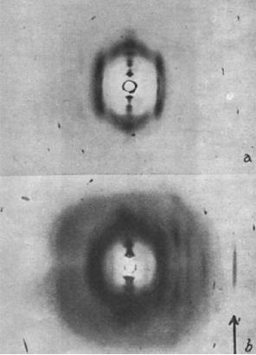
Notes:
Perutz (1998) recalled that in 1951 he "was thunderstruck by Pauling and Corey's paper" (forgetting Branson) and that "The structure looked dead right." He finally realized that none of the helical models could account for Astbury's 5.15A meridional reflexion (although this was why his helices with Bragg were integral). But among all the proposed models, only Branson's 3.7 helix had a 1.5A residue repeat, which predicted a meridional reflexion at this spacing - so he tilted a horsehair, a frog muscle and a synthetic polypeptide fiber and - lo and behold - there was the 1.5A meridional reflexion in every case.
(From M. F. Perutz 1951 paper in Nature.)

Slide 14
Notes:
He wrote to Pauling with pride that his June 30, 1951 Nature paper confirmed the 3.7-residue helix model and Pauling replied that, in one of his papers with Corey (not cited), he had referred to the 1.5A spacing from MacArthur's 1943 Nature paper, indicating he knew all about the 1.5A spot.
(Letter from Pauling to Perutz.)

Slide 15
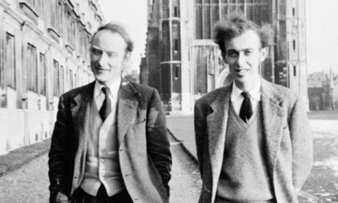
Notes:
Crick and Watson circa 1951.
Later in 1951, Cochran and Crick corrected an inadequate helical diffraction theory initiated by Vand and then showed that the diffraction patterns from a synthetic polypeptide fiber, which has a 5.4A layer line with off-meridional maxima, was accounted for by the alpha helix model.
Also in December 1951, Watson and Crick proudly displayed their three-stranded DNA model with the bases pointing out, which was demolished by Rosalind Franklin, who had established that the phosphates were on the outside. Bragg then declared a moratorium on Watson and Crick's DNA model building; it was not gentlemanly to try to preempt interpretation of the experimental studies on DNA structure in progress in Randall's Lab, which was also supported by the Medical Research Council.

Slide 16
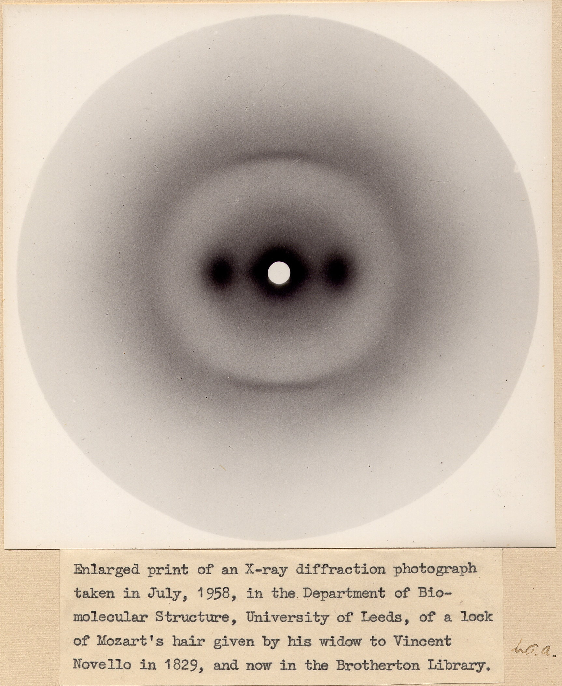
Notes:
Crick then tuned his attention to explaining Astbury's 5.15A alpha pattern meridional reflexion (while Crick was supposed to be finishing his PhD thesis on a variant crystal form of haemoglobin). The result was his ingenious 1952 coiled-coil model,
(Astbury’s alpha keratin x-ray pattern, described in slide 17.)

Slide 17
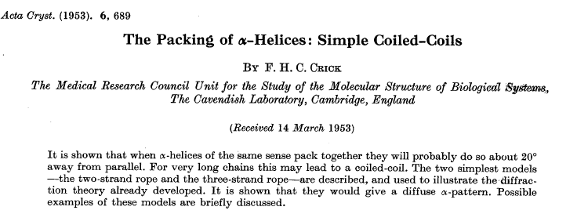
Notes:
followed by his spectacular pair of papers: first his detailed calculation of the coiled-coil diffraction pattern and then his analysis of the knobs-into-holes coiled-coil packing. These papers were received for publication at Acta Cryst on 14 March, 1953 just 19 days before Nature received the Watson and Crick Double Helix bombshell MS. With the coiled-coil there was no photo 51 but Crick with his remarkable genius had calculated his own diffraction pattern in 1953 for two and three stranded models based only on Astbury's 5.15A clue and on his insight into how Branson's helix might pack together.

Slide 18
Notes:
Watson had convinced Bragg in early 1953 that if he lifted his moratorium on Watson & Crick's DNA model building, they might beat Pauling in the race to determine the structure of DNA - the secret of life!! And save Bragg's lab from another embarrassing comeuppance by the wizard of Pasadena! Pauling was a pitiful lame horse in this "race". The real race was to publish an analysis of Franklin's photo 51 before she could. Perutz, who had reasons to be peeved with Pauling, had helped out by passing on to Watson and Crick a report from Randall's lab, which included Franklin's DNA data.

