Slide 1
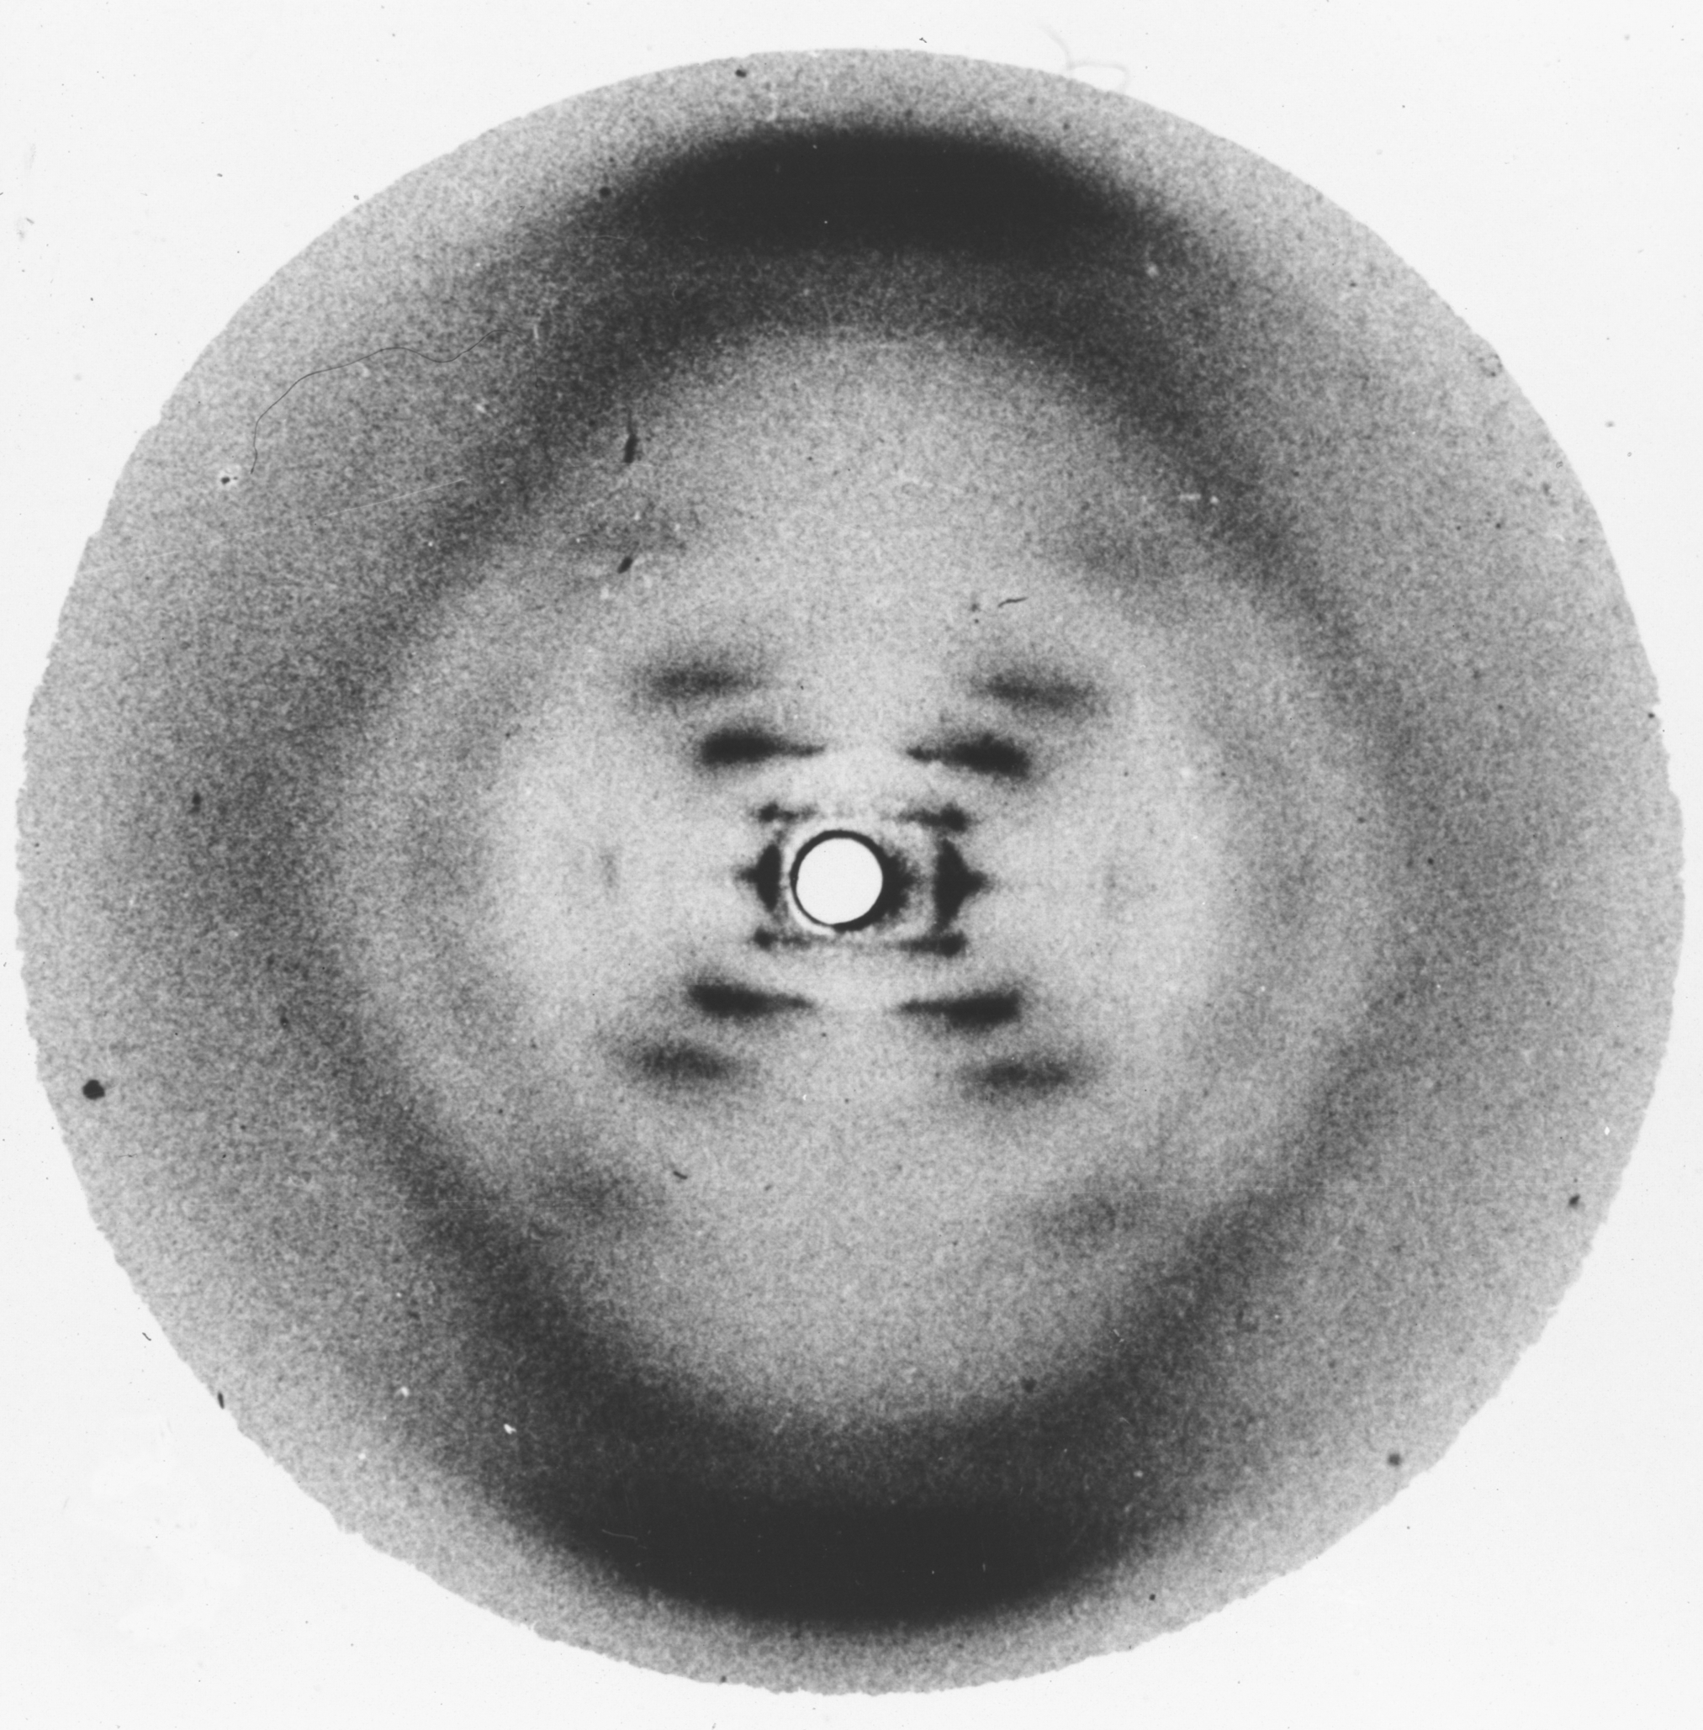
Notes:
Watson with his chauvinist bias insisted Franklin could not interpret her own data,
(Rosalind Franklin’s Photo 51 of B-DNA)

Slide 2
Notes:
Rosalind Franklin’s Photo 51 of B-DNA

Slide 3
Notes:
Rosalind Franklin’s Photo 51 of B-DNA

Slide 4
Notes:
Rosalind Franklin’s Photo 51 of B-DNA

Slide 5
3.4 Å between
base pairs
One full turn
34 Å
Radius
10 Å
Anti-parallel
backbones
Notes:
but she had no problem seeing the double helical DNA backbone in her photo 51.
(DNA helical parameters determined by Franklin.)

Slide 6
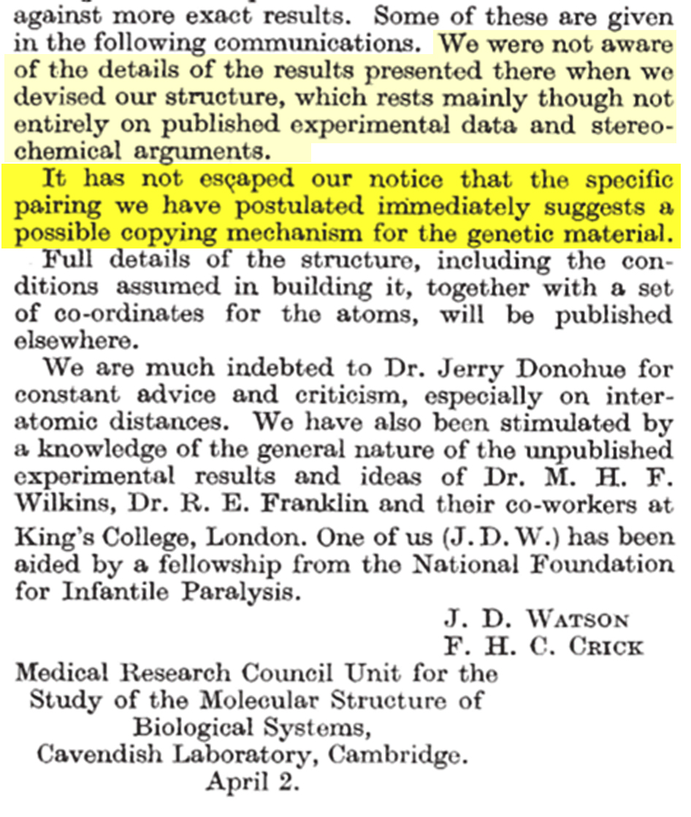
Notes:
Once Watson and Crick had fitted Chagaff's base pairs into Franklin's double helical backbone, the challenge was how to present their model while obscuring where the critical structural data had come from. What had not escaped their notice about the genetic copying mechanism suggested by their base pairing at the conclusion of their brief Nature bombshell was clever distraction.

Slide 7
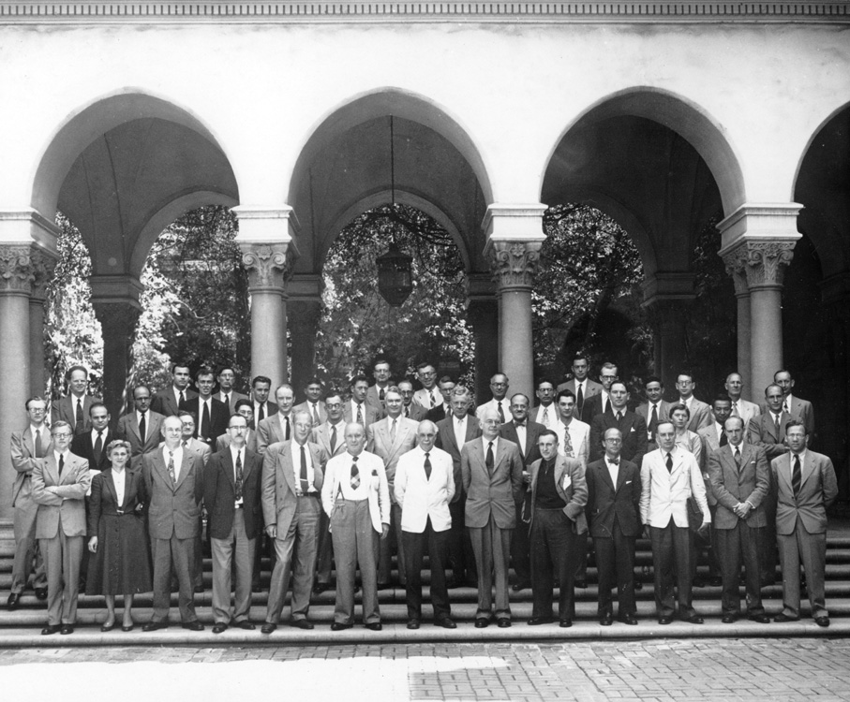
Notes:
Pauling’s September 1953 Protein Conference in Pasadena. The most notable absence was Rosalind Franklin, who was not invited. (Pauling’s listing of participants is at http://osulibrary.oregonstate.edu/specialcollections/coll/pauling/dna/pictures/1953i.19-large.html in which Hugh Huxley is misidentified as Julian Huxley and Vitorrio Luzzati’s name is misspelled. See slide 70, in which the names are indicated on the photo.)

Slide 8
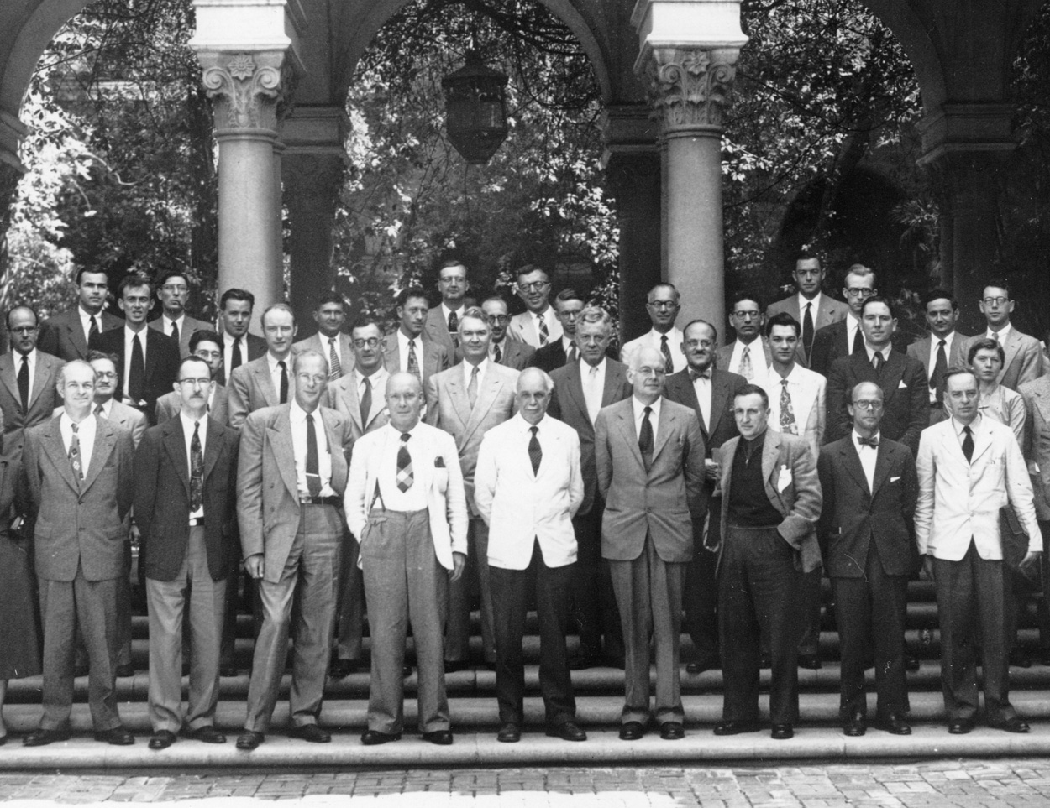
Notes:
Pauling’s September 1953 Protein Conference in Pasadena. See caption for slide 42 for information on names of those who attended.

Slide 9
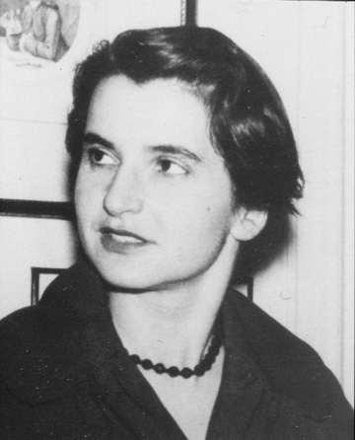
Notes:
Rosalind Franklin at the March 1956 London Ciba meeting on “The Nature of Viruses”, where she reported the correct helical structure of TMV and the location of its RNA chain.

Slide 10
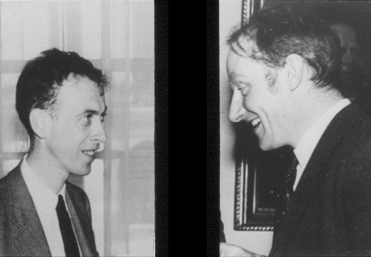
Notes:
Watson and Crick at the March 1956 London Ciba meeting on “The Nature of Viruses”. Crick reported their theory that “spherical” viruses should have cubic symmetry: tetrahedral, octahedral or icosahedral. I (Caspar) had just established that a crystalline virus had crystallographically forbidden icosahedral symmetry.

Slide 11
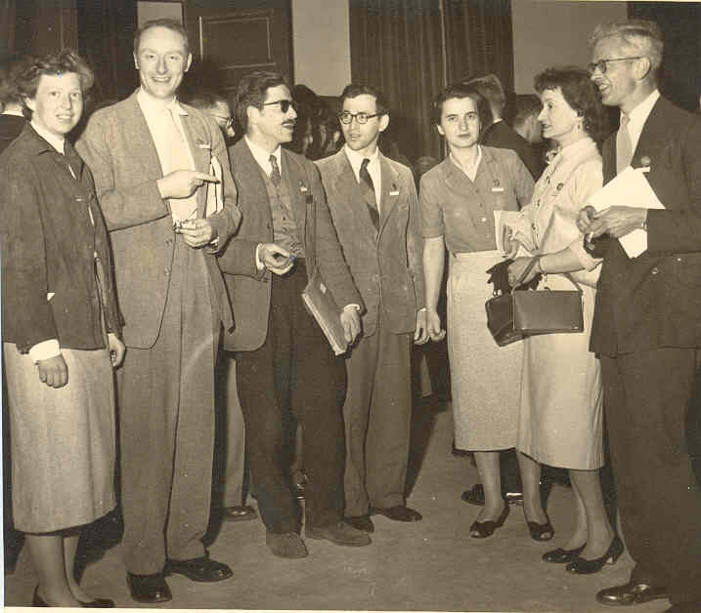
Notes:
April 1956 IUCr Symposium in Madrid. Ann Cullis, Francis Crick, Don Caspar, Aaron Klug, Rosalind Franklin, Odile Crick, John Kendrew.

Slide 12
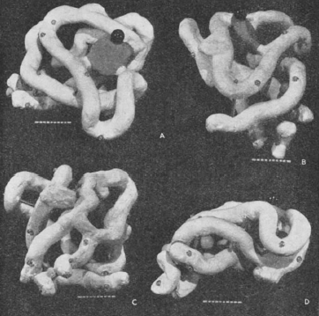
Notes:
Kendrew’s 1958 5.6 Å resolution myoglobin model.

Slide 13
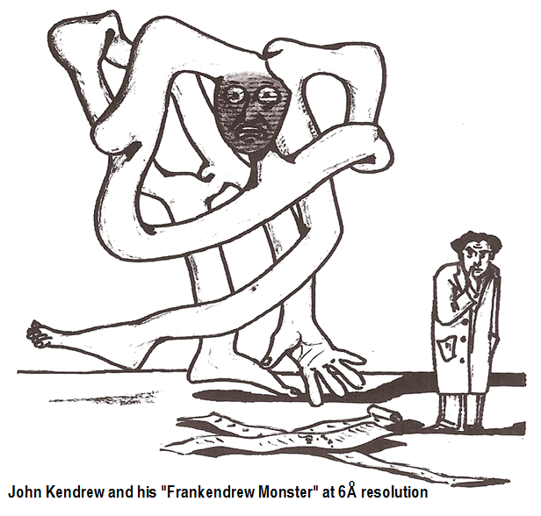
Notes:
Kendrew’s 1958 5.6 Å resolution myoglobin model.

Slide 14
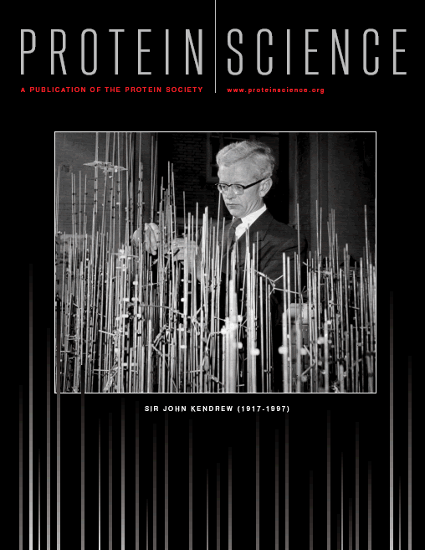
Notes:
The first atomic model of a protein: Kendrew’s 1960 2 Å myoglobin model.

Slide 15
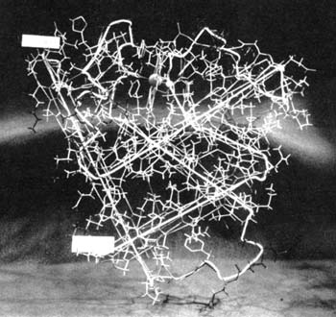
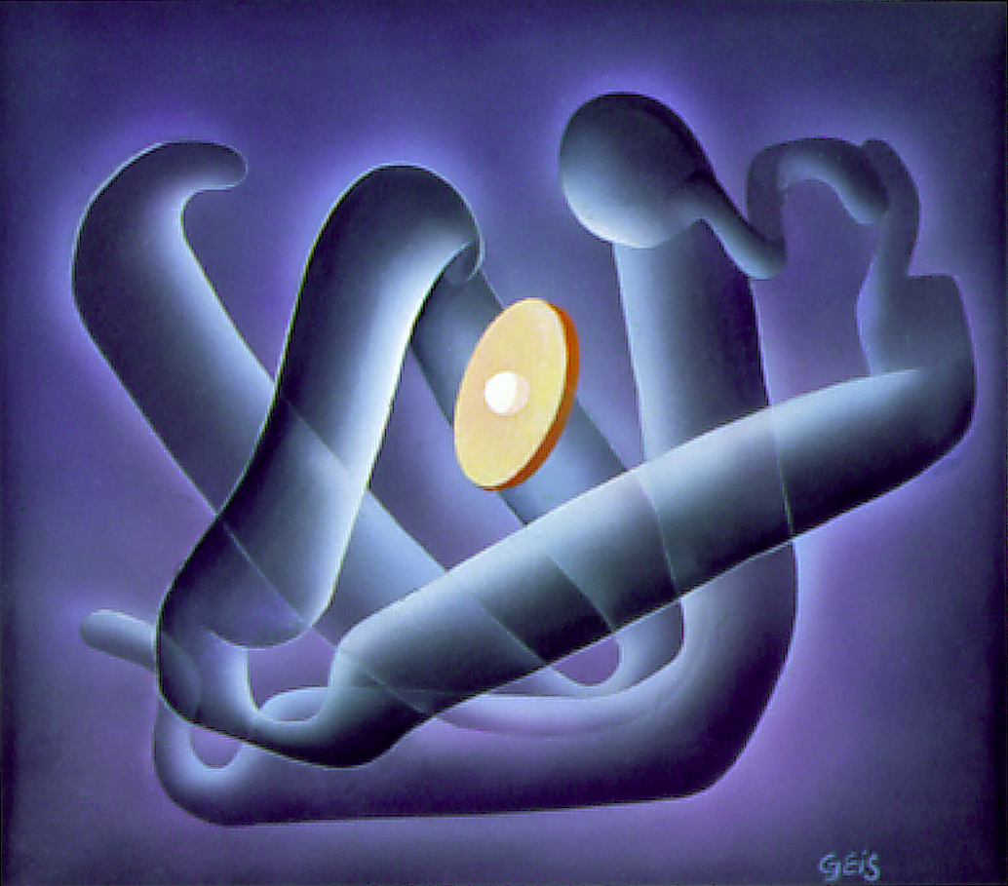
Notes:
The first atomic model of a protein: Kendrew’s 1960 2 Å myoglobin model.

Slide 16
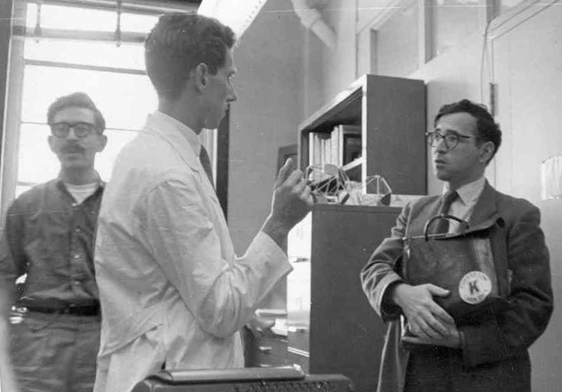
Notes:
At Boston Children’s Cancer Research Foundation Laboratory shared by Caspar and Carolyn Cohen in 1960. Caspar, Ken Holmes, Aaron Klug.

Slide 17
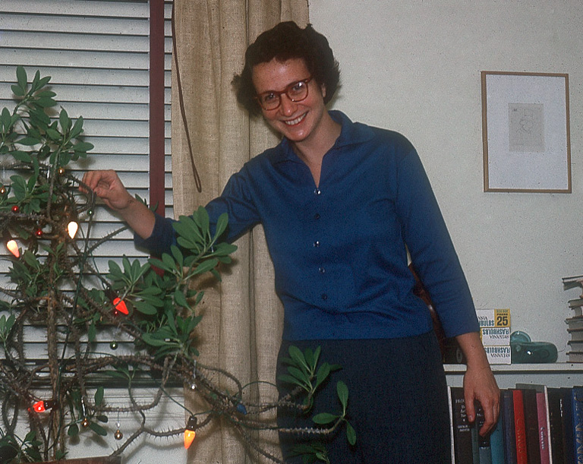
Notes:
Carolyn Cohen, December 1960.

Slide 18
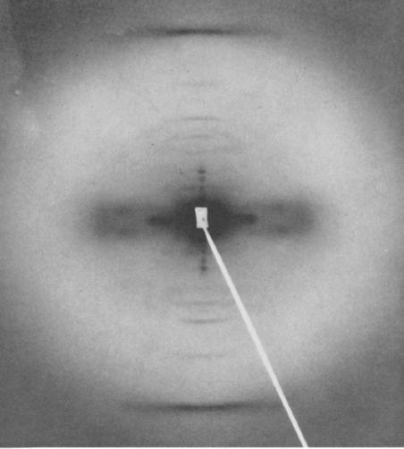
Notes:
First visualization of alpha-helical coiled-coil diffraction pattern predicted by Crick in 1953, obtained by Holmes and Cohen in 1960.

Slide 19
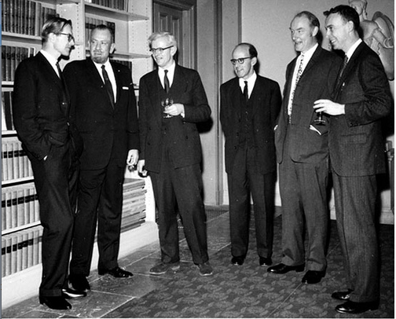
Notes:
1962 Nobel Prizes for DNA and crystalline protein structures and Grapes of Wrath: Wilkins, Steinbeck, Kendrew, Perutz, Crick and Watson.

Slide 20
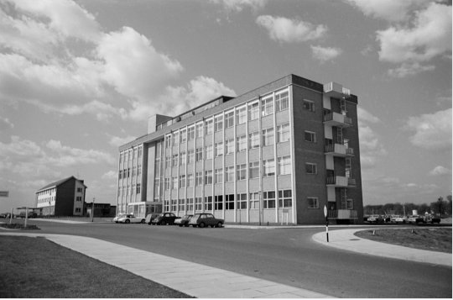
Notes:
The Medical Research Council Laboratory of Molecular Biology, Cambridge, England in 1962, formerly the MRC Unit for the Study of the Molecular Structure of Biological Systems, before it had this new home.

Slide 21
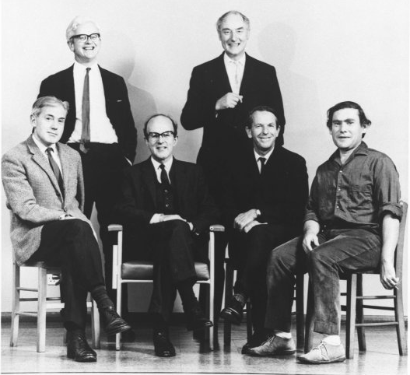
Notes:
Leaders of the new Laboratory of Molecular Biology. Rear: Kendrew and Crick; seated, Huxley, Perutz, Sanger and Brenner.

Slide 22
Notes:
Title page of festschrift for Linus Pauling organized in 1966 for his 65th birthday. (This book is now out of print..)

Slide 23
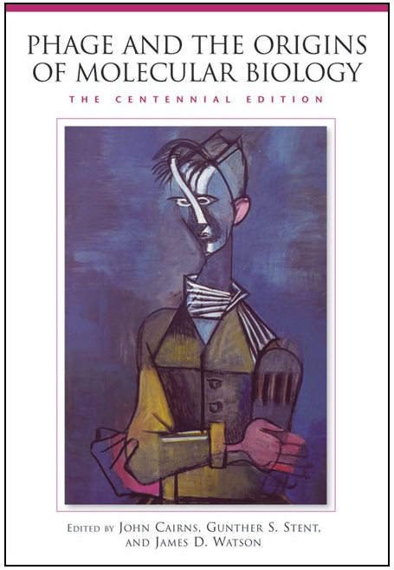
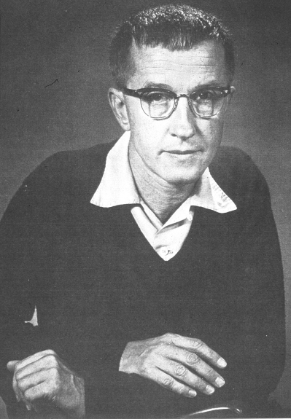
Notes:
Cover of 2006 Centenary Edition of 1966 festschrift for Max Delbrück, born 1906. (This book is still in print.)

Slide 24
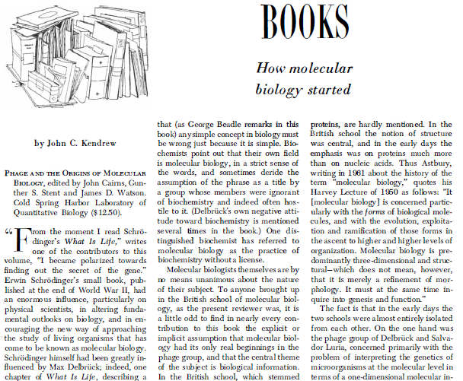
Notes:
John Kendrew’s 1967 review of the Delbrück festschrift “Phage and the Origins of Molecular Biology” from Scientific American.

Slide 25
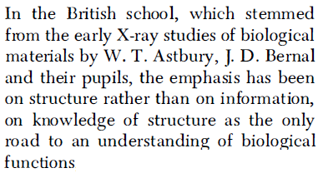
Notes:
John Kendrew’s 1967 review of the Delbrück festschrift “Phage and the Origins of Molecular Biology” from Scientific American.

Slide 26
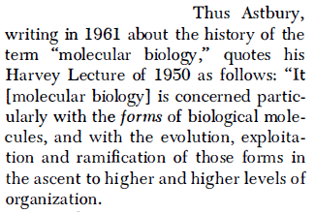
Notes:
John Kendrew’s 1967 review of the Delbrück festschrift “Phage and the Origins of Molecular Biology” from Scientific American.

