Slide 1
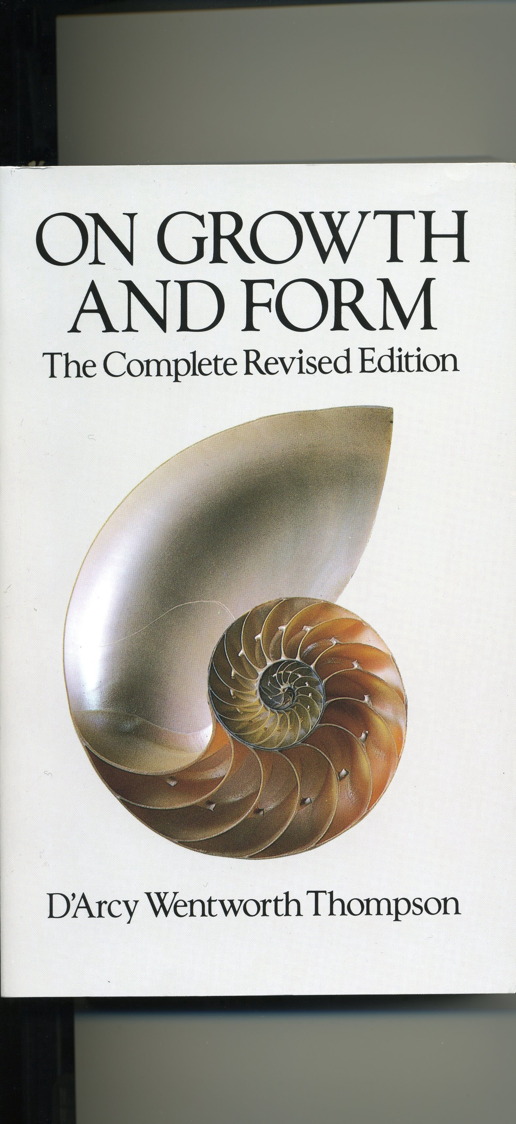
Notes:
D’Arcy Thompson’s “On Growth and Form.” First Edition 1917, revised 1942, still in print. This book is all about biological structures, but not at the molecular level.

Slide 2
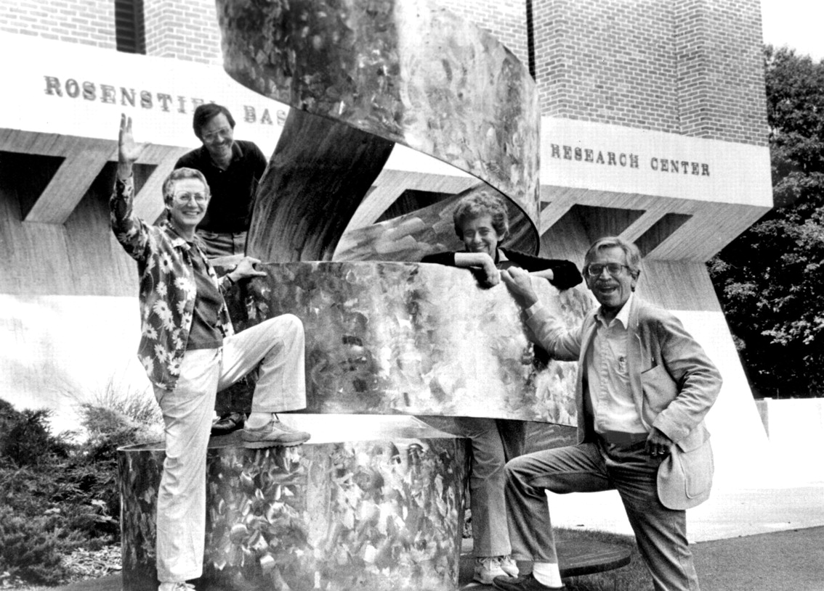
Notes:
First Laboratory to be called “Structural Biology” established at the Rosenstiel Center, Brandeis University in 1972. (The name was coined by Caspar in 1970 following the influence of Kendrew, Astbury and D’Arcy Thompson.) Carolyn Cohen, David DeRosier, Susan Lowey and Caspar.

Slide 3
W.L. Bragg: “…science is unlike the arts, where the value of original thought is often enhanced by time. Science is like a coral reef, alive only on the growing surface.”

Slide 4
David Ben Gurion: “Anyone who believes you can’t change history has never tried to write his memoirs.”

Slide 5
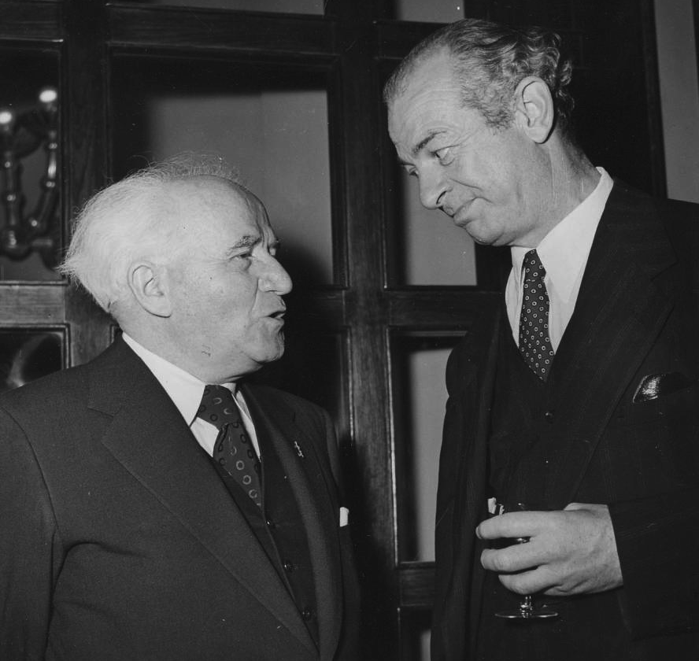
Notes:
David Gen Gurion and Pauling at the King David Hotel in Jerusalem, November 5, 1953

Slide 6
the end
of my story
of the beginning
of structural biology

Slide 8
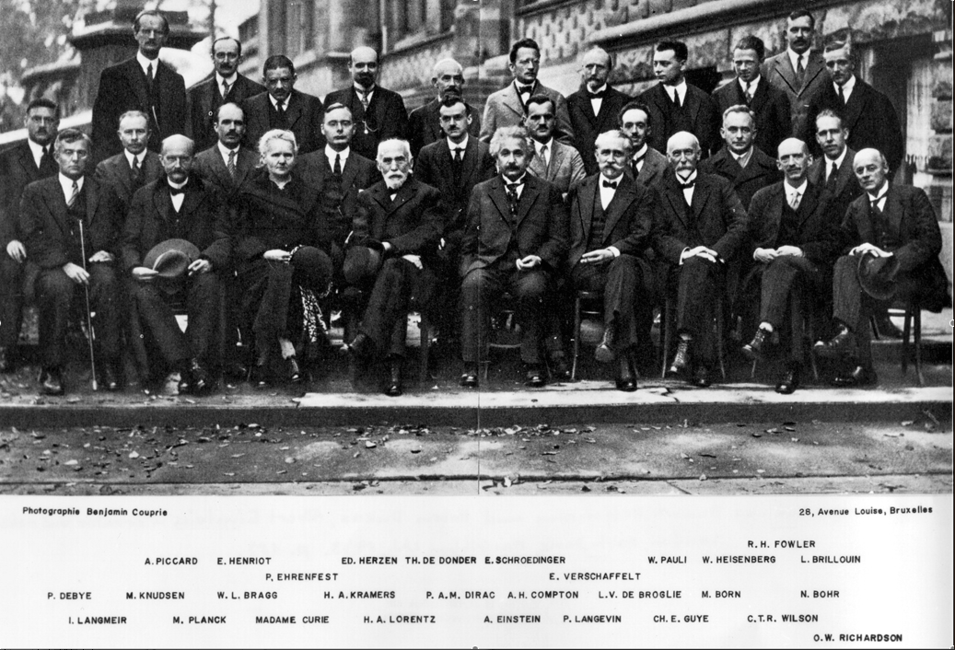
Notes:
Irving Langmuir is the correct spelling.

