Slide 1

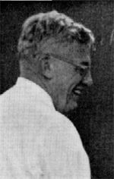

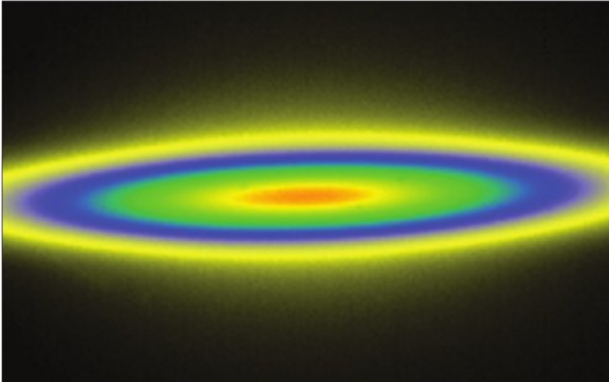
ACA Patterson Award Lecture 2014
Synchrotron radiation macromolecular crystallography: instrumentation, methods and applications
John R Helliwell
Notes:
From the ACA Newsletter Spring 2014:-
“The ACA 2014 Patterson Award will be given to University of Manchester Emeritus Professor John Helliwell, currently the Co-Editor of J. Appl. Cryst. and Joint Main Editor of Crystallography Reviews. The photo on the cover shows him inside the SRS 7.2 radiation protection ‘hutch’ leaning on the vacuum beam pipe between the monochromator and the crystal sample camera.1(See also the summer, 2013, ACA RefleXions when the award was announced.) Above, the apocrustacyanin A1 dimer showing bound Xe atoms in cyan and disulfide bonds in yellow was solved with softer x-rays and their enhanced anomalous scattering signals.2 United States crystallographers that John especially appreciated collaborating with are, at left: Vivian Stojanoff;3 center, Michael Rossmann;4 and below him Steve Ealick;5 on the right side, from the top: Britt Hedman, and Keith Hogdson;6 Keith Moffat;7 Howard Einspahr;8 and Charlie Bugg.5,9
For many years John studied protein crystal perfection at SRS, ESRF and NSLS. At NSLS he collaborated with Vivian Stojanoff as well as with students Eddie Snell, now at Buffalo and Titus Boggon, now at Yale.3 Another former student, Ashley Deacon, now at Stanford, worked on the 0.94Å data collection of concanavalin A at MacCHESS. John has served on or chaired various advisory and board panels to review and/or develop synchrotron projects, and in later years also neutron projects. He worked closely with many colleagues, among them Wayne Hendrickson and Denny Mills (APS SAC); Gerd Rosenbaum and B C Wang (SERCAT SAC); Don Bilderback and Bob Sweet (MacCHESS SAC); and Art Schultz (ORNL MANDI). One of John’s current interests is neutron Laue diffraction. During the last two decades an interesting synergy between synchrotron radiation and neutron crystallography developed involving the application of Laue diffraction. The use by the neutron facilities at the Institut Laue Langevin (ILL), at LANSCE (Paul Langan) and most recently at Oak Ridge (Dean Myles) of the Daresbury Laue diffraction images analysis package11 has led to its use in many neutron protein crystal structures. The most productive instrument in PDB depositions was the SRS wiggler 9.6,12 and it was used extensively.2,6,7,11
1) J.R. Helliwell, T.J. Greenhough, P. Carr, S.A. Rule, P.R. Moore, A.W. Thompson & J.S. Worgan, (1982) J. Phys.E. 15, 1363-1372.
2) M. Cianci, P.J. Rizkallah, A. Olczak, J. Raftery, N.E. Chayen, P.F. Zagalsky & J.R. Helliwell, (2001) Acta Cryst D57, 1219-1229.
3) T.J. Boggon, J.R. Helliwell, R.A. Judge, A. Olczak, D.P. Siddons, E.H. Snell & V. Stojanoff, (2000) Acta Cryst. D56, 868-880.
4) M. G. Rossmann & J. W. Erickson, J Appl Cryst (1983) 16, 629-636
5) S.E. Ealick, S.A. Rule, D.C. Carter, T.J. Greenhough, Y.S. Babu, W.J. Cook, J. Habash, J.R. Helliwell, J.D. Stoeckler, R.E. Parks Jr., S. Chen & C.E. Bugg, (1990) J. Biol. Chem. 265, 1812-1820.
6) B. Hedman, K.O. Hodgson, J.R. Helliwell, R. Liddington & M.Z. Papiz, PNAS.USA (1985) 82, 7604-7607.
7) D.W.J. Cruickshank, J.R. Helliwell & K. Moffat, Acta Cryst. (1987) A43, 656-674.
8) H. Einspahr, K. Suguna, F.L. Suddath, G.Ellis, J.R. Helliwell and M.Z. Papiz, Acta Cryst. (1985) B41, pp. 336-341.
9) C.E. Bugg, W.M. Carson & J.A. Montgomery, Scientific American, December 1993, 92-98.
10) A.J.K. Gilboa, D.A.A. Myles, J. Habash, J. Raftery & J.R. Helliwell, (2001) J. Appl. Cryst. 34, 454-457.
11) J.R. Helliwell, J. Habash, D.W.J. Cruickshank, M.M. Harding, T.J. Greenhough, J.W. Campbell, I.J. Clifton, M. Elder, P.A. Machin, M.Z. Papiz, & S. Zurek, (1989) J. Appl. Cryst. 22, 483-497.
12) J.R. Helliwell, M.Z. Papiz, I.D. Glover, J. Habash, A.W. Thompson, P.R. Moore, N. Harris, D. Croft and E. Pantos, Nuclear Instrum. and Methods. (1986) A246, 617-623. “

Slide 2
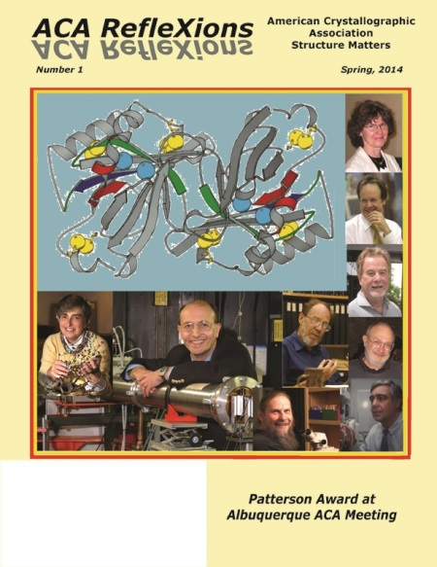
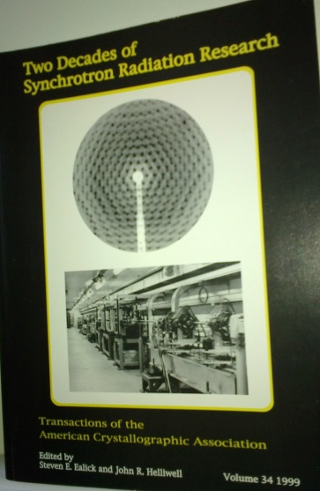

Thank you to the ACA for this
Patterson Award!
I share your vision and world view

Slide 3
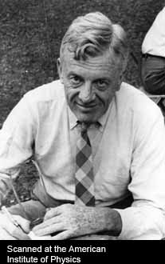
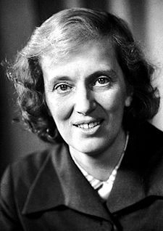
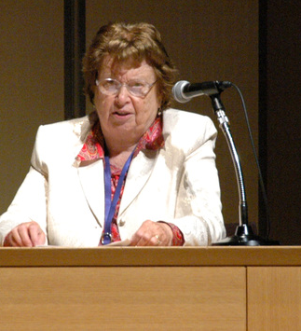

Dorothy Hodgkin on Patterson
“Patterson obtained a fellowship to go and work with
W H Bragg in London. His supervisor said that he should
alter his ways and work hard to represent the USA well.
When he arrived W H Bragg said:- “of course besides
work do enjoy yourself!”
Quoted from “Patterson and Pattersons” Edited by J P Glusker et al OUP

Slide 4
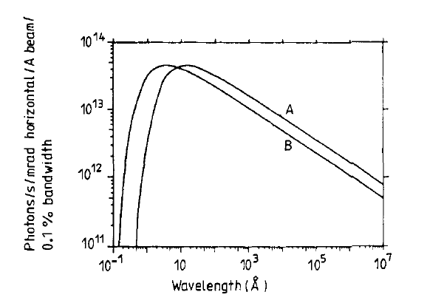
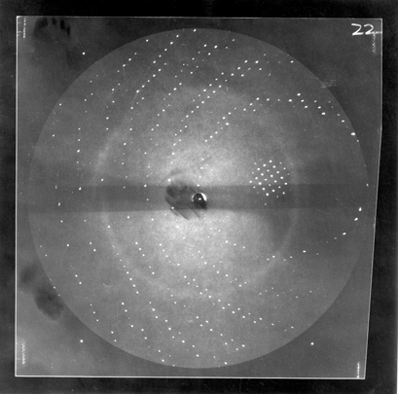
SRS PX 7.2 on the first dedicated SR X-ray source: also ensuring tuneable λ (1.2 to 2.6 Å)
Helliwell, Greenhough, Carr, Rule, Moore, Thompson & Worgan J Phys E 1982 SRS 7.2
Inspired by Keith Hodgson et al 1976 and Gerd Rosenbaum and Ken Holmes 1971
BM 1.2T
SCW 4.5T
λ=2.6 Å
I had explored gradually using longer wavelengths:- 1.488Å, 1.739Å, 1.86Å , 2.0Å, 2.6 Å.
Helliwell (1984) Reports on Progress in Physics 47, 1403-1497
I had explored gradually longer wavelengths:- 1.488Å, 1.739Å, 1.86Å , 2.0Å ...
[Helliwell (1984) Reports on Progress in Physics 47, 1403-1497. ]

Slide 5
Even though the initial SRS was not that well suited to crystallography, especially with its horizontal source size of 14mm, initially I could get 20 times the home Lab intensity, as well as being fully tuneable. The addition of the vertically focussing mirror brought us up to x100 times.
So we got our first SRS PX users, UK and international, and exciting results>>>

Slide 6
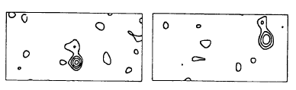
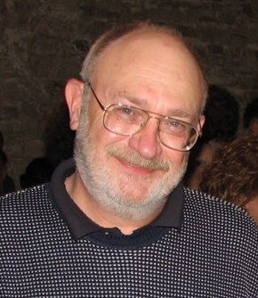
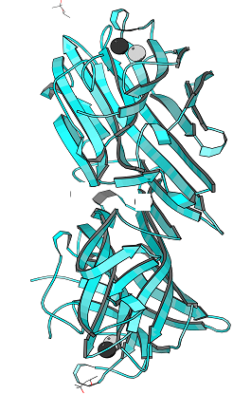
H. Einspahr, K. Suguna, F.L. Suddath, G.Ellis, J.R. Helliwell and M.Z. Papiz 'The location of the Mn:Ca ion cofactors in pea lectin crystals by use of anomalous dispersion and tunable synchrotron X-radiation'. Acta. Cryst. (1985) B41, pp. 336-341.
An early expt: In pea lectin Howard Einspahr wanted to know ‘which was Mn and which was Ca?’; the Mn K edge was accessible on SRS 7.2 at 1.896 Å; lets go for it!
Calcium ion (weak anomalous peak)
Protein subunit A
Protein subunit B
Manganese ion (strong anomalous peak)
Howard Einspahr
Alabama

Slide 7
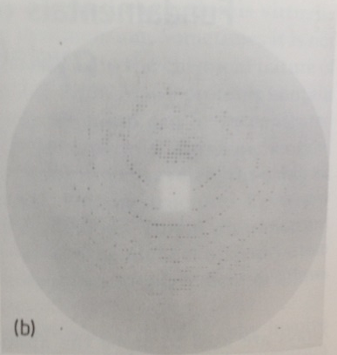
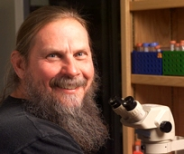
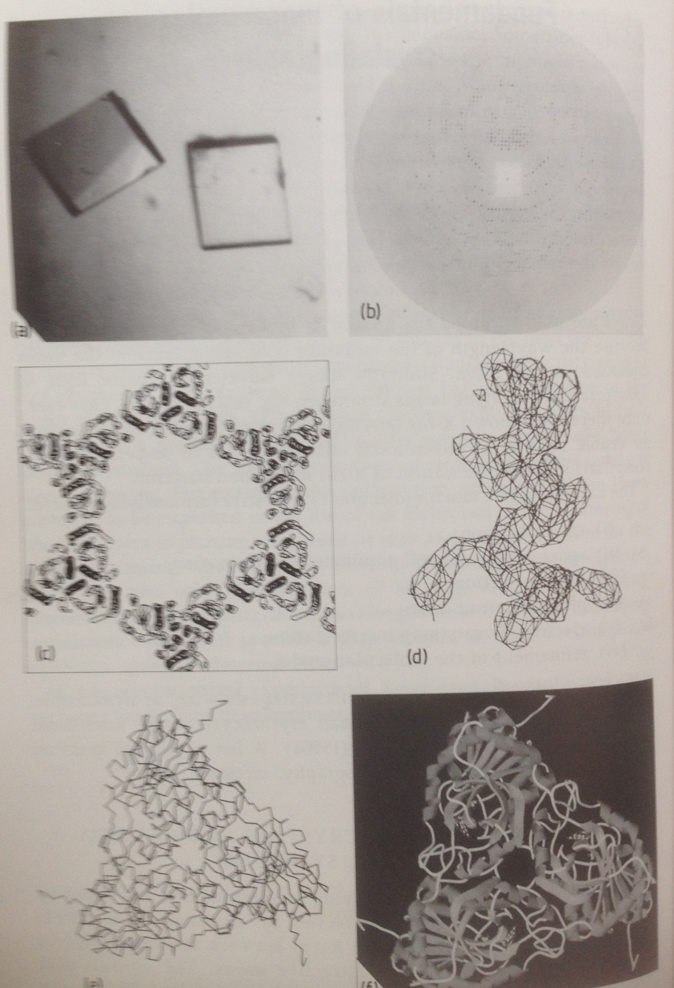
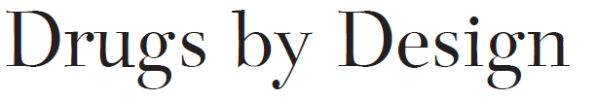

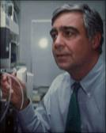
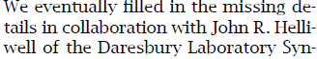
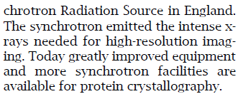
Purine nucleoside phosphorylase; the challenge of 80% solvent content in the crystal overcome at SRS 7.2
Steve Ealick
Charlie Bugg;
UAB Prof and CEO
Biocryst Pharmaceuticals

Slide 8
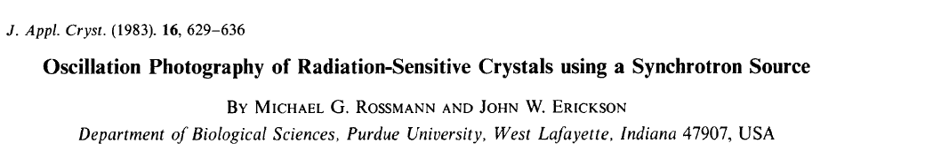
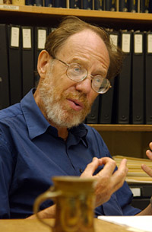
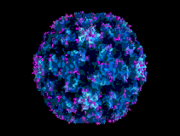
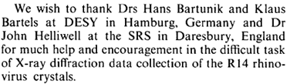
Virus structures; a key step involved the methods…
SRS Station 7.2 and Hamburg ‘DESY’:-
Prof M G Rossmann, USA;
1985 human rhinovirus-14, HRV-14; the rhinovirus structure was finally based on diffraction data measured at MacCHESS.

Slide 9
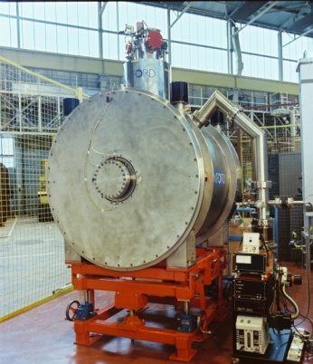
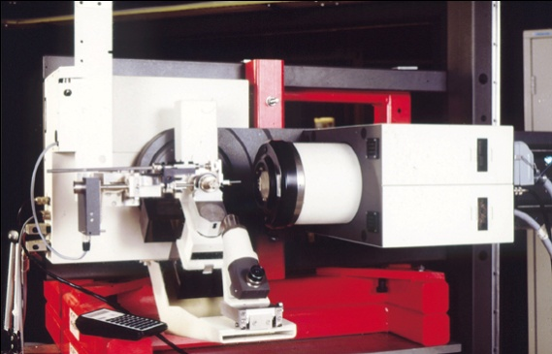
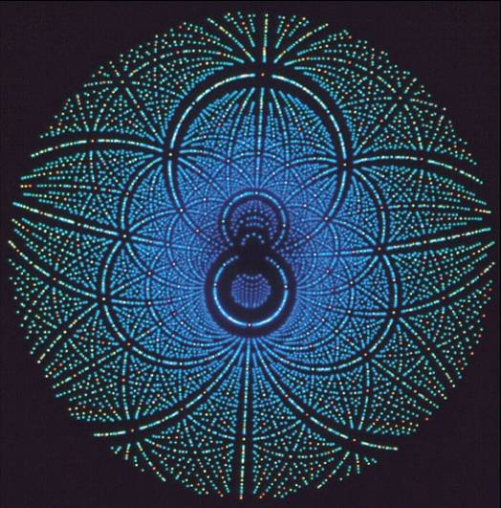
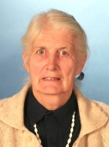
Next up: SRS PX 9.6 tuneable λ (0.6 to 1.5Å)
As well as film we broke new ground with the Enraf Nonius FAST TV diffractometer; this was the design of Uli Arndt & is shown installed on SRS 9.6
S.J. Andrews..M M Harding
'Piperazine Silicate (EU-19) - The structure of a very small crystal determined with synchrotron radiation'. Acta. Cryst. B44, 73-77 (1988)
Helliwell et al NIM (1986) A246, 617-623.
Marjorie Harding’s work on SRS 9.6 led onto SRS 9.8, SRS16.2 and DLS I19
Pea lectin Laue tests
Notes:
3

Slide 10
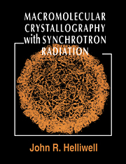
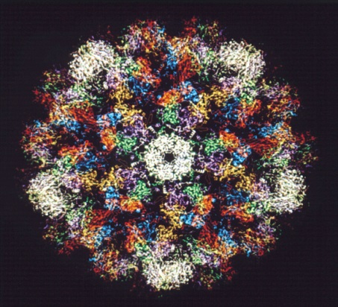
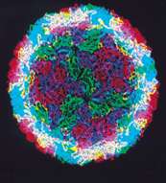
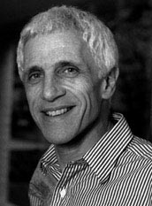
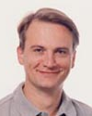
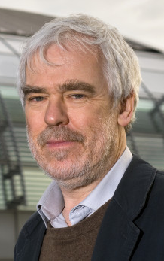
Virus crystallography at SRS 9.6
FMDV
SV 40 virion
Steve Harrison & Bob Liddington et al Harvard
using data measured at SRS 9.6 and CHESS
David Stuart

Slide 11

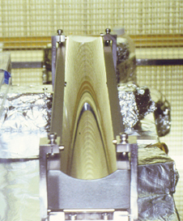
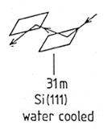
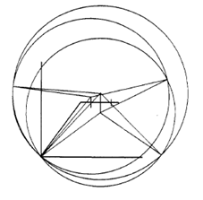
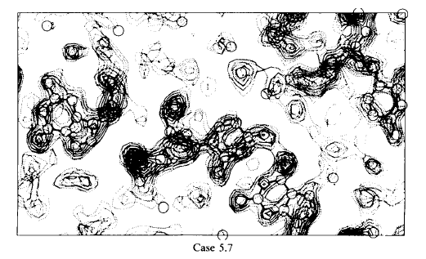
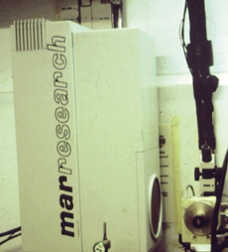
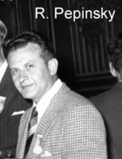
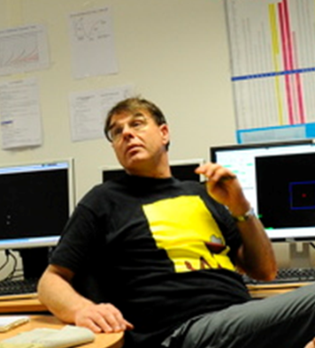
Next up SRS 9.5; focussed & rapidly tuneable X-ray beam & an IP
Sweden
Two wavelength phasing of a brominated oligonucleotide
Peterson, Harrop, McSweeney, Leonard, Thompson, Hunter and Helliwell
1996 JSR 3, 24-34
Helliwell 1979 based on Okaya and Pepinsky 1956
Andy Thompson
But we were short of intensity on SRS 9.5; this led naturally on to ESRF

Slide 12
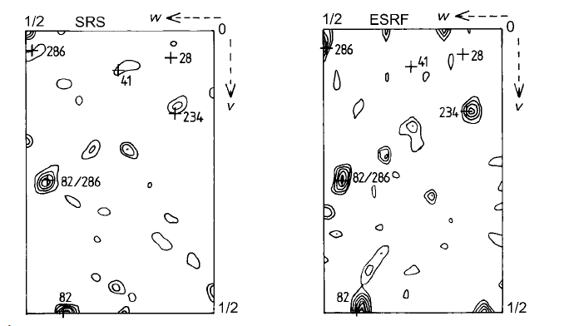
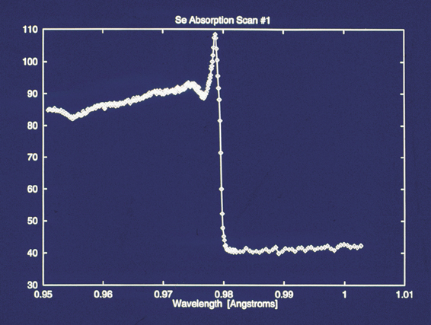
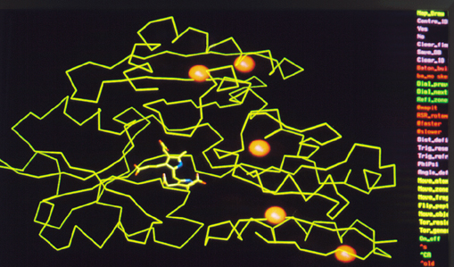
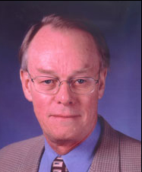
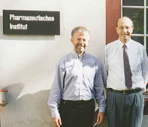
Anom diff Patterson maps
Seleno-methionine hydroxymethylbilane synthase fluorescence scan measured at SRS 9.5
In Haedener et al 1999 Acta Cryst D the SRS 9.5 and ESRF BM14 comparison showed the viability of the new stations and of the ESRF electronic detector
With Alfons Haedener,
Basle Univ
Inspired by Wayne Hendrickson

Slide 13
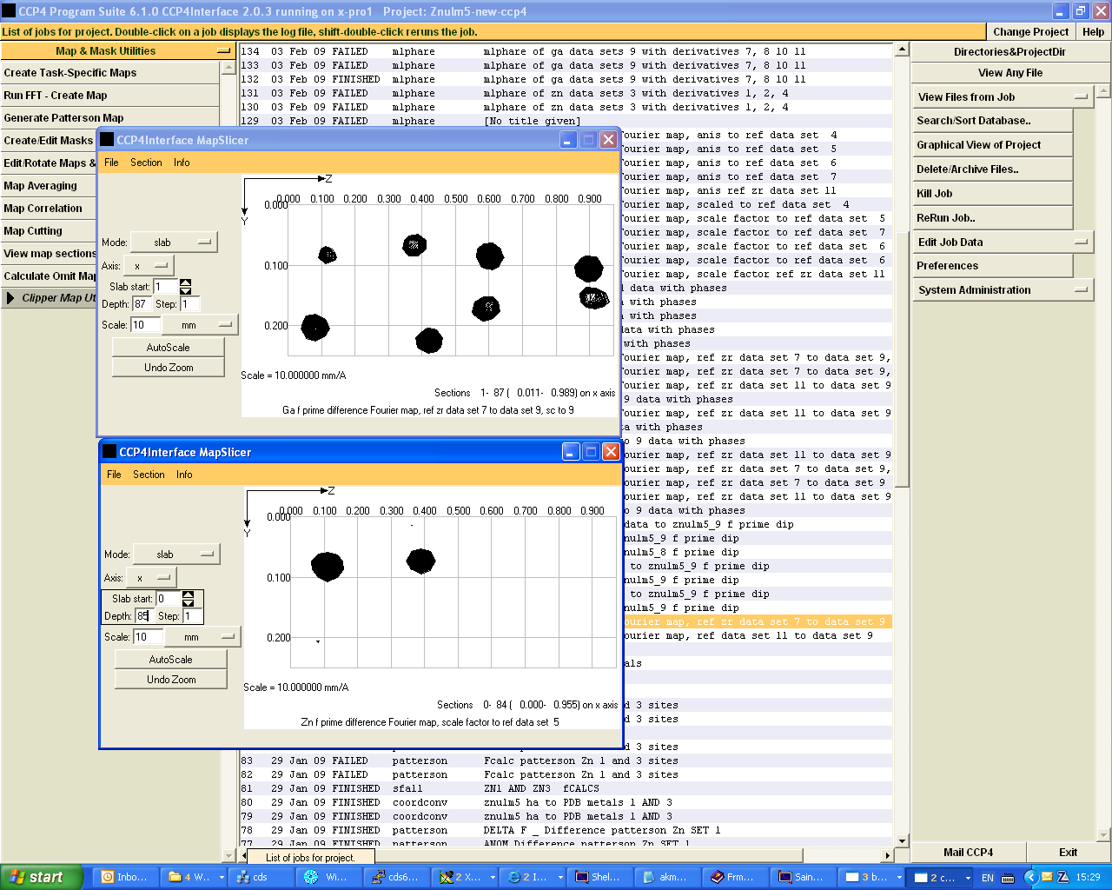
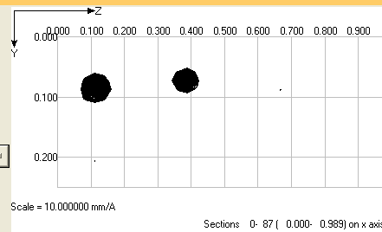
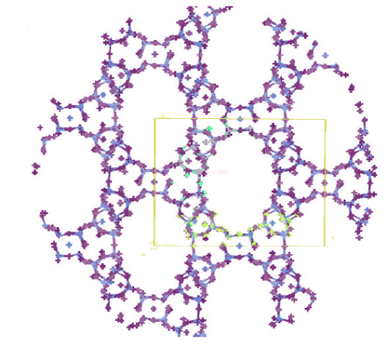
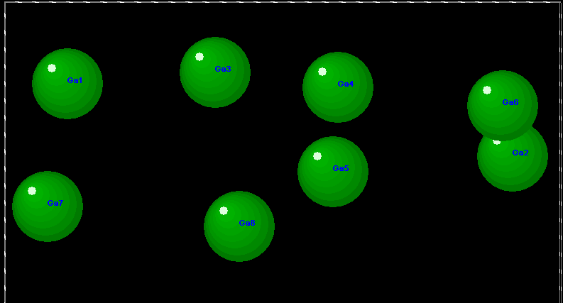
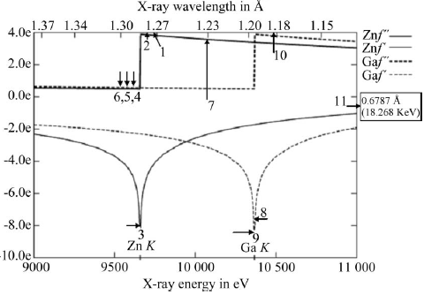


λ₃ scaled to λ₅ = Zn
Delta anom λ₁ = Zn
Spin off: MAD chemical crystallography using SRS9.8:
an 11 wavelength expt of a gallium substituted ZnULM5
λ₉ scaled to λ₇ = Ga + smaller Zn
M Helliwell, J. R. Helliwell, V. Kaucic, N. Zabukovec Logar, S. J. Teat, J. E. Warren and E. J. Dodson (2010) Acta Cryst B66, 345
Madeleine Helliwell
Simon Teat

Slide 14


Spin off: Daresbury Analytical and Research Technical Services (DARTS); an important aspect of the Economic Impact of the SRS
E.J. Maclean, P.J. Rizkallah and J.R. Helliwell (2006) Protein Crystallography and Synchrotron radiation European Pharmaceutical Review Issue 2, p71-76
Approx £300k income to SRS per annum

Slide 15




Let’s take an overview for a moment; the key SR source steps for me
1976 my initiation at NINA Daresbury with J Bordas
1981 Daresbury SRS; the first dedicated ‘2nd generation’ SR source; we attracted some very best users in the World
Mid-1980s PEP as a new ring concept emerges from SSRL
1987 ESRF Foundation Phase Report ‘Red Book’; this showed colossal increases in X-ray intensities from a new source, the X-ray undulator. Would the samples stand it?

