Slide 1
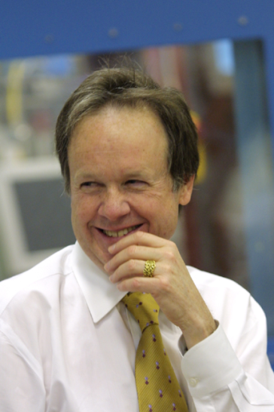
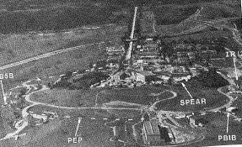
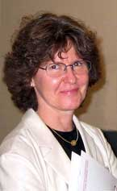
Keith Hodgson
Britt Hedman
Stanford’s New Rings Workshops in the early to mid 1980s re use of PEP highlighted the need for test assessments of such beams; a NATO Collaborative Research Award with SSRL Stanford led to some pretty seminal work
Focussing of the full SRS wiggler white X-ray beam onto a 20 microns gramicidin test crystal sample to simulate
the proposed monochromatic undulator ESRF X-ray intensities to test if microcrystals of biological macromolecules
would withstand the X-ray thermal and radiation blast.

Slide 2
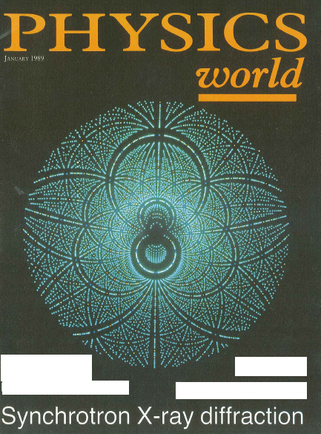
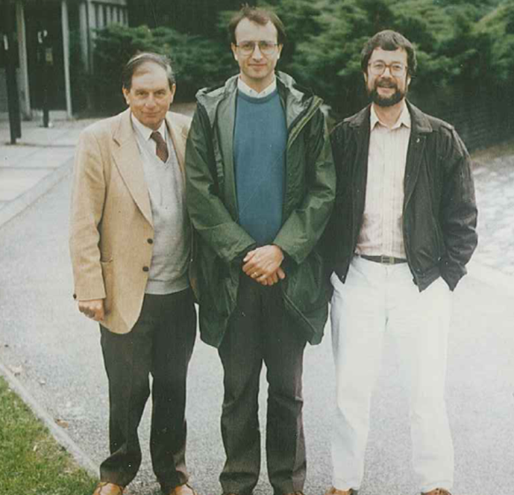
The Laue method Durward Cruickshank and I joined with Keith on this! A key result from SRS 9.6: learning that, by far, the Bragg reflections were in singlet Laue spots and which contradicted the early pioneers’ writings such as W L Bragg
Moffat:
“With the ESRF or APS a single bunch allows nsec Laue protein crystallography”
Colour coding:-
Green are singlet
reflections Laue spots;
Other colours are for
doublets, triplets etc
C H M
Cruickshank, Helliwell & Moffat Acta. Cryst. A43, 656-674 (1987)
Outside York University Physics Dept

Slide 3
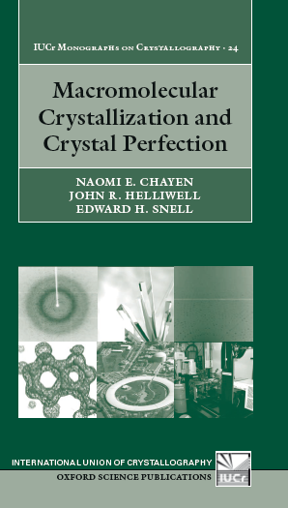
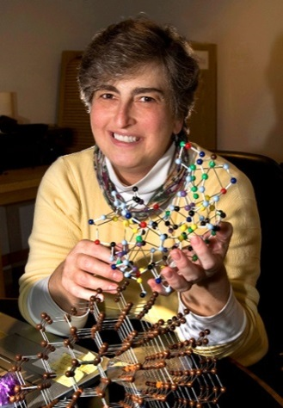
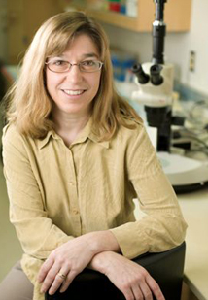
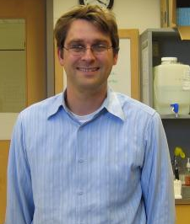
Benchmarking the crystal sample perfection Acta Cryst. (1995). D51, 1099-1102 E. H. Snell et al
Spot smearing
(SRS 9.5 in Laue mode
xstal_to_Det 2.4m)
µg research gave new vibrancy
and benchmarks to our research on
crystal growth
Microgravity
Earth grown control
Eddie Snell
Vivian Stojanoff
Gloria Borgstahl
Titus Boggon

Slide 4
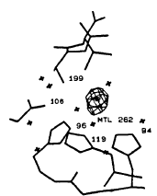
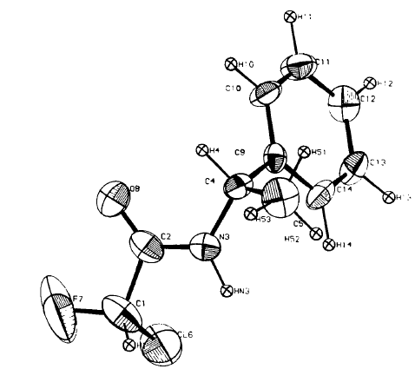
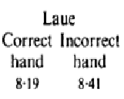
We conducted many studies to validate the Laue method and the Daresbury software
Anders Liljas
H₂O
Zygmunt
Derewenda
(1989) Rev Sci Inst60(7), 1531-1536
Dora Gomez de Anderez, M. Helliwell, J. Habash, E.J. Dodson, J.R. Helliwell, P.D. Bailey and R.E. Gammon
'A comparison of Laue and monochromatic X-ray analyses of a small molecule structure' (1989) Acta Cryst. B45, 482-488.
R %
Dora Gomez

Slide 5
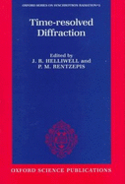
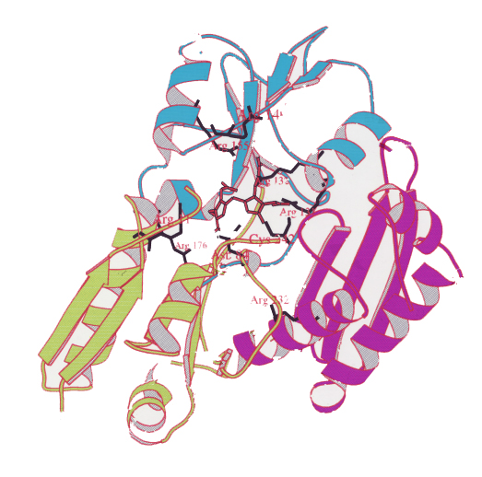
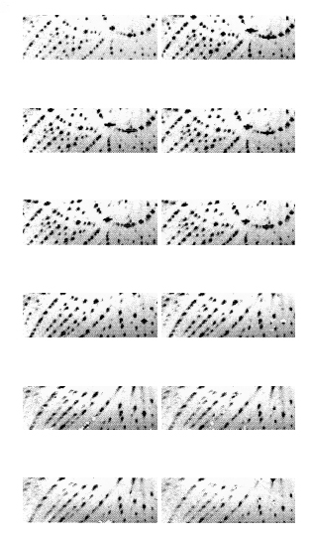
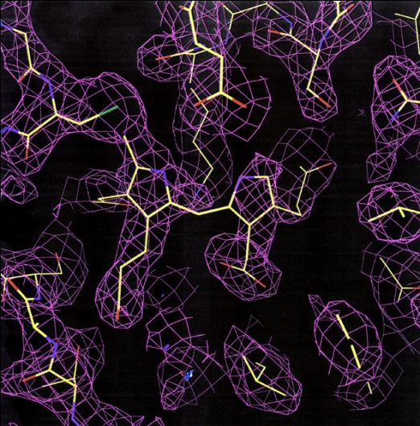
Time-resolved structures of hydroxymethylbilane synthase
Helliwell et al J Chem Soc Faraday Trans 1998, 94(17), 2615–2622
t₀
( a ) t₀ ( b) 7”
( c ) 30” ( d ) 1’
( e ) 2’ ( f ) 4’
( g ) 8’ ( h ) 16’
( I ) 32’ ( j ) 48’
time
( k ) 64’ ( l ) 128’
Good
Laue
maps
using
their
EAD.
Transient electron density in the enzyme active site

Slide 6
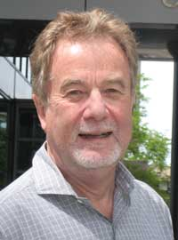
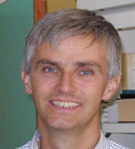
Most spectacularly Keith used SR Laue (the Chicago Zhong Ren software) to do nanosecond protein crystallography with CO myoglobin then PYP
Time!
Keith Moffat
Michael Wulff,
ESRF
Šrajer, Ren, Teng, Schmidt, Ursby, Bourgeois, Pradervand, Schildkamp, Wulff and Moffat
Protein Conformational Relaxation and Ligand Migration in Myoglobin:
A Nanosecond to Millisecond Molecular Movie from Time-Resolved Laue X-ray Diffraction.
Biochemistry (2001), 40 (46):13802–15
Notes:
This molecular movie from the Laue diffraction datasets shows, quoting from their paper:- “> the loss of the CO-bound ligand (CO) upon the laser light ‘initiating’ flash, >the Fe displacement from the heme plane (Fe), >the proximal histidine displacement toward the F helix (P), >the swing of the distal histidine toward the bound CO location (D),
> the location of the photodissociated ligand (CO*), >Other smaller features indicate changes at the heme and displacement of E and F helices.”

Slide 7
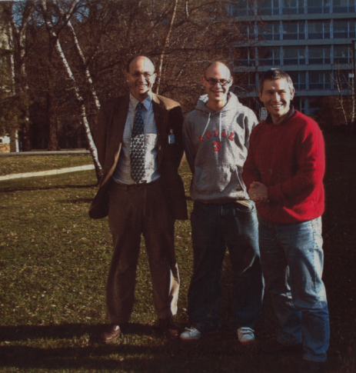
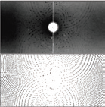
The Laue method and the Daresbury Laue data processing software were enthusiastically taken up at the Grenoble neutron reactor source>>>
50kDa glucoside concanavalin A
I2₁3 a=168 Å
Gilboa, Myles, Habash, Raftery & Helliwell
(2001) J Appl Cryst 34, 454-457
Matthew Blakeley
Dean Myles
Notes:
In the early 1990s I was contacted by Drs Clive Wilkinson and Mogens Lehman about the possibility of the Institut Laue Langevin introducing the neutron Laue method for biological and chemical crystallography with neutrons. The idea was that neutron fluxes were low compared with X-ray fluxes and by harnessing a wide spectrum of emitted neutron wavelengths this would open up a range of new and more challenging projects for crystal structure analysis. Thus in biological crystallography protonation states (as deuterium) of ionisable amino acids such as histidine, aspartic acid and glutamic acid, as well as more detailed information on the orientation of water (D₂O) molecules, could be determined on molecules which had been previously out of reach monochromatic neutron beams, such as higher molecular weight proteins and/or smaller crystals.
For chemical crystallography the interest was usually determination of the anisotropic vibrations of hydrogen atoms but again many studies were out of reach of neutron monochromatic methods due largely to too small a crystal (since the molecular weights were by definition relatively small already).
Clive and Mogens had kept a watch of the progress with the synchrotron X-radiation Laue method for quantitative crystal structure analysis and also noted that the Daresbury Laue software could be readily adapted to processing neutron Laue diffraction data. They proposed then a cold neutron source at the Institut Laue Langevin reactor experimental hall for macromolecular (largely protein) crystallography with a mean wavelength around 3Å wavelength, so as to also benefit for the scattering efficiency increasing as a function of λ² and a cylindrical image plate diffractometer which would be called LADI (Laue Diffractometer). Secondly, for chemical crystallography a hot source neutron beam, providing shorter wavelength neutron wavelengths would allow the naturally higher diffraction resolution needs for data collection to be satisfied. This instrument would be called VIVALDI (Vertical....Laue Diffractometer). Each apparatus involved a cylindrical image plate fully surrounding the crystal and the Daresbury Laue software coordinate prediction algorithm needed amendment, as did the polarisation correction formula. A critical feature was the provision of neutron sensitive image plate materials by Dr Nobuo Niimura from the Japanese Atomic Energy Research Institute (JAERI) in Tokai, Japan, which was most helpful and a collaborative gesture that was greatly appreciated here in Europe.
Clive and I wrote up a jointly authored book chapter for the HERCULES Course students book:-
J.R. Helliwell and C Wilkinson "X–ray and neutron Laue diffraction" Chaper XII in the Hercules Vol. III "Neutron and Synchrotron Radiation for Condensed Matter Studies: Applications to Soft Condensed Matter and Biology" Springer Verlag (1994).
and which outlined the ideas briefly summarised above.
A major review and summary of the field of neutron macromolecular crystallography has been published by Dr Matthew Blakeley in Crystallography Reviews Vol. 15, No. 3, July–September 2009, 157–218. This includes a comparison of the effectiveness of Laue methods in neutron macromolecular crystallography, which shows how the ceiling of high molecular weight and of small sample, as well as the speed of measurement, has been significantly improved with the neutron Laue method. The increased background noise that inevitably comes from using the broader spectral bandpass has so far had only a marginal, if any effect, on affecting the diffraction resolution limit achieved. The total elapsed time for make a data set measurement has also improved significantly.
Japan took a special initiative in this area within a major funded project known as an Organized Research Combination System (ORCS) grant from the Ministry of Education, Culture, Sports, Science and Technology of Japan to Dr Niimura and Dr Mizuno (Agriculture Research Institute, Tsukuba). Within this many scientists were involved in that effort, including many who took part in several international workshops hosted in Japan. Along with Prof Eric Westhof I was involved on the ORCS Advisory Committee over a 5 year period from 2000 to 2005 with several trips to Japan during that time. Thus I was able to repay, on behalf of Europe, and give our thanks to, Dr Niimura and Japan for the gift of the neutron sensitive imaging plates referred to above. Obviously it was also very interesting scientifically as well from which I derived considerable intellectual benefit and for which I am also personally grateful.

Slide 8
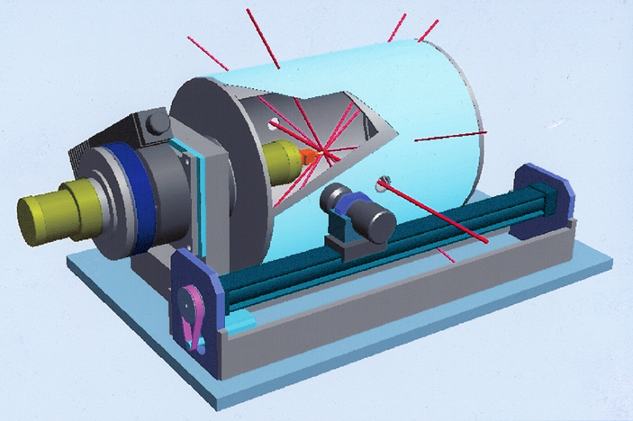
The EMBL Laue Diffractometer at ILL
> Gd₂O₃-doped neutron sensitive image plate
Typical neutron beam wavelength range:
~ 2.7 – 3.6 Å
Neutron Laue data are processed with the ‘Daresbury Laue software’
Notes:
The LADI apparatus was an EMBL development and then installed at the neutron research reactor at the Institut Laue Langevin.
Shown here is LADI I ie first version, as VIVALDI for chemical crystallography was in effect LADI II (not shown). Later LADI III has replaced LADI I with improved features. These were that the readout head was on the inner surface of the image plate and was therefore a factor of 2 more sensitive. The radius was also somewhat larger thus allowing a larger crystal and subsequent spot to spot spatial resolution to be better. Also, for a given crystal sample size, the unit cell diffraction order to order resolution could be improved. At bottom is an example LADI III protein crystal Laue pattern (courtesy Dr Matthew Blakeley).

