Slide 1

X-rays and neutrons
X-rays; Scattered from electrons proportional to Z (red). Neutrons; scattered from nuclei & evenly across all elements (green)
H B C O Al Si P Ti D
1 5 6 8 13 14 15 22 1
!
-37.4 53.0 66.5 58.0 34.5 41.5 51.3 -34.4 66.7
Large difference in the neutron cross-section among isotopes
Neutron diffraction can be used to directly determine the positions of H-isotopes at medium resolutions (~2.5 Ǻ)
!
Notes:
This slide was kindly provided to me by Dr Matthew Blakeley of the Institut Laue Langevin in Grenoble.

Slide 2
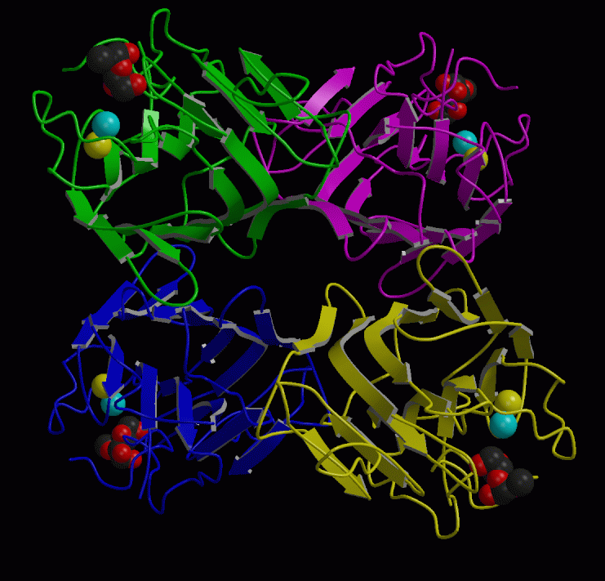
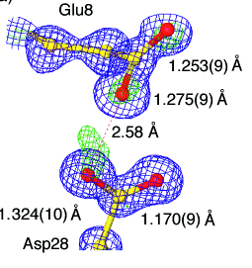
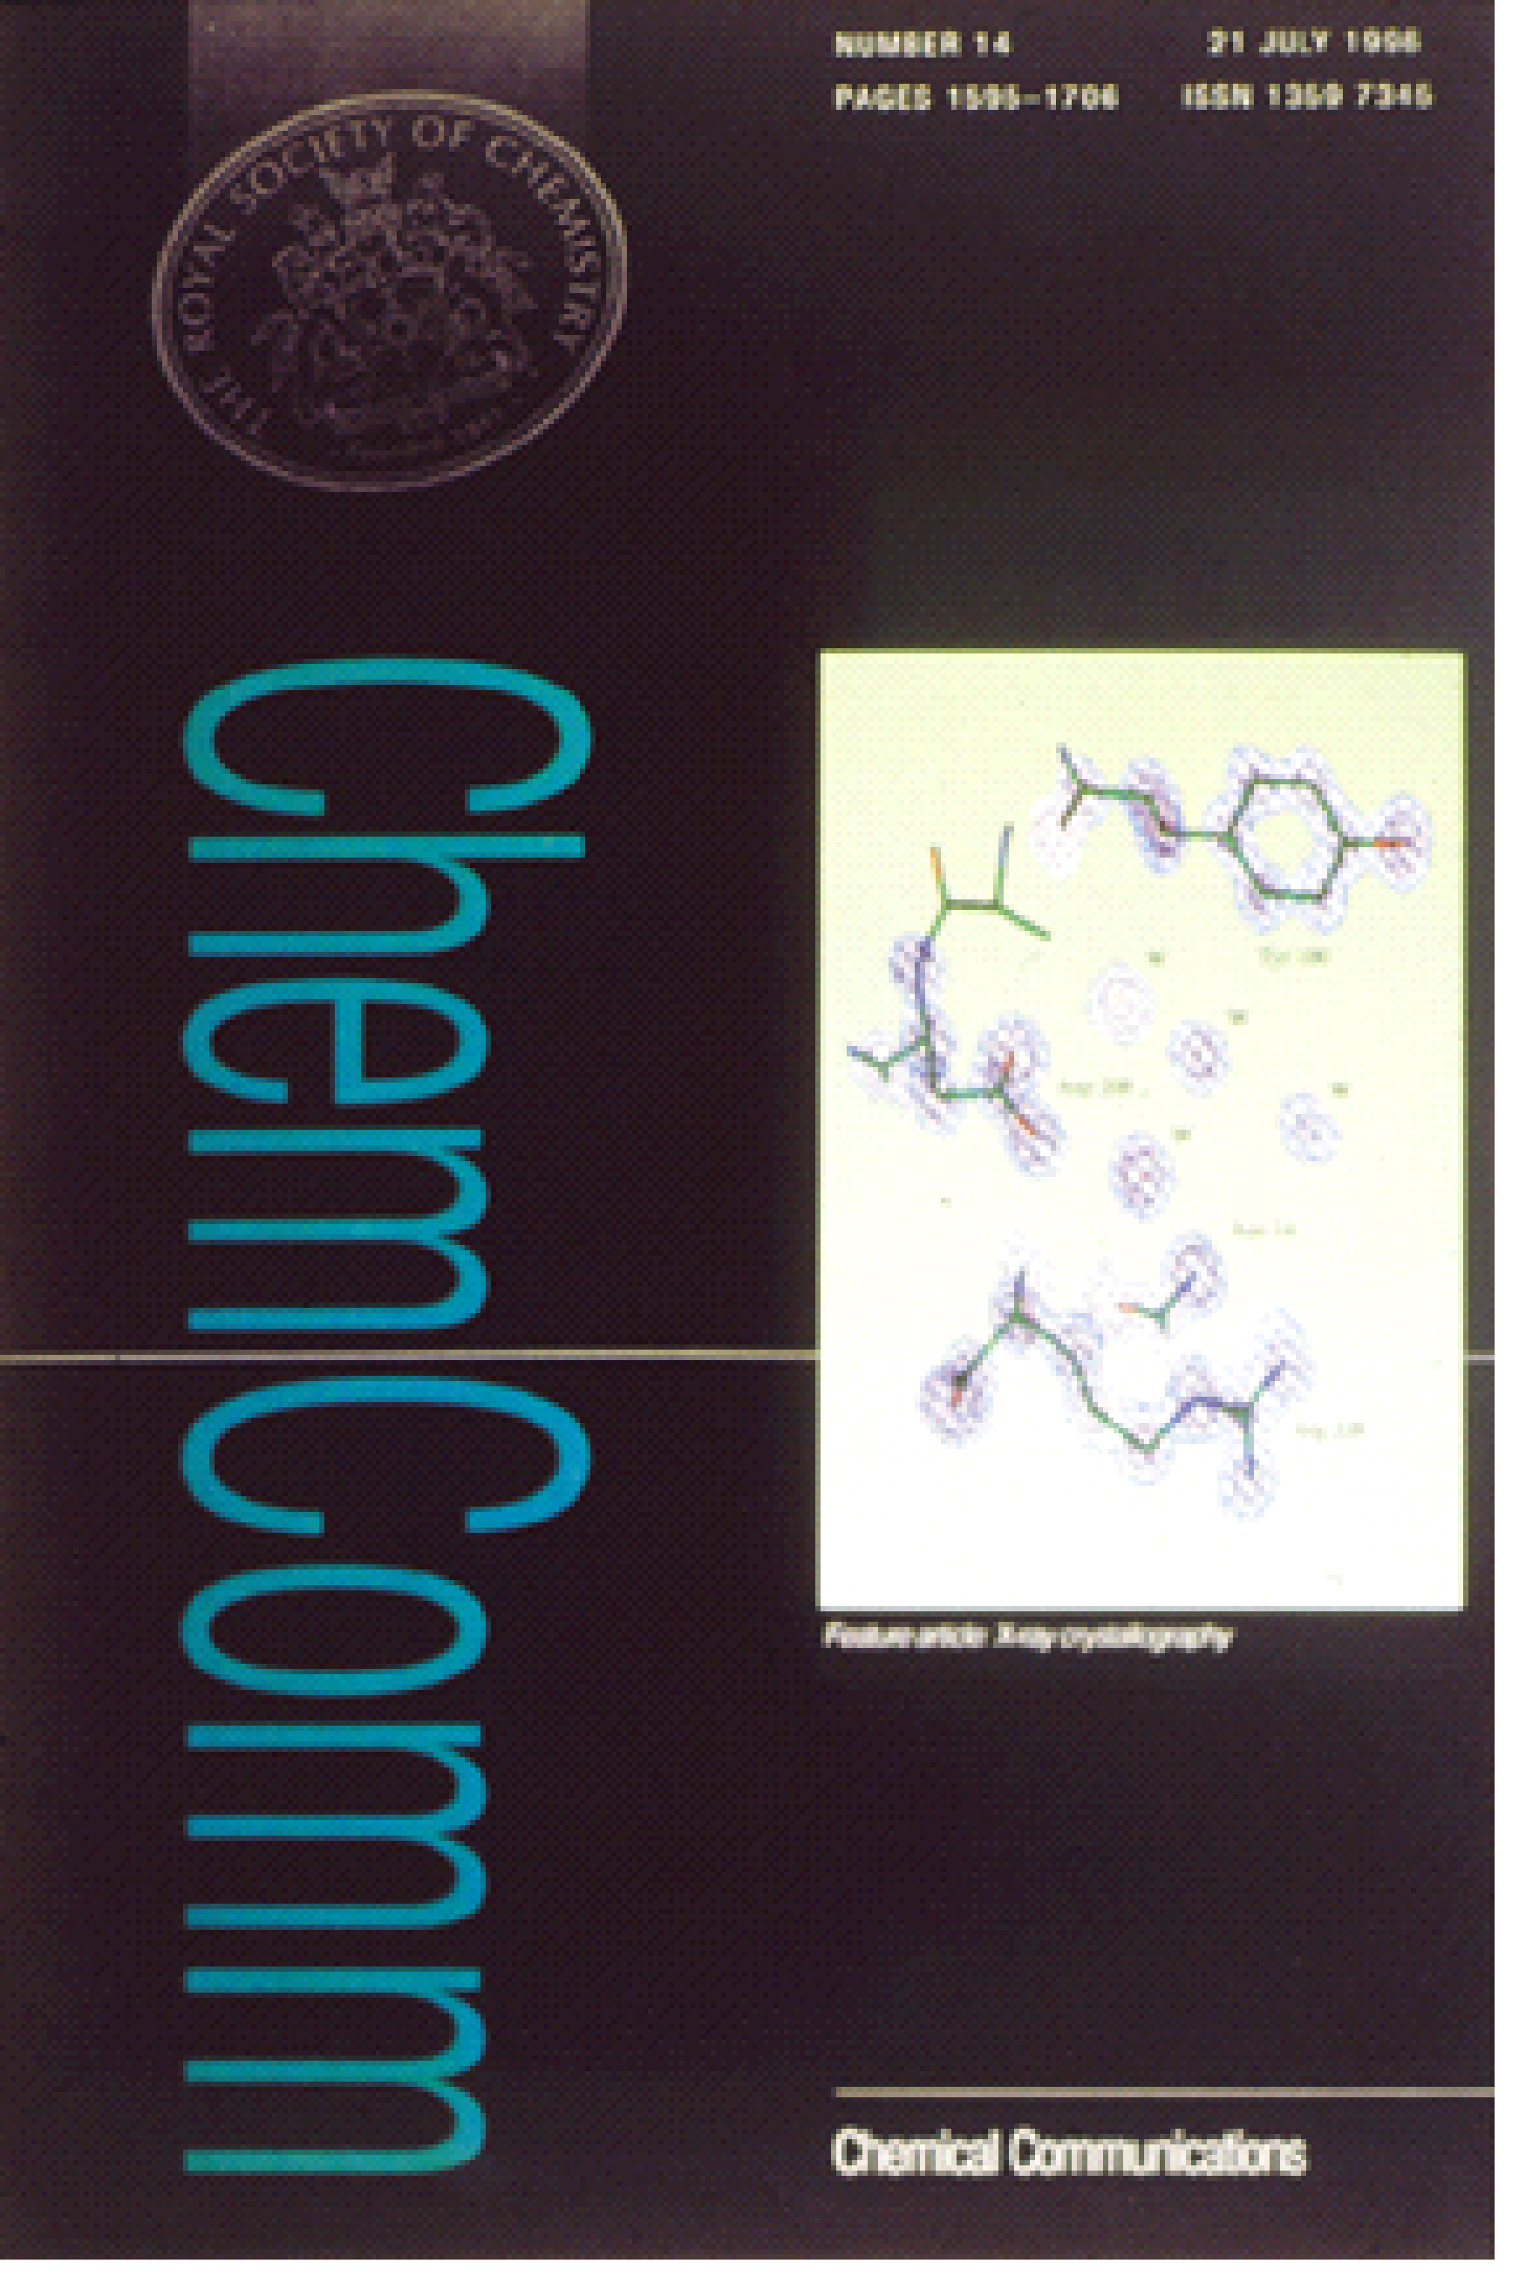
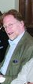
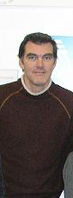
Concanavalin A studied with small molecule accuracy at 0.94Å resolution captures the Chemists’ imagination
James Raftery
Resolving protonation states
Ashley Deacon et al Faraday Transactions, 93 (24), 4305–4312.
Diffraction data measured at MacCHESS on their MPW.

Slide 3
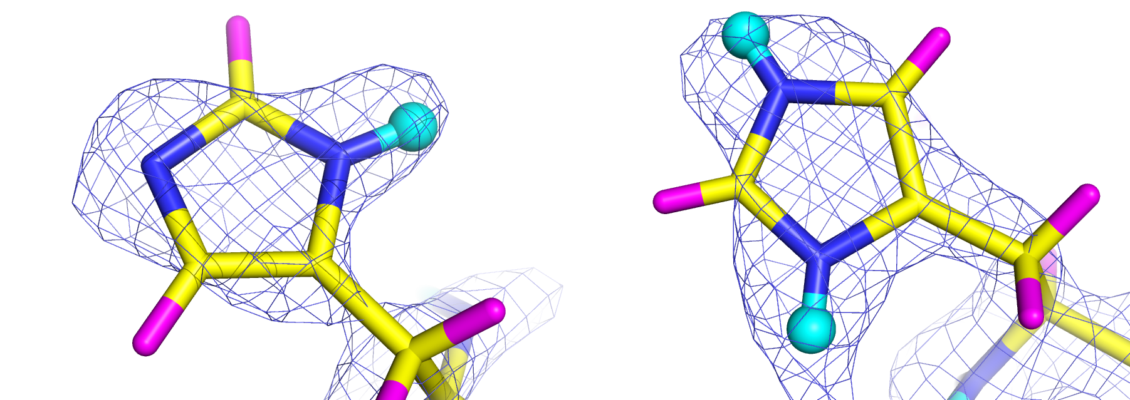
Resolving histidine protonation states with neutrons; concanavalin A at LADI
Based on data measured at the Institut Laue Langevin LAue DIffractometer LADI courtesy of the
LADI Instrument responsible Dr Matthew Blakeley
For a review see Blakeley Crystallography Reviews Vol. 15, 2009, 157–218
Neutron macromolecular crystallography

Slide 4
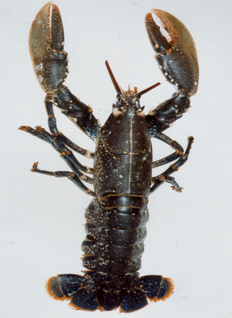
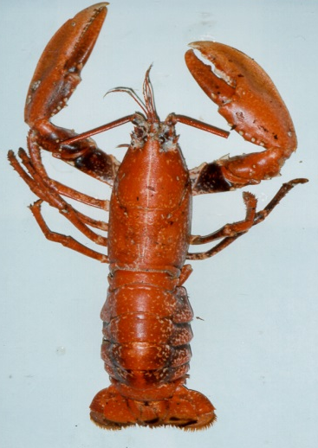
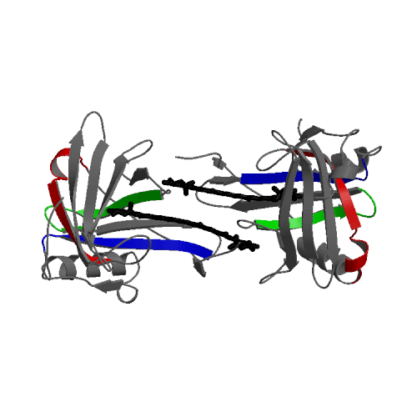
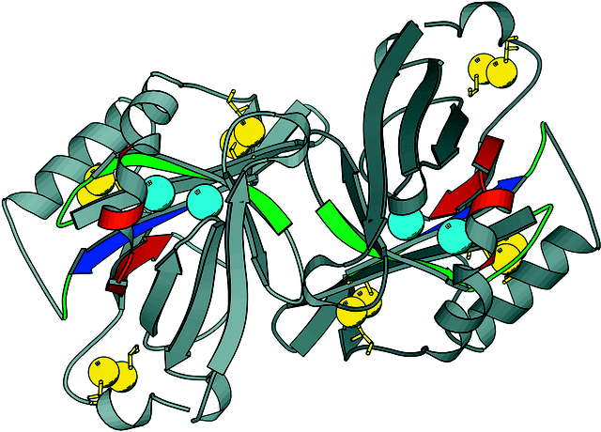
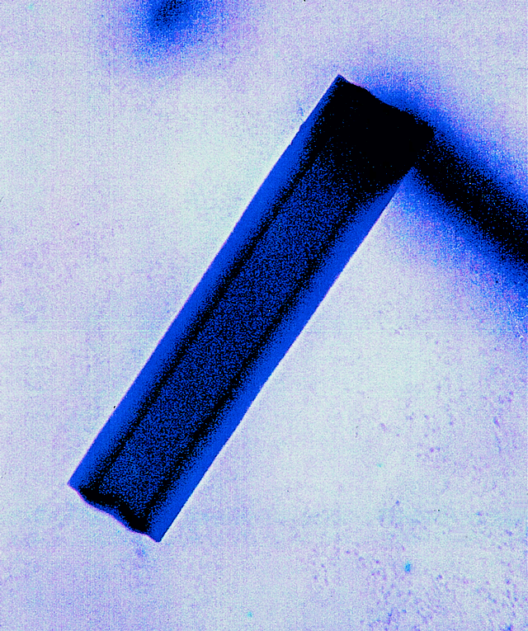
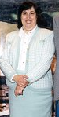
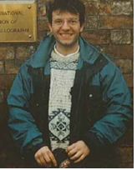
A final highlight
Marine colouration in lobster shell
.
β-Crustacyanin crystal
Apocrustacyanin A1
Cianci et al (2002) PNAS USA 99, 9795 ‘The molecular basis of the coloration mechanism in lobster shell:
β-crustacyanin at 3.2 A resolution’
Cianci et al (2001) Acta Cryst D57, 1219
“Structure of apocrustacyanin A1
using softer X-rays”
Naomi Chayen
Mike Cianci

Slide 5
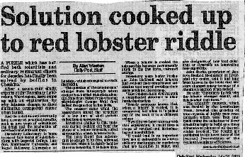
Lobster crustacyanin hits the media! starting from work at SRS in the early 2000s
From the Liverpool Daily Post but articles also in The Times,
The Guardian, The Independent also Radio, TV, Scientific American,
New Scientist, Physics Today etc.

Slide 6

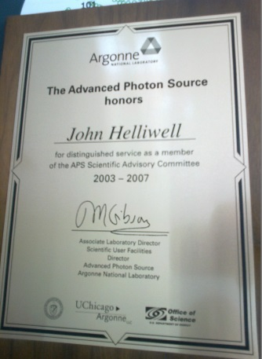
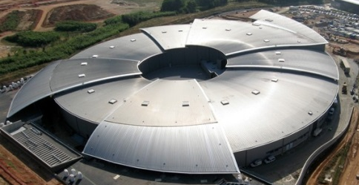


Research directions for today?
New SR sources: PETRA III the most brilliant ie the ‘ultimate storage ring’ ; also soon NSLS II, MAX IV
Diamond Light Source is a cutting edge source for UK with a vibrant research and development programme
ALBA likewise is a cutting edge SR source for Spain
ESRF has a new upgrade programme for nanofocus beams; also APS at advanced planning with its upgrade
The X-ray laser: towards nanoclusters of molecules
New neutron sources such as the SNS and ESS

Slide 7
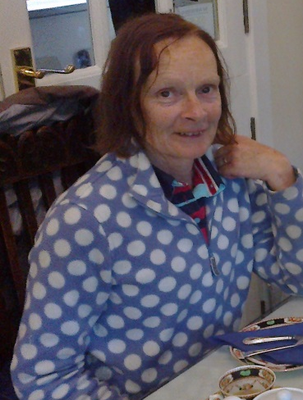
Final acknowledgements
I heartily thank my PhD students and PostDocs over the last 35 years
Daresbury Laboratory & the Universities of York, Oxford, Keele & Manchester
I heartily thank all the SR and neutron facilities for their collaboration
I especially thank my wife
Dr Madeleine Helliwell
Notes:
Prof J R Helliwell’s PhDs
Degree awarded year
Name
Sponsor
Awarding Institution
Degree awarded
Current employment
1984
Paul D Carr
Keele Univ
University of Keele
PhD
ANU Canberra (Senior Exptl Officer)
1985
Bob Liddington
York University (PhD placement student with JRH at SERC Daresbury Laboratory; Prof Guy Dodson, supervisor at York)
PhD awarded by York University 1986
Sanford Burnham Medical Research Institute, L Jolla, California
Director Bioinformatics and Structural Biology Program
1987
Stephen A Rule
Keele Univ
University of Keele
PhD
Industry (software)
1990
Dora Gomez de Anderez
SERC
University of York
PhD
Universidad de Los Andes, Merida, Venezuela. (University Professor, retired).
1992
Stephen Harrop
SERC
University of York
PhD
University of New South Wales, Sydney, Australia (Senior Research Assistant)
1992
James H Naismith
SERC/Carnegie
Award
University of Manchester
PhD
(Jointly supervised with Dr W N Hunter, now at Dundee University)
St Andrew’s University (Professor)
1993
Susanne Weisgerber
British Council
University of Manchester
PhD
Hills Road,VI form College, Cambridge (science teacher)
1995
Edward H Snell
EPSRC
University of Manchester
PhD
Hauptman-Woodward Medical research Institute, Buffalo, NY, USA
1996
Ashley M Deacon
EPSRC
University of Manchester
PhD
Stanford Synchrotron Lab, USA (Senior Research Scientist)
1996
Mark R Peterson
EPSRC
University of Manchester
PhD
(Jointly supervised with Dr W N Hunter, now at Dundee University)
Industry (Computers; sales)
1997
Yeu Perng Nieh
OS/Private funds
University of Manchester
PhD
Director of own IT company in Taiwan
1997
Gail M Bradbrook
EPSRC
University of Manchester
PhD
Project Manager, Swindon
1998
Titus J Boggon
Samuel Hall Fund, Univ Manchester
University of Manchester
PhD
Faculty member Pharmacy Dept, Yale University, USA
1999
Helen J Price
British Council/Woolfson Foundation
University of Manchester
PhD
Aerospace industry (Research scientist)
2000
Nicola S Hunter
BBSRC
University of Manchester
PhD
Housewife
2002
Michele Cianci
EPSRC/Univ Manchester
University of Manchester
PhD
Research Group Leader, Petra 3 project, EMBL Hamburg, DESY, Germany.
2003
Matthew Blakeley
EPSRC/Institut Laue Langevin
University of Manchester
PhD
Staff scientist at the Institut Laue Langevin, Grenoble.
2004
Alessia Minichino
EU Marie Curie Training visit (12 months)
University of Manchester
PhD visitor (2002-3)
Pharmaceutical company, Milan, Italy
2007
Helal Ahmed
BBSRC Case (with GSK)
University of Manchester
PhD
Science School Teacher (Essex)
2005
Nicola Pasquato
EU Marie Curie Training visit (5 months)
University of Manchester
PhD visitor (2004)
PhD at University of Padova, Italy; now graduated.
2005
Giuditta Bartalucci
EU Marie Curie Training visit (6 months)
University of Manchester
PhD at University of Firenze; now graduated.
Research scientist at Procter and Gamble, Frankfurt, Germany
2006
Simin Rahigi
Private Funds
University of Manchester
PhD visitor (2006)
PhD student at KEK, Tsukuba, Japan; now graduated.
PostDoc Stanford University with Prof Dr Soichi Wakatsuki.
2009
Stu Fisher
University of Manchester and the Institut Laue Langevin
University of Manchester
PhD
PostDoc University of Graz, Austria based at the Institut Laue Langevin, Grenoble. Now working at Diamond Light Source.
2010
Simon Tanley
EPSRC
University of Manchester
PhD
Graduated March 2014
JRH’s PhD Students’ Honours and Prizes:-
Paul D Carr (PhD 1984); 1990; British Crystallographic Association Biological Structures Group Annual Conference ‘David Blow’ Poster Prize.
Susanne Weisgerber (PhD 1993); 1993; British Crystallographic Association Biological Structures Group Annual Conference ‘David Blow’ Poster Prize.
Helal U Ahmed (PhD ; 2006); British Crystallographic Association Biological Structures Group Annual Conference ‘David Blow’ Poster Prize Trophy.
Stu Fisher; 2008; HERCULES Course Poster Prizewinner, Grenoble; Neutron and Muon Users’ Meeting, Nottingham University Poster Prizewinner.
Dr Michele Cianci (PhD 2002); 2008 AIC (Italian Crystallography Association) ‘Mario Nardelli’ Prize (Joint winner).
Prof James H Naismith (PhD 1992); 2009 Royal Society of Chemistry Chemical Biology Interface Forum ‘Jeremy Knowles Award’ to Jim Naismith for his ‘outstanding applications of protein crystallography in the study of enzyme reaction mechanisms’. [J H Naismith's PhD, awarded 1992, was jointly supervised with Dr, now Prof, W N Hunter, now at Dundee University.]
Prof J R Helliwell’s Postdoctoral Research Assistants
Date
Name
Location
Sponsor
Current position
1981 to 1983
Dr Trevor J Greenhough
Keele University
SERC
Prof of Structural Biology, Keele University
1983 to 2003
Dr George Habash
Keele, York and Manchester Universities
SERC and The Wellcome Trust
Retired; Guest researcher University of Manchester
1984 to 1986
Dr Miroslav Papiz
Keele University and SERC Daresbury Laboratory
SERC
Principal Scientific Officer (band 3) CCLRC Daresbury Laboratory and Chair of the BioMed College, Synchrotron Radiation Department, Daresbury Laboratory; now based at Liverpool University.
1984 to 1986
Dr E Townes-Andrews
SERC Daresbury Lab
SERC Daresbury Lab
CCLRC Strategy Dept. Now based at University of Huddersfield.
1985 to 1987
Dr Steve Andrews
Liverpool University
SERC; Jointly with Dr Marjorie Harding, Liverpool University
Computer Systems support specialist, CCLRC Daresbury Laboratory.
1986 to 1988
Dr Alok Mukherjee
York University
SERC
Jadavpur University, Calcutta, India; Professor.
1990
Dr Christianne Emmerich
Manchester University
DFG, Germany
Germany
1990
Dr Yuri Lobsanov, Moscow University
Manchester University
The Royal Society
USA
1992
Dr Bernard Gallois
Manchester University
The Royal Society/CNRS Exchange scheme
Research scientist, Bordeaux University, France. Retired.
1992 to 1995
Dr Stephen Harrop
Manchester University
SERC
University of New South Wales, Research Officer.
1995 to 1998
Dr Hao Quan
Liverpool University
EPSRC; Jointly with Dr Marjorie Harding, Liverpool University
Group Leader of MACCHESS, Cornell University, USA; now University of Hong Kong.
1996 to 1997
Dr Alberto Cassetta
Manchester University
EC
Elettra Sincrotrone, Trieste, Beamline research scientist.
1996 to 1997
Dr Thomas Gleichmann
Manchester University
EC
1997
Dr Ashley Deacon
Manchester University;
Structural Genomics Group Leader, Stanford Synchrotron Radiation Laboratory, USA.
1998
Dr Serena Cooper
Manchester University
The Wellcome Trust
Research Councils UK Administration, Swindon, UK.
1999 to 2001
Dr Stefi Arzt
Liverpool University
EPSRC; Jointly with Dr Marjorie Harding, Liverpool University
Beamline scientist ESRF, Grenoble.
1999 to 2000
Dr Andrzej Olczak
Manchester University
EC
University of Lodz, Poland, Lecturer in Crystallography.
2002 to 2006
Dr Michele Cianci
CCLRC Daresbury Laboratory
BBSRC/MRC/EPSRC; jointly with Prof S S Hasnain at CCLRC Daresbury Laboratory
PETRA 3 Research Group Leader, Hamburg, Germany.

Slide 8
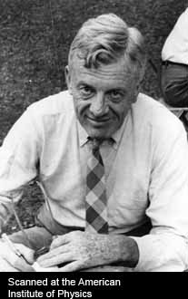
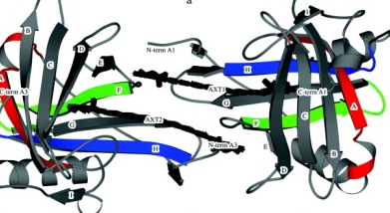
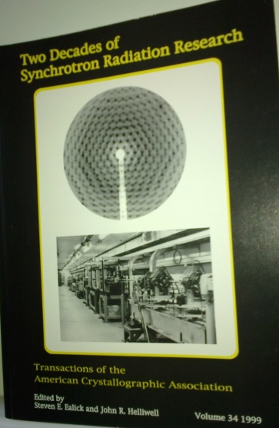
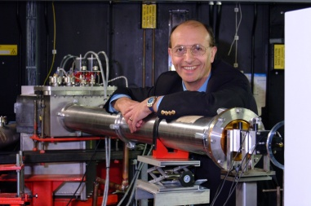

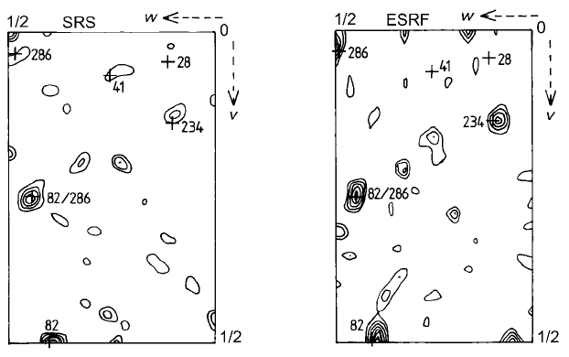

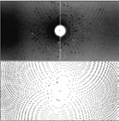
Thank you

